Slide 1
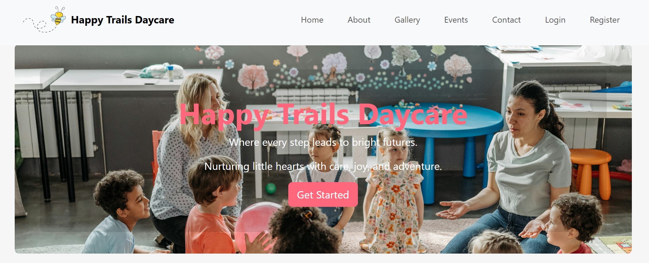
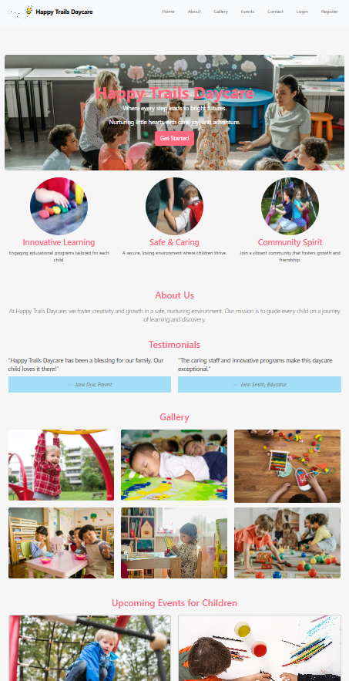
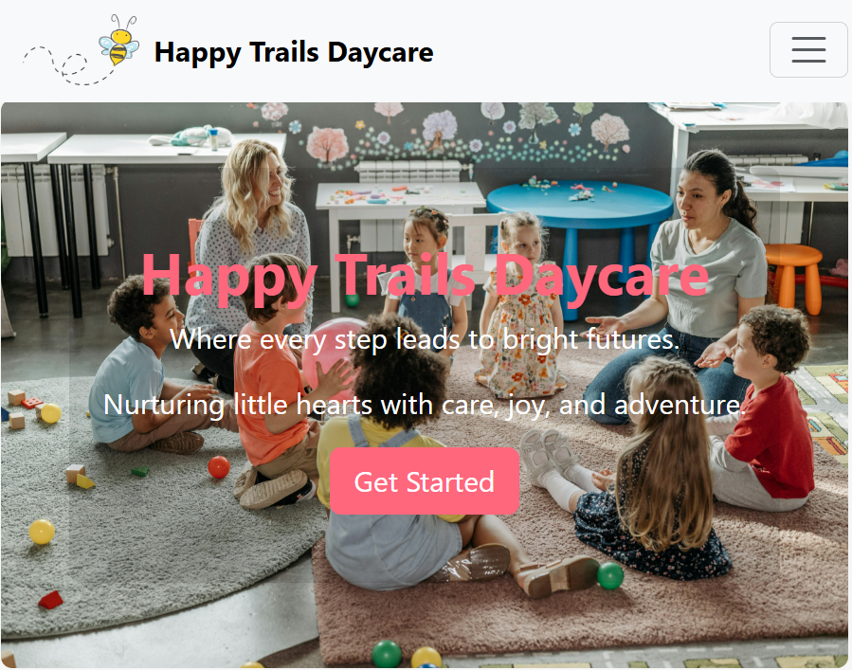
Day Care Management System
Shao Hang Li, Ritu Arora, Qi He

Slide 2
Purpose of the System
The goal is to digitize and streamline key daycare tasks such as:
Recording daily attendance of children
Tracking child profiles and updates
Improving communication between staff and guardians
Ensuring compliance and accountability
Notes:
Why This Matters (Business Perspective)
Many daycare centers still rely on manual paperwork or disconnected systems
Staff spend valuable time on administrative tasks instead of engaging with children
A centralized system:
Reduces human error
Improves parent satisfaction
Enhances operational efficiency
Provides real-time insights for management

Slide 3
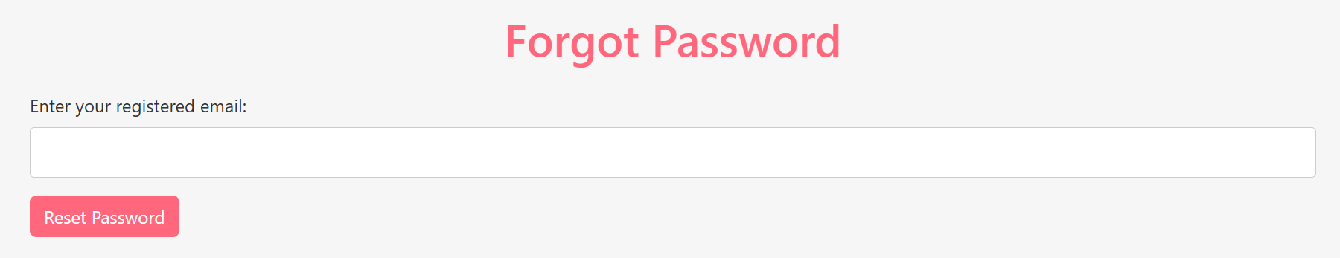
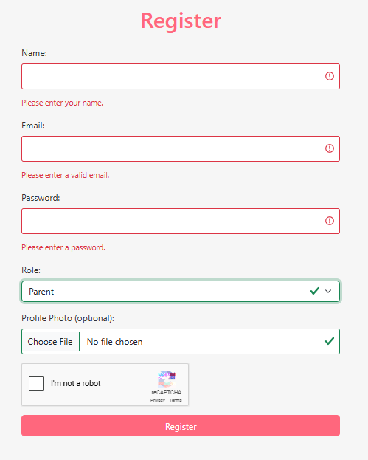
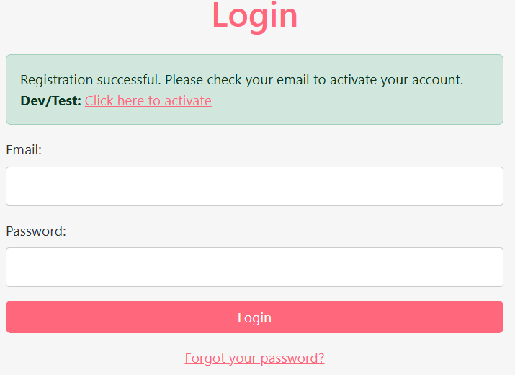
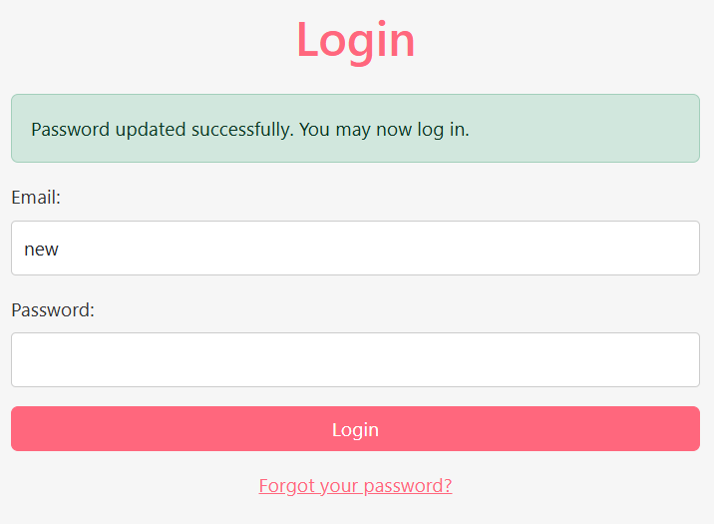
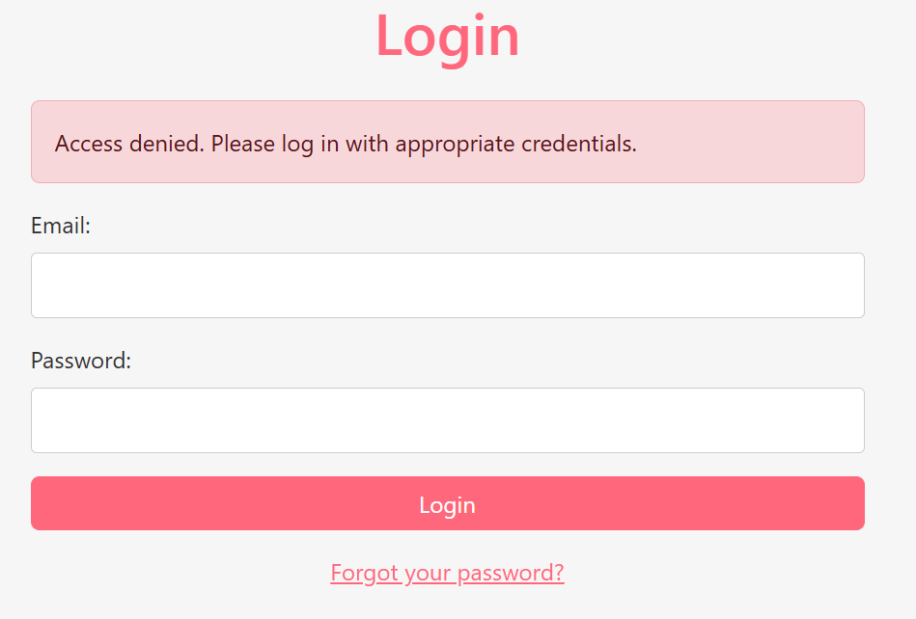
Secure Login & Registration System

Slide 4
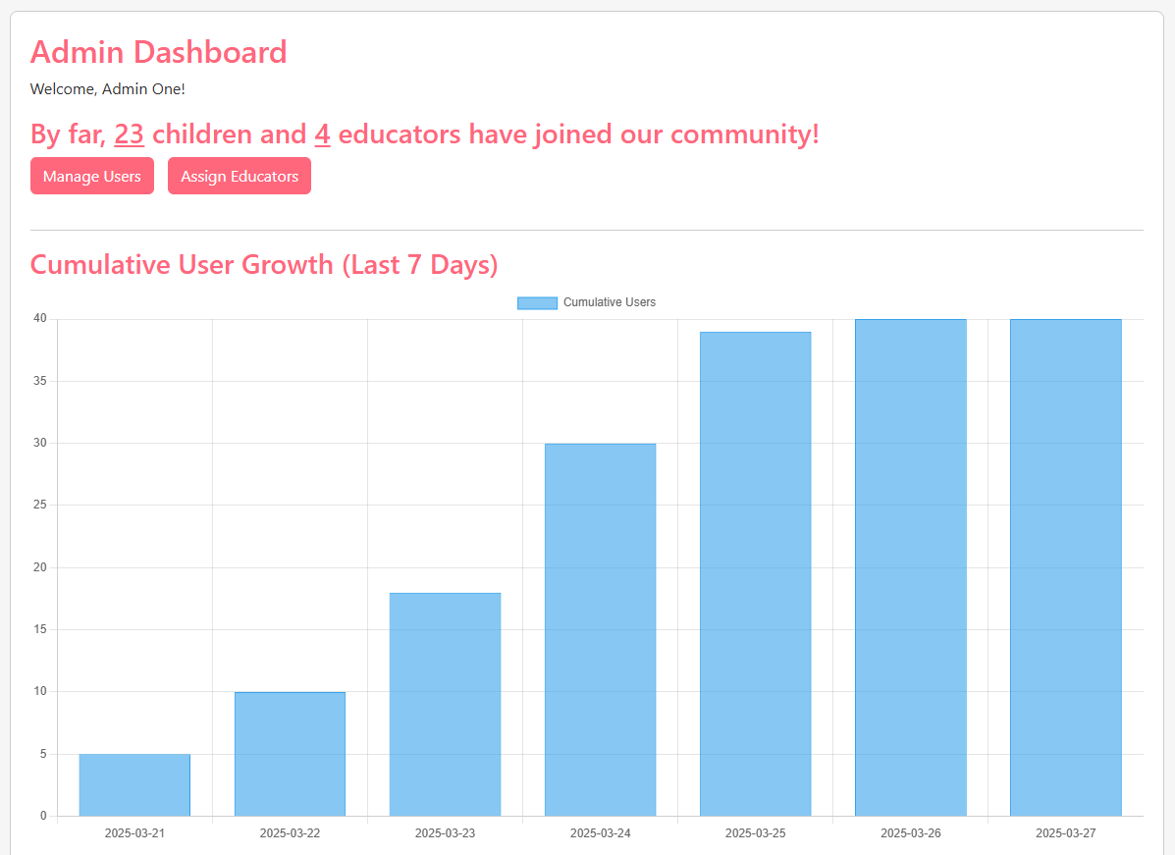
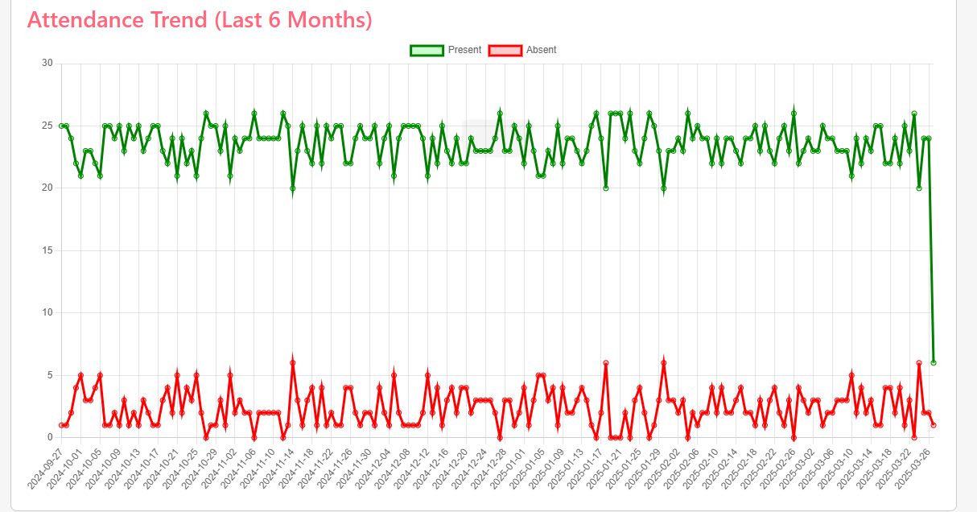
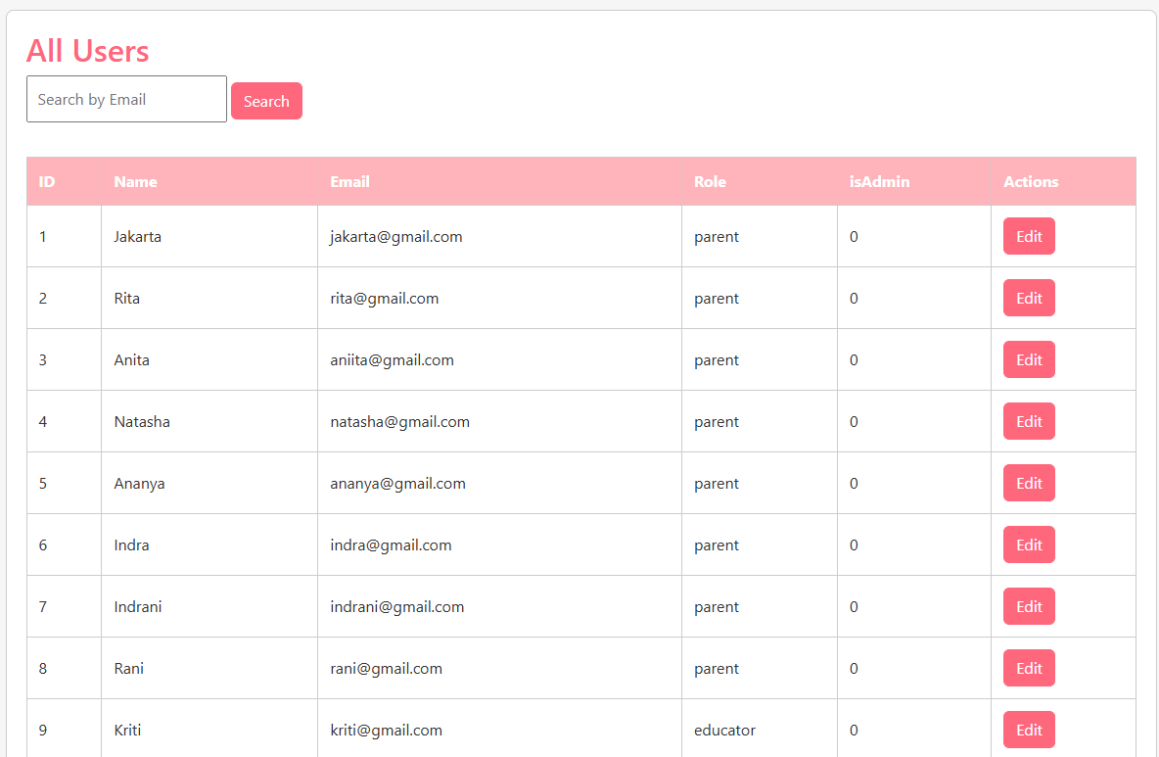
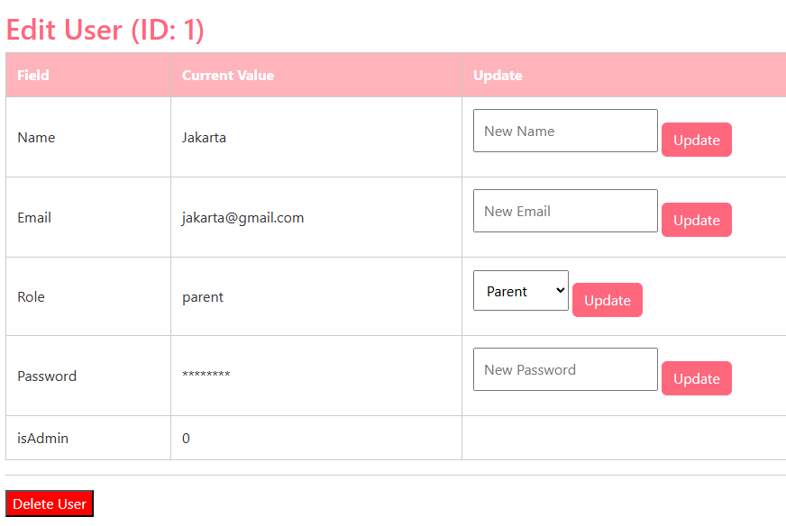
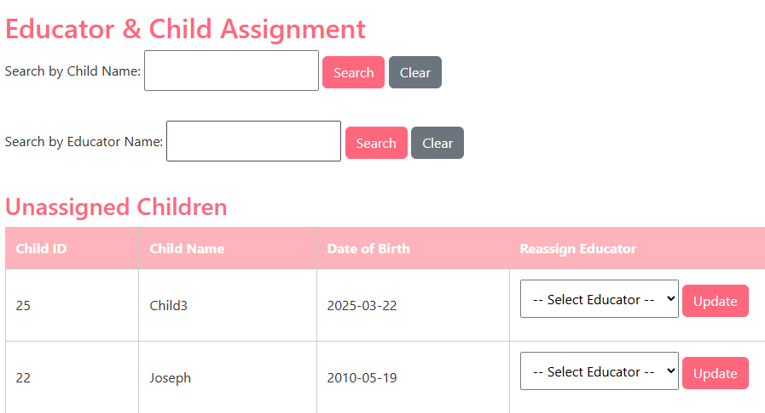
Admin Dashboard

Slide 5
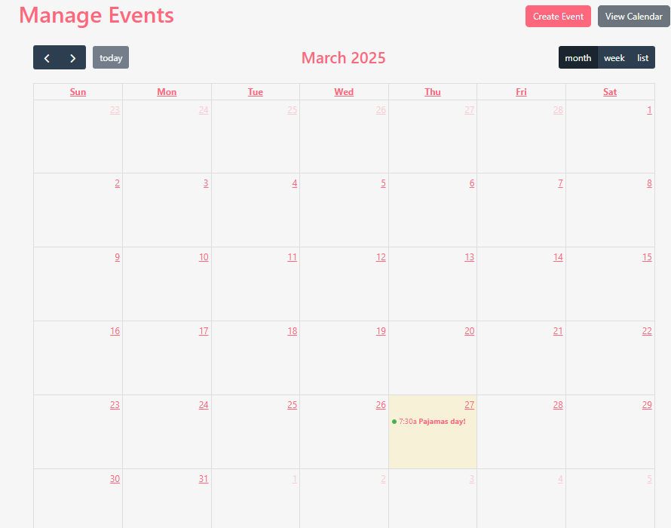
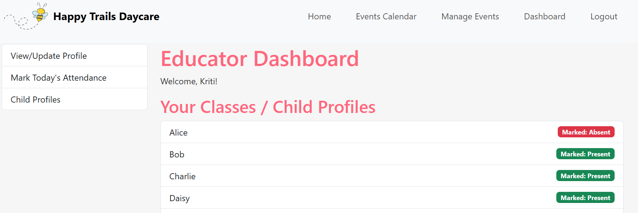
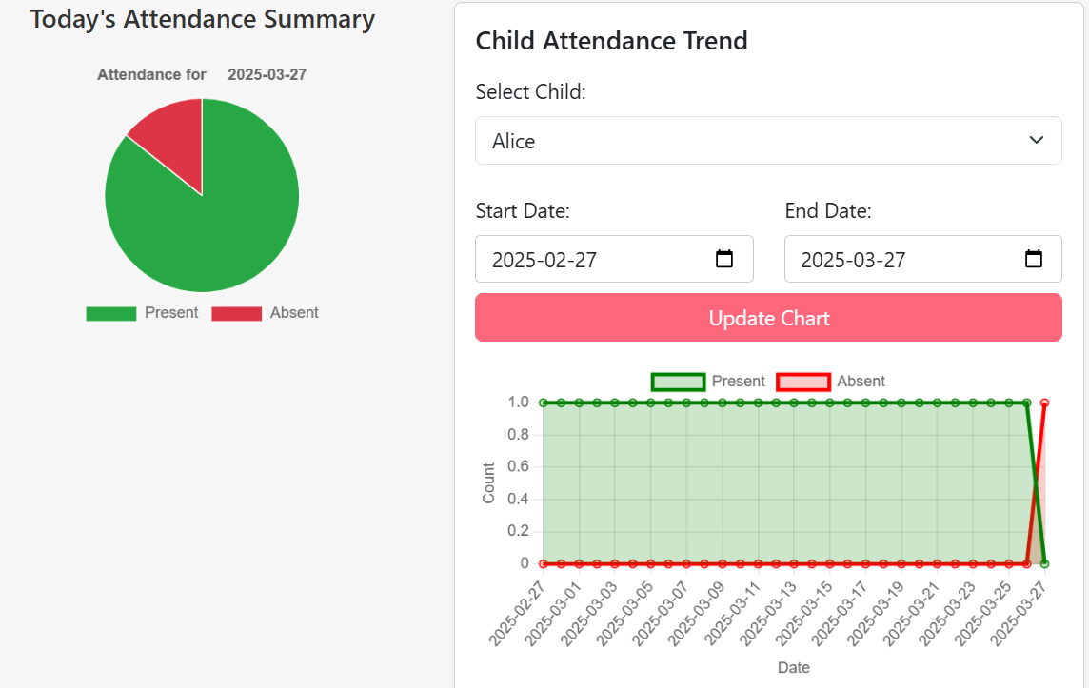
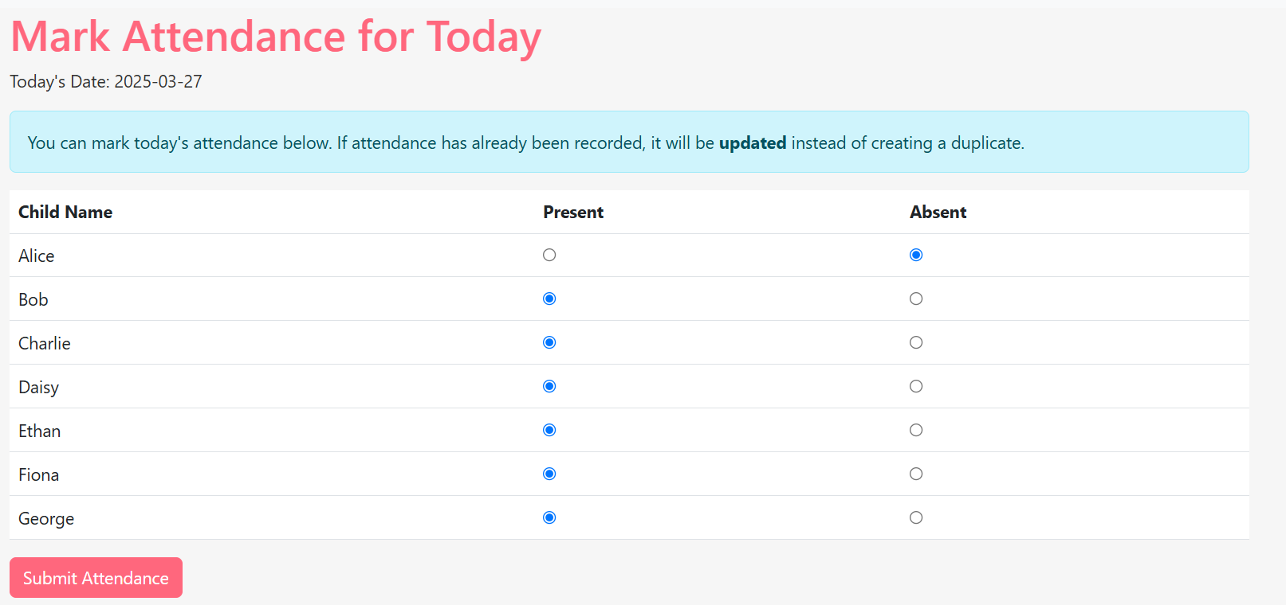
Educator Dashboard

Slide 6
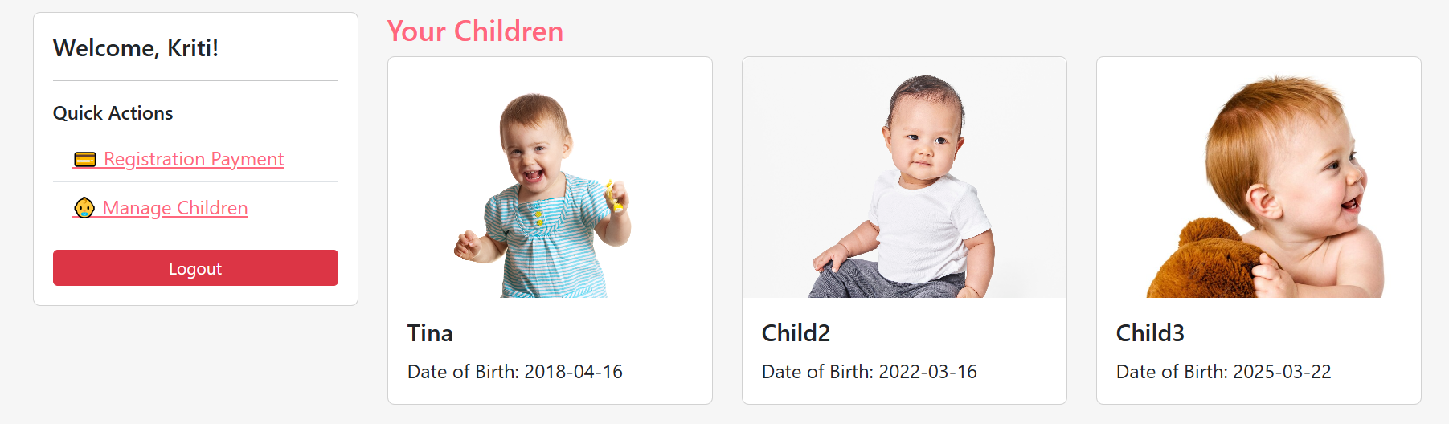
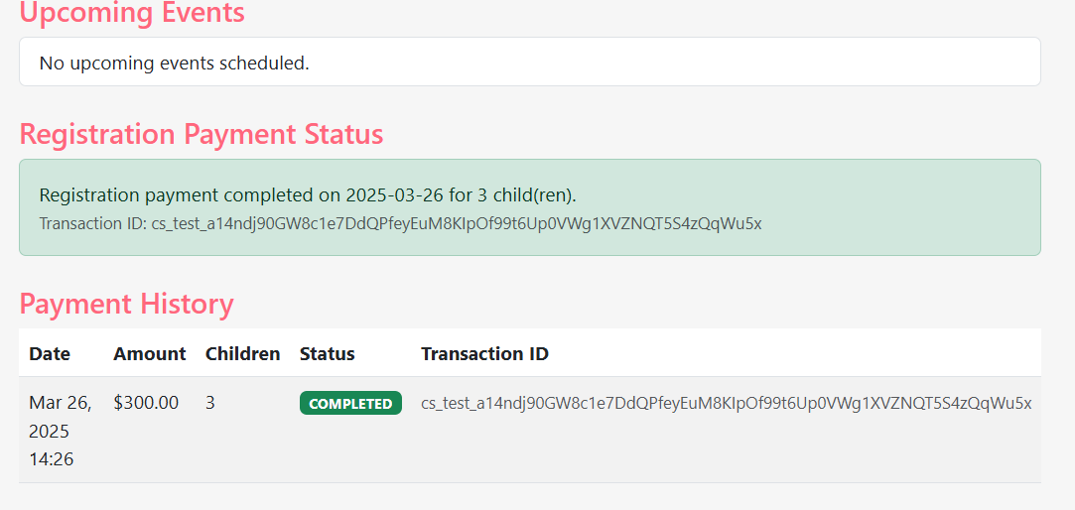
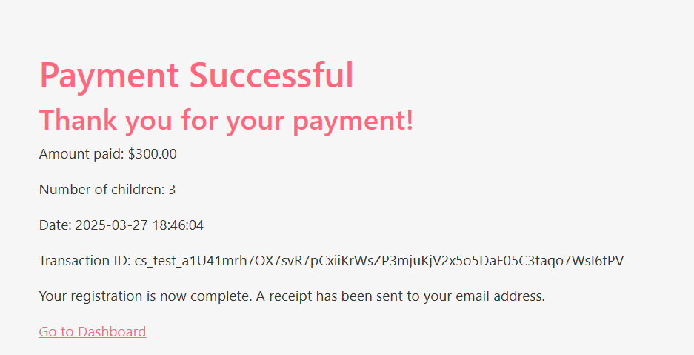
Parent Dashboard

Slide 7
Who did what
Secured role-based login and registration system
Ritu Arora
Admin dashboard
Qi He
Shao Hang (implemented calendar to manage events)
Educator dashboard
Ritu Arora
Shao Hang (implemented calendar to manage events)
Parent dashboard
Qi He
Shao Hang (implemented Events View/Create feature)
Shao Hang (integrated Stripe Payment API)
UI design & project planning
Ritu Arora

Slide 8
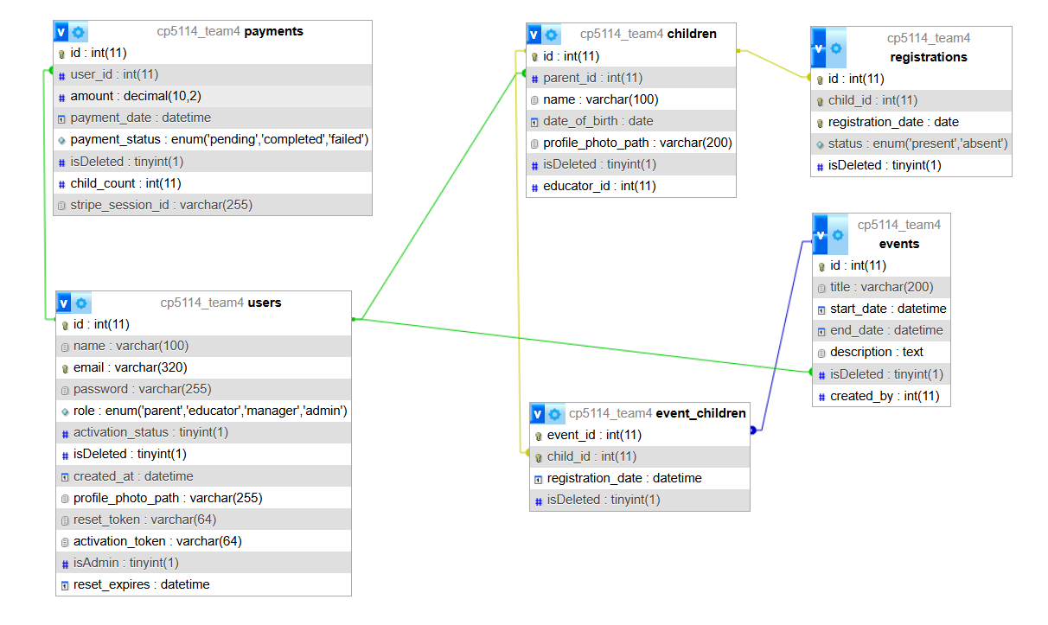
Database Design

Slide 9
Cloudflare Integration: How It Works
You point a subdomain (e.g. cdn.team4.fsd13.ca) to Cloudflare
Cloudflare caches & serves /uploads/* content globally
Update file paths:
<!-- Before --> <img src="/uploads/logo.png"> <!-- After --> <img src="https://cdn.team4.fsd13.ca/uploads/logo.png">

Slide 10
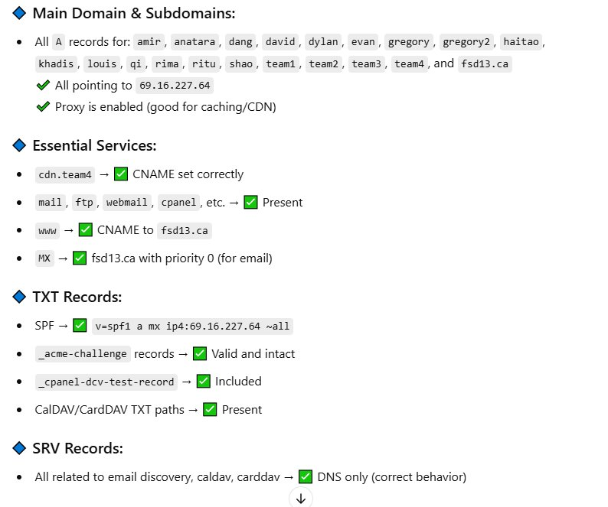
Cloudflare Integration: What & Why
Why Use Cloudflare? Cloudflare acts as a reverse proxy and CDN, offering: ✅ Faster load times (via caching & global edge servers) ✅ Enhanced security (DDoS protection, SSL, firewall) ✅ DNS management with real-time updates ✅ Reduced bandwidth usage

Slide 11
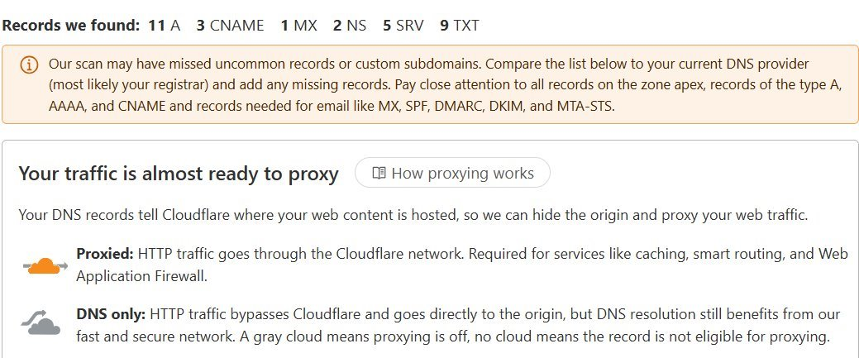
How We Set It Up
Create Cloudflare Account → Add your domain (e.g., fsd13.ca)
Import DNS Records → Cloudflare pulls existing records automatically
Update Nameservers → At your domain registrar (e.g., Domain Robot Enterprises Inc.), replace the old nameservers (e.g., ns14.datona-1.com, ns15.datona-1.com) with Cloudflare’s (e.g., bowen.ns.cloudflare.com, dora.ns.cloudflare.com)
DNS Propagation Begins → Takes up to 24–48 hours globally → Use tools like Google Dig to confirm
Traffic Routed via Cloudflare → Static files (e.g., images, CSS) now served from nearest edge server → Real-time control via Cloudflare dashboard (SSL, caching, security rules)

Slide 12
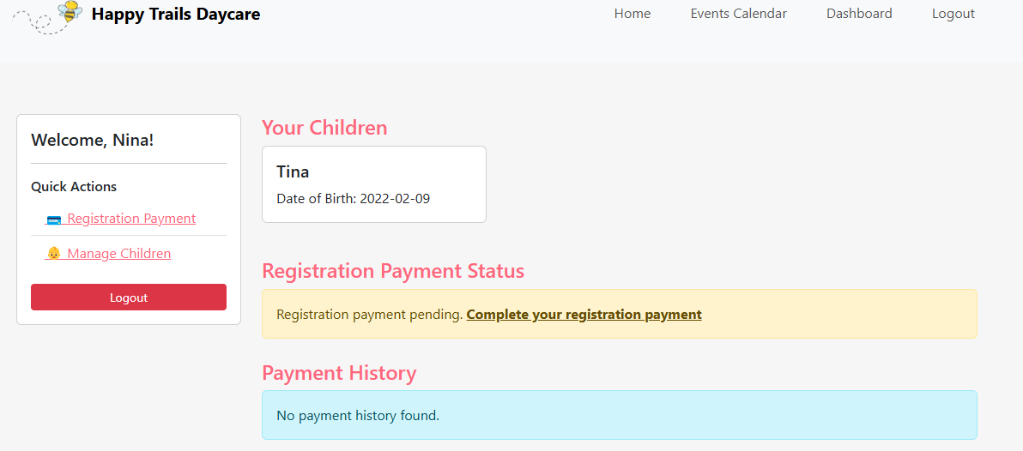
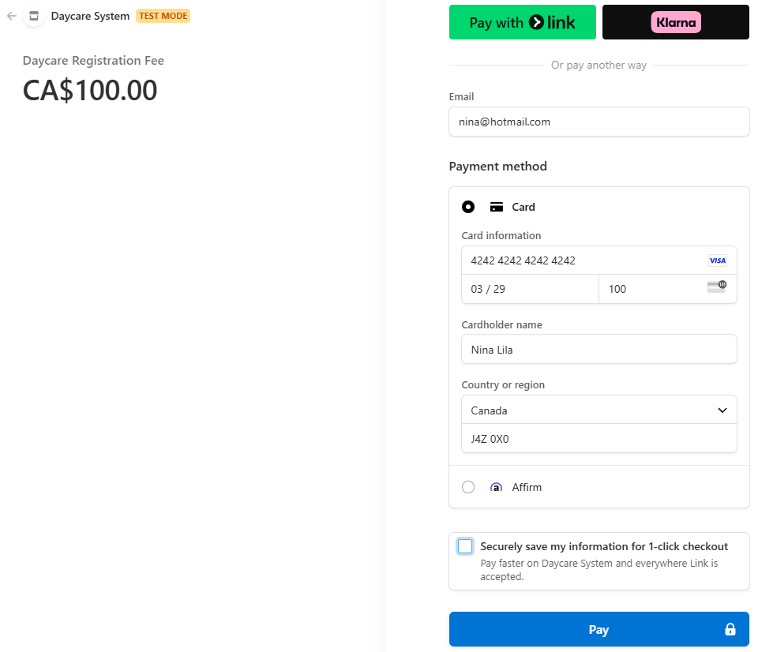
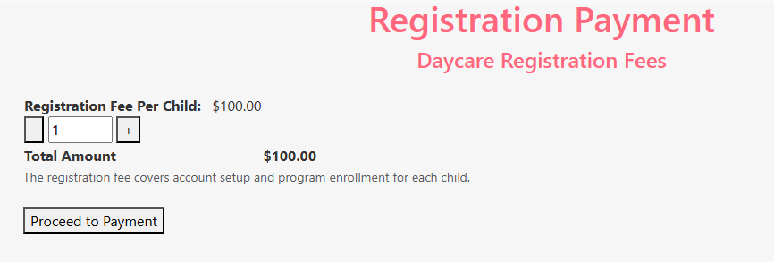
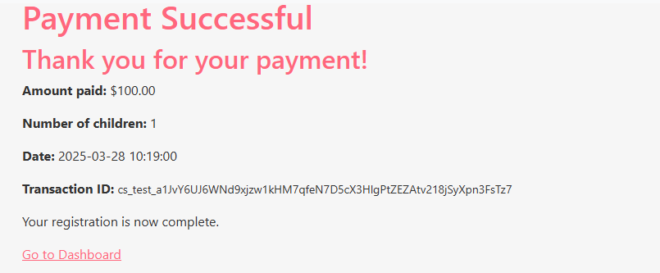
Payment with Stripe PHP/API
composer require stripe/stripe-php (More convenient if you're using PHP)

Slide 13
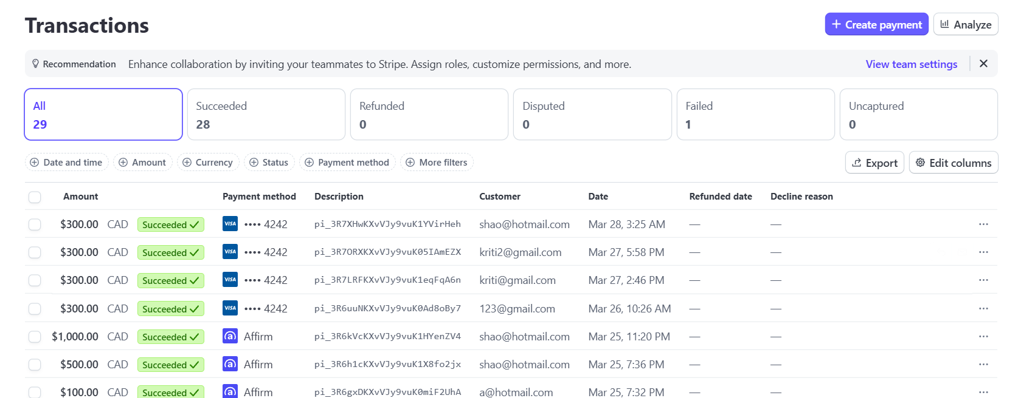
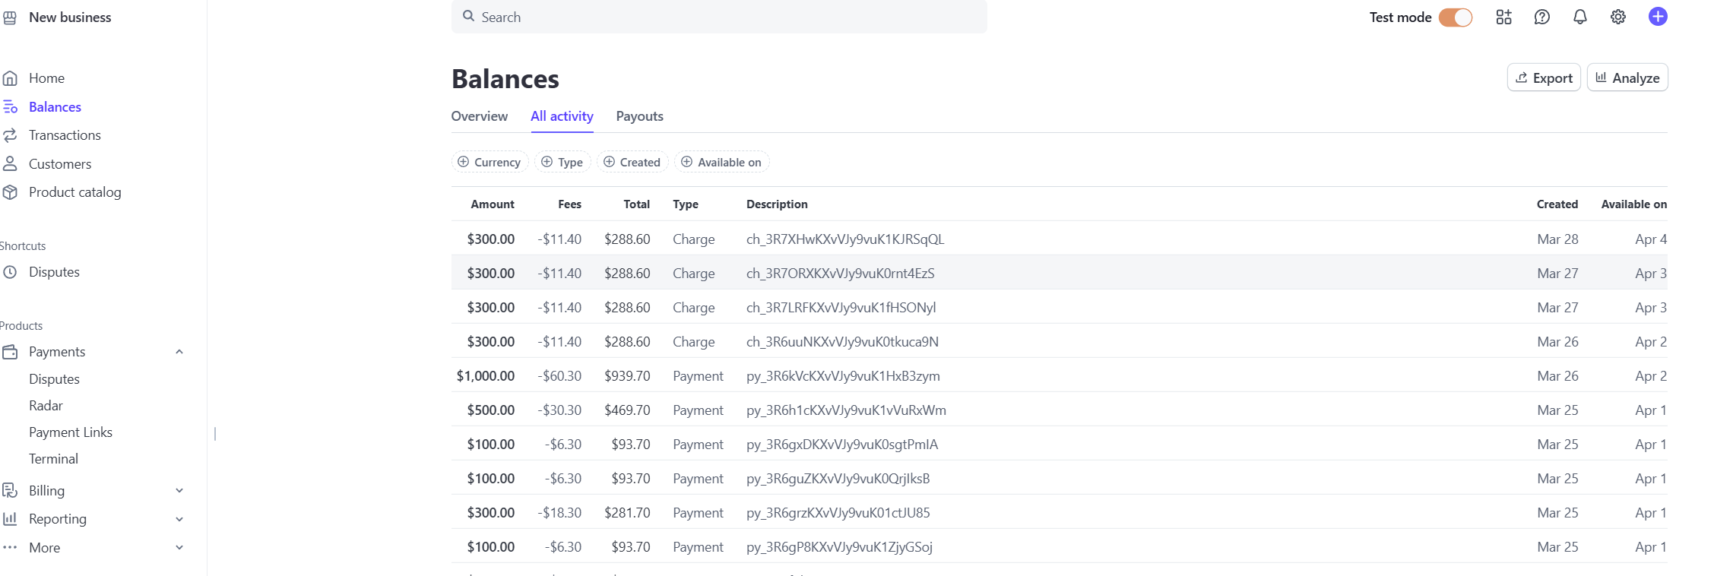
Stripe personal dashboard
View all your transactions
Different kinds of analytics (payout, etc.)

Slide 14
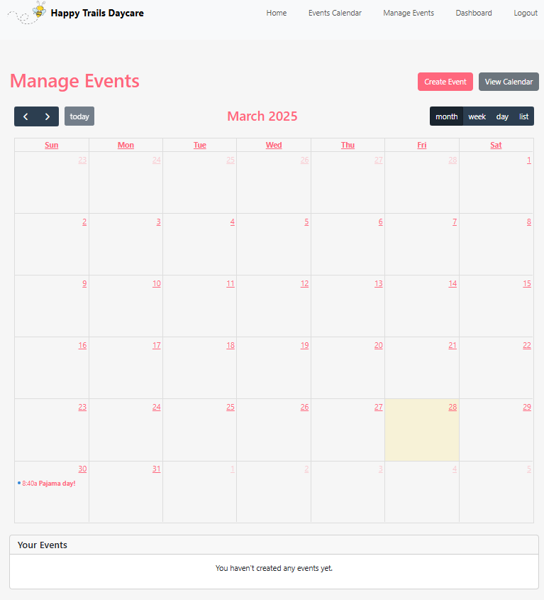
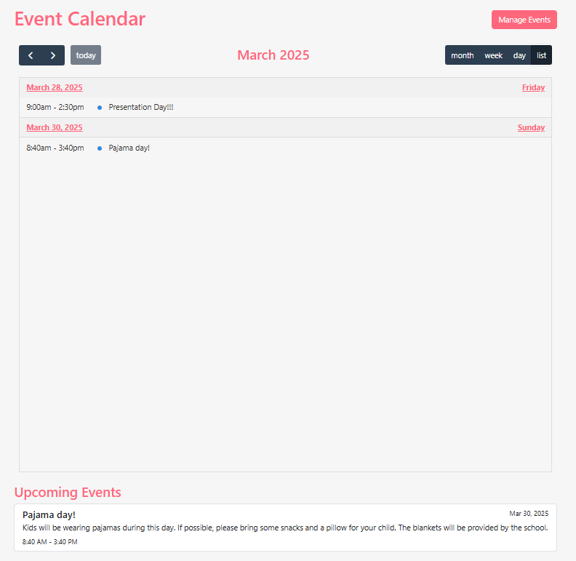
FullCalendar for events

Slide 15
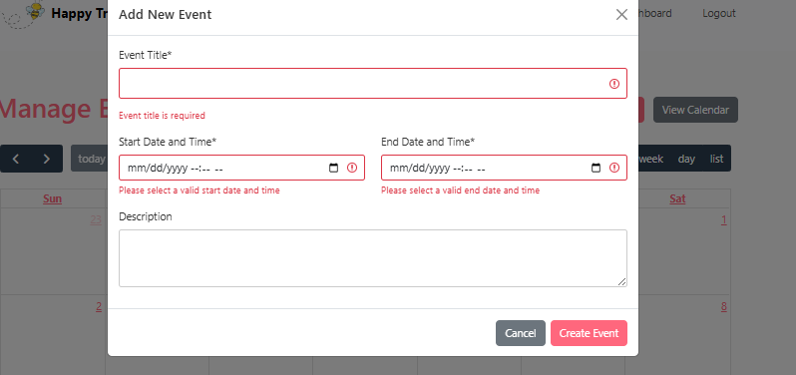
- Create/Edit events
-Validation to successfully create an event
Parents dashboard
Vs
Educator/Admin dashboard

Slide 16
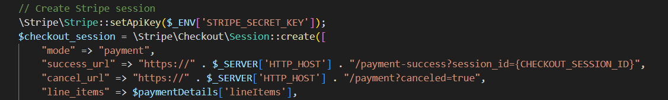
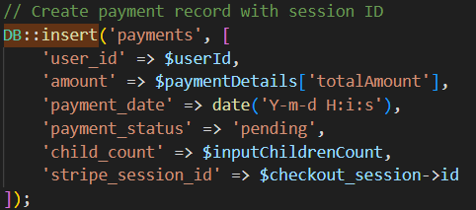
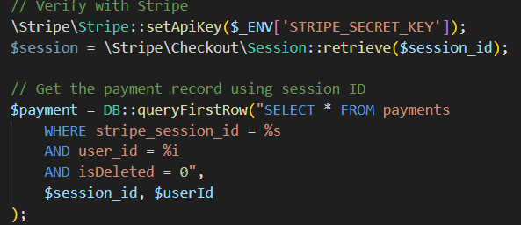
Challenges/Teaching

Slide 17
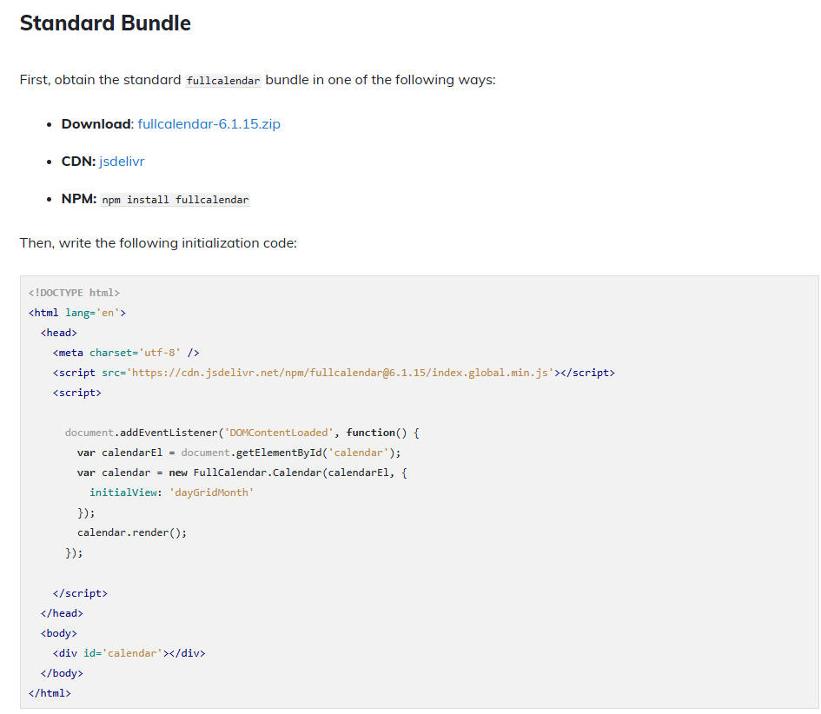
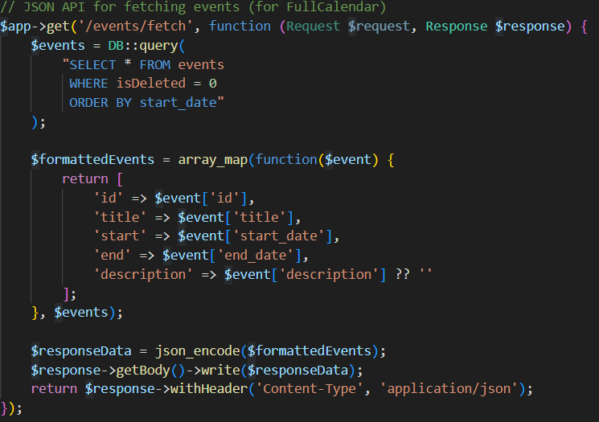
Fullcalendar.io

Slide 18
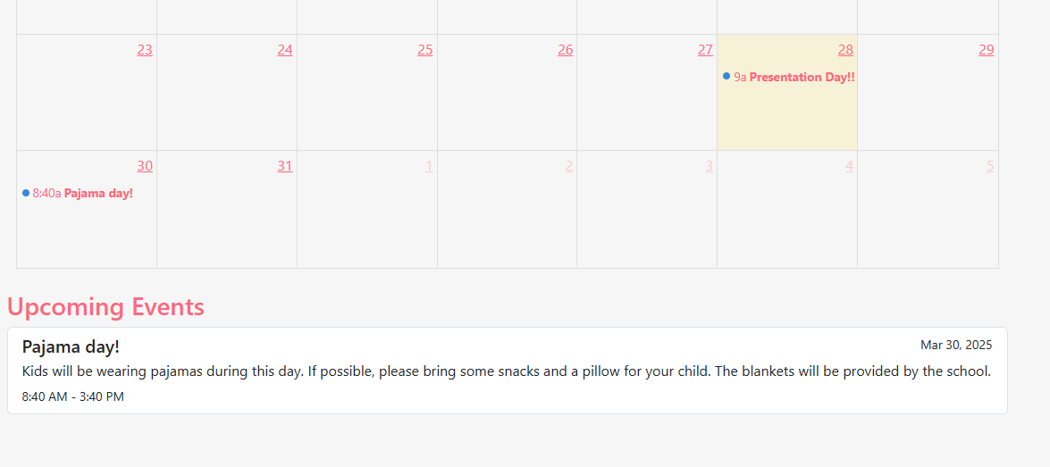
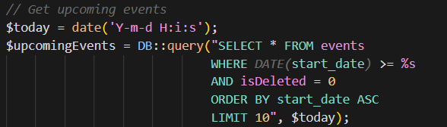
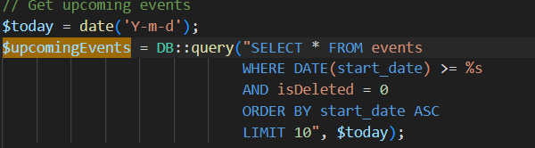

FullCalendar.io

Slide 19
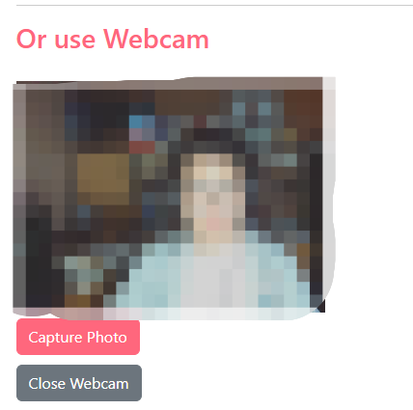
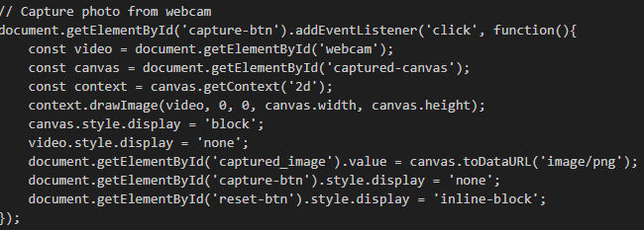
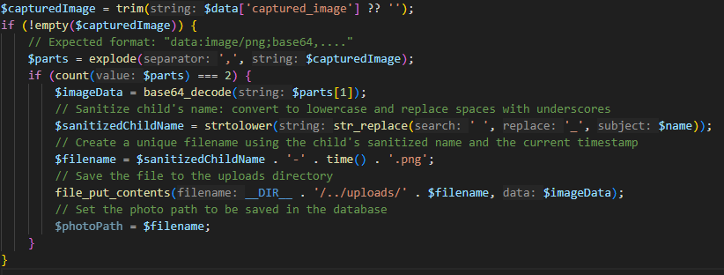
Image Capture Feature
HTML5's getUserMedia API
Live Video Stream
Optional Activation
Base64 Encoding
Sanitizing and Renaming the File
Facial Recognition in the Future!

Slide 20
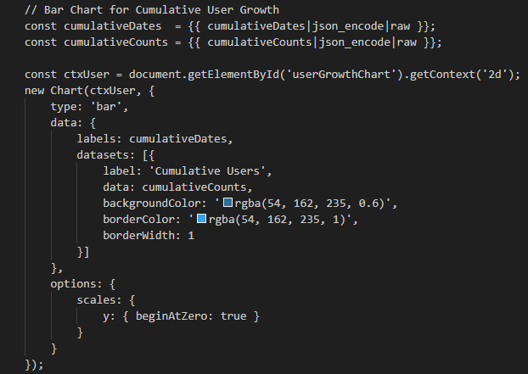
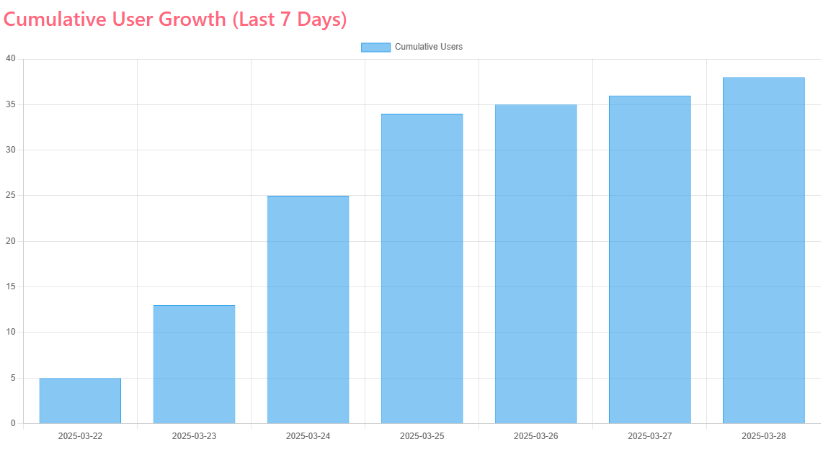
Data Visualization
Chart.jg library
Pass PHP-generated arrays directly to the JS code using Twig’s json_encode.
dynamic and interactive

Slide 21
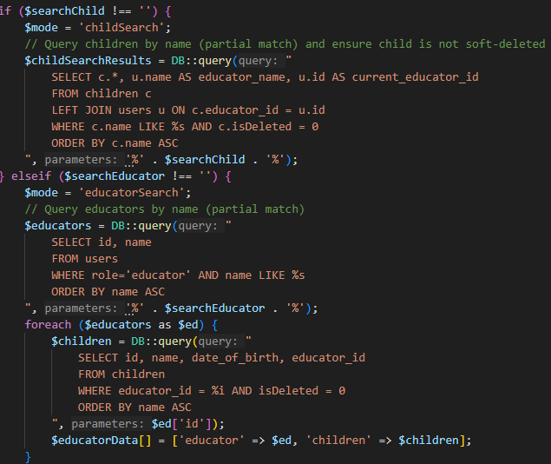
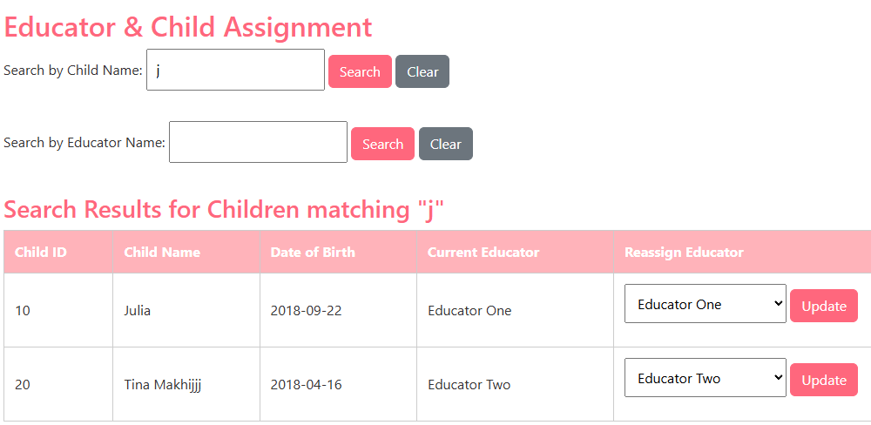
Flexible Data Retrieval
LIKE operator
% wild card
Ensure soft deleted case
More forgiving experience

Slide 22
Future work
🔐 Social Login Integration (Google/Facebook)
OAuth-based login flow
Google/Facebook login setup pending for Parent Dashboard
Will improve convenience & reduce login friction
🈯 Multi-Language Support
Enable language switching (e.g., English/French)
Make the system accessible to a broader user base and comply with bilingual requirements.

Slide 23
Summary
User Registration & Login Role-based signup with email activation, profile photo upload, password reset, and secure login.
Role-Based Access Control Different dashboards and features for Parents, Educators, and Managers.
Child & Attendance Management Educators can view assigned children, mark daily attendance, and track attendance history.
Manager Features Overview dashboard with key stats, educator-child assignments, and event scheduling (partially done).
Security & Enhancements ReCaptcha protection, mobile-responsive design, dynamic attendance charts.

Slide 24

Thank you :)

Slide 25
Back up

Slide 26
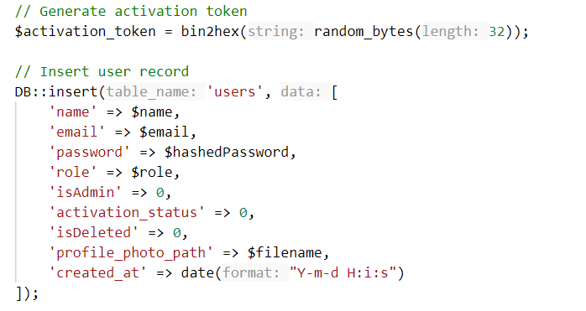
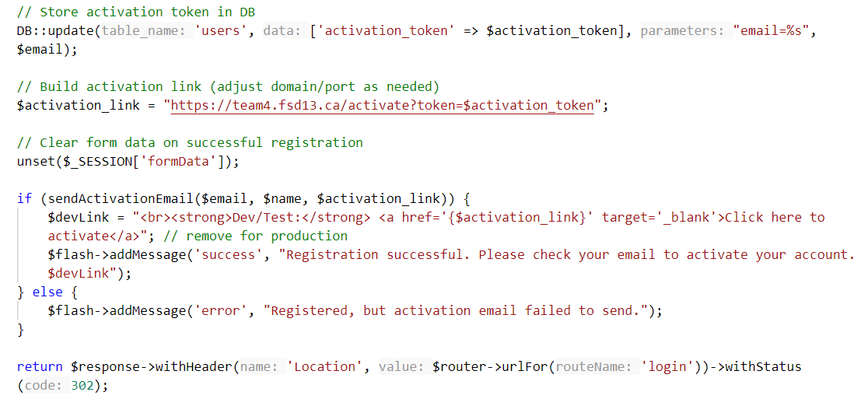
Email Activation
Notes:
🔄 Token Generation
Securely create a random token using: bin2hex(random_bytes(32))
Produces a 64-character unique string.
🗃️ Store the Token
Save it in the database with the user record (e.g., activation_token column).
📧 Email the User
Send a link like: https://team4.fsd13.ca/activate?
token=UNIQUE_TOKEN_HERE

Slide 27
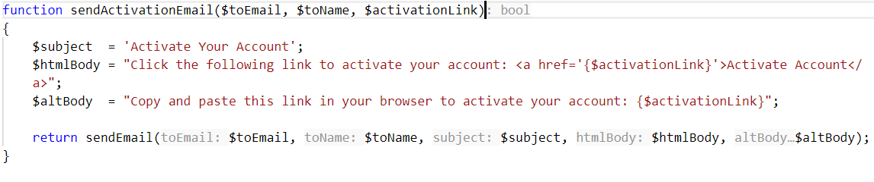
Email Activation
Notes:
🔍 Token Verification
On click, app reads token from URL
Looks it up in DB → activates user if valid
Optional: remove token to prevent reuse
🚪 Post-Activation
User is redirected to login/dashboard
Email is now verified — account is active ✅

Slide 28



Email Activation

