Slide 1
Shopify

Slide 2
Shopify : Overview
Shopify partner account
Store Dashboard
Customization
Core Files
Development Tool for Shopify
Support by Liquid
Development Phases
App-Multiple Stores
Resources

Slide 3
Shopify partner account
The Shopify Partner account allow designers, developers, marketers, and affiliates who use the Shopify platform to build ecommerce websites, themes, and apps.
Link : https://www.shopify.com/partners

Slide 4
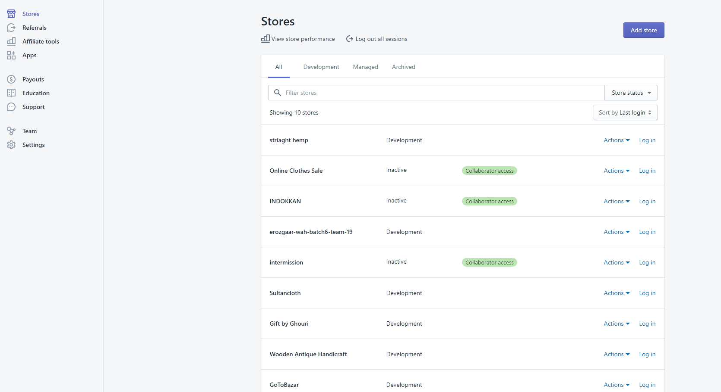
Dashboard of Partner Account

Slide 5
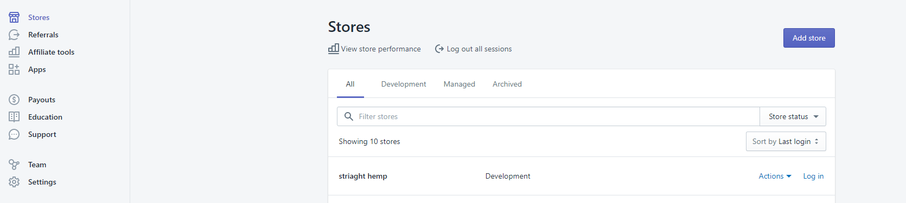
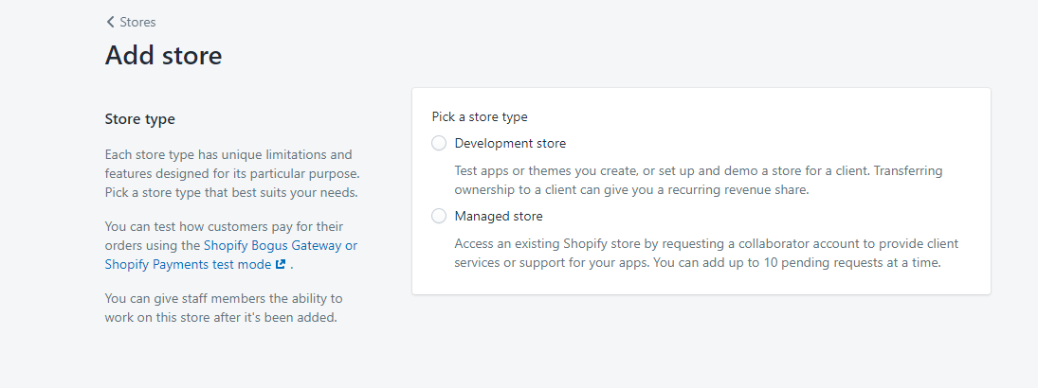
How to create a store using partner account
2. Click on add stores
1. Click on stores
3. Click to create store from scratch or
3. Click to mange existing store
4. Fill in the field and save. A store will appear in dashboard. Login and this will direct to store dashboard where developer have full access.

Slide 6
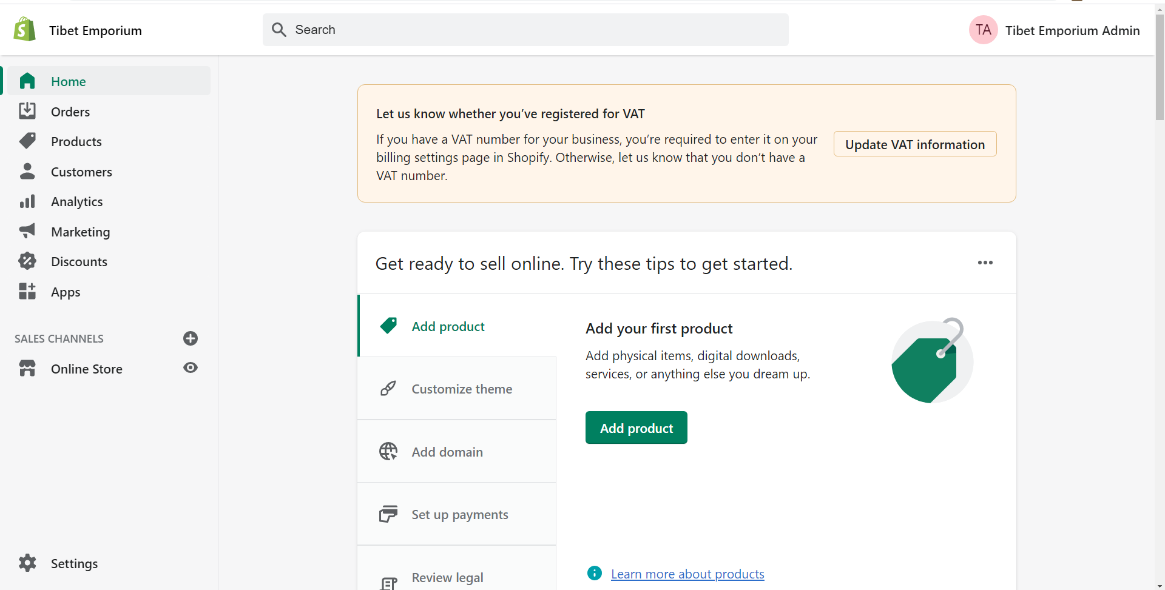
Store Dashboard

Slide 7
Store Dashboard: General Options
Order : Show orders and can add orders
Products : Add products and create collections
Customers : View customers
Analytics : Store Status
Marketing : Grow audience, promote sales event, or showcase new products
Discount : Create discount codes
Apps : Shopify app store

Slide 8
Store Dashboard: General Options
Sale Channels : Add Facebook, instagram or different marketing places

Slide 9
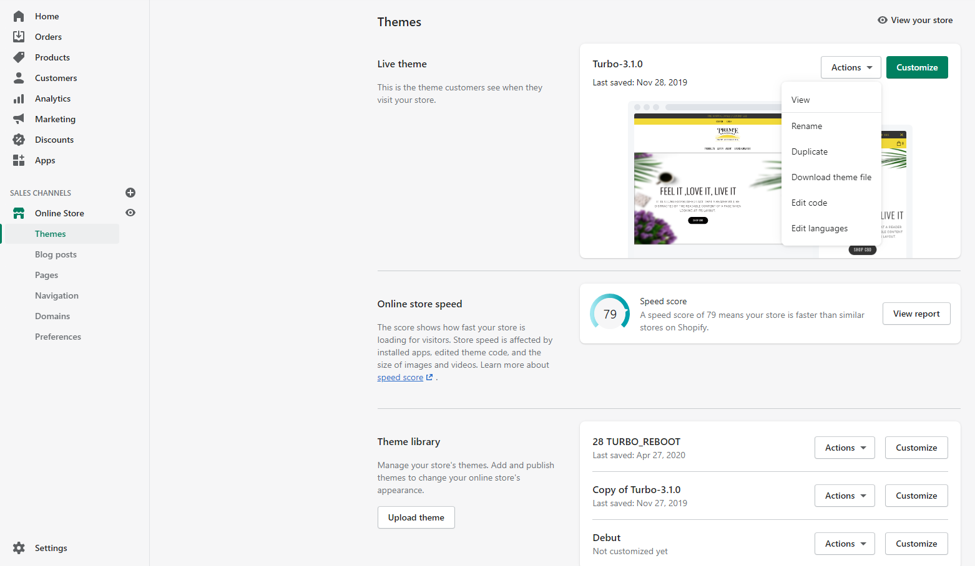
Store Dashboard: Online Store
Theme :
5.Theme Customization
1.View theme
2.Duplicate the theme
3. Download Theme
4.Edit the core file of theme
6. Theme version
5.Upload Theme

Slide 10
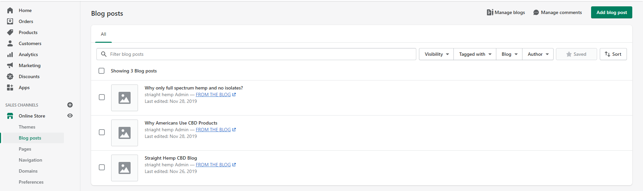
Store Dashboard: Online Store
Blog post : Add blog post

Slide 11
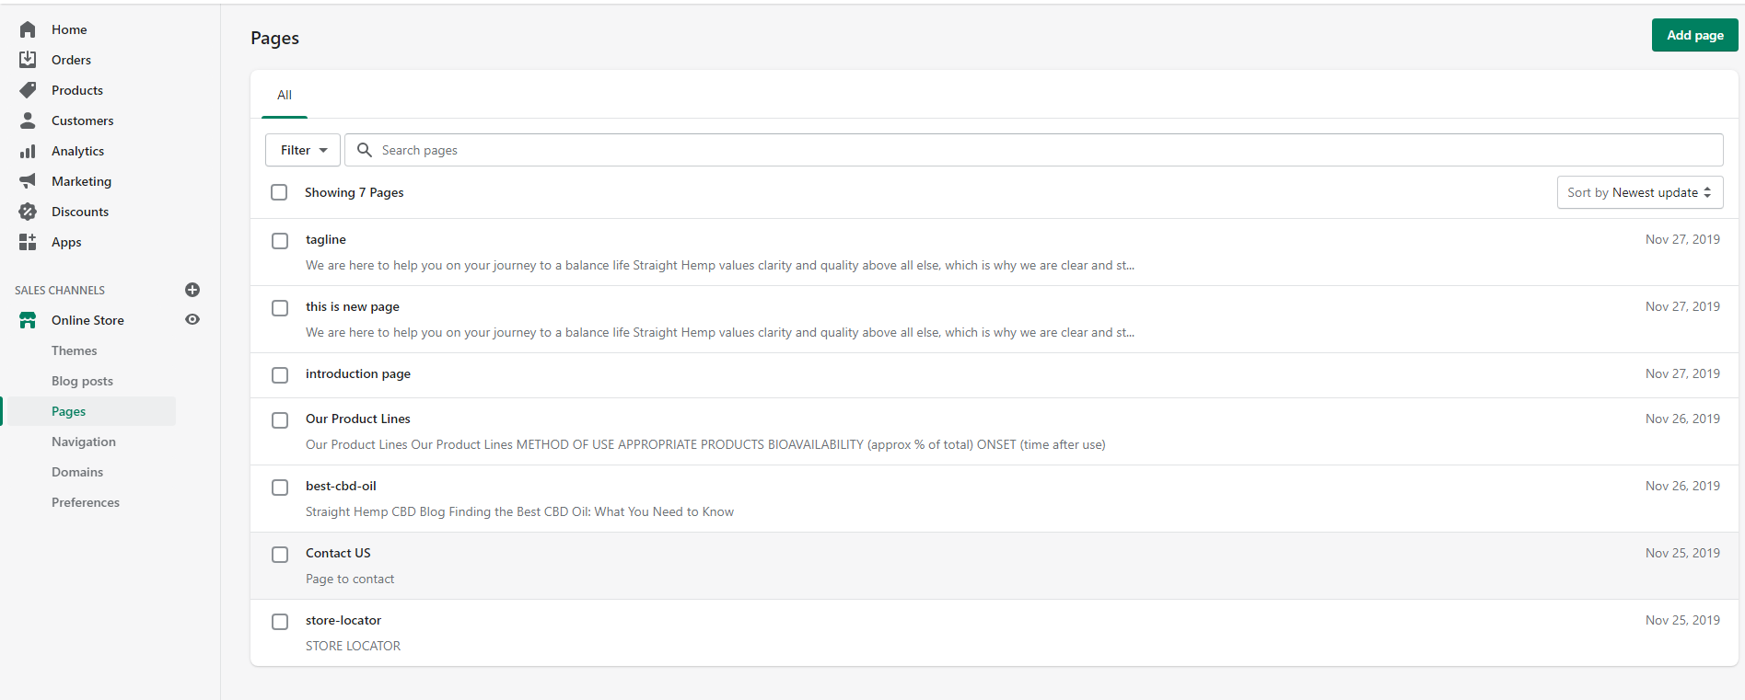
Store Dashboard: Online Store
Pages: Add and edit pages like contact us page

Slide 12
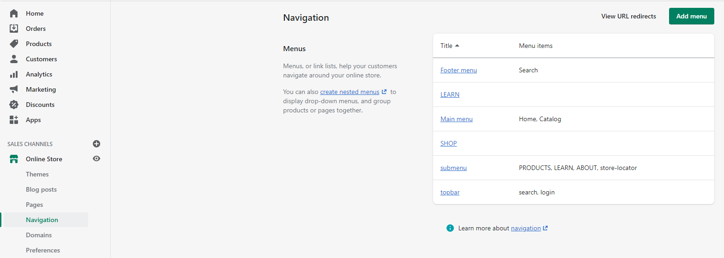
Store Dashboard: Online Store
Navigation: Add and edit menu bar and footer menu

Slide 13
Store Dashboard: Online Store
Preferences :
Title and meta description
Social sharing image
Google Analytics
Facebook Pixel
Customer privacy
Password protection

Slide 14
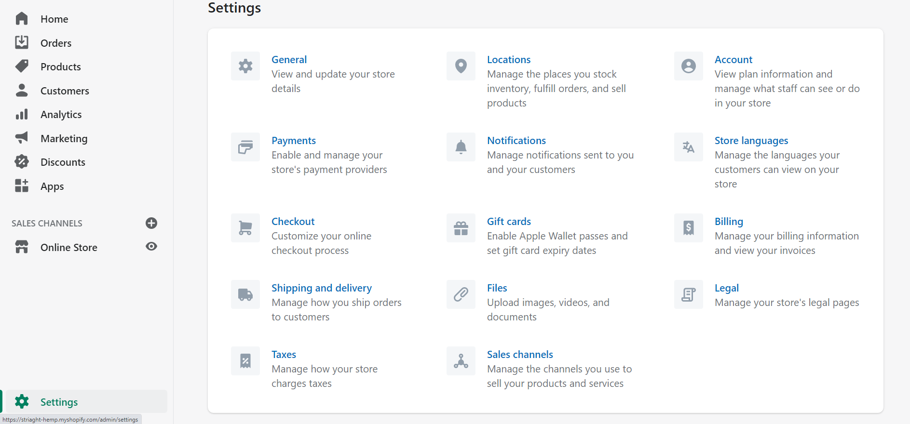
Store Dashboard: Settings

Slide 15
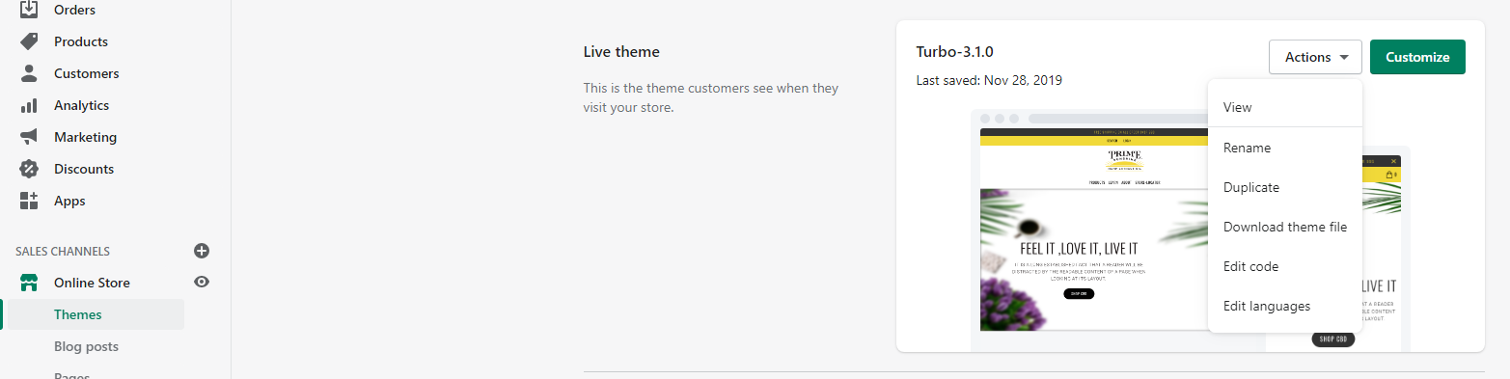
Customization
Shopify allow theme customization.To navigate to customization options:
Click on customization button

Slide 16
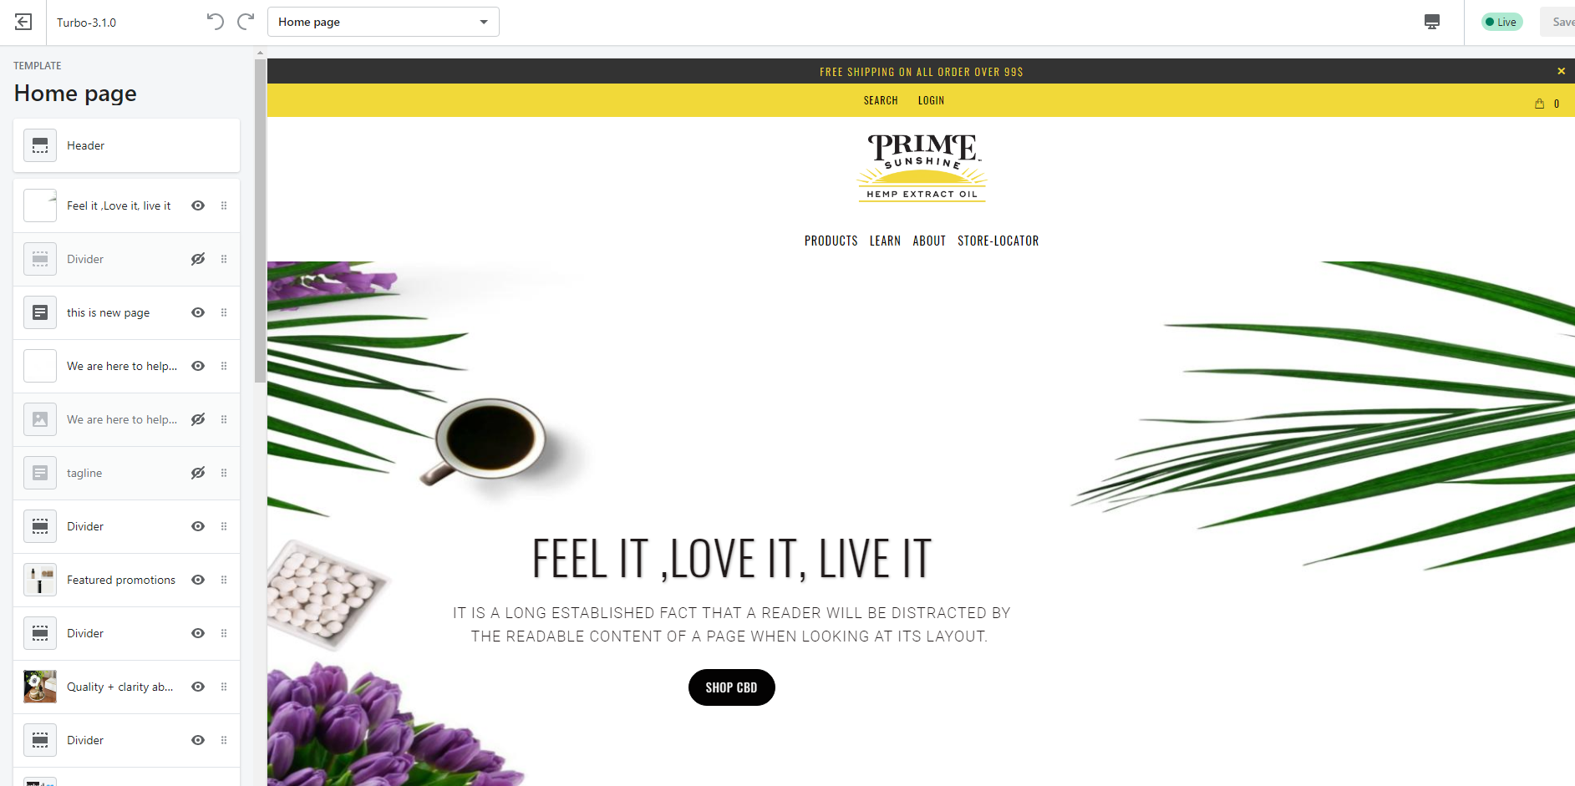
Customization
Select the page to customize
Each page is divided in section.
Sections can be edited.
New sections can be added or removed.
Section order can be changes.
Section can be hide or unhide.
Custom section can also be create.
Section can be added by code too.

Slide 17
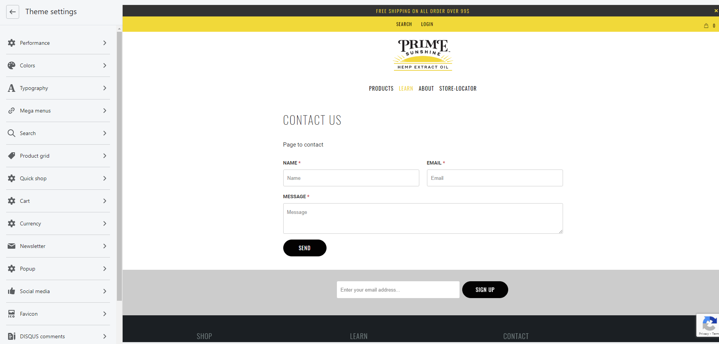
Customization
Theme Settings controls the overall options theme
These are setting that will implement on all the site.
Colors, Tyography ,mega menu , curreny will change the overall site appear and behaviour

Slide 18
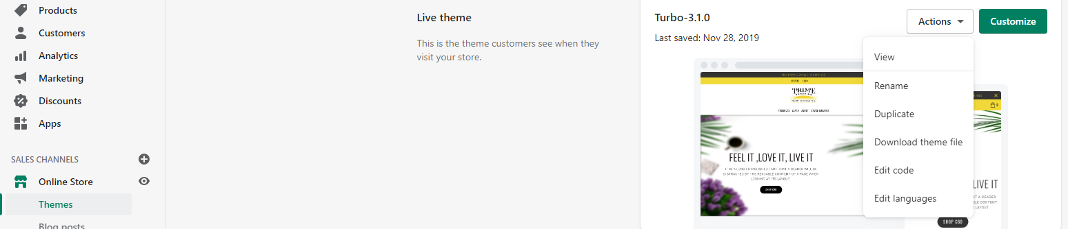
Core Files
Changes or modifications that can be done without customization then changes has to be done from core files of theme.
To navigate to core files
1.Click to themes
2.Click edit code

Slide 19
Core Files : File Structure
Layout : It contains theme layout templates, which by default is the theme.liquid file.
Templates : It contains all other Liquid templates, including those for customer accounts.
Sections : It contains a theme's sections, which are reusable modules of content that can be customized and re-ordered by users of the theme.
Snippets : It contains all the theme's Liquid snippet files, which are bits of code that can be referenced in other templates of a theme.

Slide 20
Core Files : File Structure
Assets : It contains all the assets used in the theme, including images, stylesheets, and javascript files.
Locales : It contains the theme's locale files, which are used to provide translated content for the theme.
Config : It includes settings_schema.json file and a settings_data.json file.

Slide 21
Development Tool
Theme Kit is development kit for shopify
Procedure to install
First install chocolaty using power shell
Install Theme Kit
Link Complete guide to install:
https://www.youtube.com/watch?v=oFwvq_HaOCg&list=PLB4AdipoHpxbTycAd8VriLJoROLb3hYmh&index=8
https://www.youtube.com/watch?v=3XUXxW7sU40&list=PLB4AdipoHpxbTycAd8VriLJoROLb3hYmh&index=9

Slide 22
Supported by Liquid
Shopify is a template language
The double curly brace delimiters {{ }} denote output, and the curly brace percentage delimiters {% %} denote logic.
CSS – Styling
Assets styles.scss.liquid
Code Hierarchy
Snippets Section Templates
Resources mention in the end

Slide 23
Development Phases
A DEVELOPMENT PHASE
1)Add products
2 )Add collections
3 )Add theme and customize
customize using editor
customization using coding
4) Domain
B PAGES
5)About us page
6)Contact us page
7) F/Q

Slide 24
Development Phases
C PREFERENCES
8)Create menu
9)Location of store ,payment - transaction and credit card bill and fee , taxes
11)Terms and services/currency
12 Shipping /delivery time ,rate
13) Legal refund ,sale polices ,terms and service
14)Add functionalities
D TEST PHASE
E SALE CHANNELS
Link to sale channels
Have marketing plan
F TRANSFER OWNERSHIP

Slide 25
App – Multiple Stores
Shopify allow to have multiple stores.This feature
can be enabled by adding shopify apps.
Some of popular multiple store apps:
nChannel
Stitch Labs
‍Veeqo
Skubana
Rewind Backups
Replay

Slide 26
Resources
Complete Course Guide link:
https://www.youtube.com/watch?v=0274iR1XENE&list=PLB4AdipoHpxbTycAd8VriLJoROLb3hYmh&index=1
Shopify Official resources
learning-liquid-updated.pdf
https://help.shopify.com/en?utm=guru-email
https://shopify.github.io/liquid-code-examples/
https://www.youtube.com/channel/UCSG_dVp-hi_hWP-Z7DlpRgQ
Some Other :
https://www.youtube.com/watch?v=6-GBuEz7qmk&list=PLGIR20diRHtBnRE6aj79CRMbqQQwQ9yV_&index=2

