Slide 1
NAME:- PALAK DAVE CLASS:-FYBsc.It ROLL NO:- 132
Topic:- Zoom APP

Slide 2

What is ZOOM App ?
Zoom is an online audio and web conferencing platform. People use it to make phone calls or to participate in video conference meetings.
It was founded in 2011 by Eric Yuan, a former Cisco executive.
So, whenever there is a need to share your personal opinion or put a query, participants can shoot it right away using the chat tool.

Slide 3
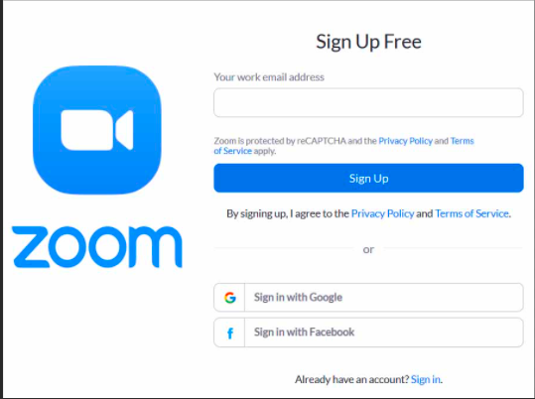
How does ZOOM App work ?
To start your own Zoom Meeting, you'll need a Zoom account, which you can create for free. Go to the Zoom web site and click Sign Up, It's Free at the top of the page and follow the instructions. Once completed, you'll be able to start your own meetings.
Either,You'll need to click a link to install the Zoom app, and then enter the conference code to sign into the meeting to which you've been invited.
You can record and save your meetings, share your desktop with the meeting attendees, and use chat tools during the meeting.
The Zoom app is available on all major desktop and mobile operating systems, including Windows, macOS, Android and iOS.

Slide 4
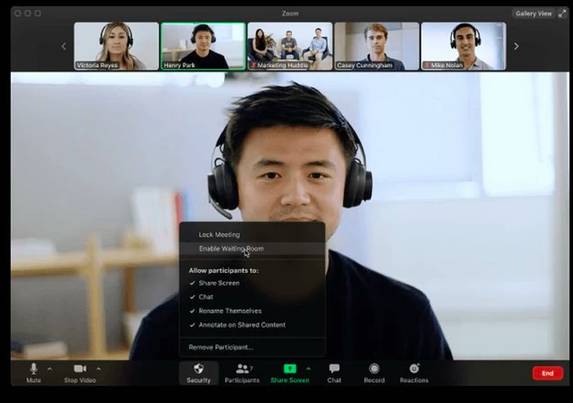
Features of ZOOM App ?
Group video conferences: Host up to 500 participants . The free plan, however, allows you to host video conferences of up to 40 minutes and up to 100 participants.
Screen sharing: Meet one-on-one or with large groups and share your screen with them so they can see what you see.
Recording: You can record your meetings or events too.

Slide 5
Advantages of Zoom App ?
Zoom appliances help you out with setting up virtual meetings and conferences in a way more simplified manner than any other application.
Participants can communicate anytime through live chats in the middle of the conversation.
Zoom is available free of charge to anyone and the basic free version offers all the facilities most people will need.
Zoom ensures your work is as productive as before whether you are travelling or staying at home.
.

Slide 6


