Slide 1
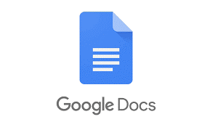
GOOGLE DOCS
GOOGLE DOCS

Slide 2
OVERVIEW.
Google docs is a free internet tool that allows you to share documents with co-workers or with the people you want. It is a simple but powerful word processor for spreadsheets, presentations, etc.
Google Docs is available as a web application supported on Google Chrome, Mozilla Firefox, Internet Explorer, Microsoft Edge, and Apple Safari web browsers.
Users can access all Docs, as well as other files, collectively through the Google Drive website.
Well It Was Released In July, 2009 but it was officially renamed in October 2012 as Google Docs.

Slide 3
ADVANTAGES OF GOOGLE DOCS.
The Documents are stored online, this allows us to access it from any computer with an internet connection.
The Large Number of Formats that it supports.
Its Price: It is totally Free.
It Is supported in every devices from Mobile to Computer.
It is accessible in website for Computer and for Mobile Devices application is available.

Slide 4
LIMITATION OF GOOGLE DOCS.
Unlike Microsoft Word and most other word processors, Google Docs runs in a Web browser -- you don't need to install Docs on your computer. Running Docs through the Internet makes it possible to work on any Internet-connected computer, but this presents a limitation: If you lose your Internet connection, you lose access to the program.
Limited features when compared to MS office.

Slide 5
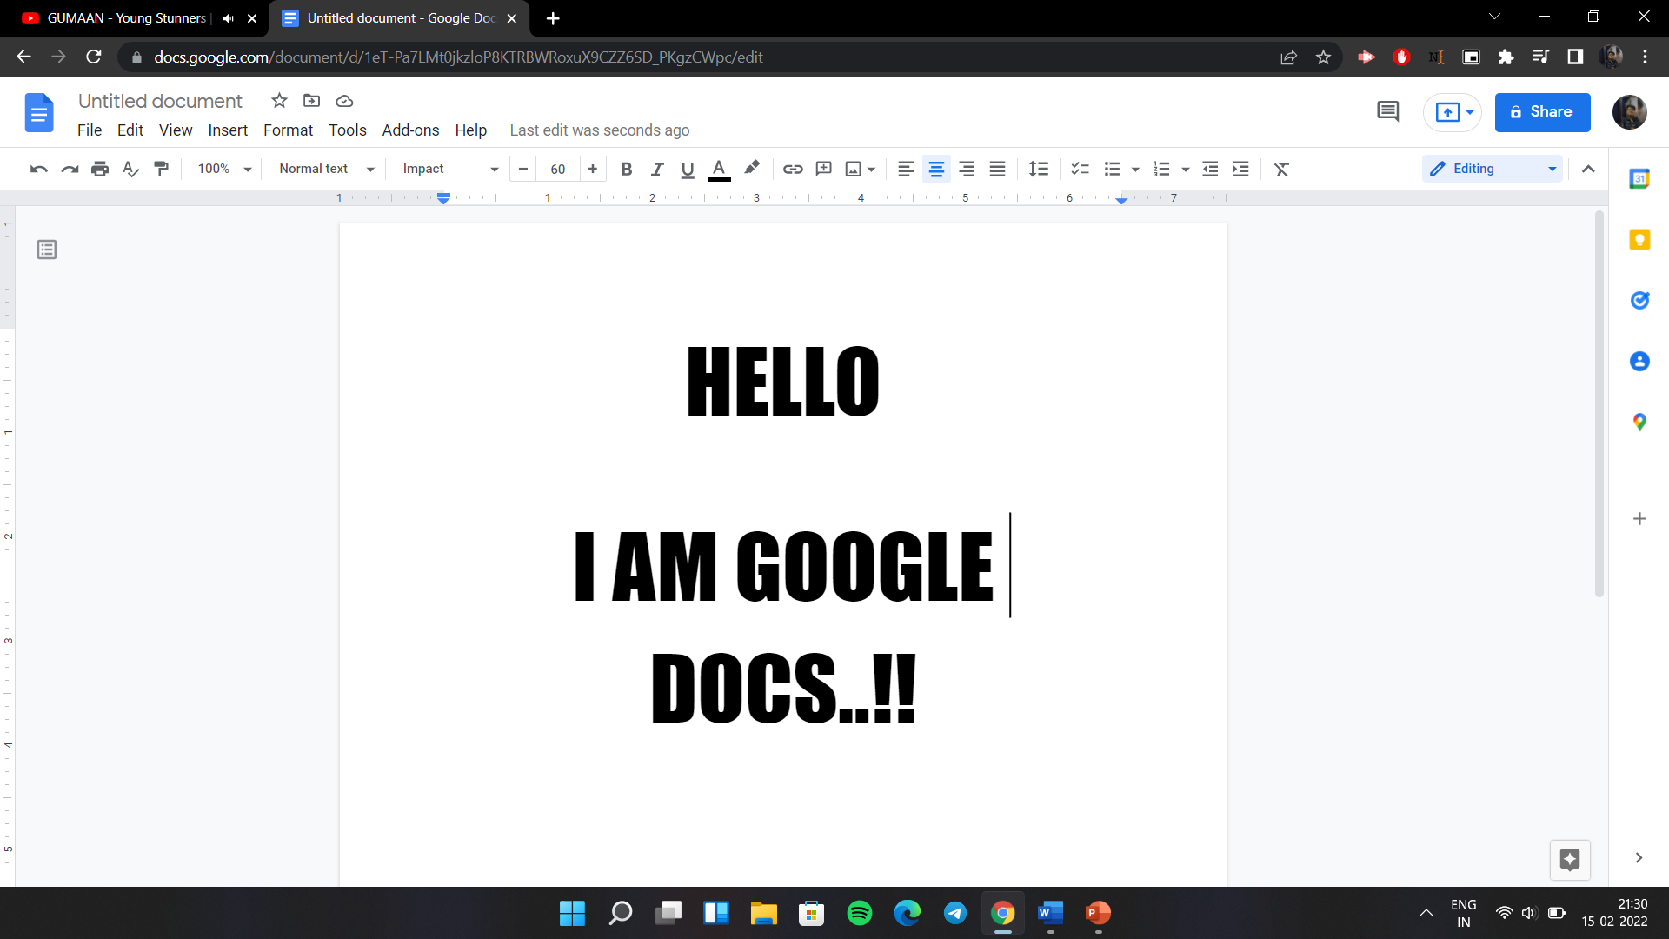
HOW TO USE IT ?
In order to use Google Docs, we must have a Google account.
One of the ways to enter is by opening Google Apps And then in the google menu we click on Google Docs. This Method Works On Every Device.
For Mobiles, App Is Available From Where We Can Work And Save Our Data.

Slide 6
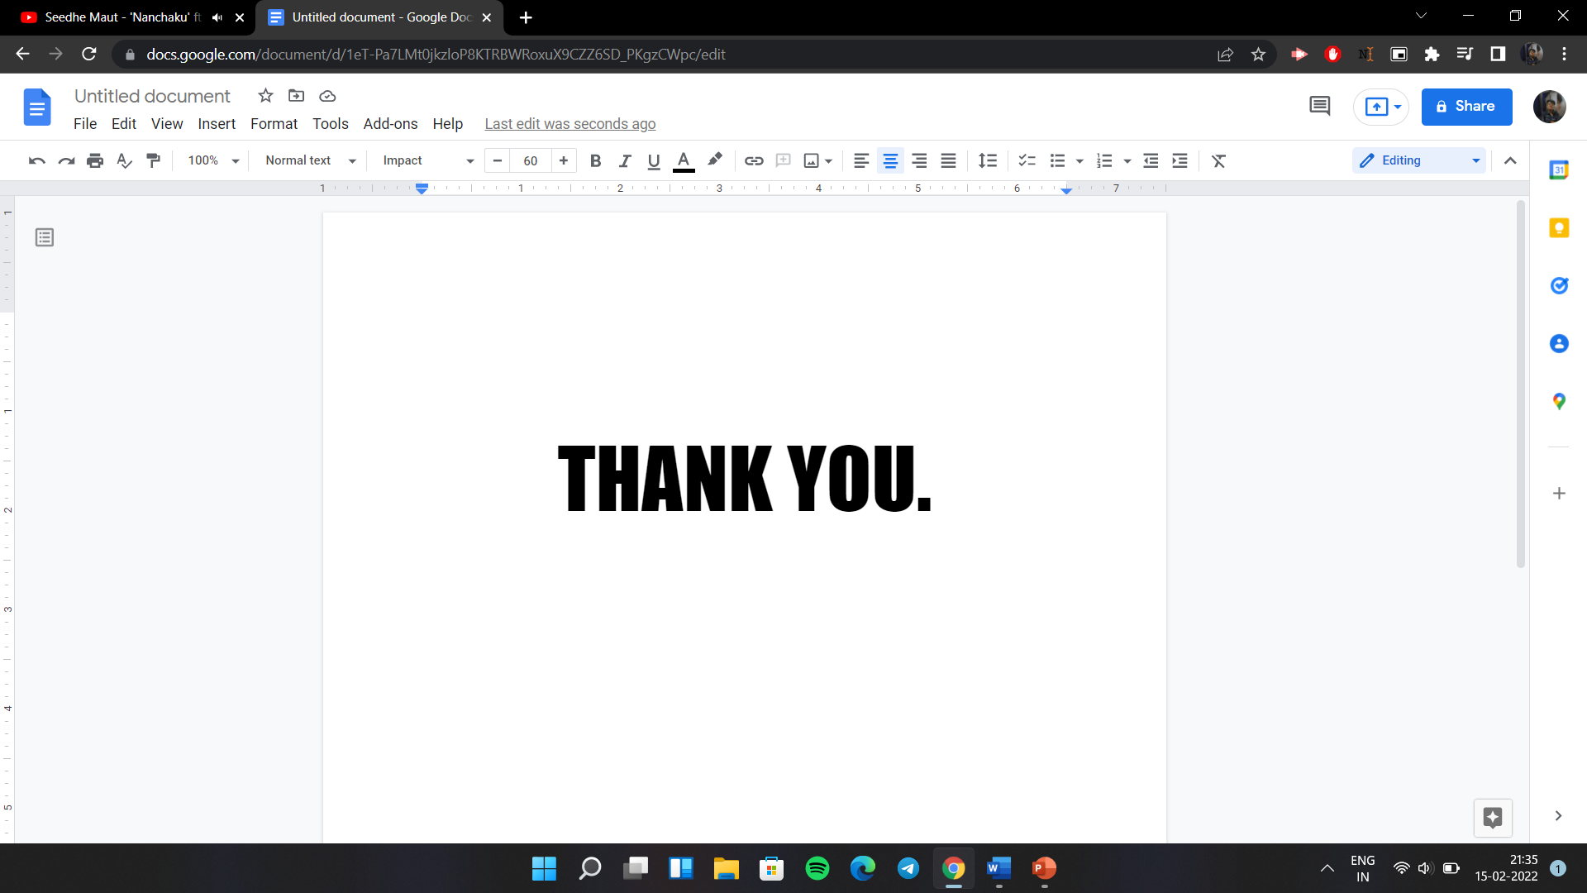
BY: FYIT_39_Yash

