Slide 1
鲁棒性问题中的Trade-off和Win-Win
4

Slide 2
目录
1. 从置信度正则(confidence-regularization)角度解决Out-Of-Distribution和In-Distribution性能间的Trade-off问题
2. 从(因果推断)反事实控变量控制(Counterfactual Variable Control)角度解决机器问答中的鲁棒性问题
3. 从具备分布意识的多专家(Diverse Distribution-aware Experts)角度解决长尾分布中头和尾性能间Trade-off问题

Slide 3
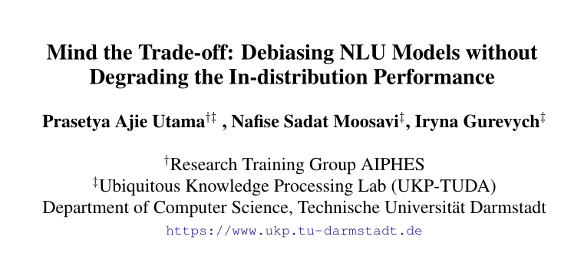
Notes:
ACL2020

Slide 4
Mind the Trade-off: Debiasing NLU Models without Degrading the In-distribution Performance
名词解释:
biases： are commonly characterized as surface features of input examples that are strongly associated with the target labels.
out-of-distribution： associative patterns between the surface features and the target labels are not present.
in-distribution： evaluation on the original test data which contains the same associative patterns in the training data.
robust model: the models are robust against dataset biases.

Slide 5
Mind the Trade-off: Debiasing NLU Models without Degrading the In-distribution Performance
NLU场景1： Natural Language Inference
任务定义: 给定premise和hypothesis预测两者关系（entailment; neutral; contradiction）
In-Distribution现象：1. premise和hypothesis之间有着严重的word overlapping，而这一现象和entailment标签有着很强的表面联系； 2. Hypothesis中经常包含和目标标签高度相关的词。
OOD数据集：HANS 和 MNLI-hard test set
Notes:
HANS: The dataset is constructed based on the finding that the word overlapping between premise and hypothesis in NLI datasets is strongly correlated with the entailment label. HANS consists of examples in which such correlation does not exist, i.e., hypotheses are not entailed by their word-overlapping premises.
MNLI-hard： It allows a simple model that predicts based on the hypothesis-only input to perform much better than the random baseline. Gururangan et al. (2018) presents a “hard” split of the MNLI test sets, in which examples cannot be predicted correctly by the simple hypothesis-only
model.

Slide 6
Mind the Trade-off: Debiasing NLU Models without Degrading the In-distribution Performance
NLU场景2： Fact Verification
任务定义: 给定evidence sentence来评估一个claim sentence的有效性(validity) （support，refutes，not enough information）
In-Distribution现象：claim中的存在和对应标签有很强bias的单词短语。即依赖claim-only完成预测。
OOD数据集：Fever-Symmetric
Notes:
手工重构， relying on cues of the claim can lead to incorrect predictions

Slide 7
Mind the Trade-off: Debiasing NLU Models without Degrading the In-distribution Performance
NLU场景3： Paraphrase Identification
任务定义: 给定两个问题看两者意思是否相同（duplicate； non-duplicate）
In-Distribution现象：1. 问题对中有很多highly overlapping的词；2. 大部分问题对都是non-duplicate的。
OOD数据集：PAWS (Paraphrase Adversaries from Word Scrambling)
Notes:
PAWS是通过用Word Scrambling对QQP数据制造扰动Paraphrase Adversaries。

Slide 8
动机
Several proposed debiasing methods are shown to be very effective in improving out-of-distribution performance. However, their improvements come at the expense of performance drop when models are evaluated on the in-distribution data.
Ideally, if such an improvement in OOD test set is achieved for the right reasons (i.e., better reasoning capabilities by learning a more general feature representation), a debiased model should still be able to maintain its accuracy on previously unambiguous instances even when they contain biases.
所以这篇工作要打破这个trade-off，这个shortcoming
Notes:
于是分析了一下原来工作在ID上表现不好的原因

Slide 9
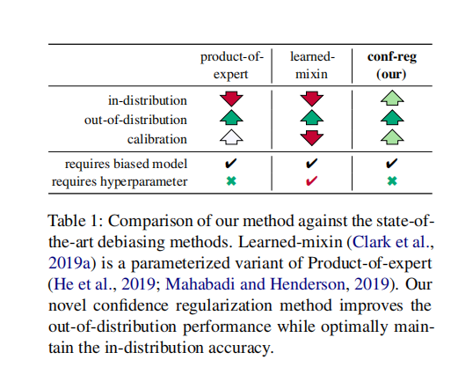
动机
Several proposed debiasing methods are shown to be very effective in improving out-of-distribution performance. However, their improvements come at the expense of performance drop when models are evaluated on the in-distribution data.
Ideally, if such an improvement in OOD test set is achieved for the right reasons (i.e., better reasoning capabilities by learning a more general feature representation), a debiased model should still be able to maintain its accuracy on previously unambiguous instances even when they contain biases.
所以这篇工作要打破这个trade-off，这个shortcoming
Notes:
于是分析了一下原来工作在ID上表现不好的原因

Slide 10
Why can’t ?
原来方法的做法：Existing work(product-of-expert/learned-mixin) introduce several strategies to overcome the known biases by correcting the conditional distribution of the target labels given the presence of biased features. They achieve this by reducing the importance of examples that can be predicted correctly by using only biased features. As a result, models are forced to learn from harder examples in which utilizing solely superficial features is not sufficient to make correct predictions.
弊病所在：While this approach prevents models from learning the task mainly using biased features, it also reduces model’s ability to learn from examples that can be solved using these features. As a result, models are unable to optimize accuracy on the original training distribution, and they possibly become biased in some other ways

Slide 11
Main Idea：
Confidence Regularization： explicitly encourage models to make predictions with lower confidence (i.e., assigning a lower probability to the predicted label) on examples that contain biased features.
新思路: draws a connection between the robustness against dataset biases and the overconfidence prediction problem.
Why we can? Iinstead of using it to diminish the training signal from these examples, we use it to scale the confidence of models’ predictions. This enables the model to receive enough incentive to learn from all of the training examples.

Slide 12
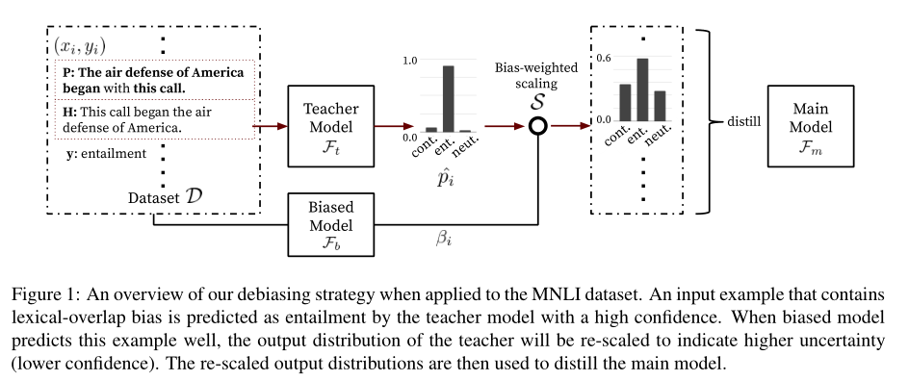
Method

Slide 13
Method
soft target ： knowledge distillation

Slide 14
Method
HANS&PAWS: 1.hypothesis和premise共现词百分比
2.premise和hypothesis词向量的cos距离
分别用两者来训练两层非线性分类器。
MNLI-hard&Fever-Symmetric：
用hypothesis/claim单一训出的model

Slide 15




Method
主要创新点：Bias-weighted Scaling
bias趋近1了所有预测概率都很低
bias趋近0了则不改变原始预测概率

Slide 16

Method
自蒸馏

Slide 17
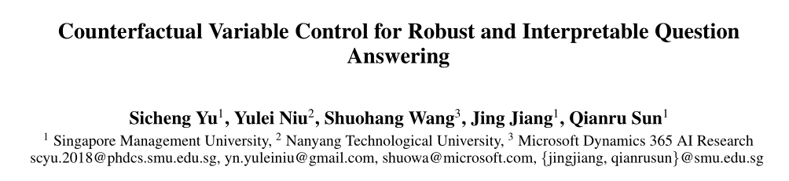

Slide 18
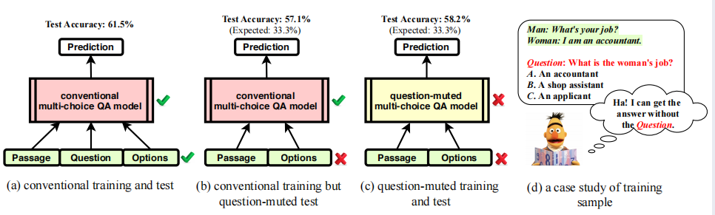
Counterfactual Variable Control for Robust and Interpretable Question Answering
任务场景:
给定passage+options+question来预测答案(选择)
现有方法的缺点:
1. 缺乏可解释性
2.对抗场景下效果很差（安全性问题）
原因分析：overfit to the correlation in training

Slide 19
反思
Can we just conclude that questions have little effect on answers? We must say no, as we understand this totally violates our common sense about the causality of QA — the question causes the answer. Similarly, we may ask what effect the passage has.
Notes:
1.drop小，说明学到的不是正确的reasoning
2.d图是overlapping的例子

Slide 20
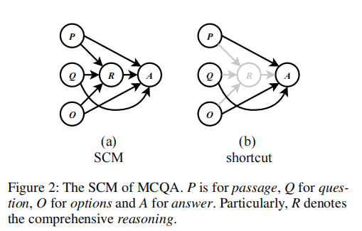
SCM(structural causal model) of MCQA and shortcut
目标：找出mediator变量R和A的关系。

Slide 21
Main Idea : Counterfactual Variable Control
The idea of CVC is to preserve only the robust prediction which is derived by comprehensive reasoning rather than any shortcut correlations.
两个理论：
Counterfactual analysis :
imagines a counterfactual world where the controlled variable (e.g., Q) had existed to derive its subsequent variables (e.g., R). This avoids any inter_x0002_ference on uncontrolled variables that are not input (e.g., R).
Variable control :
enables us to explicitly separate comprehensive reasoning and shortcut correlations by variable control
Notes:
1.探究Q的影响，Q不存在R也不存在，但是直接去掉R不合理，忽视了R的影响了。

Slide 22
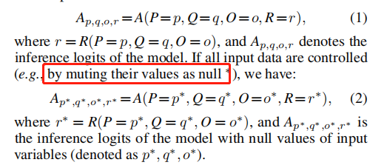
CVC：Normal Prediction（NP）
CVC：Counterfactual Prediction（CP）
the model makes the prediction when some variables are controlled but the others are assigned with counterfactual values by imagining a counterfactual world of no variable control.
(i) control only input variables; (ii) control only mediator variable.

Slide 23
两种CVC的实现
为什么两种？
反事实的想象可以用在input(Q/O/P) variable (IV)上也可以用在mediator variable(MV)上:
CVC on Input Variables (CVC-IV)
CVC on Mediator Variable (CVC-MV)
两者相同点和区别
Both CVC-IV and CVC-MV aim to capture the causal effect of comprehensive reasoning in QA. Their difference lies in on which variables to apply the control.
理解
判断跟踪A才来到岛上的B是否为杀人犯

Slide 24
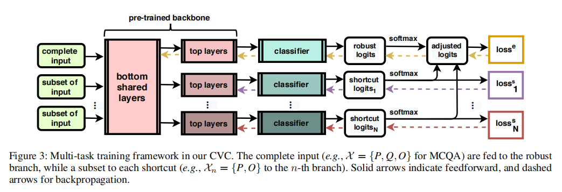






Model ： The Implementation of CVC
为什么要先过softmax？不直接用logits？
Notes:
1. Multi-task Training
multi-branch结构：包含Robust Branch 和 Shortcut Branch
各个loss相同（各自都是CE），但是相互独立
底层优化（只有RobustBranch可以）

Slide 25
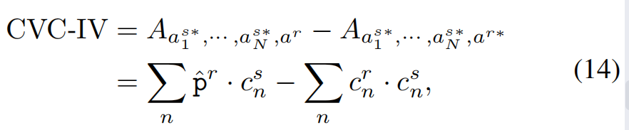
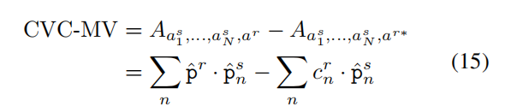
Counterfactual Inference
+
Notes:
C其实是个常数
在MV中可自动求C，两层全连接tanh网络，其中Distance用js距离。) 即共同参与联合训练。it updates c-adaptor using cross-entropy loss (computed between the CVC-MV logits and the ground truth)

Slide 26
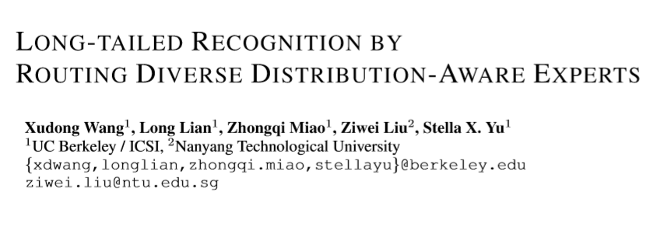

Slide 27
LONG-TAILED RECOGNITION BY ROUTING DIVERSE DISTRIBUTION-AWARE EXPERTS
任务场景： 长尾分布分类任务
A few classes contain many instances, while most classes contain only a few instances.
现有方法：
1. class re-balancing/re-weighting
2. grouping
缺点：
tend to focus on tail performance gain, often at the expense of head performance loss from increased classifier variance.

Slide 28
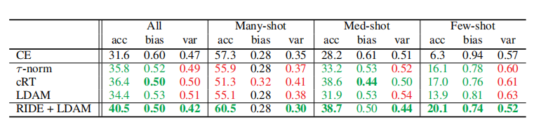
LONG-TAILED RECOGNITION BY ROUTING DIVERSE DISTRIBUTION-AWARE EXPERTS
先列结果
1. 往年方法在many-shot上的acc下降，我们上升
2. 我们比往年方法在tail-shot上下降了更多的bias
3. 往年方法都提高了方差，我们减少了方差

Slide 29
Why Can’t ？
该方法和ensemble and grouping思路的方法最为相似。
分析一下为什么往常方法不能头尾兼顾：
思路：对各类别分组，每个组安排一个专家（分类器），因此均为multi-expert framework。
BBN: 头尾各一个专家，头正常训练，尾使用sampling 来平衡数据
LFME：多个teacher分别关注较为平衡的各个group，然后蒸馏到同一个模型上。
总结： each expert do not have a balanced access to the whole dataset, which damages the overall generalizability, especially head classes.

Slide 30
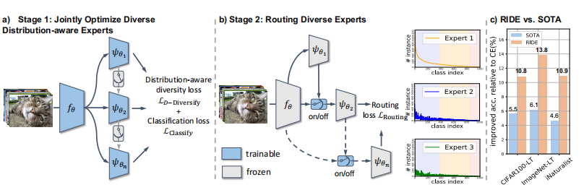
Why we can ？ Model Overall
Since tail classes are inclined to be confused with other classes, by adding the expert assignment module, the data imbalance ratio for later experts can be automatically reduced without any distribution-aware loss, which allows focusing less on confident head classes and more on tail classes. 不行就多来个专家。（专家共享信息+专家各司其职）
Notes:
多专家框架，各个专家联合训练，f共享，o不共享
一个多样性loss，一个CEloss
测试的时候求专家之间的算数平均值。

Slide 31


Model
The distribution-aware diversity loss:
目的： penalize the inter-expert correlation
完整训练loss：
Notes:
e. This way, we give lower temperature to tail classes, which generates
higher probability for the tail classes in distributions that we apply KL Divergence on, encouraging
more diversity in tail classes.
而较低的温度，应对熵比较大的预测的样本时会分配较大的负梯度，而对熵小的预测结果的样本则会分配较小的负梯度。

Slide 32
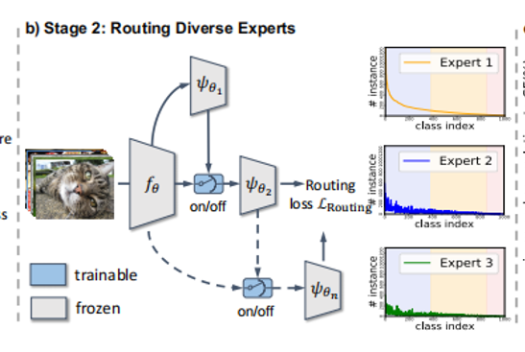

Model
ROUTING DIVERSIFIED EXPERTS
W维度很小，只有16，防止过拟合。
其中（该机制的input）l和v是top-z logits和normalized feature of expert i。
而监督该loss的ground truth的构造如下：
当当前专家没有预测正确，而下一个专家预测正确时，设置ground
truth为1，否则则为0。
k个专家共k-1个专家路由机制。其中W2在各个路由机制上共享参数。
Notes:
认为只有top z的成绩有意义
专家之间是串联的，当前专家预测出一个概率分布，然后还会预测出是否让下一个专家来继续预测。

Slide 33
感谢倾听！ 61快乐！

