Slide 1
ASPECT SENTIMENT TRIPLET EXTRACTION
A near complete solution of Aspect-based Sentiment Analysis
Li Jiangnan
2021/4/13
Notes:
首先介绍一下情感分析, 然后再说一下细粒度情感分析的优势

Slide 2
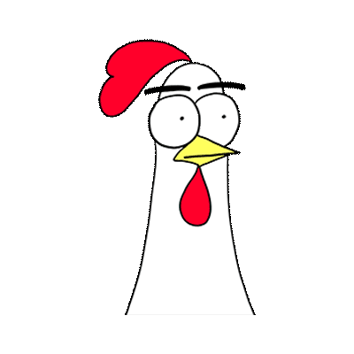


Aspect-based Sentiment Analysis
Common ABSA:
food
was
so so
but
excited
to
see
many
vegan options
food
Aspect term
[CLS] food was so so but excited to see many vegan options [SEP] food [SEP]
Neutral
Notes:
介绍平时见过的细粒度情感分析怎么做的

Slide 3


Aspect-based Sentiment Analysis
Why making such a prediction?
food
was
so so
but
excited
to
see
many
vegan options
vegan options
Aspect term
Aspect term Extraction
Aspect term Extraction (AE): extracting all aspect terms in a sentence.
Notes:
一句话里面不止一个aspect.

Slide 4

Aspect-based Sentiment Analysis
Why making such a prediction?
An opinion term “excited” is provided
food
was
so so
but
excited
to
see
many
vegan options
vegan options
Aspect term
Opinion term Extraction
Aspect term Extraction
Opinion term Extraction (OE): extracting opinion terms for a targeted aspect term.

Slide 5
Why not considering these subtasks of ABSA as one task?
food
was
so so
but
excited
to
see
many
vegan options

Slide 6
Why not considering these subtasks of ABSA as one task?
food
was
so so
but
excited
to
see
many
vegan options

Slide 7
Why not considering these subtasks of ABSA as one task?
food
was
so so
but
excited
to
see
many
vegan options

Slide 8
Why not considering these subtasks of ABSA as one task?
food
was
so so
but
excited
to
see
many
vegan options
[food; so so]
[vegan options; excited]
Aspect Opinion pair Extraction
[food; so so; ]
[vegan options; excited; ]
Aspect Sentiment Triplet Extraction

Slide 9





CONTENTS
Position-Aware Tagging for Aspect Sentiment Triplet Extraction
Grid Tagging Scheme for Aspect-oriented Fine-grained Opinion Extraction
A Multi-task Learning Framework for Opinion Triplet Extraction
First Target and Opinion then Polarity: Enhancing Target-opinion Correlation for Aspect Sentiment Triplet Extraction
A Joint Training Dual-MRC Framework for Aspect Based Sentiment Analysis

Slide 10


Position-Aware Tagging for Aspect Sentiment Triplet Extraction
Conference: EMNLP2020
Institutes: Singapore University of Technology and Design; DAMO Academy; ByteDance.
Background: Previous works use pipeline approaches.
(2 stages: Extracting terms + pairing for classification)
2 stages and independent extraction.
e.g. fresh RelatedTo food, service Express .
Extracting terms: sequence tagging with BIOES system.
Limitation of capability of expression for joint extraction.
Limitation: no position information can be captured by BIOES system
?
food
was
so so
but
excited
to
see
many
vegan options
S
O
B
E
O
S
O
O
O
B
E
A
P
P
P
A
A

Slide 11







Position-Aware Tagging for Aspect Sentiment Triplet Extraction
Position-Aware Tagging scheme (extend tag B and tag S in BIOES to new tags)
1. Choosing Aspect terms as the main observation (BES only for aspect terms).
$$S_{j,k}^{ε}$$
$$B_{j,k}^{ε}$$
food
was
so so
but
excited
to
see
many
vegan options
$$S_{2,3}^{0}$$
O
O
O
O
O
O
O
O
$$B_{−4,−4}^{+}$$
E
2. Choosing Opinion terms as the main observation (BES only for opinion terms).
food
was
so so
but
excited
to
see
many
vegan options
O
O
$$B_{−2,−2}^{0}$$
O
$$S_{4,5}^{+}$$
O
O
O
O
O
E

Slide 12




Position-Aware Tagging for Aspect Sentiment Triplet Extraction
The new tags contain the position information. However, the position of the targeted term can alter randomly. There will be infinite types of tag. Therefore, the authors set a maximum distance.
Solutions: CRF + Position-aware Virterbi Decoding
CRF:
where y is the tagging sequence; x is the word sequence.
where y is the transition score; x is the factorized feature score.
y1
y2
yn
…
x
Notes:
CRF

Slide 13

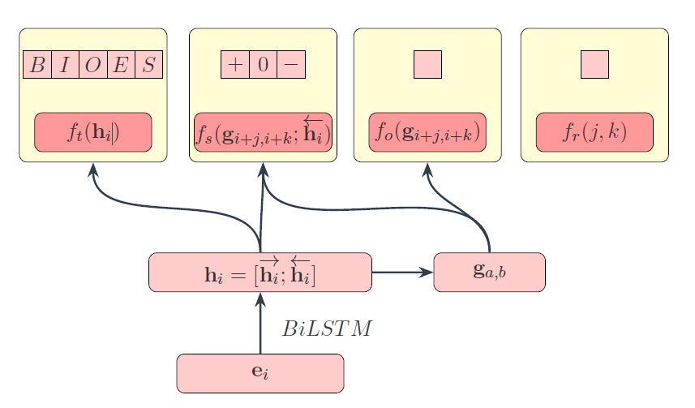



Position-Aware Tagging for Aspect Sentiment Triplet Extraction
Calculate the factorized feature score.
The representation of an opinion span a, b:
Factorized feature score contains three parts:
(f is a linear unit)
1. The score for sentiment:
2. The score for opinion span:
3. The score for offsets:
Notes:
第一部分转移特征按照常规的CRF操作, 主要的设计在于状态特征

Slide 14
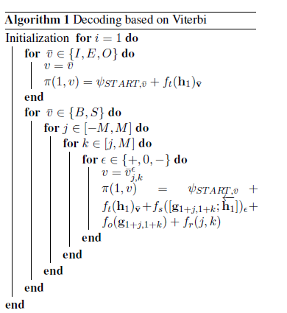
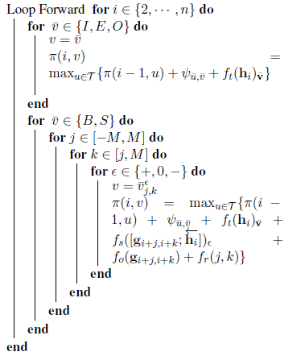
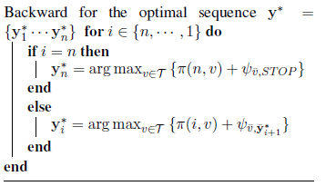
Position-Aware Tagging for Aspect Sentiment Triplet Extraction
Decoding based on Viterbi.
M is the maximum relative distance, T is the set of tags
Time complexity is: O(n*M^2)
Notes:
维特比算法, 动态规划呗

Slide 15
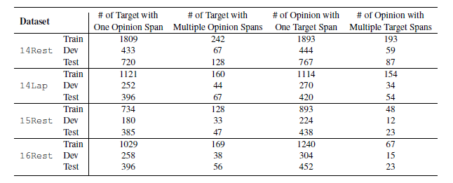
Position-Aware Tagging for Aspect Sentiment Triplet Extraction
Features of data.
Food
is
fresh
and
hot
ready
to
eat
Aspect with multiple opinions.
JET_{o}
High
price
and
service
,
value
for
the
money
Opinion with multiple aspects.
JET_{t}

Slide 16
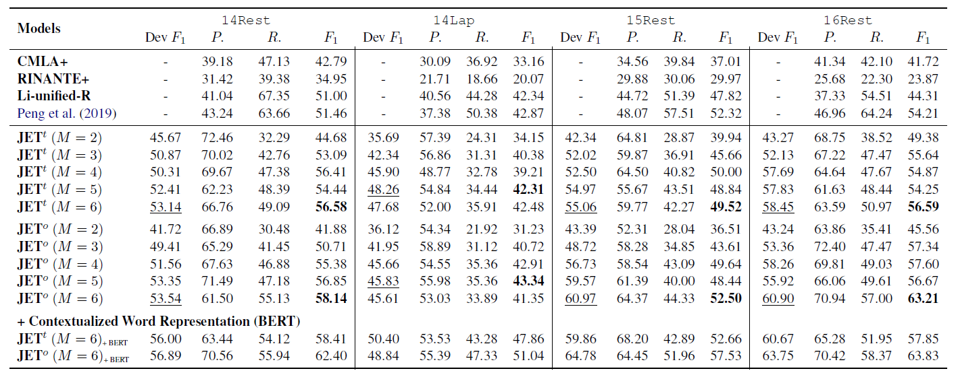
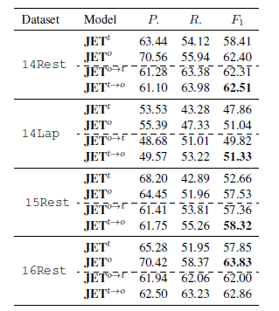
Position-Aware Tagging for Aspect Sentiment Triplet Extraction
JET_{t} to JET_{o}.
JET_{o} to JET_{t}.
Results of different variants of JET.
Results of ensemble.

Slide 17
Grid Tagging Scheme for Aspect-oriented Fine-grained Opinion Extraction
Journal: EMNLP2020 Findings
Institutes: Nanjing University; Nanjing University of Science and Technology.
Background: Previous works use pipeline approaches.
(2 stages: Extracting terms + pairing for classification)
pipeline.
Easily suffering from error propagation and inconvenience in real-world scenarios.
Solution: Grid Tagging Scheme.
For both Opinion Pair Extraction and Opinion Triplet Extraction.

Slide 18
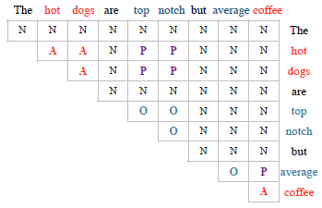
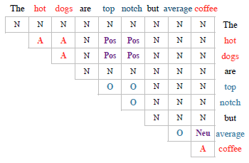
Grid Tagging Scheme for Aspect-oriented Fine-grained Opinion Extraction
Grid Tagging Scheme (GTS) uses four tags {A, O, P, N} for Opinion Pair Extraction, where A is for aspect; O is for opinion; P is for a-o pair; N is for other words.
GTS uses six tags {A, O, Pos, Neu, Neg, N} for Opinion Triplet Extraction, where Pos, Neu, Neg are for a-o pairs with their corresponding sentiments.

Slide 19
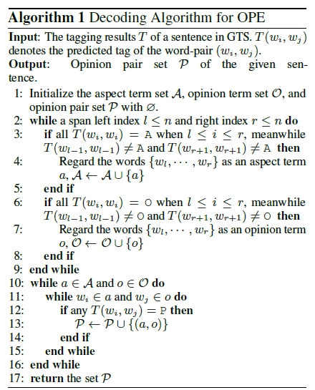
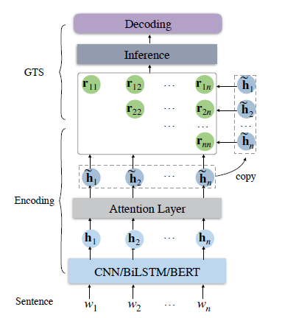
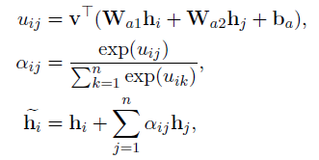
Grid Tagging Scheme for Aspect-oriented Fine-grained Opinion Extraction
Decoding Algorithm
Model Structure

Slide 20
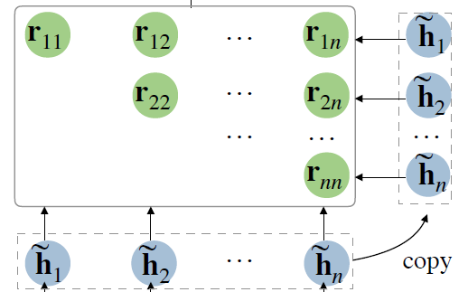

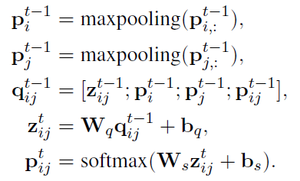


Grid Tagging Scheme for Aspect-oriented Fine-grained Opinion Extraction
Inference on GTS
Initial prediction:
where $r_{ij}=[{\tilde{h}}_{i}, {\tilde{h}}_{j}]$
Iterative prediction:
where $p_{i:}^{t−1}=(p_{1:i}^{t−1};p_{i:n}^{t−1})$
(1) relations between Wi and other words (except
Wj) can help detection;
(2) The previous prediction helps infer the tag of the current turn.

Slide 21
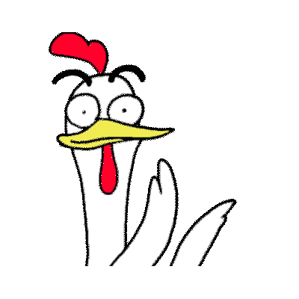
A Multi-task Learning Framework for Opinion Triplet Extraction
Journal: EMNLP2020 Findings
Institutes: Beijing Institute of Technology; Padova University.
Background: Unified tagging scheme for aspect.
(BIO + POS, NEU, Neg on B, I for aspect)
The 1st issue: degrading the sentiment parsing to a binary classification.
Inefficient to model the interaction between aspect and sentiment.
The 2nd issue: disregarding the interaction between aspect, opinion, and sentiment.
Triplet overlapping issue.
food
so so
but
excited
to
see
many
vegan options
High
price
and
,
is
fresh
was
service
value
for
the
money
Food
and
hot
ready
to
eat

Slide 22

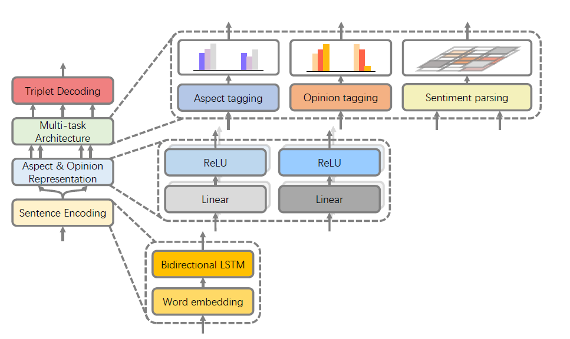


A Multi-task Learning Framework for Opinion Triplet Extraction
Model Structure
BIO for aspect
BIO for opinion
Word-level Sentiment Dependency Parsing:
{NEU, NEG, POS, NO-DEP} for word-pair
battery
startup
Great battery, startup speed
great
speed
,
great
{battery; great; POS}
battery
{startup speed; great; POS}
{speed; great; POS}
,
startup
speed

Slide 23
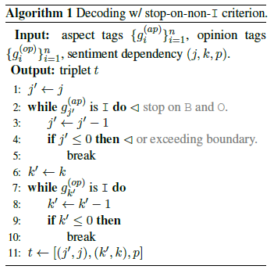
A Multi-task Learning Framework for Opinion Triplet Extraction
Triplet Decoding
Aspect tagging
{O,B,O,B,I}
Opinion tagging
{B,O,O,O,O}
Sentiment dependency
battery
startup
great
speed
,
great
battery
,
startup
speed
Output triplets:
{battery; great; POS}
{startup speed; great; POS}
This work is too simple

Slide 24
Triplet Overlapping
JETo
JETt
GTS
MTL-OTE
Food
is
fresh
and
hot
ready
to
eat
√
×
√
√
High
price
and
service
,
value
for
the
money
×
√
√
√

Slide 25
First Target and Opinion then Polarity: Enhancing Target-opinion Correlation for Aspect Sentiment Triplet Extraction
arXiv 2021
Institutes: Peking University; Baidu Inc.
Back to two-stage processing.
First extracting aspect, opinion terms; Then pairing words for sentiment recognition.
The 1st issue: triplet overlapping should be considered.
This observation is not novel.
The 2nd issue: previous works ignore correlation within the target-opinion pairs.
Claiming this is not considered in MTL-OTE.
This is not a good story.

Slide 26
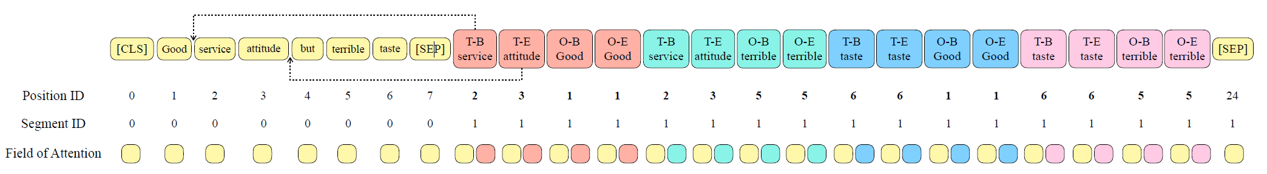
First Target and Opinion then Polarity: Enhancing Target-opinion Correlation for Aspect Sentiment Triplet Extraction
The 1st stage: aspect and opinion extraction.
BERT + Linear + Softmax
Tagging scheme: {BIOES} for aspect and opinion.
The 2nd stage: perceivable pairs for sentiment classification.
Pairing aspects and opinions. For the i-th aspect and the j-th opinion:
A_{ij} = {T-B_{i}, T-E_{i}, O-B_{j}, O-E_{j}}
{POS, NEU, NEG, O}
service attitude; good
{service, attitude, good, good}

Slide 27
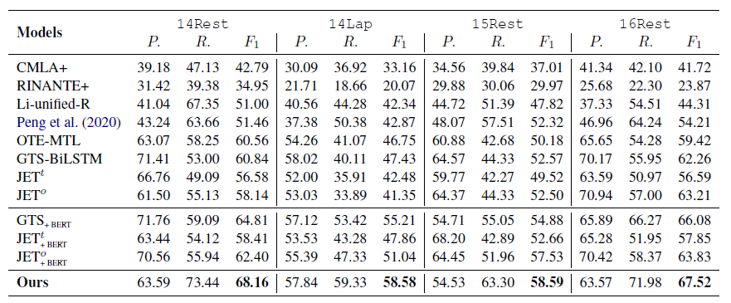
First Target and Opinion then Polarity: Enhancing Target-opinion Correlation for Aspect Sentiment Triplet Extraction

Slide 28
A Joint Training Dual-MRC Framework for Aspect Based Sentiment Analysis
Conference: AAAI2021
Institutes: Alibaba Group.
Background: no unified end-to-end framework for ABSA.
All kinds of ABSA subtasks including Aspect Opinion Triplet Extraction.
Sequence tagging for all kinds of extraction (BIOES scheme).
Solution: construct two machine reading comprehension task to extract aspects, opinions, and sentiments.
Extraction by MRC has been proposed by a previous work in EMNLP.

Slide 29

A Joint Training Dual-MRC Framework for Aspect Based Sentiment Analysis
Input text: The ambience was nice, but service was not so great.
Annotations: {ambience, nice, positive}, {service, no so great, negative}
Query-1: Find the aspect terms in the text.
Answer-1: ambience, service
Query-2: Find the sentiment polarity and opinion terms for ambience in the text.
Answer-2: {nice, positive}
Query-1: Find the aspect terms in the text.
Answer-1: ambience, service
Query-2: Find the sentiment polarity and opinion terms for service in the text.
Answer-2: {not so great, negative}

Slide 30
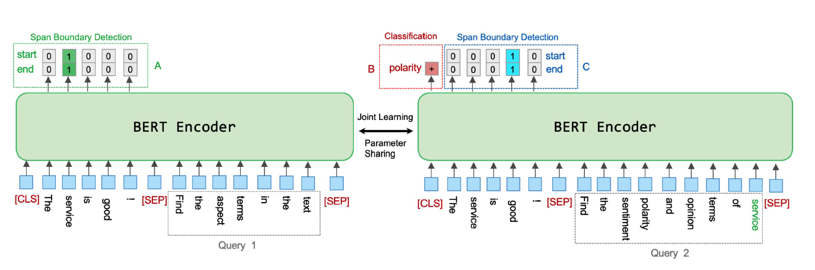


A Joint Training Dual-MRC Framework for Aspect Based Sentiment Analysis
[CLS] sentence [SEP] Query-1 [SEP]
[CLS] sentence [SEP] Query-2 [SEP]
Start
End
Sentiment
Start
End

Slide 31
OPINION EXTRACTION (Optional)
One paper is present

Slide 32
Introducing Syntactic Structures into Target Opinion Word Extraction with Deep Learning
Conference: EMNLP2020
Institutes: University of Oregon; Adobe Research; VinAI Research.
Background: previous works ignore the syntactic information which is useful for OE.
All warranties honored by XYZ (what I thought was a reputable company) are disappointing.
disappointing
warranties
are
thought
All
honored
what
I
company
XYZ
was
a
reputable
Words close to target aspect are more likely to be opinion words.
by
Syntactic information should be considered. How?
ON-LSTM to capture structural representations for words.
GCN to capture useful contextual information based on output of ON-LSTM and the syntactic tree.

Slide 33
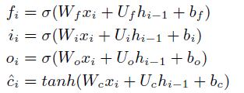
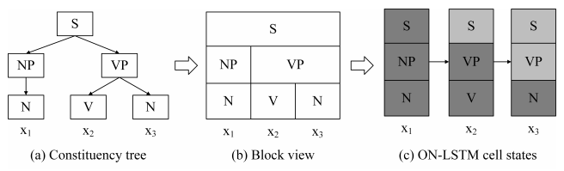
Introducing Syntactic Structures into Target Opinion Word Extraction with Deep Learning
ON-LSTM.
C_{i-1}
Ĉ_{i}
C_{i}
0
More important neurons should not be updated frequently.
LSTM
d_{f} and d_{i} are positions to divide neurons to three parts
d_{f}
d_{f}
d_{f} < d_{i}
0-d_{f} : Ĉ_{i}
d_{f} - d_{i} :
d_{i}
d_{i}
d_{i} - N :
C_{i-1}
forget gate decides how much information need to be forgotten.
N
input gate decides how much information need to be forgotten.
C_{i-1}
Ĉ_{i}
C_{i}
0
d_{f} > d_{i}
0-d_{i} : Ĉ_{i}
d_{i} - d_{f} : 0
d_{i}
d_{i}
d_{f} - N :
C_{i-1}
No hierarchical structure is considered in the neurons of LSTM.
d_{f}
d_{f}
High-level neurons can be kept for a long distance, while lower-level neurons will be updated frequently.
N
https://spaces.ac.cn/archives/6621

Slide 34




Introducing Syntactic Structures into Target Opinion Word Extraction with Deep Learning
ON-LSTM.
C_{i-1}
Ĉ_{i}
C_{i}
0
LSTM
Two new gates to “softly” model df and di:
d_{f}
d_{f}
cumsum
d_{i}
d_{i}
forget gate decides how much information need to be forgotten.
N
[0, 0, 0, 0, 1, 1, 1, 1, 1, 1]
[1, 1, 1, 1, 1, 1, 0, 0, 0, 0]
C_{i-1}
Ĉ_{i}
C_{i}
input gate decides how much information need to be forgotten.
$${\overline{f}}_{i}$$
0
Updated forget gate and input gate:
[f1, f2, f3, f4, f5, f6, f7, f8, f9, f10]
[f1, f2, f3, f4, f5, f6, 1, 1, 1, 1]
d_{i}
d_{i}
[0, 0, 0, 0, f5, f6, 1, 1, 1, 1]
No hierarchical structure is considered in the neurons of LSTM.
$${\overline{i}}_{i}$$
d_{f}
d_{f}
The final cell representation of i step:
[i1, i2, i3, i4, i5, i6, i7, i8, i9, i10]
[1, 1, 1, 1, i5, i6, i7, i8, i9, i10]
N
[1, 1, 1, 1, i5, i6, 0, 0, 0, 0]

Slide 35
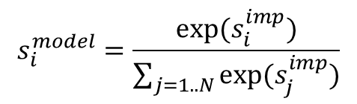
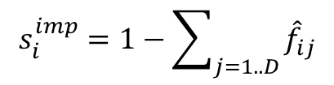
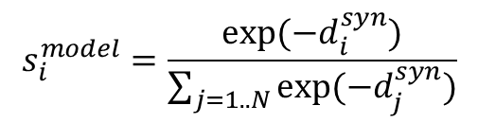
Introducing Syntactic Structures into Target Opinion Word Extraction with Deep Learning
ON-LSTM: Model-based informativeness scores.
If a word is considered as more important, more neurons are activated.
$$s_{i}^{imp}=1−\sum_{j=1..D}{{\hat{f}}_{ij}}$$
The informativeness score of a word:
$$s_{i}^{model}=\frac{exp⁡(s_{i}^{imp})}{\sum_{j=1..N}{exp⁡(s_{j}^{imp})}}$$
Informativeness score from ON-LSTM:
Syntax-base possibility scores.
If a word is closer to the target aspect word, a higher score is assigned.
$$s_{i}^{model}=\frac{exp⁡({−d}_{i}^{syn})}{\sum_{j=1..N}{exp⁡({−d}_{j}^{syn})}}$$
Informativeness score from Syntactic tree:
To introduce syntactic information into ON-LSTM and keep syntax-model consistency, the KL-divergence between these two scores will be minimized.

Slide 36



Introducing Syntactic Structures into Target Opinion Word Extraction with Deep Learning
GCN: capturing contextual information; two factors.
(1) The neighboring words of a word (the adjacent matrix of the syntactic tree):
(2) The neighboring words of the target word in the syntactic tree:
where
Integrating this two matrices for GCN:

Slide 37

Introducing Syntactic Structures into Target Opinion Word Extraction with Deep Learning
Representation regularization.
Three groups of words in a sentence: the target words, the opinion words, and other words.
Warning: Max-pooling fails to preserve the syntactic information for representation computing.
Solution: Two pruned syntactic trees are constructed, and GCN is used to aggregate representations for different groups.
The final loss function:

Slide 38


Conclusion
No conclusion, byeeee!

Slide 39
THANKS
facebook.com/Freepik
@Freepik
company/freepik-company
Please keep this slide for attribution

