Slide 1
Lung cancer Detection using machine learning for Histopatholgy Images
Supervisor : Dr.Gulistan Raja

Slide 2

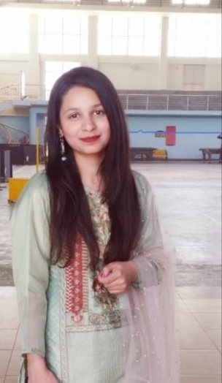

Our team
Azib
Sabahat
Irtaza
Javeria
18-EE-43
Project Lead
18-EE-01
18-EE-46
18-EE-53

Slide 3
Table of contents
03
01
02
Introduction
Statement
Literature
04
05
06
Methodology
Analysis & Results
Schedule, Ethics & Budget
Lung cancer and it’s types
Histopathology Images
Background
Aim and Objectives
Conventional Method
Modern approaches and DL
Theoretical Studies
Experimental Setup
Analysis metrics
Results and Society
Work Schedule, Ethics and budget
References

Slide 4
01
Introduction
Javeria Noor
18-EE-53

Slide 5
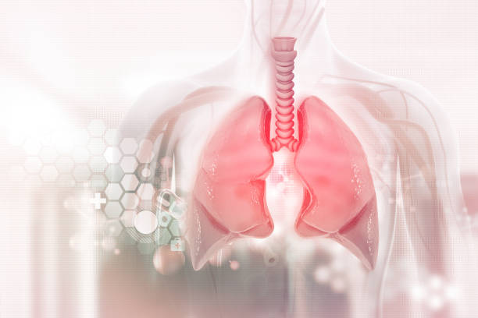
Lung cancer & Types
Lung cancer is deadliest cause of death among individuals. Biggest cause of lung cancer is smoking.
Non-Small Cell Lung Cancer (SCLC)
Squamous cell carcinoma
Adenocarcinoma
Large cell carcinoma
Small Cell Lung Cancer (SCLC)
Small Cell Carcinoma
Combined Small Cell Carcinoma

Slide 6
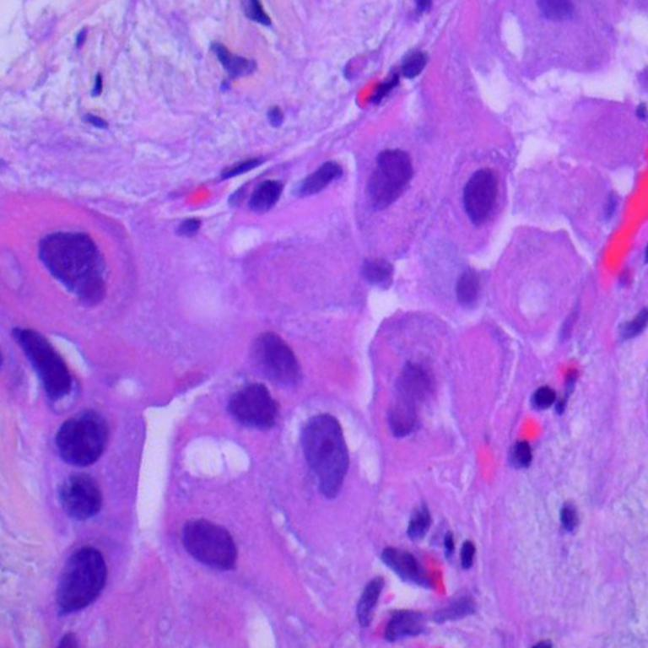
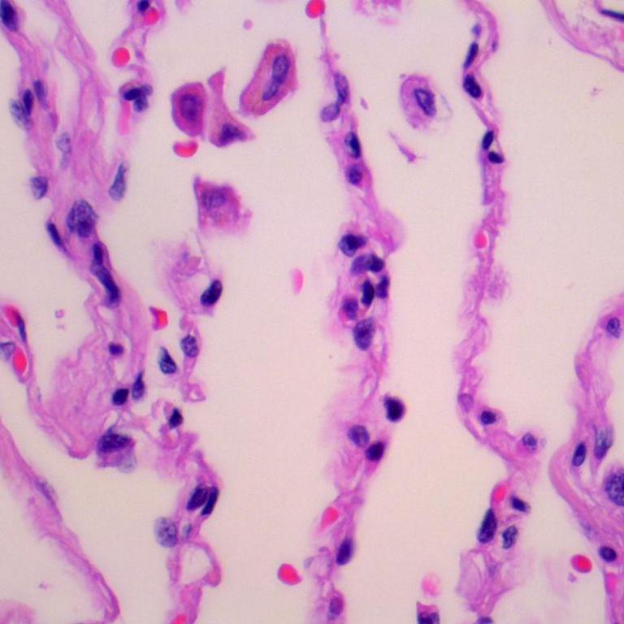
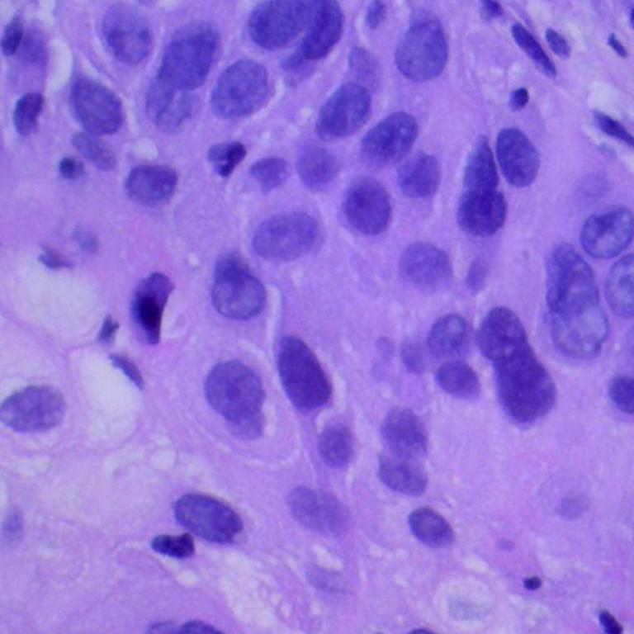
Histopathological Images
Microscopic digital image of tissue sample obtained through biopsy.
Used in Cancer Diagnostics.
Whole slide enriched in digital information.

Slide 7
02
Problem Statement
Sabahat Tabassum
18-EE-01

Slide 8
03
Literature
Syed Irtaza
18-EE-46

Slide 9
Literature Review
Authors | Technique | Accuracy
It’s the closest planet to the Sun | It has very high temperatures | Mars is actually a very cold place
It’s the smallest planet of them all | Venus has a beautiful name | Mars it's full of iron oxide dust

Slide 10
04
Methodology
Azib Farooq
18-EE-43

Slide 11
Tools
Language
Dataset
Hardware
Following tools are fundamental to our project
Python is used for
programming and
development purposes
LC25000 dataset is used for training and validation purposes.
Google Colab is the prime priority for training and testing the model.

Slide 12
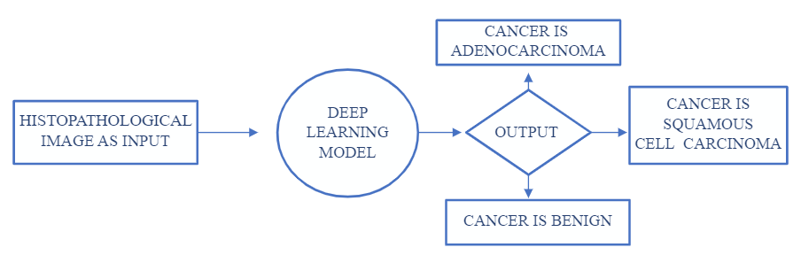
High Level Block Diagram

Slide 13
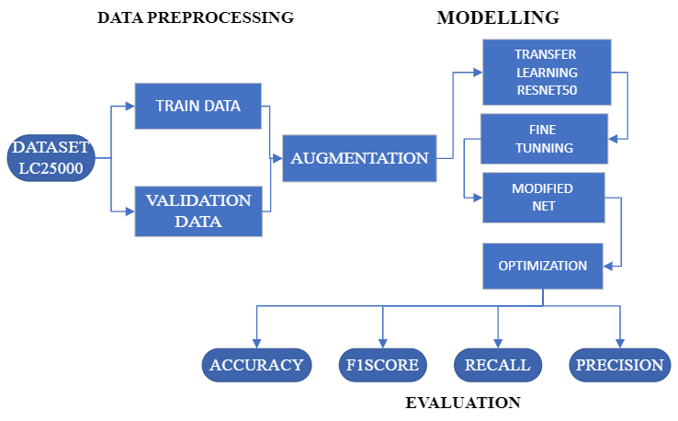
Deep Learning Model Internal Block Diagram

Slide 14
Theoretical Studies
Deep Learning
Transfer Learning
Pre-trained Models
CNNs
RNNs
Feature Extraction
Weight Transfer
ImageNet
ResNet

Slide 15
Experimental Setup
Data
Pre-processing
Modelling
Data Augmentation
Data Split
Fine Tuning
Modify CNN
Optimization

Slide 16
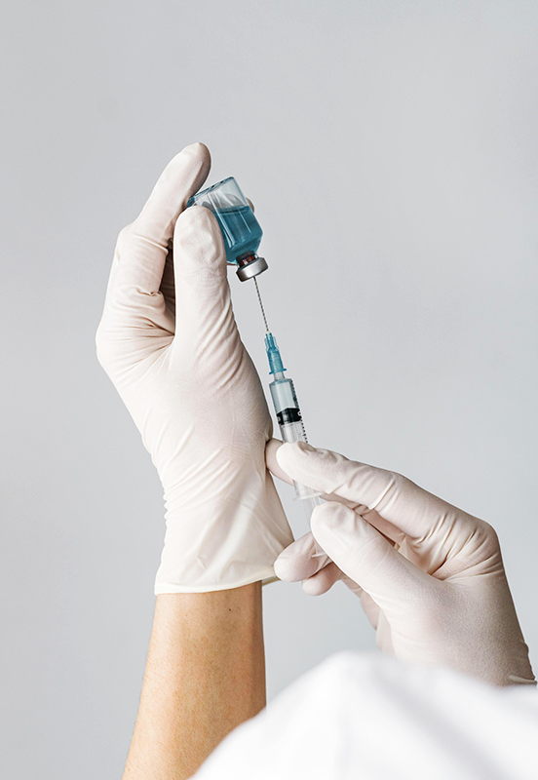
Data Preprocessing
Data
Augmentation
Data
Split
Original samples : 750
Final samples : 15000
Augmentation : 1/20
Training : 12000
4000 per class
Validation : 3000
1000 per class

Slide 17
Modelling
Fine Tuning
Modifying CNN
Optimization
Setting Hyperparameters
Freezing hidden layers
Freezing weights
Removing Last layer
Adding 3 neuron Dense layer with sigmoid activation
Adam optimizer is used for compiling model with different hyperparameters.

Slide 18
05
Analysis & Results
Azib Farooq
18-EE-43

Slide 19



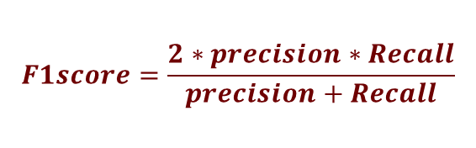

Analysis Metrics
Precision
Accuracy
F1score
Recall
$$T_{p}=True Positive;T_{n}=True Negative;$$
$$F_{p}=False Positive;F_{n}=False Negative$$
$$Accuracy=\frac{T_{p}+T_{n}}{T_{p}+T_{n}+F_{p}+F_{n}}$$
$$precison=\frac{T_{p}}{T_{p}+F_{p}}$$
$$F1score=\frac{2∗precision∗Recall}{precision+Recall}$$
$$Recall=\frac{T_{p}}{T_{p}+F_{n}}$$

Slide 20
Result & Society
Classification
Reduce Burden
Visibility
Speed
The model is expected to achieve acceptable accuracy on all metrics.
Following the anticipated benefits of our model.
Classifying lung cancer
patients as low and high
risk.
Assist histologists to
focus high risk patients.
Give more visibility of the
area of interest in
histopathological images.
Faster and better treatment and swift prescription.

Slide 21
06
Supplements
Javeria Noor
18-EE-53

Slide 22
Schedule

Slide 23
Ethics

Slide 24
Budget

Slide 25
References
AUTHOR (YEAR). Title of the publication. Publisher
AUTHOR (YEAR). Title of the publication. Publisher
AUTHOR (YEAR). Title of the publication. Publisher
AUTHOR (YEAR). Title of the publication. Publisher
AUTHOR (YEAR). Title of the publication. Publisher

Slide 26
Thank You

