Slide 1
SENIOR DESIGN PROJECT
SABAHAT TABBASSUM 18-EE-001
AZIB FAROOQ 18-EE-043
SYED IRTIZA HUSSAIN 18-EE-046
JAVERIA NOOR TARIQ 18-EE-053

Slide 2

OUR TEAM
Jenna Doe
John James
You can rscreen with your own
You can replace the image on the screen with your own

Slide 3
TITLE
LUNG CANCER DETECTION USING HISTOPATHAELOGICAL IMAGE ANALYSIS

Slide 4
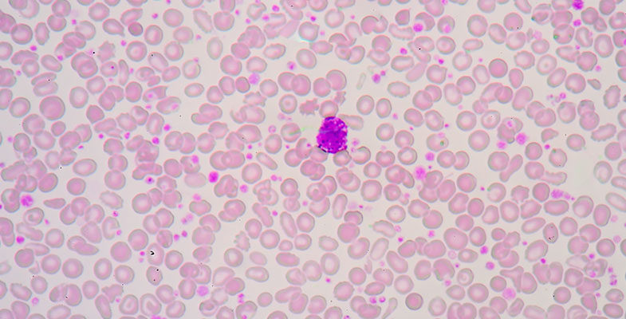
HISTOPATHOLOGY
Histopathology is the diagnosis and study of diseases of the tissues, and involves examining tissues and/or cells under a microscope. Histopathologists are responsible for making tissue diagnoses and helping clinicians manage a patient’s care.

Slide 5
HISTOPATHOLOGICAL IMAGE ANALYSIS
The histopathological image analysis includes the computations performed at different magnifications (×2, ×4.5, ×10, ×20, and × 40) for multivariate statistical analysis, diagnosis and classification
Digital scanners for pathological image acquisition provide us the digital image data for computer assisted image analysis using digital image processing algorithms.
Computer assisted disease diagnosis (CAD) plays a very important role and has become a major research subject in histopathological imaging and diagnostic where different image processing techniques can be used to analyze these images for disease diagnosis and prognosis.
Various local features such as gray level co-occurrence Matrix (GLCM) and local binary pattern (LBP) have been used for histopathological image analysis, but deep learning algorithms such as convolutional neural network [ 9, 10, [12], [13], [14]] starts the analysis from feature extraction.

Slide 6
METHODOLOGY
PREPROCESSING AND SEGMENTATION
FEATURE EXTRACTION AND SELECTION
DISEASE DETECTION AND CLASSIFICATION
Smoothing
Color illumination
Denoising
Enhancement
Thresholding
Active Contour
Morphometry
Color
Textural
Intensity based
Morphological
Linear, Non-linear feature ..
Supervised
Unsupervised
Neural Network
K-nearest neighborhood
Fuzzy System
Morphological Functions

Slide 7
Work Schedule Plan
Activity | Time Schedule
Collection of Literature | Dec 13 – Dec 21 2021
Study of Literature | Dec 22 – Jan 5 2021
Analysis of Proposed Scheme | Jan 6 – Jan 26 2021
Preparation of Schemes / Model | Feb 08 – Feb 27 2021
Implementation of Schemes/Model | Feb 28 – March 27 2021
Analysis & Simulation | March 27 – April 17 2021
Result Formulation | April 18 - May 1 2021
Final Write-up & Thesis Submission | May 2 – May 15 2021

Slide 8
ETHICAL ISSUES
Medical ethics has a closed relationship with law. Ethical principles such as respect for the persons, informed consent and confidentiality are basic to the patient-physician relationship
Autonomy
Beneficence
Confidentiality
Non-Maleficence
Justice and Equity

Slide 9
BUDGET DESCRIPTION
Dedicated hardware is required to be purchased for training of the model, namely abbreviated as GPU. GPU is basically a Graphic Processing Unit, originally designed to accelerate graphics rendering. GPUs can process many pieces of data simultaneously, making them useful for machine learning, video editing, and gaming applications.
Name | Price | Memory | Time
Google Colab | Free | 6GB | 6 hours
Kaggle | Free | 40GB | N/A
Nvidia A100 | $0.80/month | 8GB | N/A
Colab Pro | $9.99/month | 12GB | 6 hours
AMD RX 6800 | $850 | 4GB | N/A

Slide 10
UTILIZATION OF SDP
Classifying the lung cancer histopathological images.
Expert reviews can be made based on the pre-identified histology images.
Healthcare sector can utilize results to manage increasing number of lung cancer cases.
Give histologist more visibility of the area of interest in histological image.
Faster and better treatment and medicine prescription for serious patients.

