Slide 1


Drums of War
Justin Yip
Isaac Lee
Chung Wei Qi

Slide 2

Content
Technical Information
What is “Drums of War”
Unique Selling Point
Gameplay
Level Design
Customization
Production Milestone

Slide 3

Technical Information
Target platform: PC
Distribution platform: Steam
Monetization: Digital Distribution

Slide 4
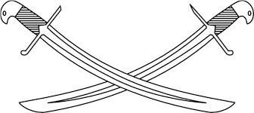
What is “Drums of War”
Single Player 2D Side Scrolling War Game.
Player commands their army by a sequence
of drum beats.
Many Enemies and other Obstacles in the way.

Slide 5
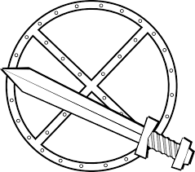
Unique Selling Point
Not many of such games on App Store or on PC.
Easy to learn, hard to master.
Able to customize your army anytime outside of battle.

Slide 6

Gameplay
Player’s Army starts at the left, moving to
the endpoint located at the right.
Enemies and Obstacles will be in between
you and the end.
Player are given four different drum beats.
Druming 4 beats over 2 seconds in rhythm.
Different Sequence of 4 give different results.
Your Units will response to the right Sequences.

Slide 7
Level Design
The base game will contain 17 levels.
  Only level 1 is unlocked initially.
  Completing the latest level will unlock
  the next level.
New levels may introduce new enemy
types and items.

Slide 8
Customization
Customize the shape and colour of your Units.
Equipping weapons to strengthen your Units.

Slide 9

Production Milestone

Slide 10
Q&A

