Slide 1

Christmas Demonstration
Simon GABORIT
GMIT
BEngH Software and Electronic Engineering

Slide 2
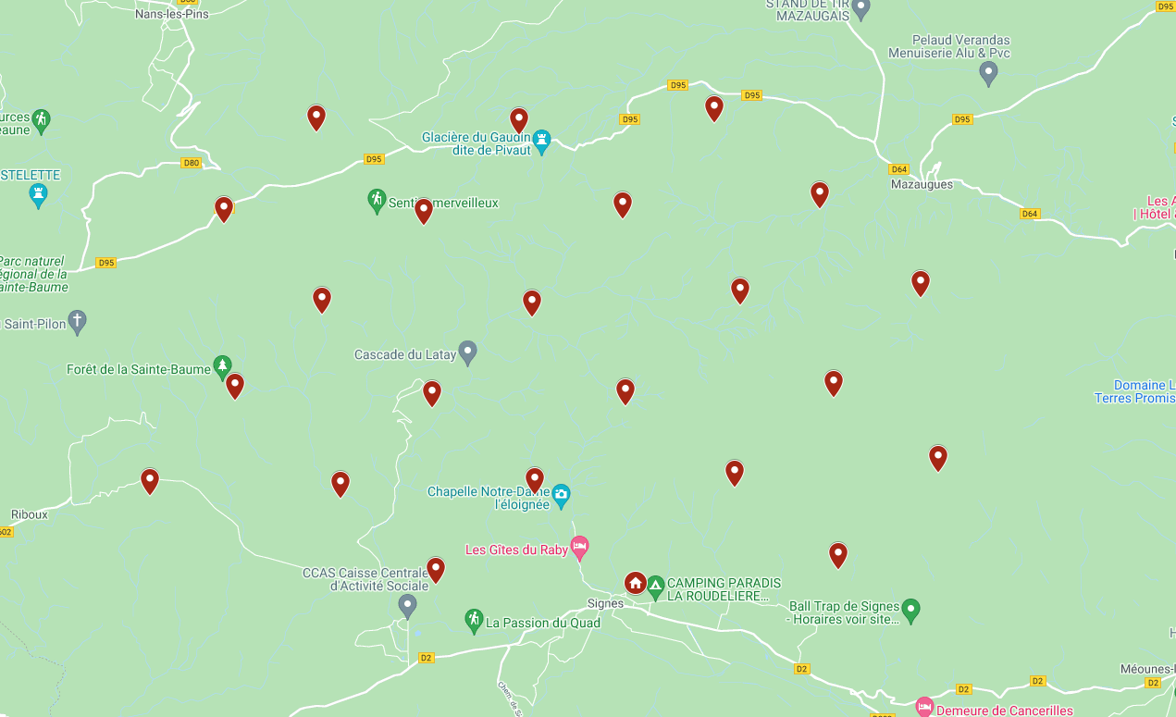
Project Description
Wildfire: Greece, Italy, Turkey, France, Australia, USA, …
Detection: towers with temperature sensors and IoT Network module.
Display: webpage → Map to display the monitored zone.
→ Realtime update of the status of the towers.
→ Page with weather forecasts

Slide 3
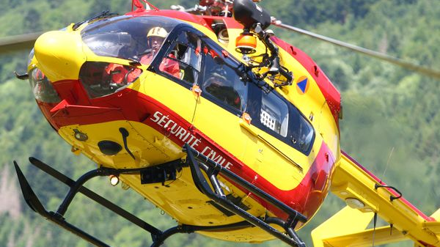
Innovation of this project
Current system: Patrol teams in the forest + Officer in helicopter.
Cost of equivalent: 3400€/flying hour of helicopter.
Monitoring system replace the patrol.
The forecast based on the weather forecasts → predict the behaviour of the fire.

Slide 4
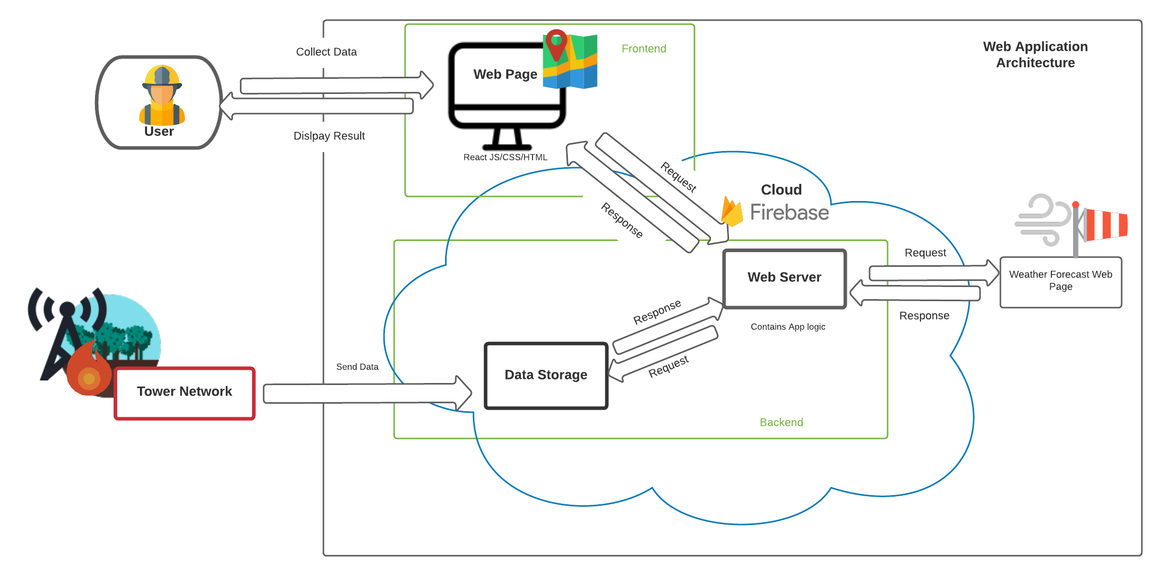
Architecture Diagram

Slide 5
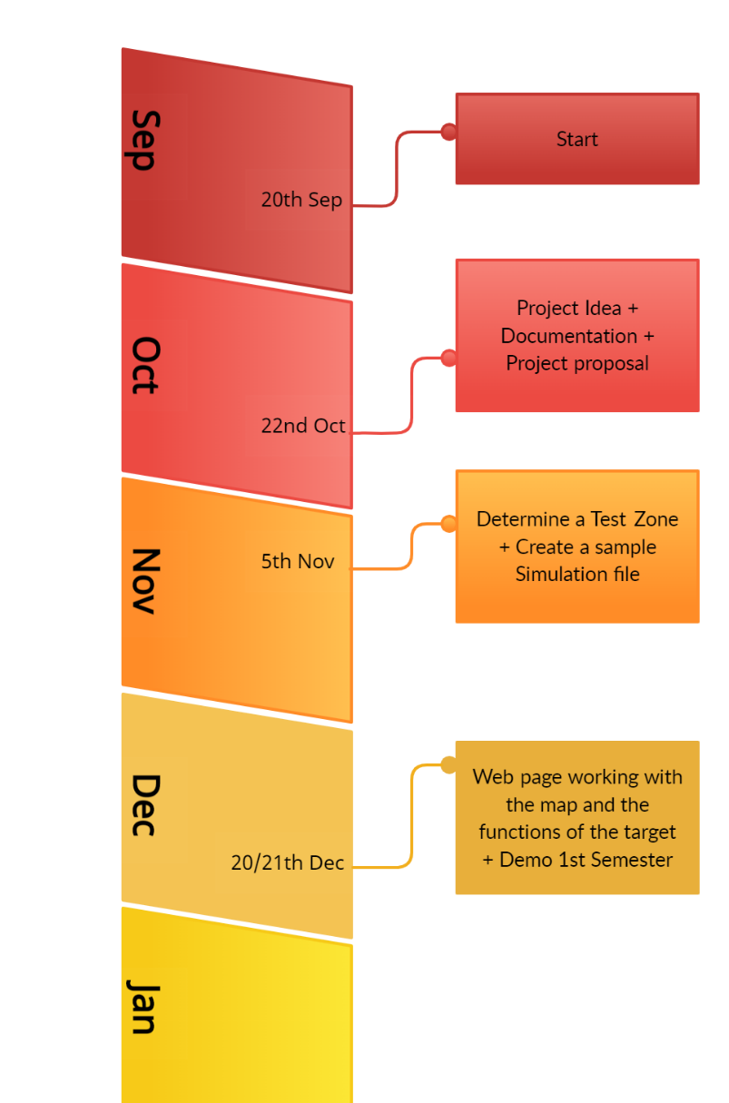
Semester 1
Researche on the topic.
Find a solution.
Think about the technology to use.
Build the structure of the project.
Set the tools needed for the project.
(Firebase, API key, Maps, VS Code module…)
Start coding the web page.

Slide 6

Let see the Web site
…

