Slide 1

Christmas Demonstration
Simon GABORIT
GMIT
BEngH Software and Electronic Engineering

Slide 2
Project Description
Wildfire: Greece, Italy, Turkey, France, Australia, USA, …
Project based: simulation in a forest in the south of France.
Detection: towers with temperature sensors and IoT Network module.
Display: webpage → Map to display the monitored zone.
→ Realtime update of the status of the towers.
→ Page with weather forecasts

Slide 3
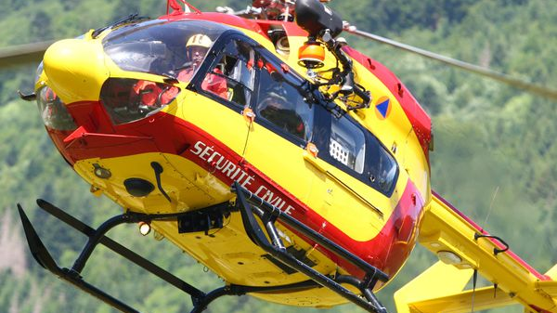
Innovation of this project
Current system: Patrol teams in the forest + Officer in helicopter.
Cost of equivalent: 3400€/flying hour of helicopter.
Monitoring system replace the patrol.
The forecast based on the weather forecasts → predict the behaviour of the fire.

Slide 4
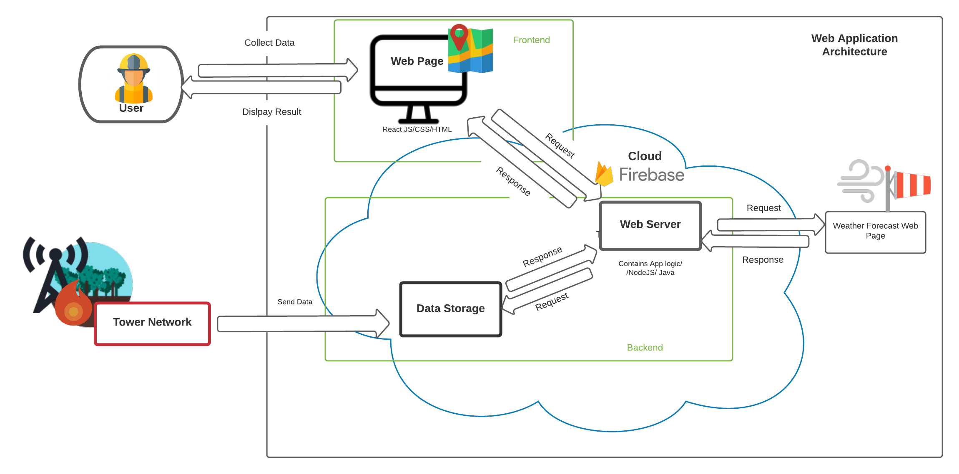
Architecture Diagram

Slide 5
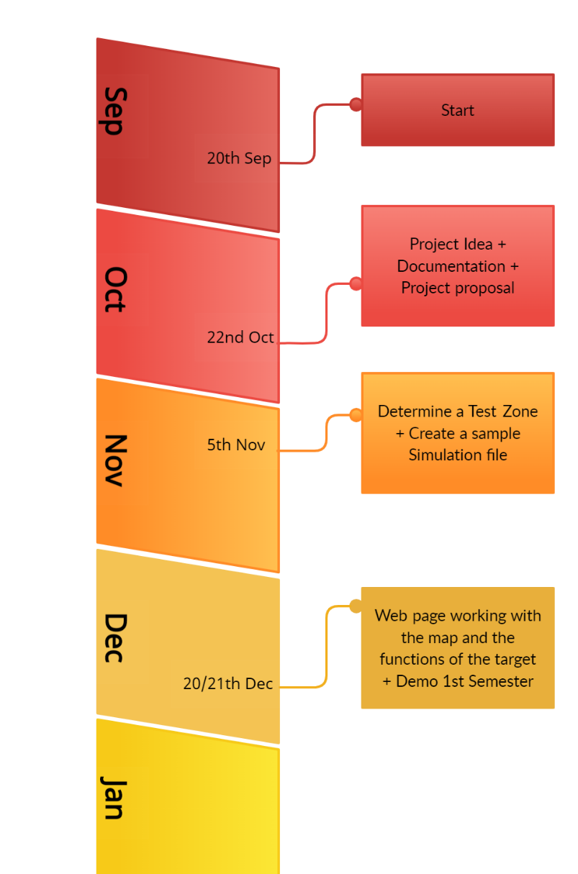
Semester 1
Researche on the topic.
Find a solution.
Think about the technology to use.
Build the structure of the project.
Set the tools needed for the project.
Start coding the web page.

Slide 6

Let see the Web site
…

