Slide 1
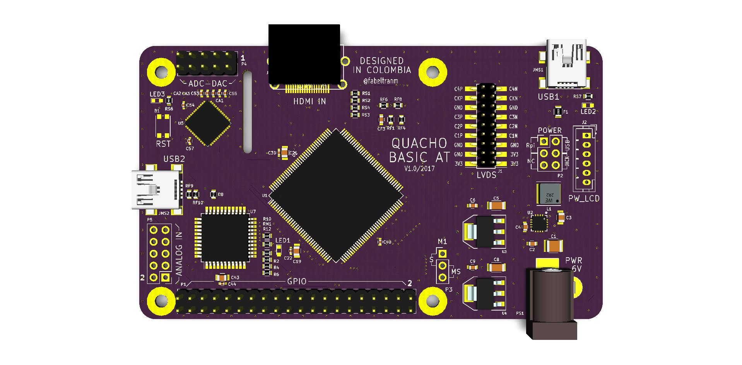

Slide 2
Power Control
P1 40 Pin header
Analog in/out
10Pin Header
Config M0
SPARTAN6
ATMEGA32U
USB 2.0
Power LCD
Config Power
MAX
5864
LVDS
18 Pin header
Flash
memory
Conector
SDCard
Micro USB
JTAG
FT232
Conector
HDMI
ADC-DAC
10 Pin header

