Slide 1

When Open Source Hardware
Fall in love with Fedora
Presented by
Tong Hui
Open Source Evangelist of DFRobot
License statement goes here. See https://fedoraproject.org/wiki/Licensing#Content_Licenses for acceptable licenses.

Slide 2


About Tong Hui
Open Source Evangelist @ DFRobot
Open Source Embedded Mentor
Embedded Mentor at AKAEDU
Embedded Engineer
FAS: Tonghuix
Weibo: http://weibo.com/tonghuix
Twitter: @tonghuix
Website: http://tonghuix.tk
Blog: http://tonghuix.blogspot.com

Slide 3


Agenda
What is Open Source Hardware(OSHW)
Developing OSHW in Fedora
  Arduino
  ARM-based Chips
  Embedded Linux
Good News for Fedora
Plans and Hopes
Q & A

Slide 4
What is
Open Source Hardware
(OSHW)

Slide 5



Open Source Hardware
Based on Open Source Software idea
  Mechanical drawings
  Schematics
  BOM table
  PCB layout
  HDL layout
  …...
One of open source culture movement
License – Most of FOSS are suitable OSHW
https://en.wikipedia.org/wiki/Open_source_hardware

Slide 6
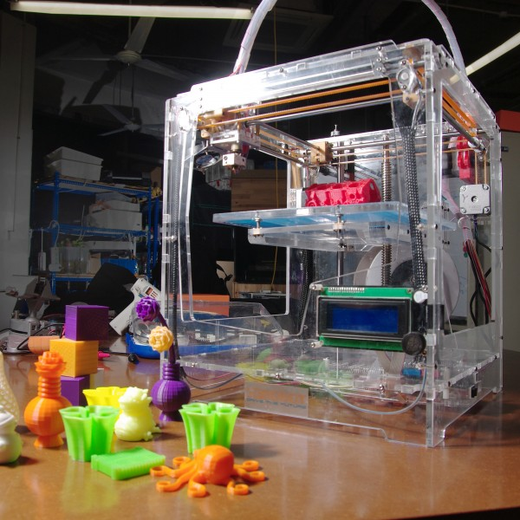
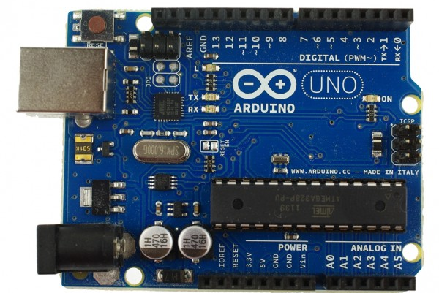
Some OSHW projects
Arduino
RepRap – 3D Printer
OpenSPARC / OpenRISC
OpenMoko / GTA04
Open Embedded / Yocto

Slide 7

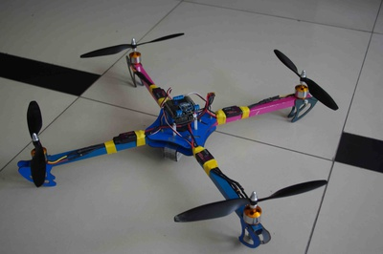
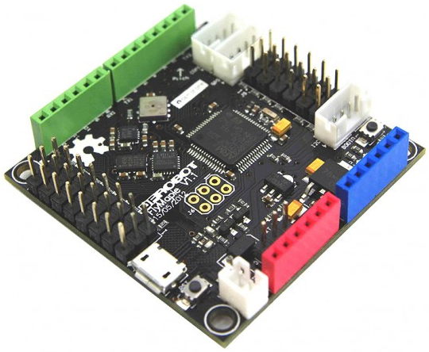

My Contributing Projects
OpenDrone Quadcopter
  Www.open-drone.org
FlyMaple – forked from “Leaflabs Maple”
  ARM Cortex-M, STM32 Boards
Dreamer MEGA - Arduino-based Boards

Slide 8
Development OSHW in Fedora

Slide 9
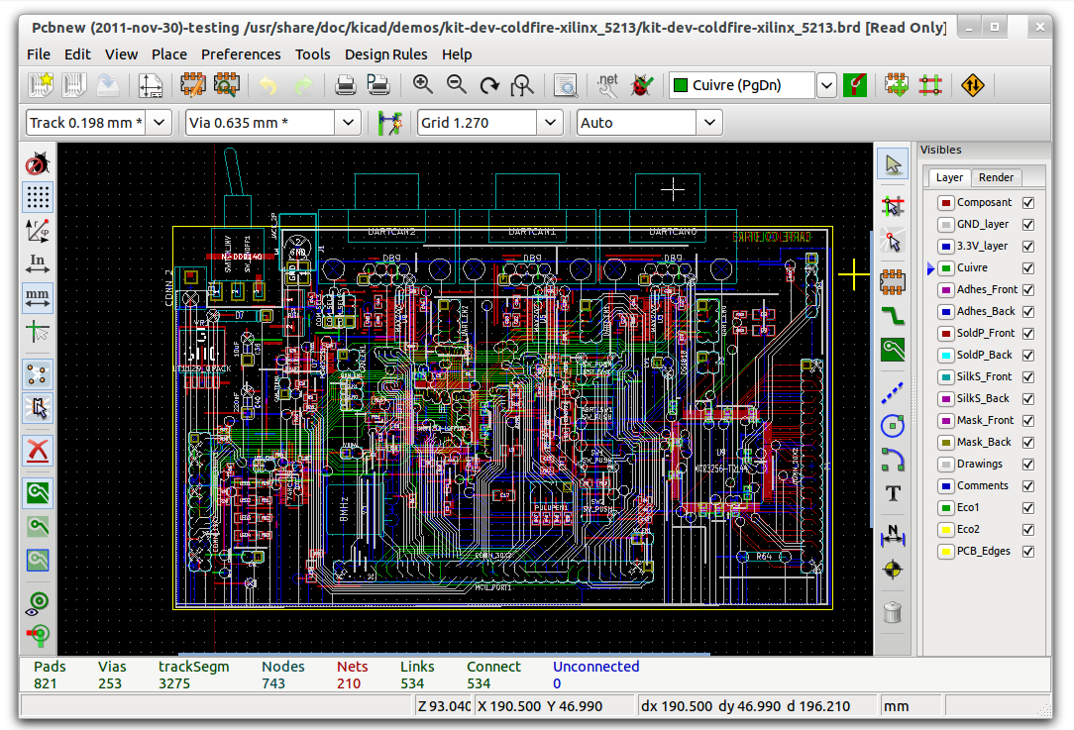
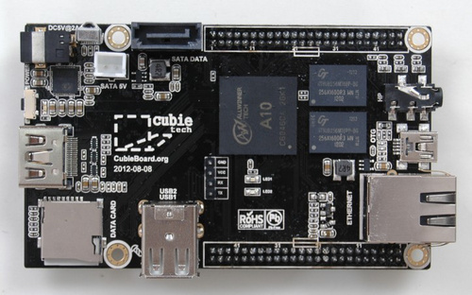
Needed
Software
  PCB (KiCAD, gEDA, Eagle)
  CAD (FreeCAD, Blender)
  Cross Compile Toolchain
  Arduino IDE
  Fritzing
Hardware
  Arduino
  Bealgeboard / Pandaboard
  Raspberry Pi
  Cubieboard

Slide 10
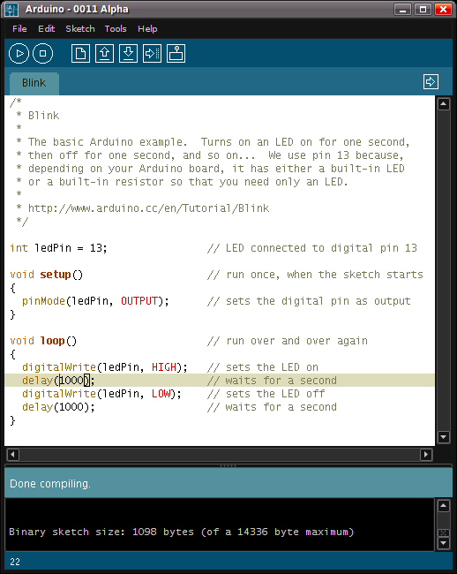
Play Arduino in Fedora
Install Arduino IDE
  yum install arduino
Add user to plugdev
and dialout group
All Done, Play now!

Slide 11
ARM MCU or Bare Development
Suggestions
  ARM Cross Compile Toolchain (linaro)
  JTAG/SWD Debugger (OpenJTAG)
  OpenOCD
  Leaflabs Maple ( STM32 Boards, MCU)
  Oscilloscope (Xoscope)
  Qemu

Slide 12
Demo: Flymaple
Flymaple, A flight controller with 10 DOF IMU, based on STM32F103. It forks from “Leaflabs Maple”, use same Maple IDE, and supported Arduino pin-out and API.
Install Maple IDE – Download it from Leaflab.com
Or install toolchain manually http://www.open-drone.org/develop_flymaple_in_unix_toolchain
All done, and Play!

Slide 13
Embedded Linux
Kernel Limitation for closed platform ( R Pi )
Please focus:
  Yocto Project – Hosts by Linux Foundation
  Tizen Project – Hosts by Linux Foundation
  Open Embedded
  OpenWRT – router os
  OLPC Tablet
  Fedora for ARM / Ubuntu for ARM / OpenSUSE for ARM

Slide 14
Fedora ARM
Includes support for Beagleboard-xM, Dreamplug, Guruplug, Highbank, iMX, Pandaboard, Sheevaplug, Trimslice, Versatile Express(QEMU) and more!
IRC: #fedora-arm @ Freenode
Maillist: arm@lists.fedoraproject.org
Cubieboard Fedora ARM distribution
Raspberry Pi Fedora Remix

Slide 15
Plans and Future

Slide 16
Plans
Fedora 19 will support 3D-Printing!
  https://fedoraproject.org/wiki/Features/3D_Printing
Fedora 18 could run Cura 12.12, more test is needed.
  http://daid.github.com/Cura/
OpenDrone will package Flymaple SDK in RPM
OpenDrone will release Quadcopter

Slide 17
Open Source Hardware Future
License is needed – now shared FOSS licenses GPL, MIT, Apache and Creative Commons
Embedded Devices supporting more widely (Linux, Mac OS X and Win)
MCU Development easier than before
More Commercial Applications – from DIYer to Business
Back to “MIT Hacker Age”...

Slide 18
Questions?
+ = Future
Contact:
tonghuix@gmail.com
Summarize first topic
Summarize second topic
License statement goes here. See https://fedoraproject.org/wiki/Licensing#Content_Licenses for acceptable licenses.

Slide 19
Happy Hacking!
Happy Chinese New Year!

