Slide 1
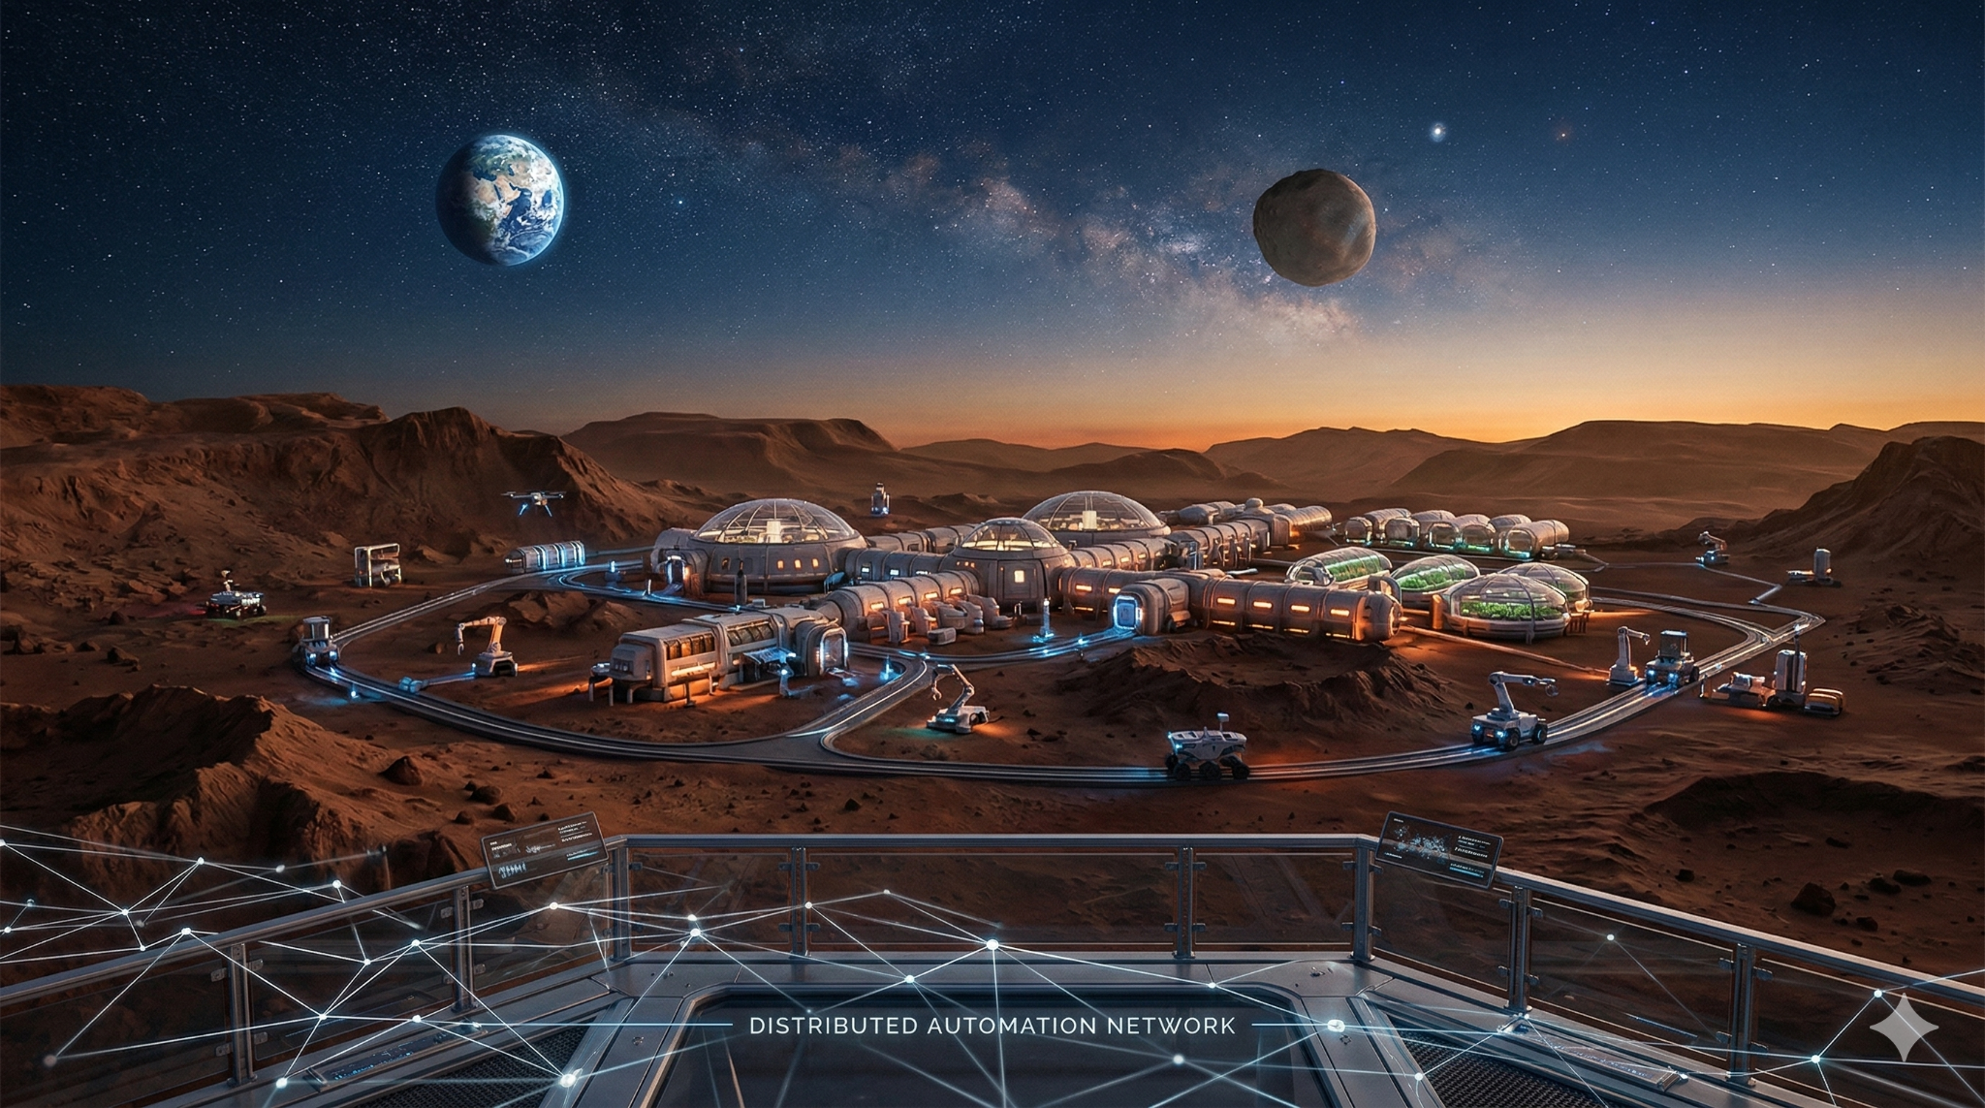
Mars IOT Simulator
Laboratory of advanced Programming 2025/2026
Group: Zazaki
Members:
Devops: Federico Zaza
Back-end: Giulio Maria Schintu
Front-end: Andrea Pulsoni

Slide 2
Problem and goal
Problem: Real-time management of sensors and actuators in a simulated Martian habitat.
Objective: Monitor data, apply automated rules, and allow manual override.
Key requirements: Microservices architecture, event-driven communication, Docker deployment.

Slide 3
User stories
INGESTION & MESSAGING
US-01 REST Sensor Polling
US-02 Telemetry Stream Consumption
US-03 Unified Event Schema Normalization
US-04 Message Broker Integration
US-05 In-Memory State Caching
AUTOMATION & RULES ENGINE
US-06 Create Automation Rule
US-07 List Active Rules
US-08 Delete Automation Rule
US-09 Rule Evaluation Engine
US-14 Rule Persistence Across Restarts
DASHBOARD & CONTROL
US-10 Live Sensor Value Display
US-11 Historical Telemetry Chart
US-12 Manual Actuator Control
US-13 Actuator Status Monitor
DEPLOYMENT
US-15 One-Command Deployment

Slide 4
Architetture Overview
The system is built on an event-driven microservices architecture.
The IoT Simulator (port 8080) provides sensor data and receives actuator commands.
The Ingestion Service collects REST and telemetry data, normalizes it, and publishes events to Kafka.
The Rule Engine consumes events, evaluates automation rules, and updates actuator behavior.
Redis is used as a fast state cache.
PostgreSQL stores persistent rules and actuator data.
The API Gateway (port 8000) exposes REST and WebSocket endpoints to the Frontend Dashboard (port 3000), enabling real-time monitoring and control.

Slide 5
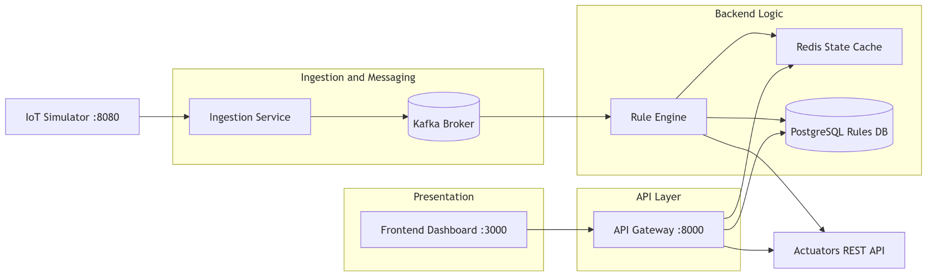

Slide 6
System Data Flow & Pipeline
Multi source ingestion:
Simulator Data: Collects heterogeneous data from REST Polling and SSE Telemetry Streams
Normalization: The Ingestion Service converts raw payloads into a Standard Event Schema (Unified JSON)
Event Streaming:
Kafka Broker: Acts as the central nervous system, ensuring decoupled and reliable message delivery between services.
Topic: Published to mars.telemetry.normalized for real-time processing
Rule Logic & Actuation Loop:
Rule Engine: Consumes Kafka events and evaluates IF-THEN conditions stored in PostgreSQL
Execution: Triggers REST commands to the Simulator Actuators to maintain habitat stability
Caching: Uses Redis to prevent command redundancy.
Monitoring & Gateway Layer: API Gateway
WebSockets: For sub-second telemetry updates (Live graphs).
REST APIs: For rule management (CRUD) and manual actuator overrides

Slide 7
DevOps and Deployment
Full containerized architecture with one Dockerfile per service and a single docker-compose.yml.
One-command deployment through docker compose up --build, satisfying the reproducibility requirement.
Service orchestration includes startup dependencies and health checks for Kafka, PostgreSQL, and Redis.​
Internal Docker network connects simulator, ingestion, broker, rule engine, API Gateway, frontend, Redis, and PostgreSQL.​
Persistent storage is provided through a Docker volume for PostgreSQL rule data.
Public entry points are exposed on ports 8080 (simulator), 8000 (API Gateway), and 3000 (dashboard).

Slide 8
Backend
TECHNOLOGY
Python + FastAPI & Uvicorn + Kafka + Redis + PostgreSQL + Docker
FEATURES
Persistent rules stored in PostgreSQL (automation_rules)
Actuator state stored in PostgreSQL (actuators)
Cache/state and pub-sub managed with Redis
Main APIs:
GET /api/state
GET/POST/PATCH/DELETE /api/rules
GET/PATCH /api/actuators/…
WS /ws/telemetry

Slide 9
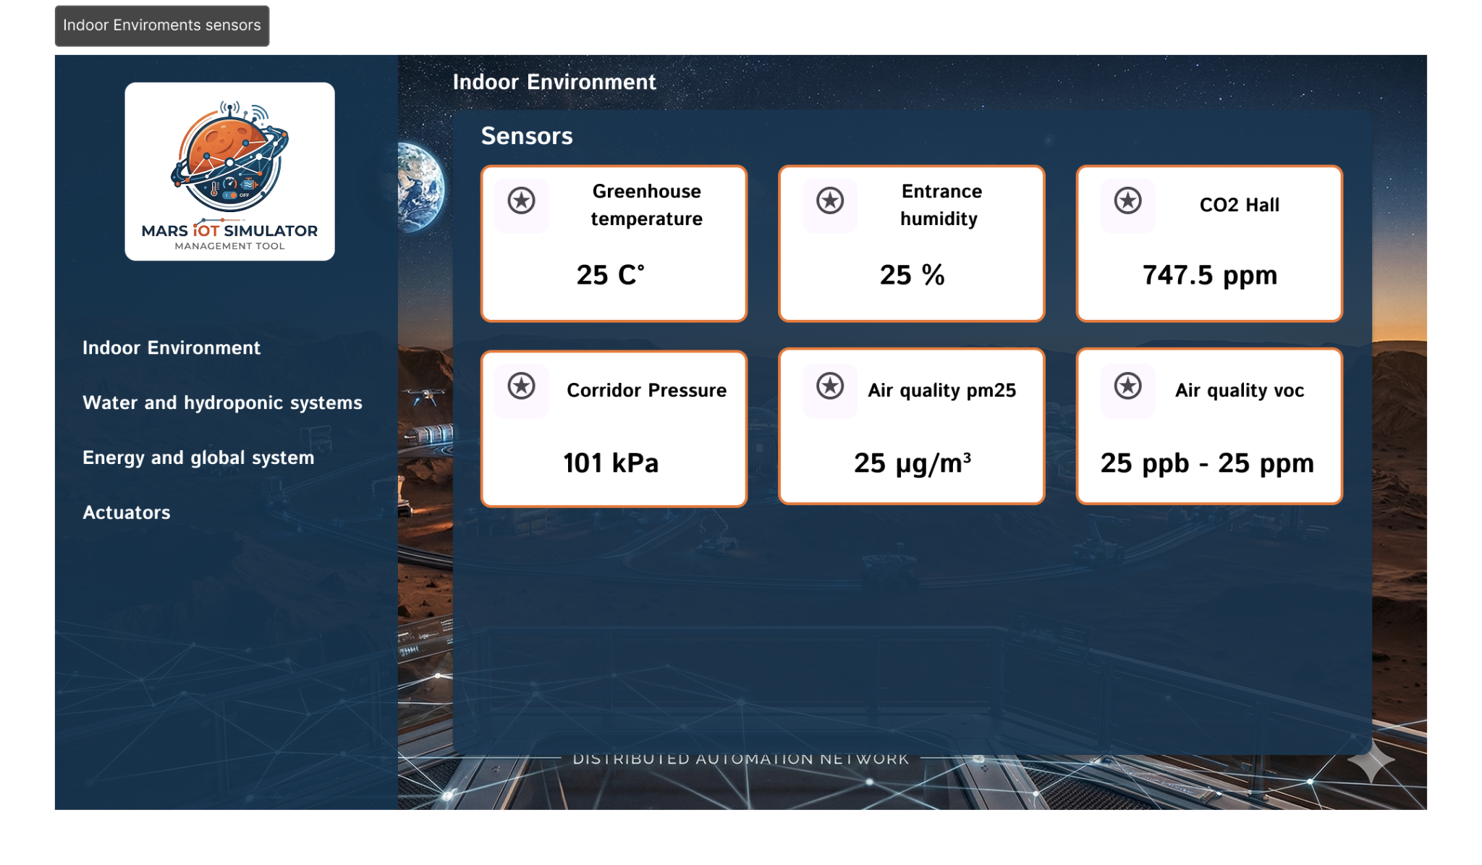
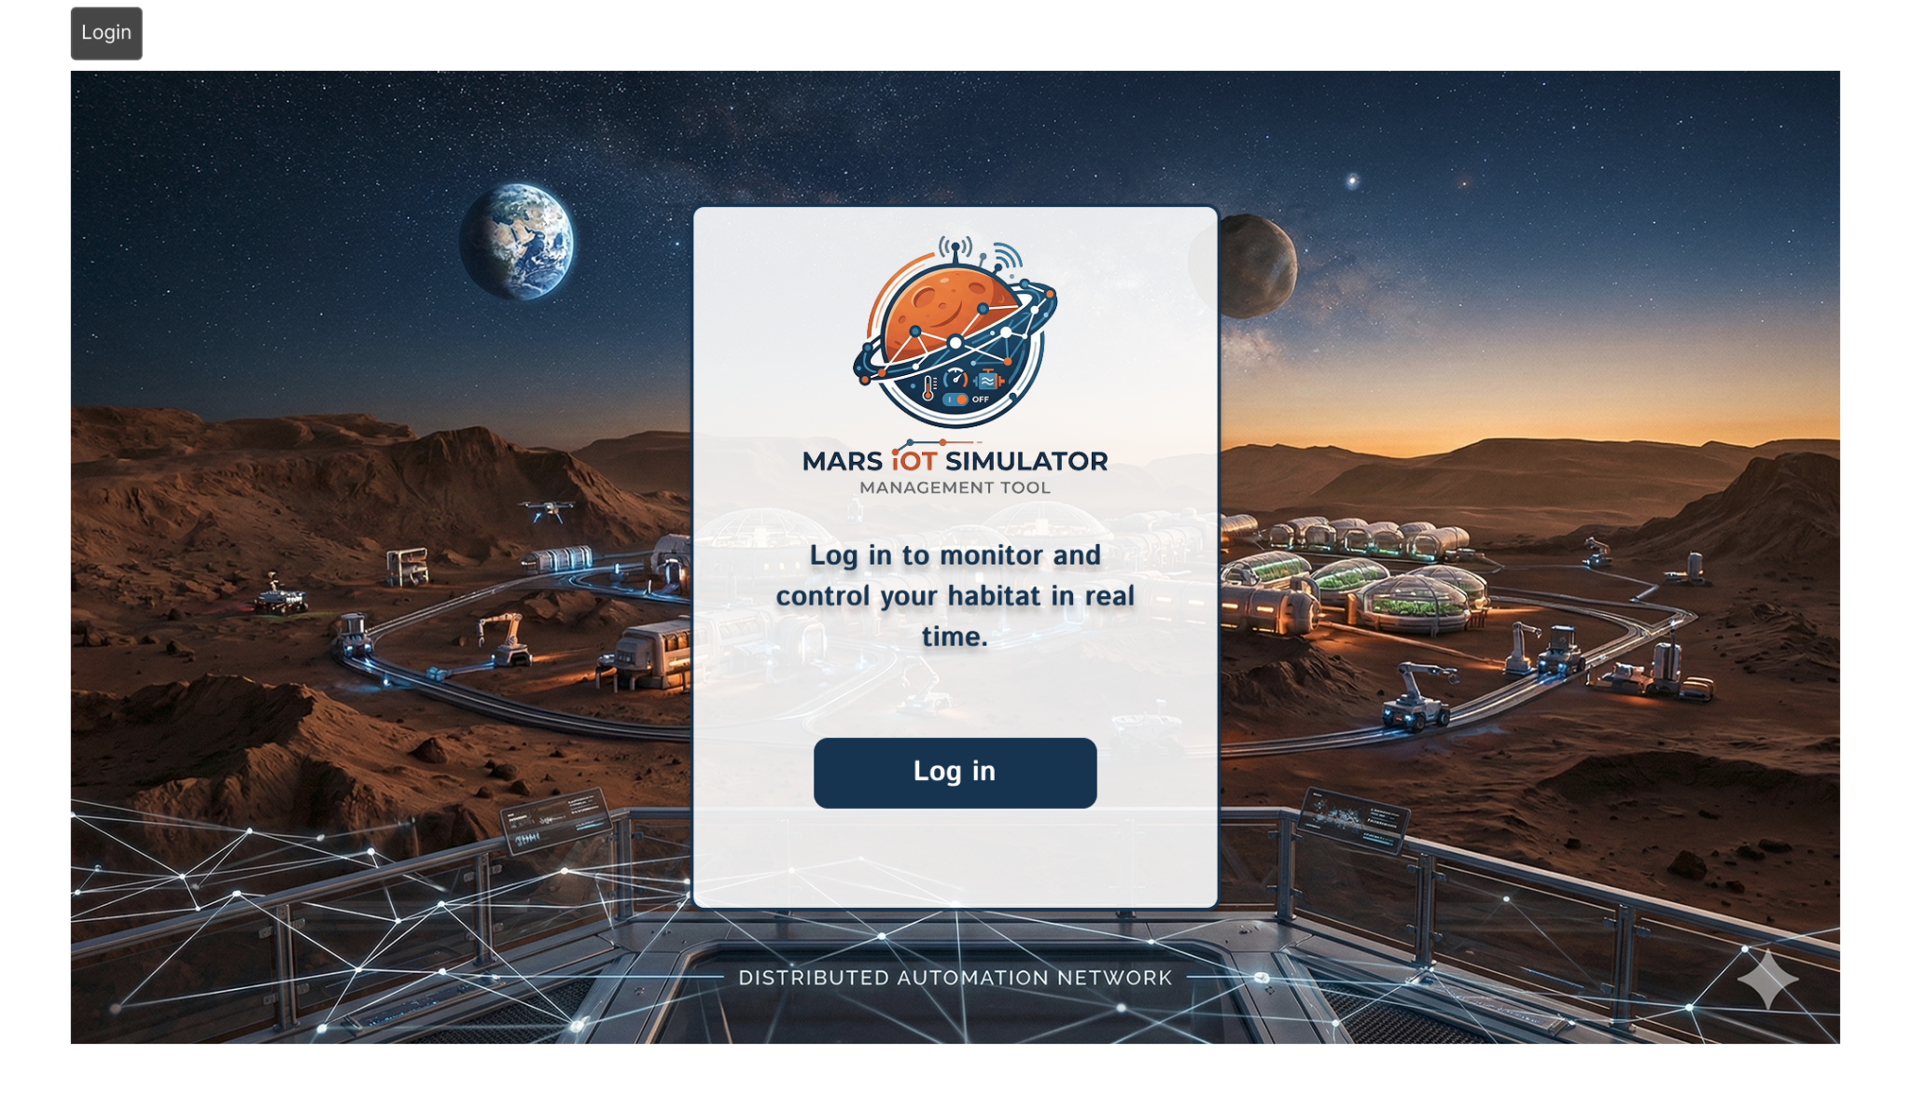
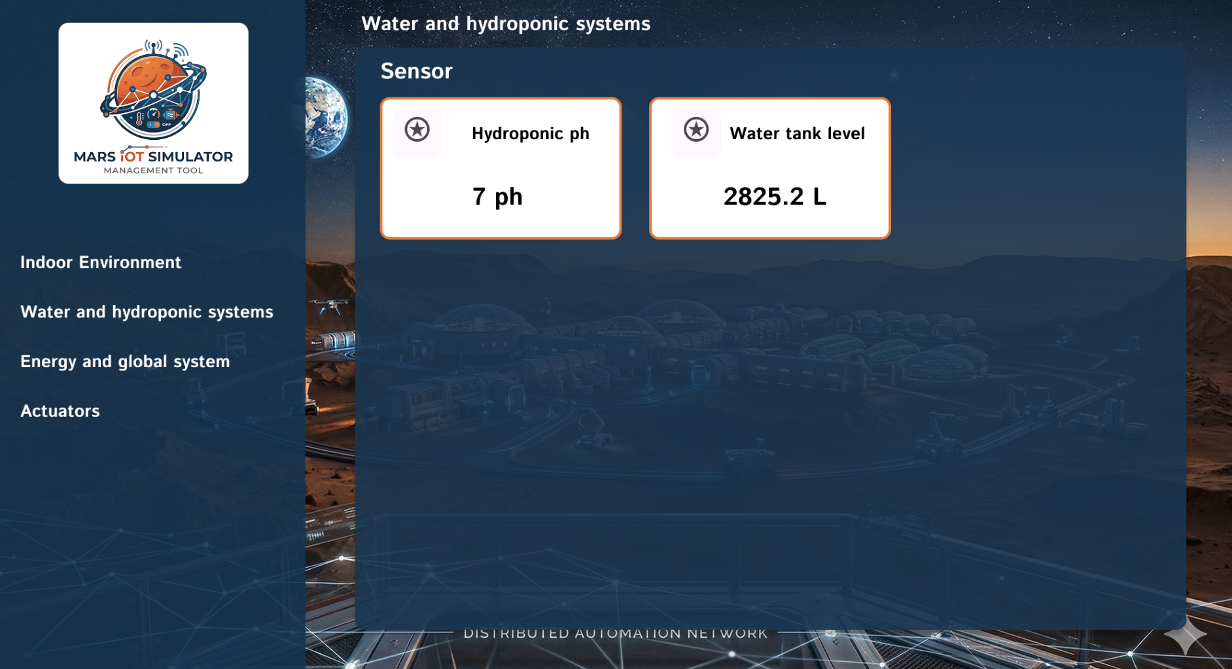
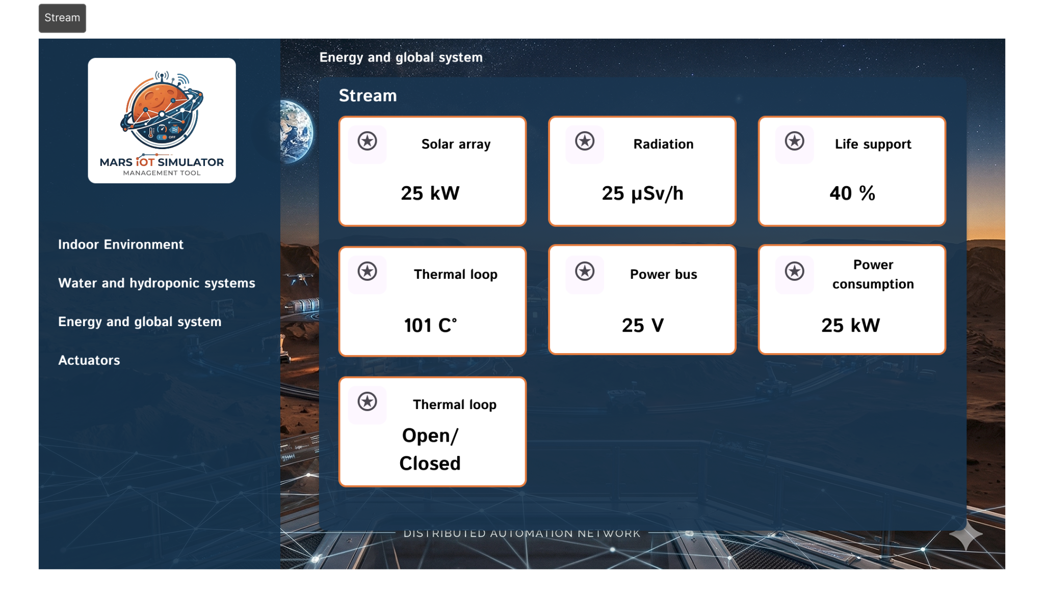
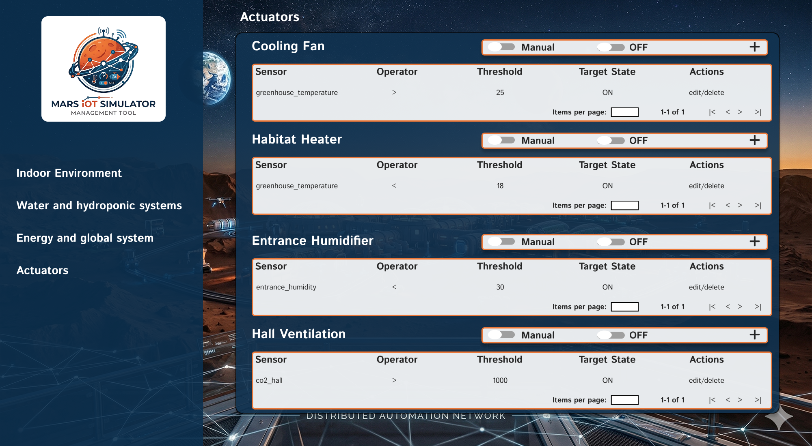
Lo-fi Figma Mockups

Slide 10
Frontend
TECHNOLOGY
Vue.js + Vite + Vuetify + Pinia + Chart.js + FIGMA
Routing: vue-router
FEATURES
Dashboard with real-time sensor and stream cards (Polling and Websocket)
Line/area/bar charts
Actuators page:
AUTO/MANUAL mode
ON/OFF switches
Rules table with create/edit/delete operations

Slide 11
Project summary
End-to-end architecture implemented and running
Real-time sensor monitoring and telemetry visualization
Rule-based automation engine integrated with actuator control
Manual/automatic actuator management from the dashboard
Containerized deployment with Docker Compose
Deliverables completed: source code, docs, architecture, user stories, mockups

