Slide 1

Towards a Lightweight Software Architecture for PX4 Computer Vision

Slide 2
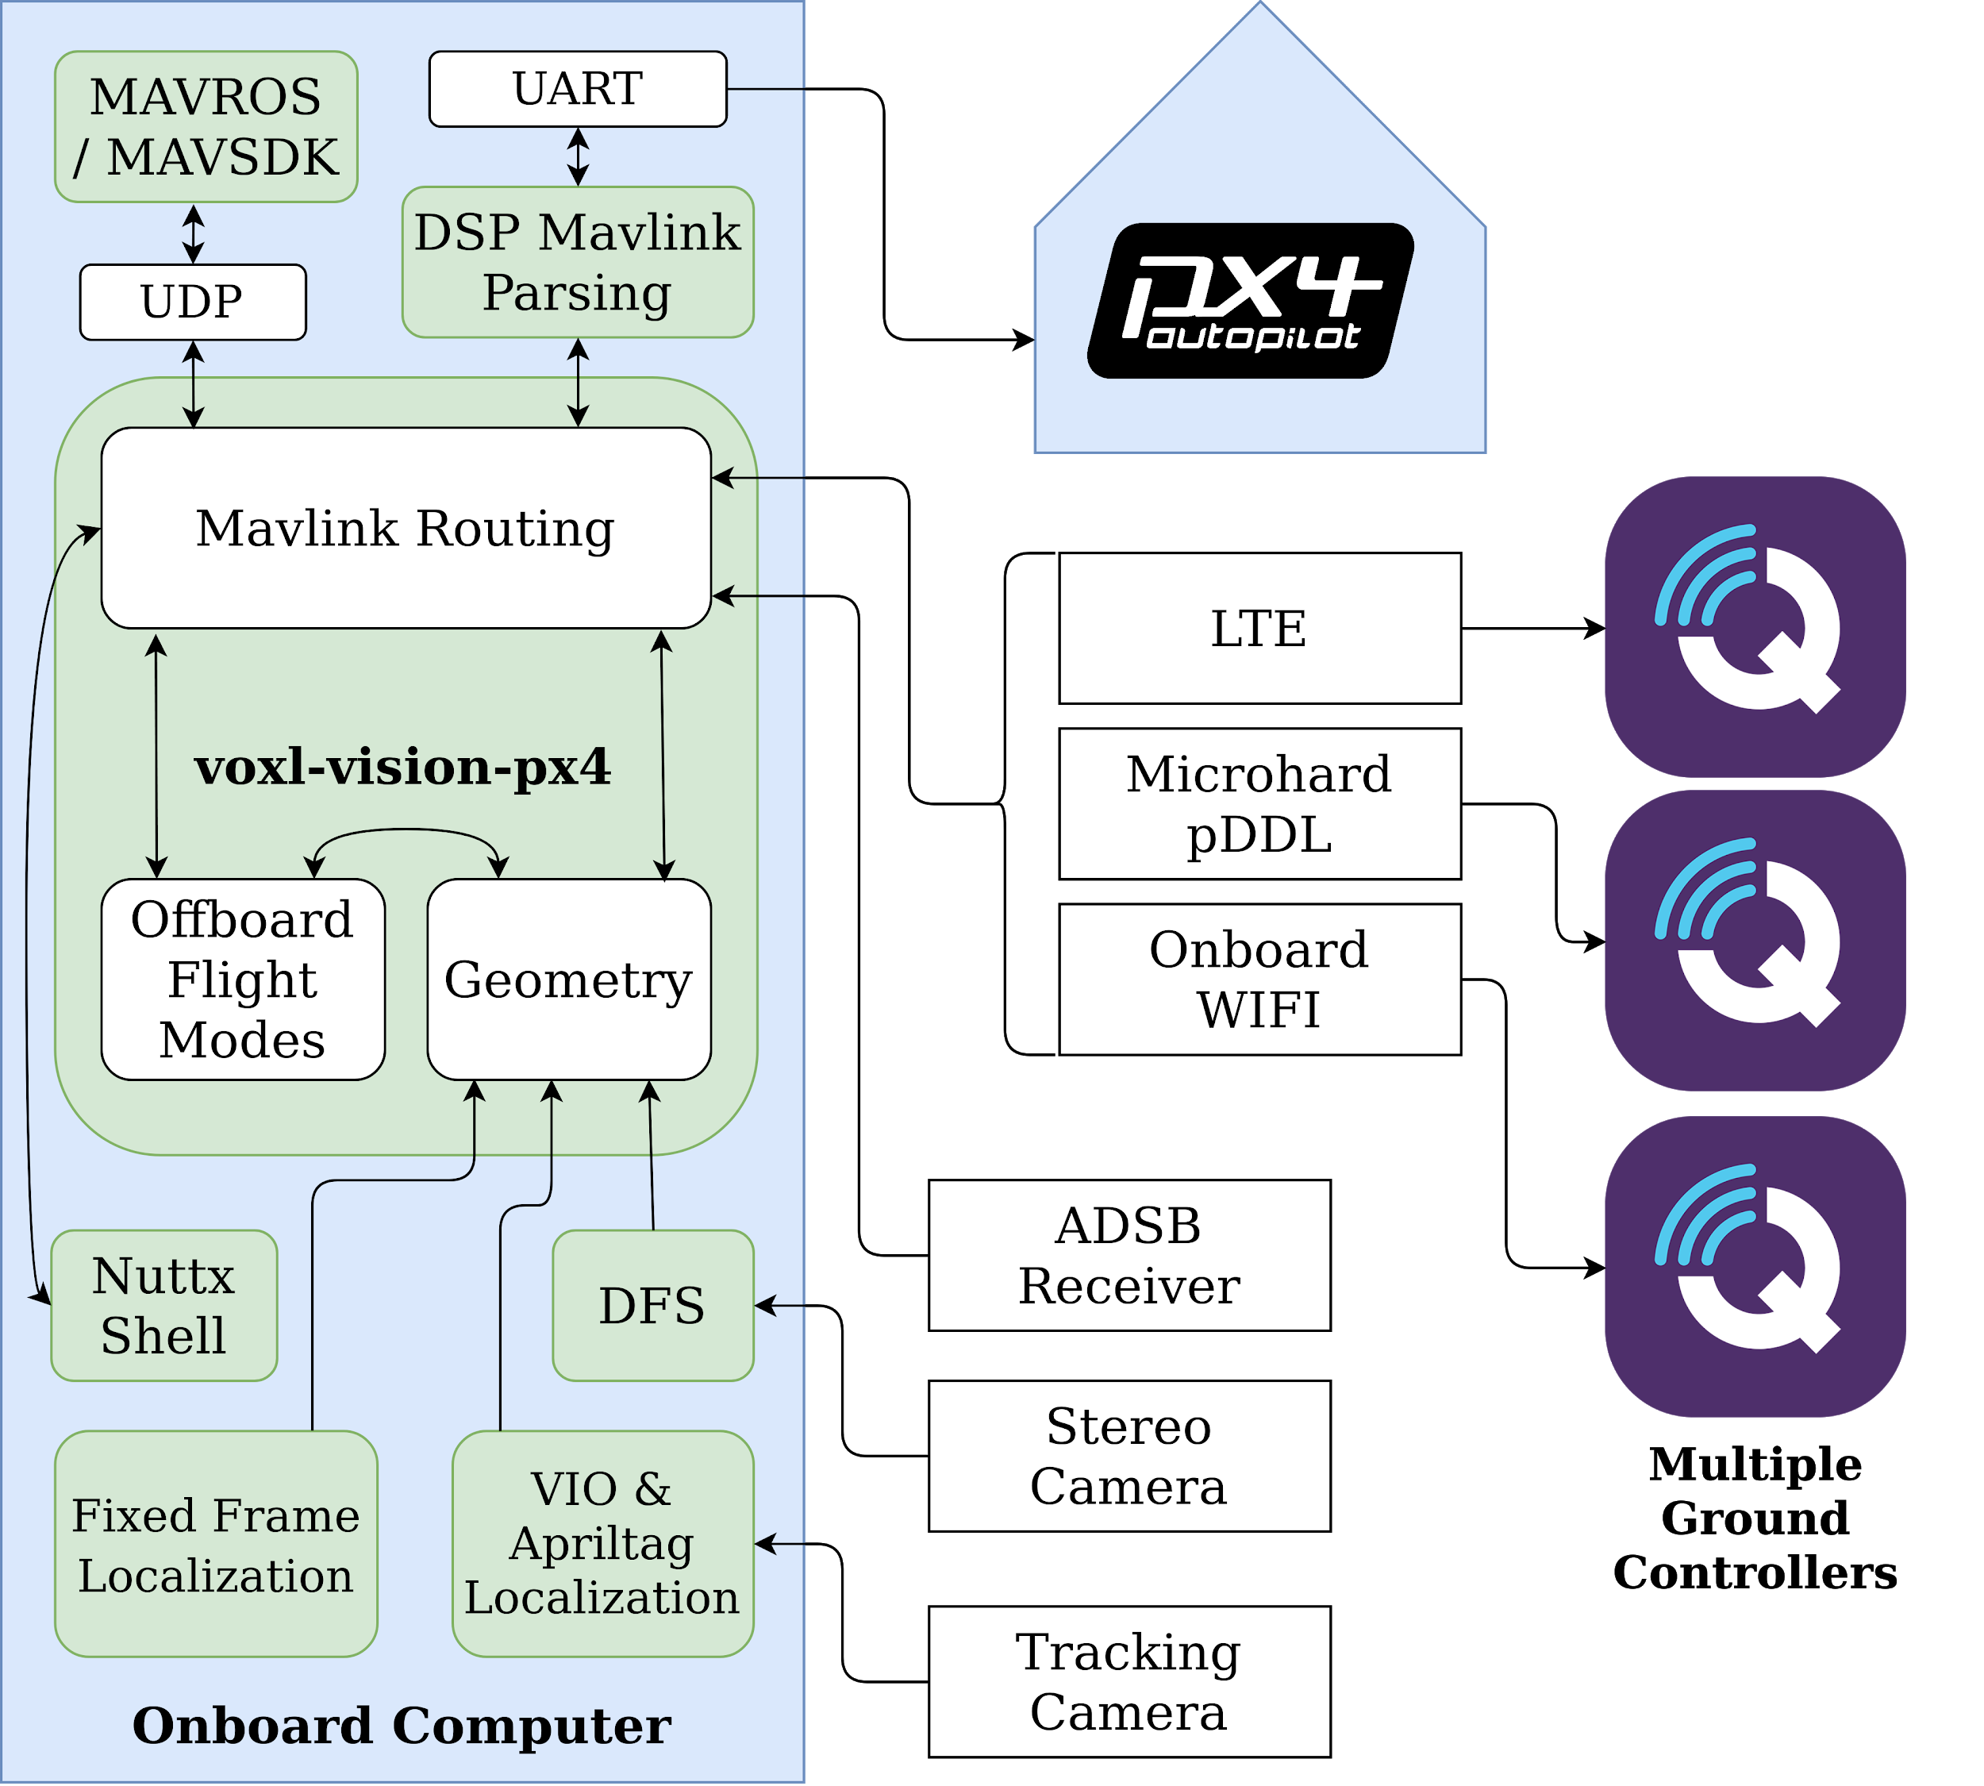
Discussion Topics
What Connects Where?
Can use MAVLINK Router
or do by hand
Fundamental Computer Vision Tasks:
Visual Inertial Odometry
Fiducial Marker Relocalization
Stereo Collision Prevention
Keeping Track of Frames of Reference
Can Use ROS/TF2
or do by hand
Experiences with Open-Source VIO

Slide 3
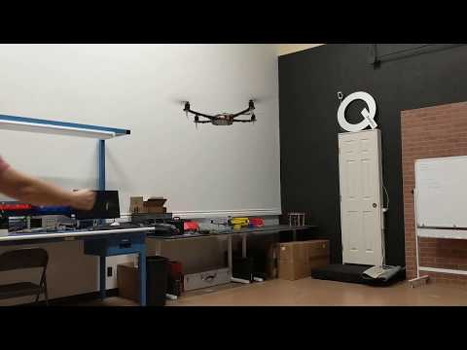
Foundation: GPS-denied VIO

Slide 4
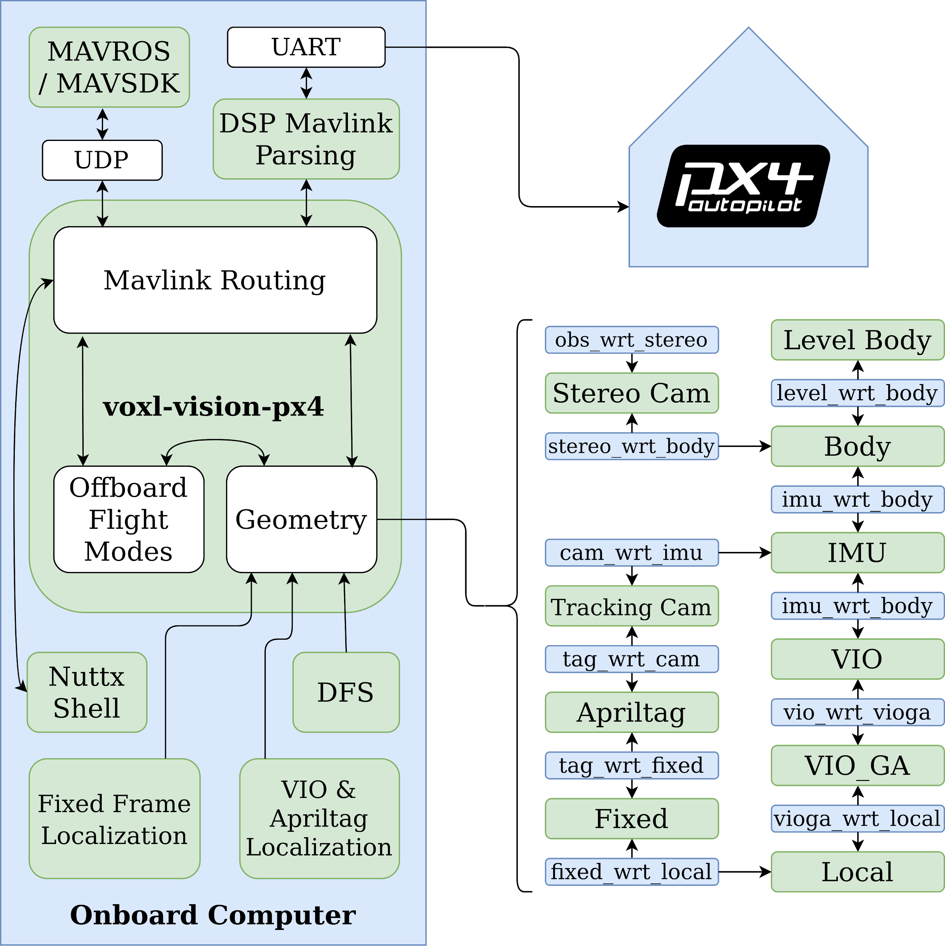
VIO Data Path
We choose to consume Visual Odometry data through a named-pipe for portability, light weight, and minimal dependencies.
Rotated/Transformed in geometry module
then passed through shared memory to DSP-accelerated Mavlink handler.
This could easily be done with TF2/MAVROS. Whichever path the data takes:
Data must be rotated and translated into the correct frame,
constructed into the appropriate Mavlink packet,
and timestamped correctly!

Slide 5
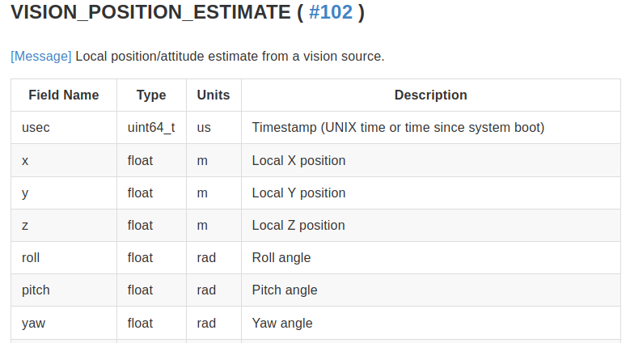
Mavlink Option #1

Slide 6
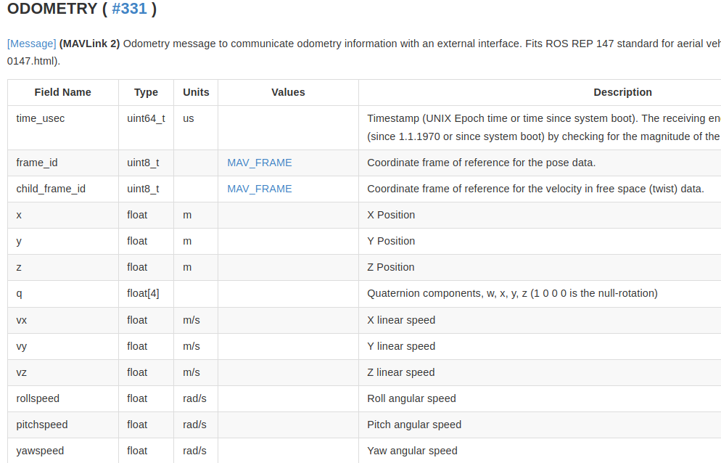
Mavlink Option #2

Slide 7
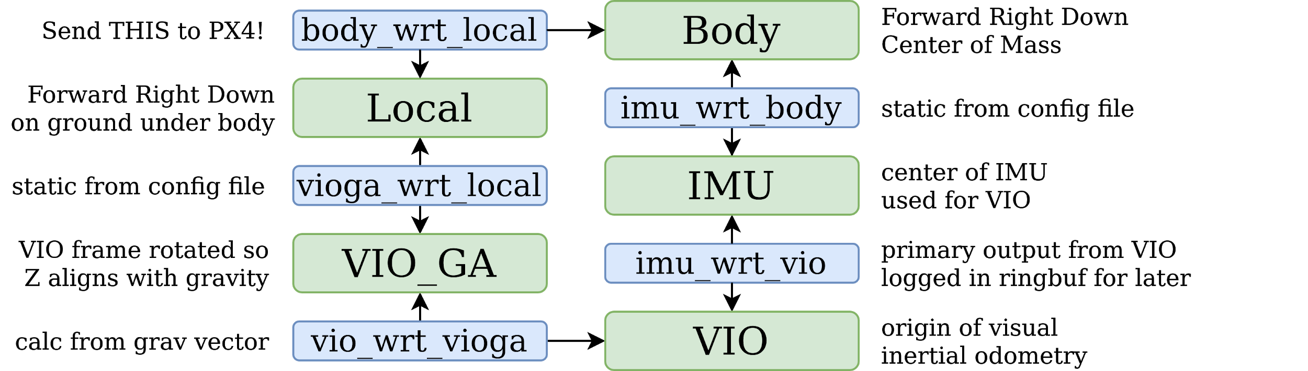
Frames of Reference: Odometry

Slide 8
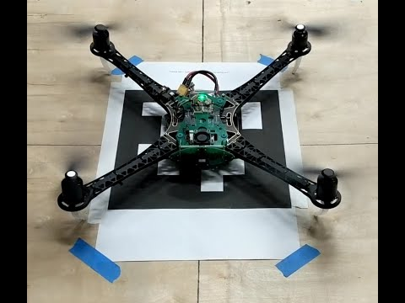
Fiducial Relocalization

Slide 9
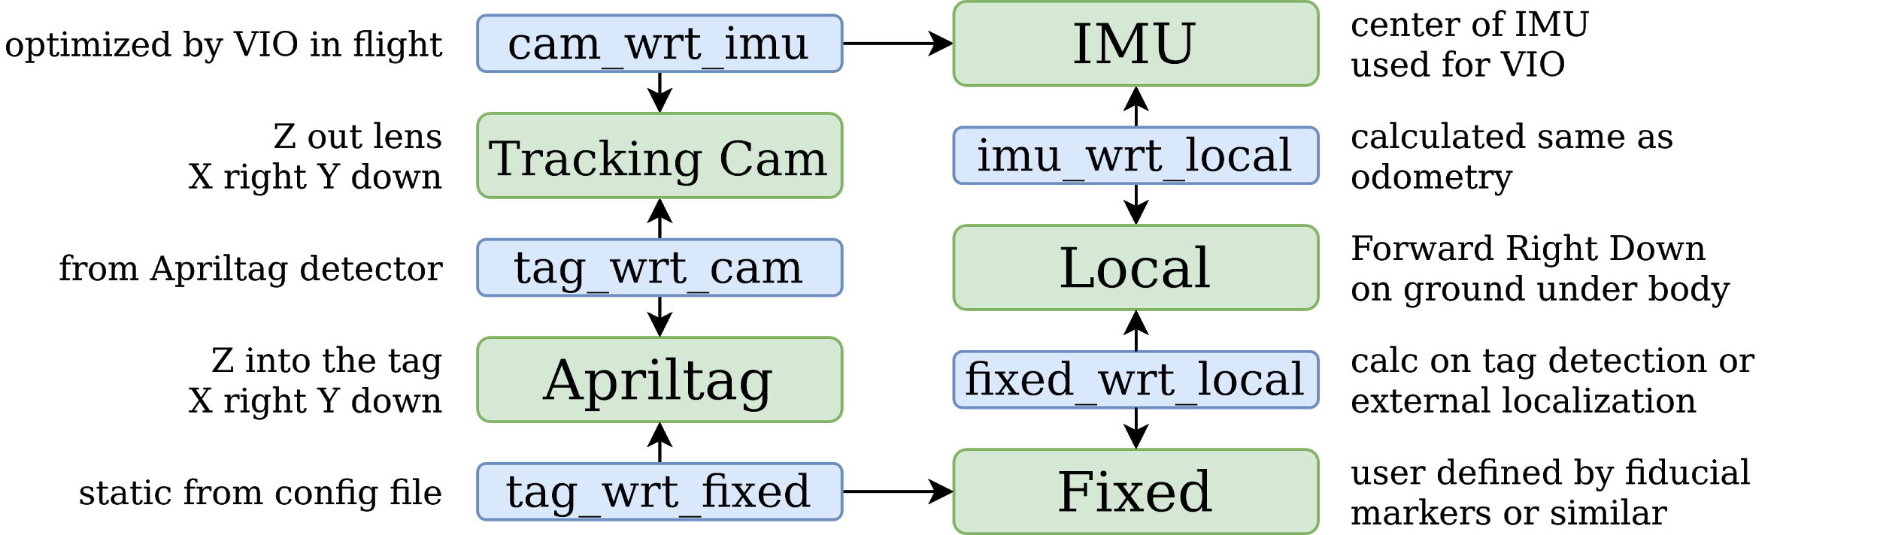
Frames of Reference: Fiducial Relocalization

Slide 10
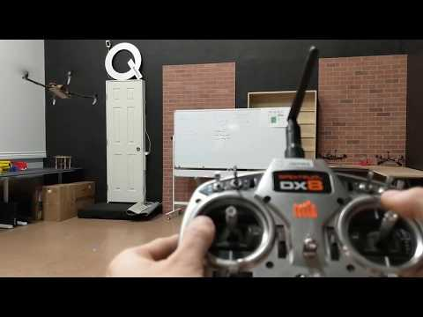
VOA Video

Slide 11
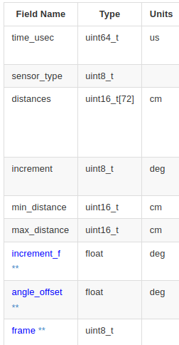
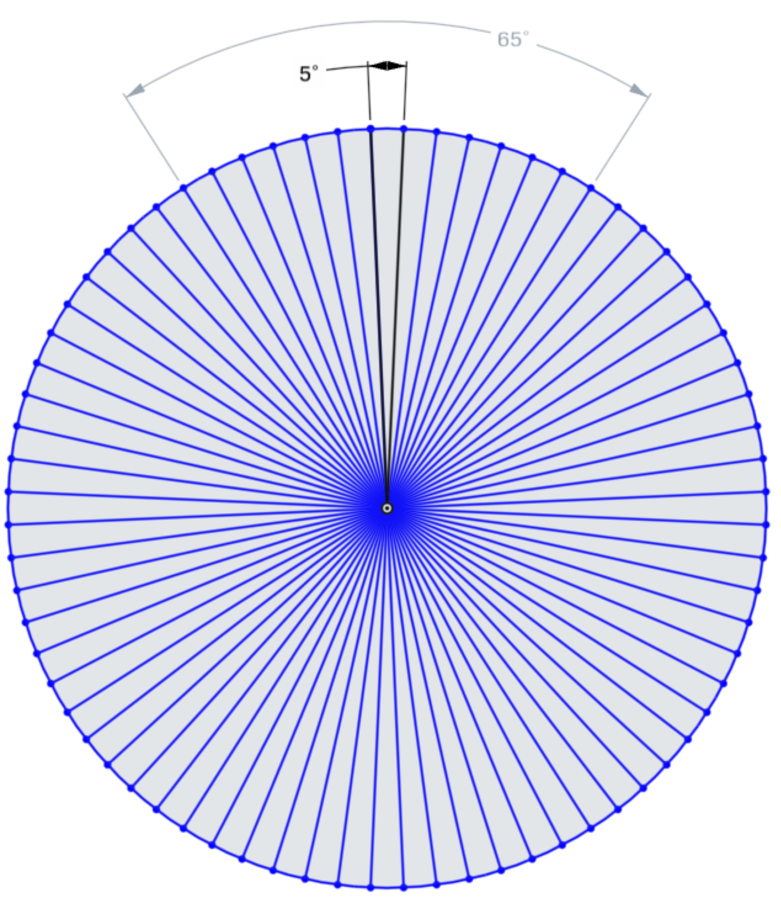
Obstacle Distance Data Structure (msg_id 330)
dist[0]
increment
dist[71]
dist[1]
dist[70]
dist[2]
min max
distance

Slide 12
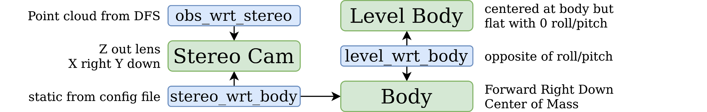
Frames of Reference: Collision Prevention

Slide 13
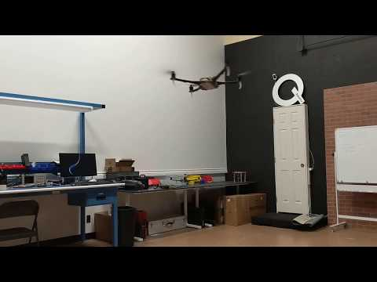
Integration With MAVROS

Slide 14
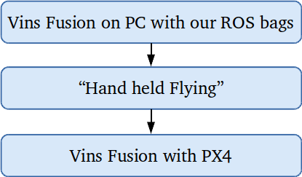
Moving to VINS Fusion - GPLv3 VIO
Step 1: PC with ROS bags
Handheld and in-flight ROS bags
Helps resolve fundamental issues
Example: Extrinsic / Intrinsic calibration, feature tracking, imu noise parameters
Fix assumptions if any
Example: Focal length, IMU only pose generation
Step 2: Robust “Handheld Flying”
Move from PC to Onboard computer
Work with live camera + IMU data
Real-time Embedded Performance
GPU for feature tracking
Ceres solver in Vins Fusion
Pose estimation period
Step 3: Flying with PX4
Vins Fusion data to PX4
PX4 skipped VIO packets
Incorrect parameter in VIO data
Current time Vs VIO pose time
Pose reporting frequency
Pose snapping resulting from IMU only pose generation

Slide 15
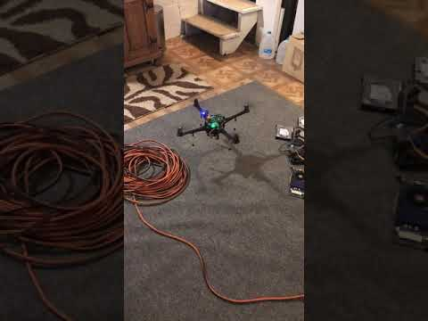
VINS Fusion Demo

Slide 16




contact@modalai.com
twitter.com/modal_ai
Q&A
instagram.com/modal_ai/

