Slide 1
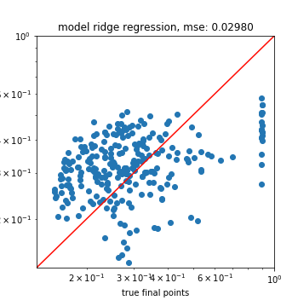
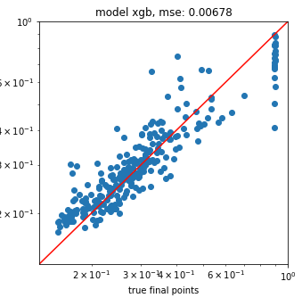
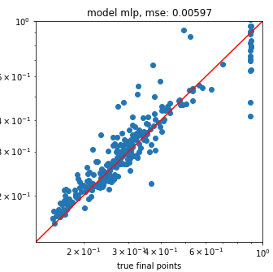
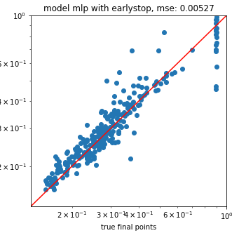
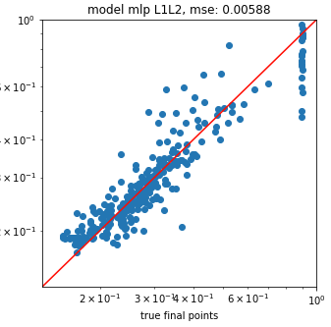
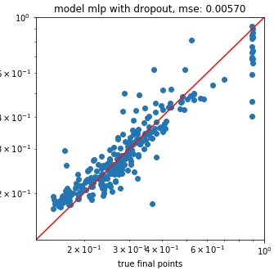
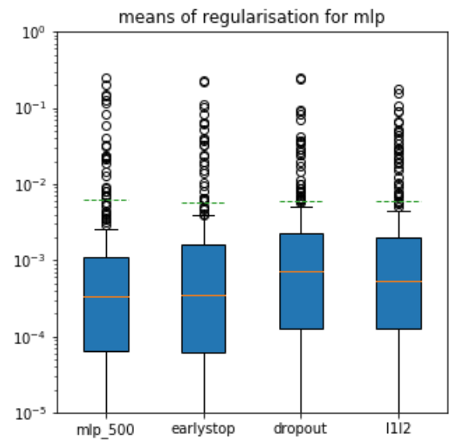
Extrapolating learning curves with rnns
Jochen Sautter, Fabian Glöckle
Models predicting directly from configuration
Regularisation L1L2, Dropout, Earlystop,
Notes:
1

Slide 2
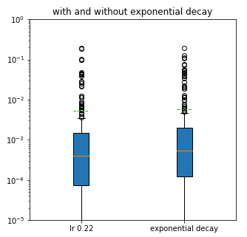
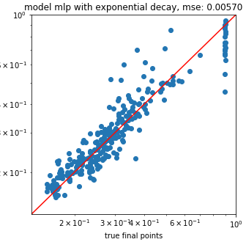
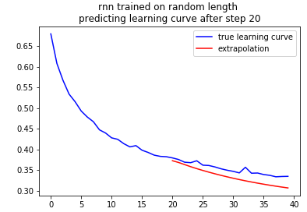
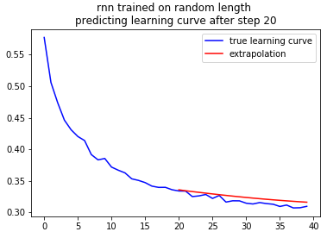
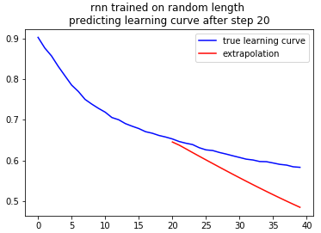
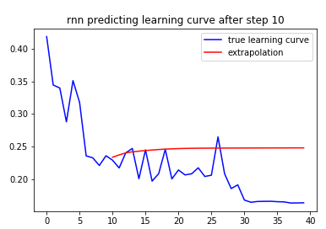
Extrapolating learning curves with rnns
Jochen Sautter, Fabian Glöckle
Mlp exponential decay
Learning curve extrapolations
Notes:
2

Slide 3





Extrapolating learning curves with rnns
Jochen Sautter, Fabian Glöckle
Scatterplots rnns trained stepwise
Baseline XGB trained stepwise
Notes:
3

Slide 4




Extrapolating learning curves with rnns
Jochen Sautter, Fabian Glöckle
Scatterplots rnns trained on final point
Notes:
4

