Slide 1

Notes:
MinorFlow is an open-source visualizer that turns gem5 MinorCPU traces into the multi-cycle pipeline diagram undergraduate students already know. We built it at FaMAF, Universidad Nacional de Córdoba.

Slide 2
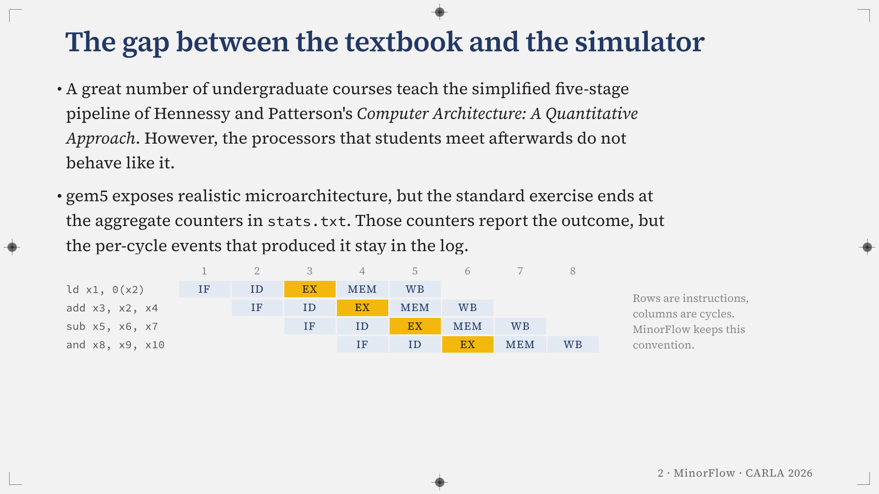
Notes:
A great number of undergraduate courses teach a simplified five-stage pipeline, the one in Hennessy and Patterson, Computer Architecture: A Quantitative Approach. The diagram below is that convention, rows of instructions and columns of cycles, the same one MinorFlow keeps.
gem5 lets students meet a realistic core, but the usual exercise ends in a text file of aggregate counters. Those counters report the outcome and hide the events that produced it.

Slide 3
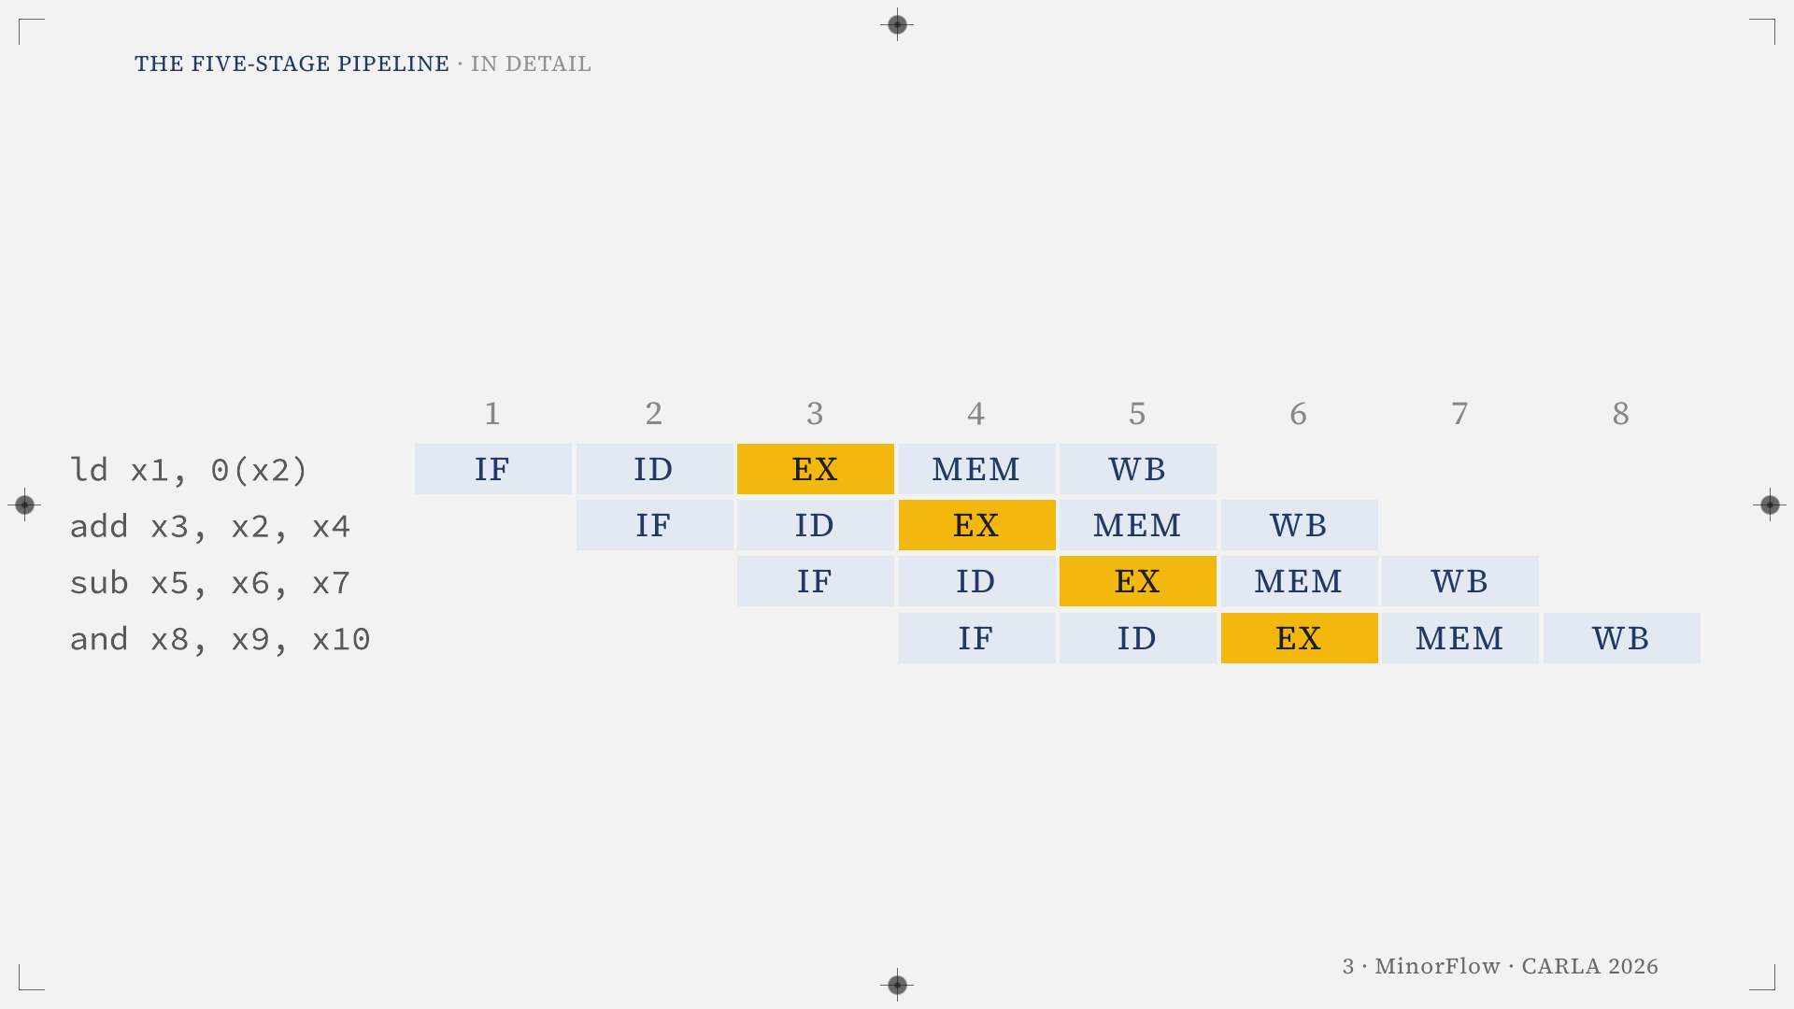
Notes:
Enlarged view of the five-stage diagram. Rows of instructions, columns of cycles, EX in yellow. It is the convention MinorFlow keeps.

Slide 4
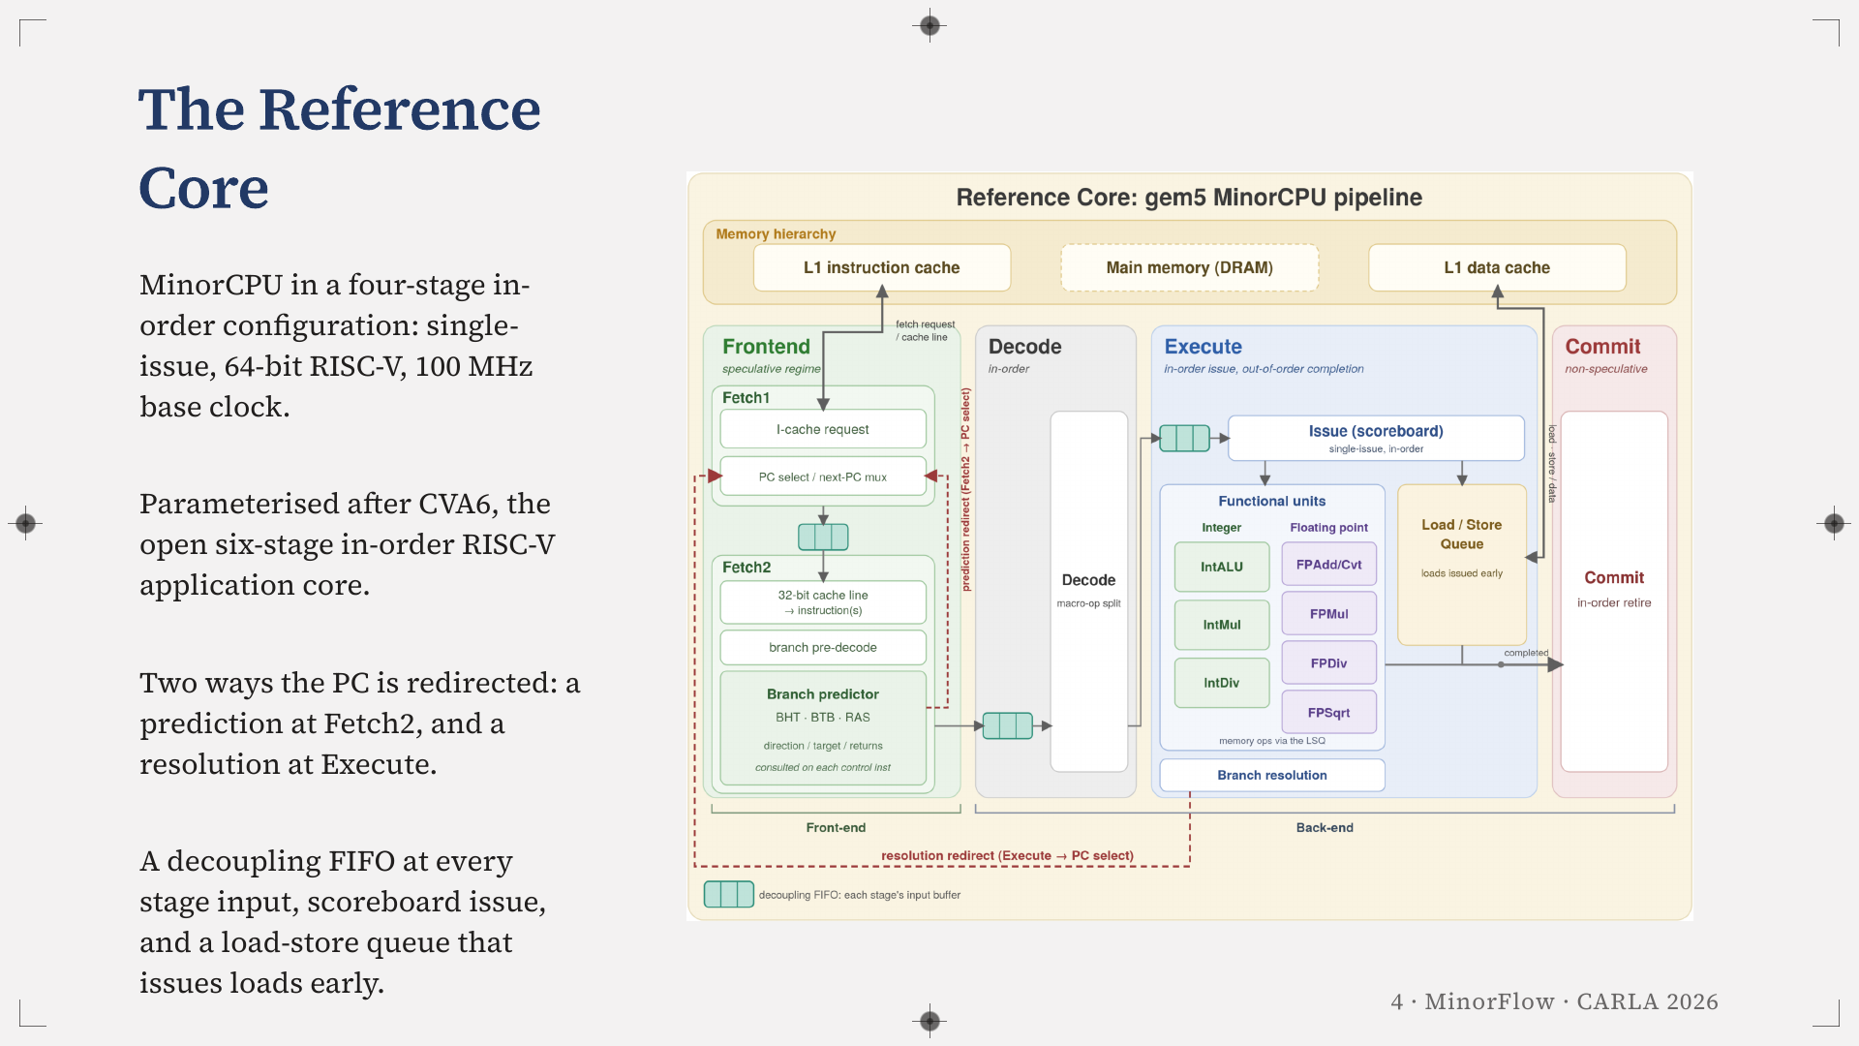
Notes:
This is the configuration everything in the work is measured on. A 64-bit RISC-V core, single-issue, in-order, at 100 MHz, parameterised after CVA6, the open six-stage in-order RISC-V core.
Note the two red arrows: the prediction redirect from Fetch2 and the resolution redirect from Execute. Those two paths come back in Case B.

Slide 5
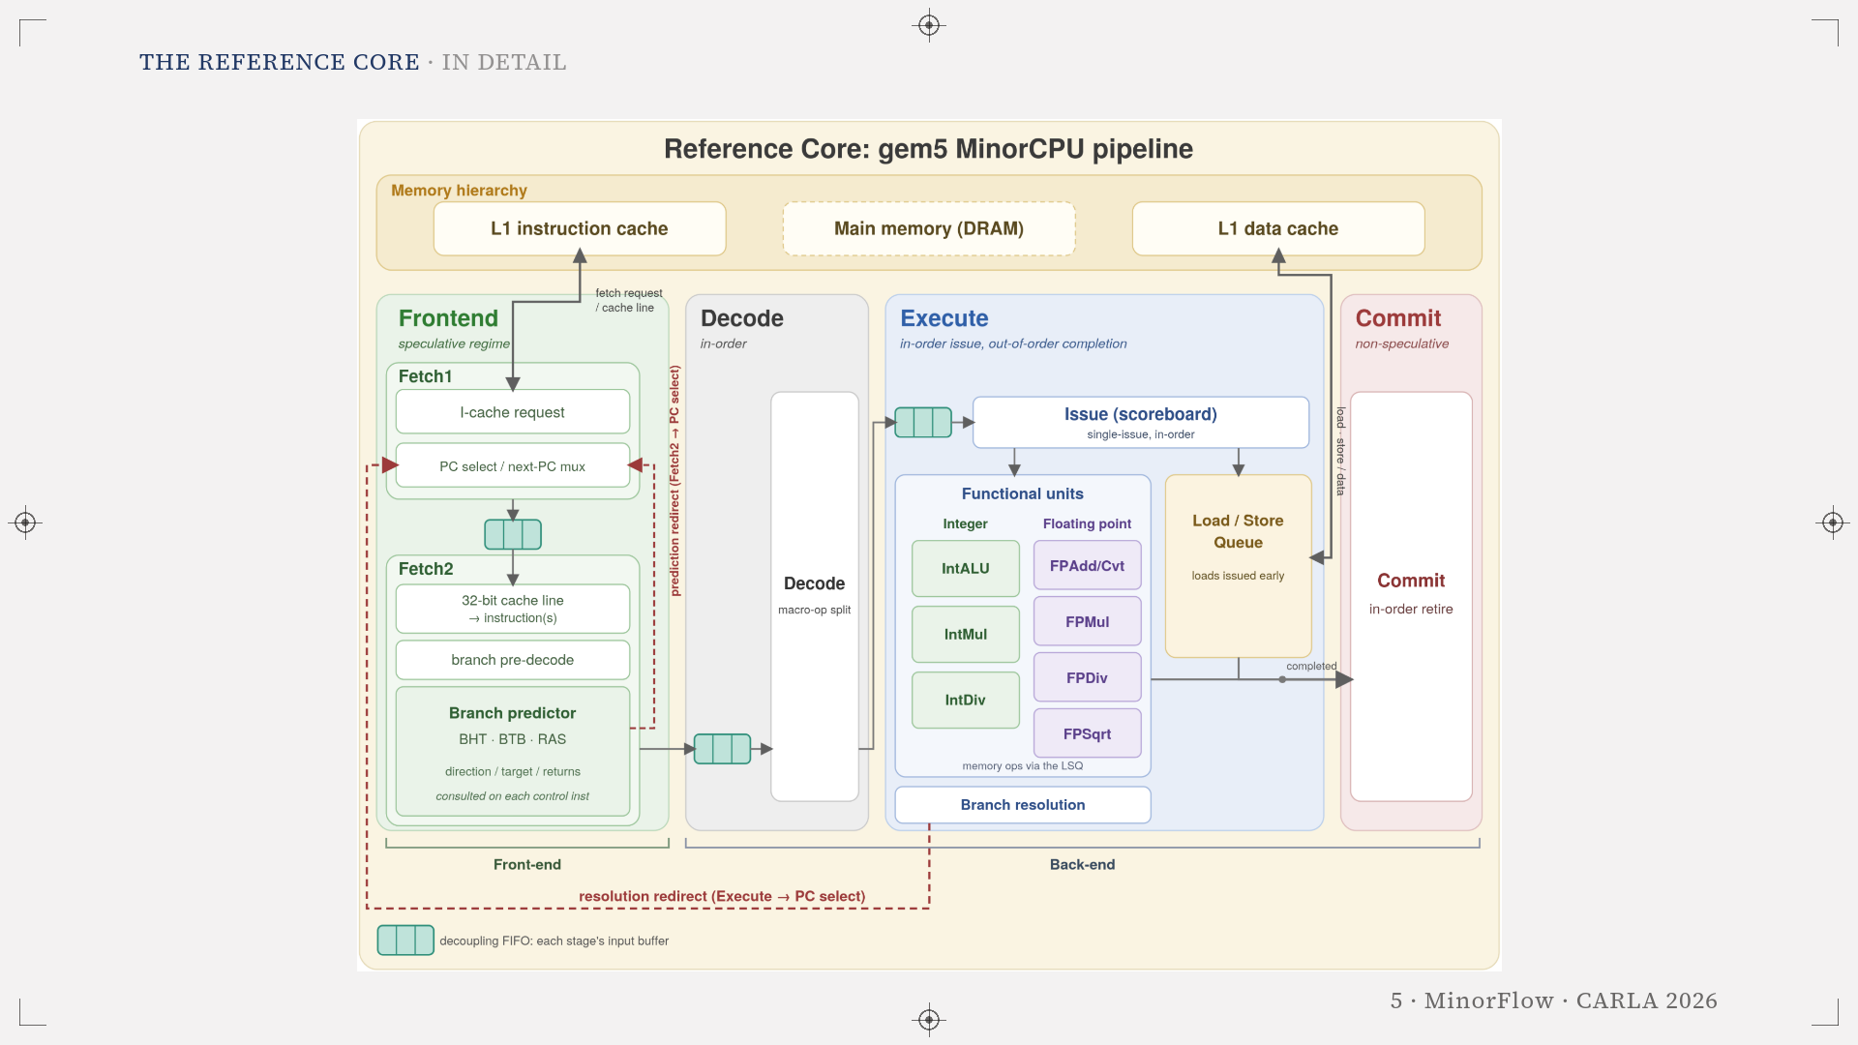
Notes:
Enlarged view of the previous figure: The Reference Core.

Slide 6
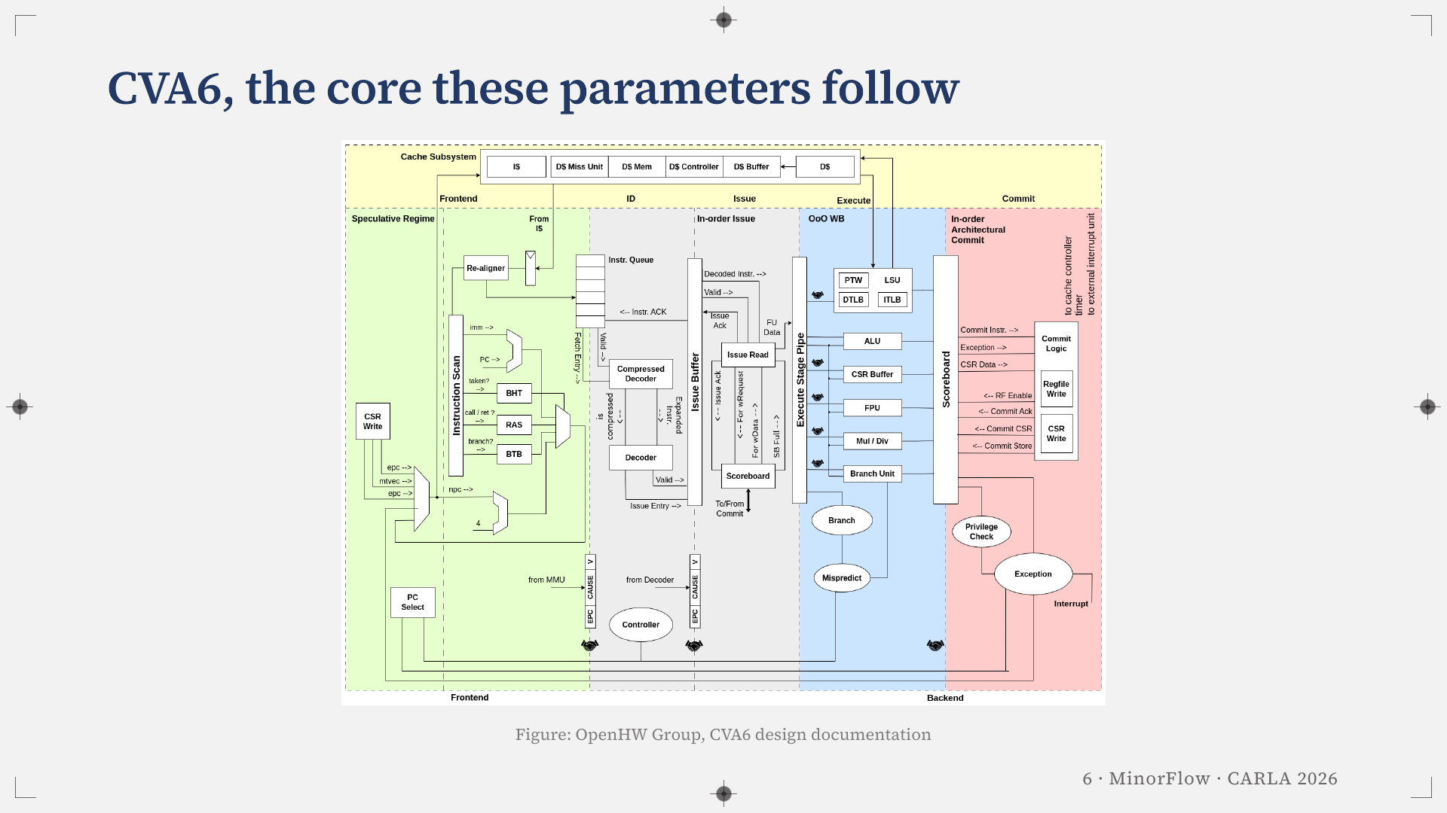
Notes:
This is CVA6, the open six-stage in-order RISC-V core we took as the reference for parameterising the Reference Core.

Slide 7
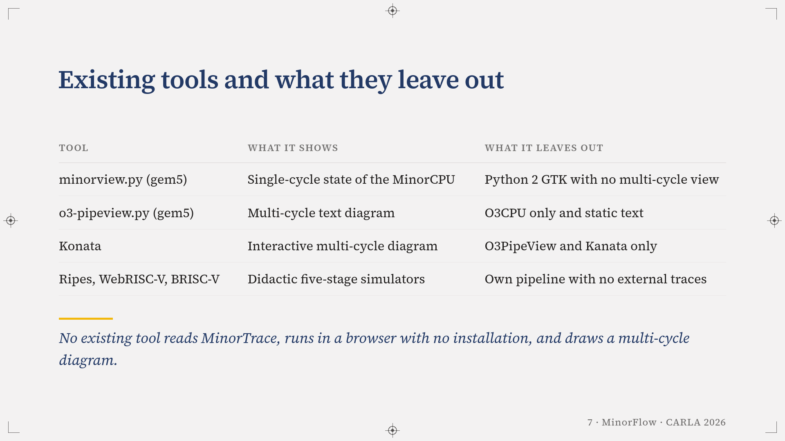
Notes:
There are four families of tools:
- minorview, from gem5, reads MinorTrace but is a single-cycle view in Python 2 with GTK.
- o3-pipeview draws a multi-cycle diagram, for the out-of-order model only.
- Konata is the de facto standard, but no parser reads MinorTrace.
- The teaching simulators have their own pipeline and take no external traces.

Slide 8
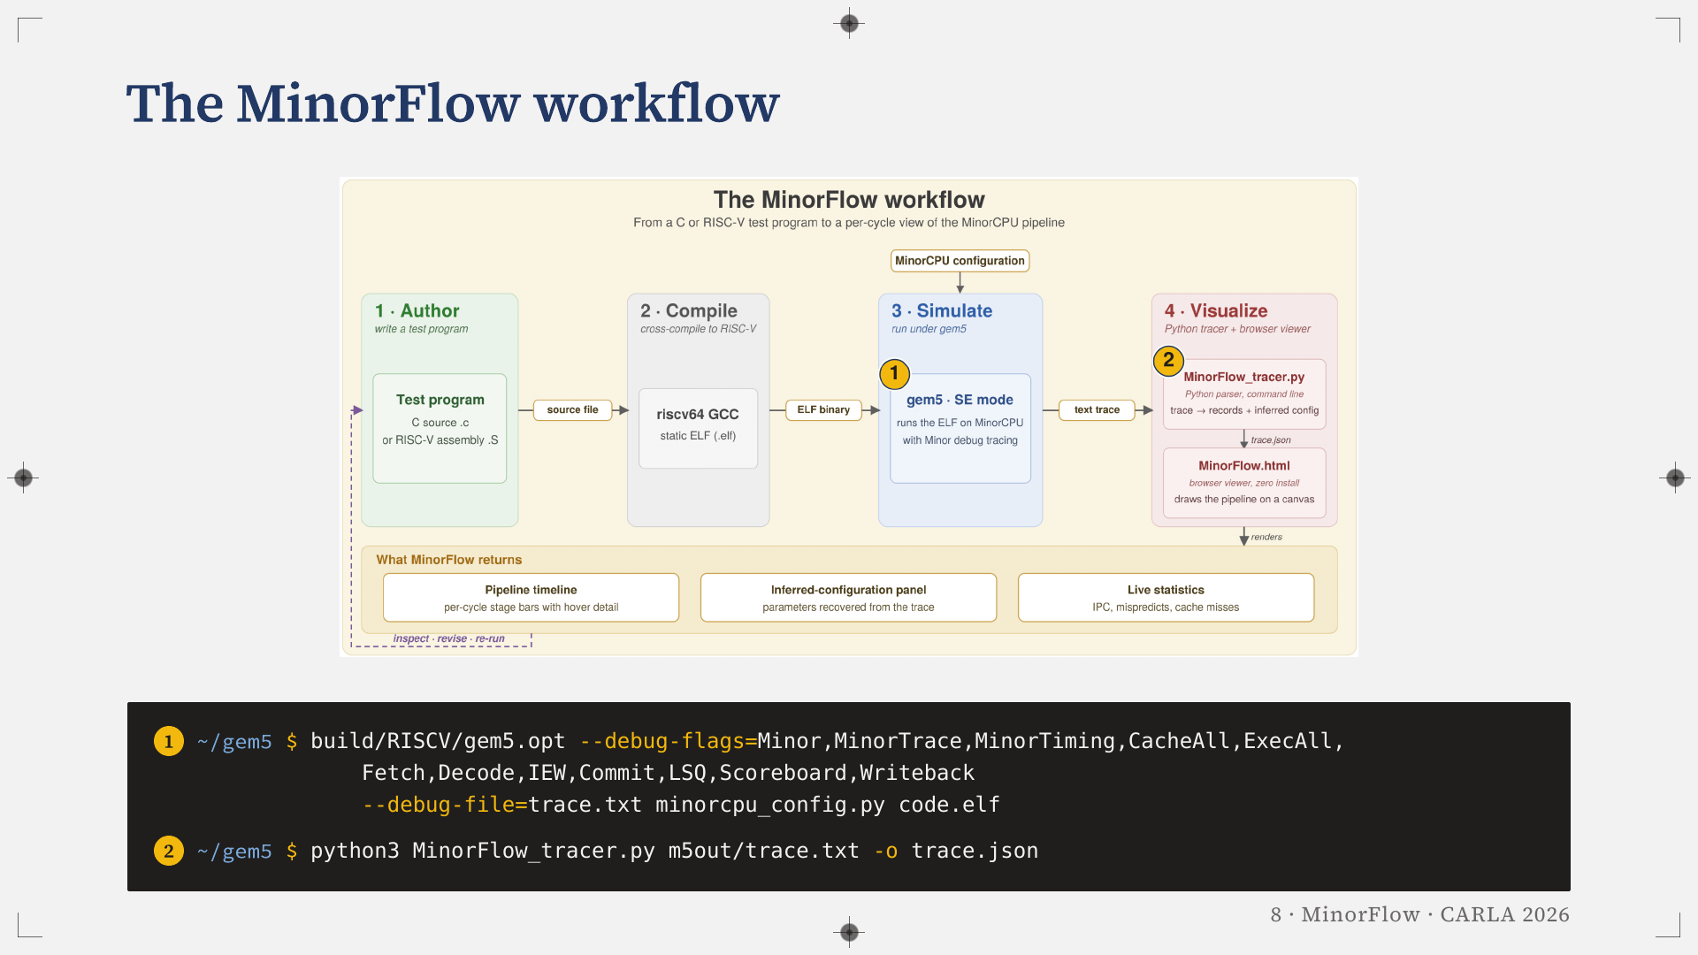
Notes:
The workflow adds one flag and one command to what a gem5 user already does. The two pins on the diagram mark where each command lands: the first runs the simulation in step three, the second converts the trace in step four. Write a test program, cross-compile it, simulate it with the debug flags, convert the trace once, and drag the result onto the viewer. The tracer streams its input, so trace size does not depend on browser memory.

Slide 9
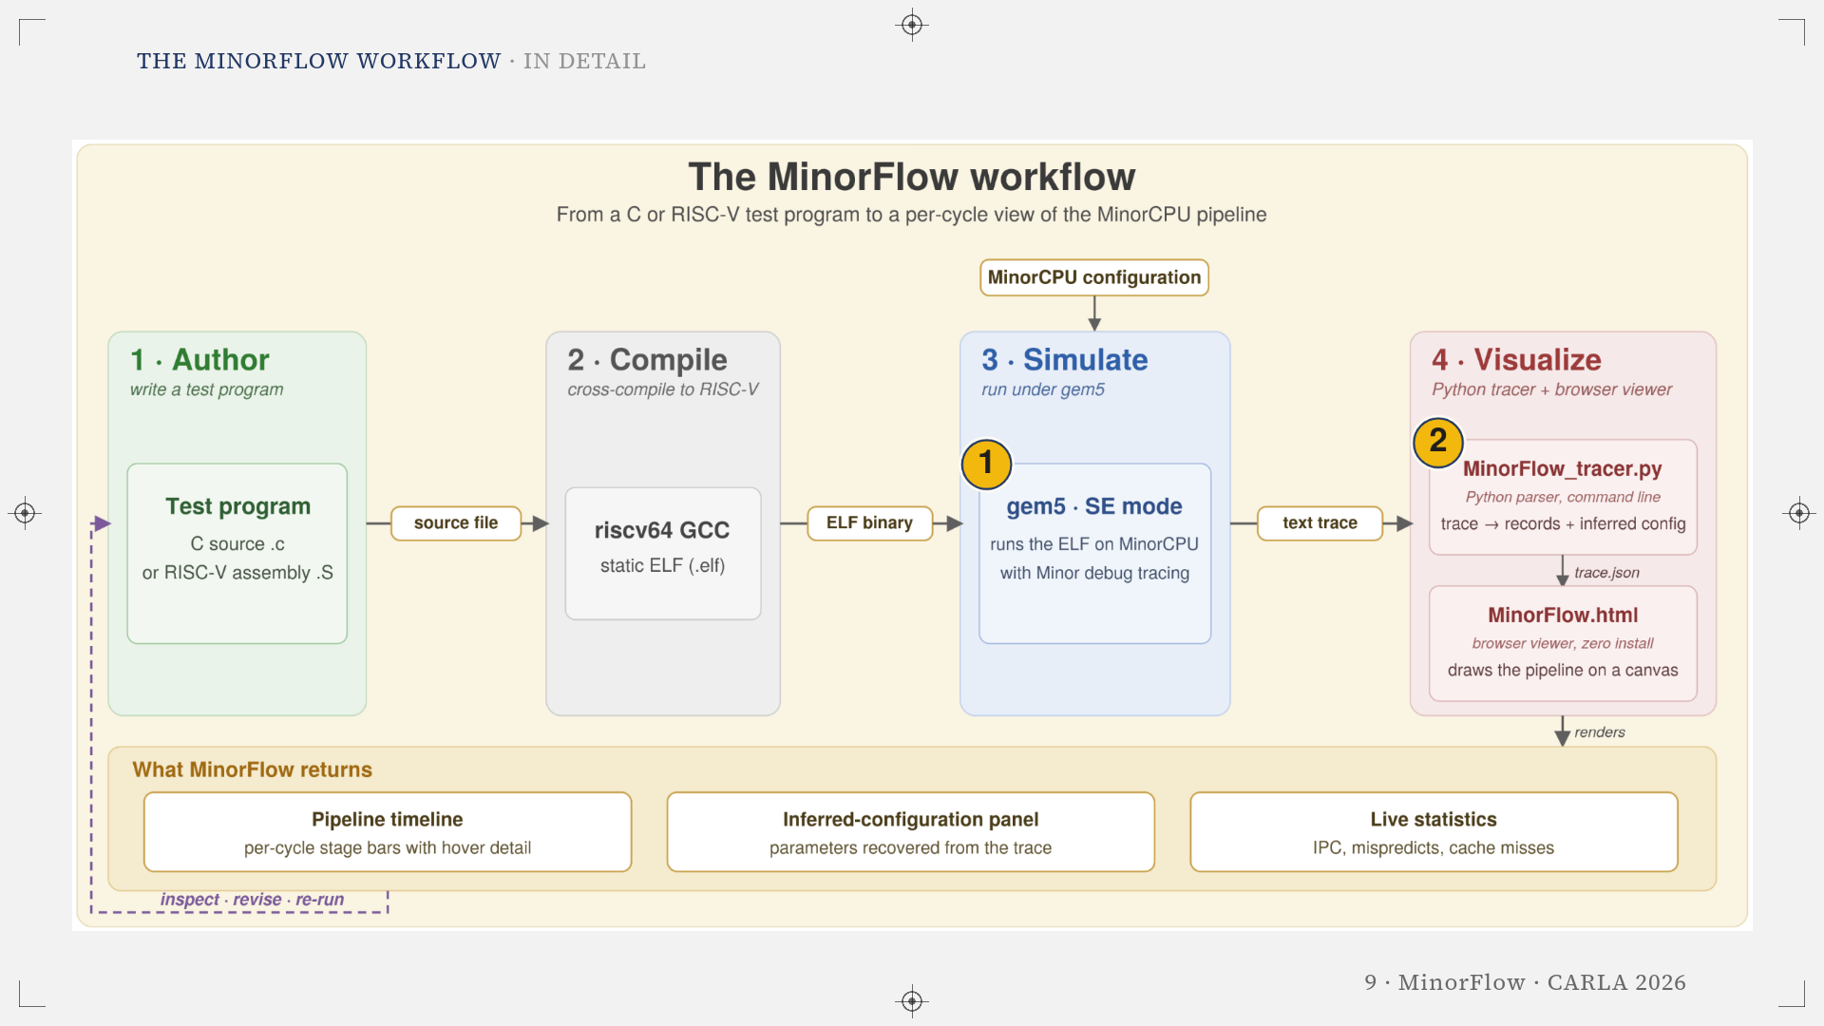
Notes:
Enlarged view of the previous figure: The MinorFlow workflow.

Slide 10
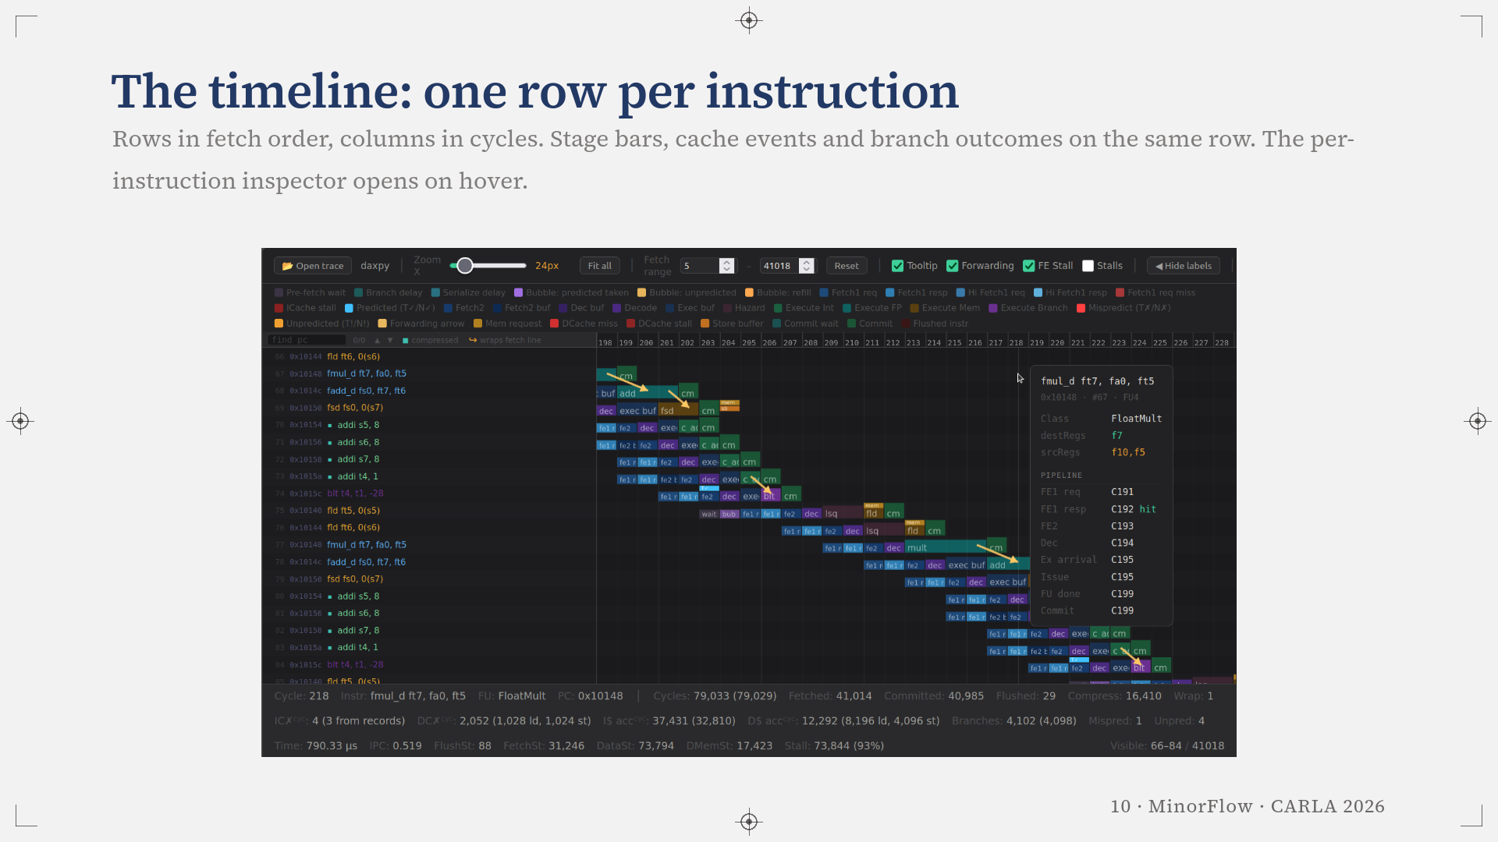
Notes:
This is the default view after loading a document. One row per instruction in fetch order and one column per cycle, the Patterson and Hennessy convention. Segments are coloured by stage and the Execute bar is tinted by functional unit. Commit is drawn as its own stage even though MinorCPU retires from within Execute, so the diagram matches the five-stage reading students bring with them. Hovering a row opens the inspector on the right.

Slide 11
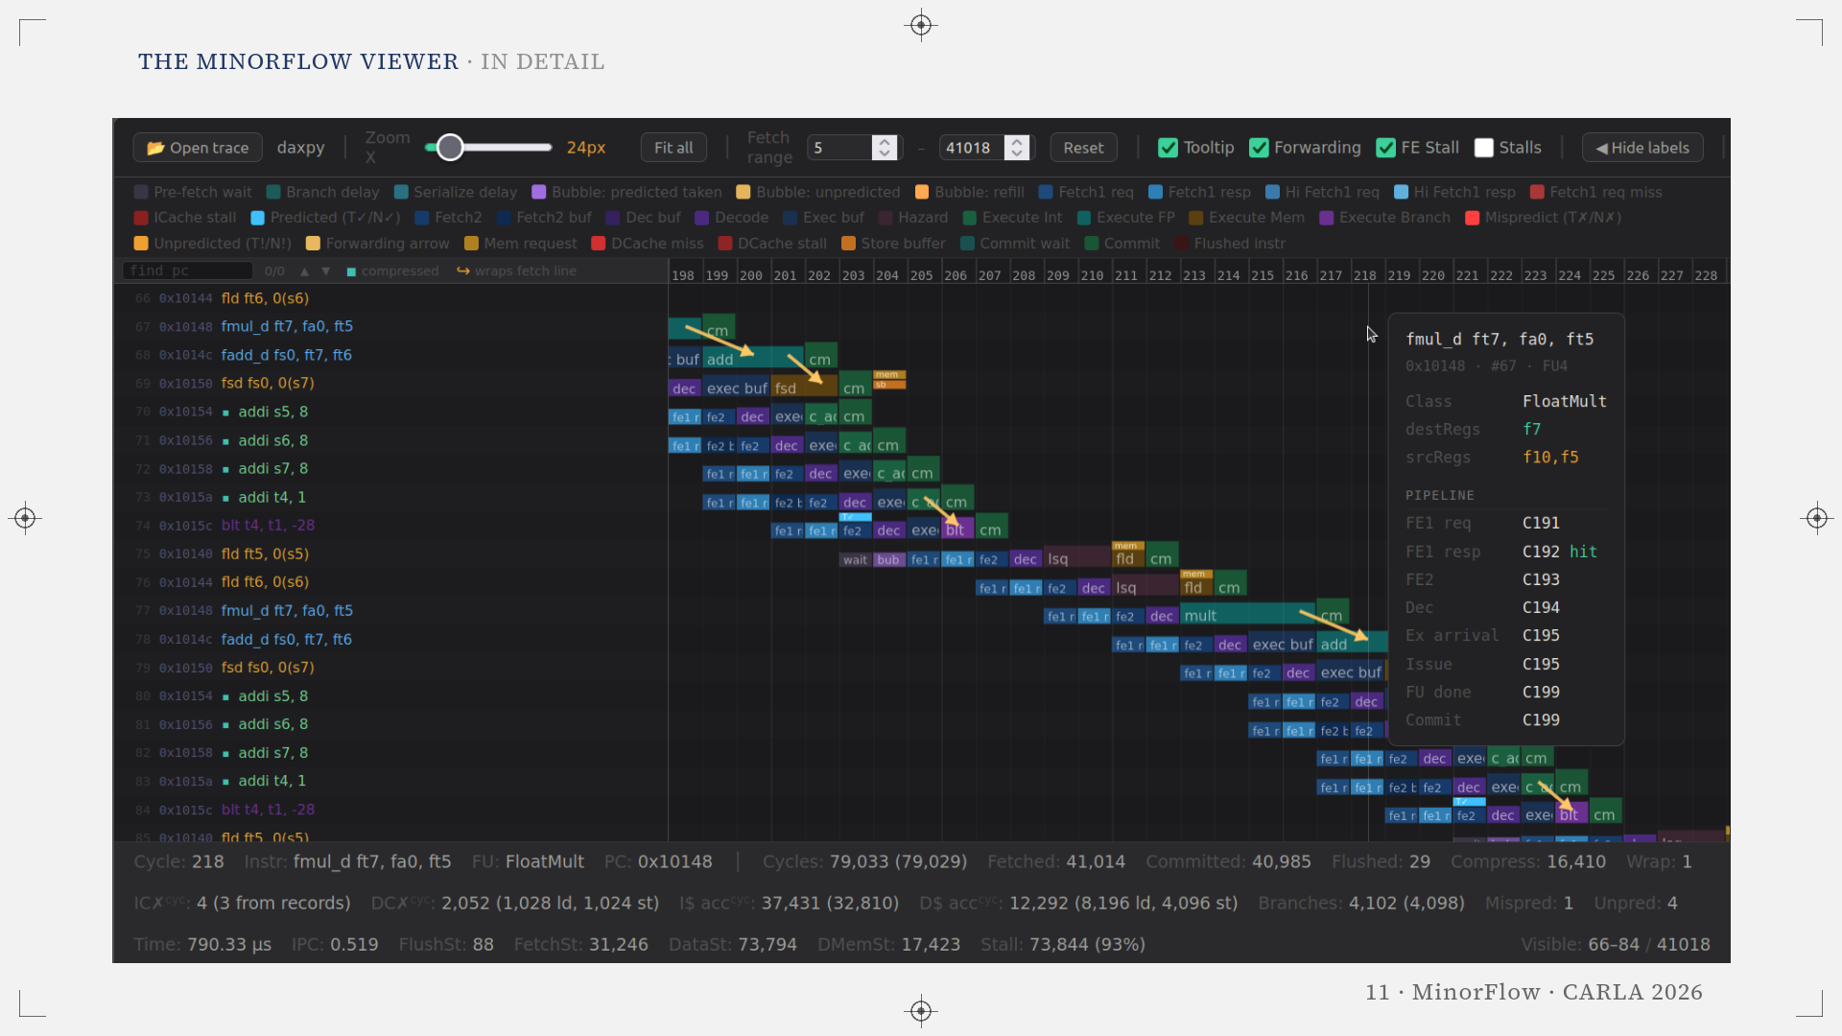
Notes:
Enlarged view of the previous figure: The MinorFlow viewer.

Slide 12
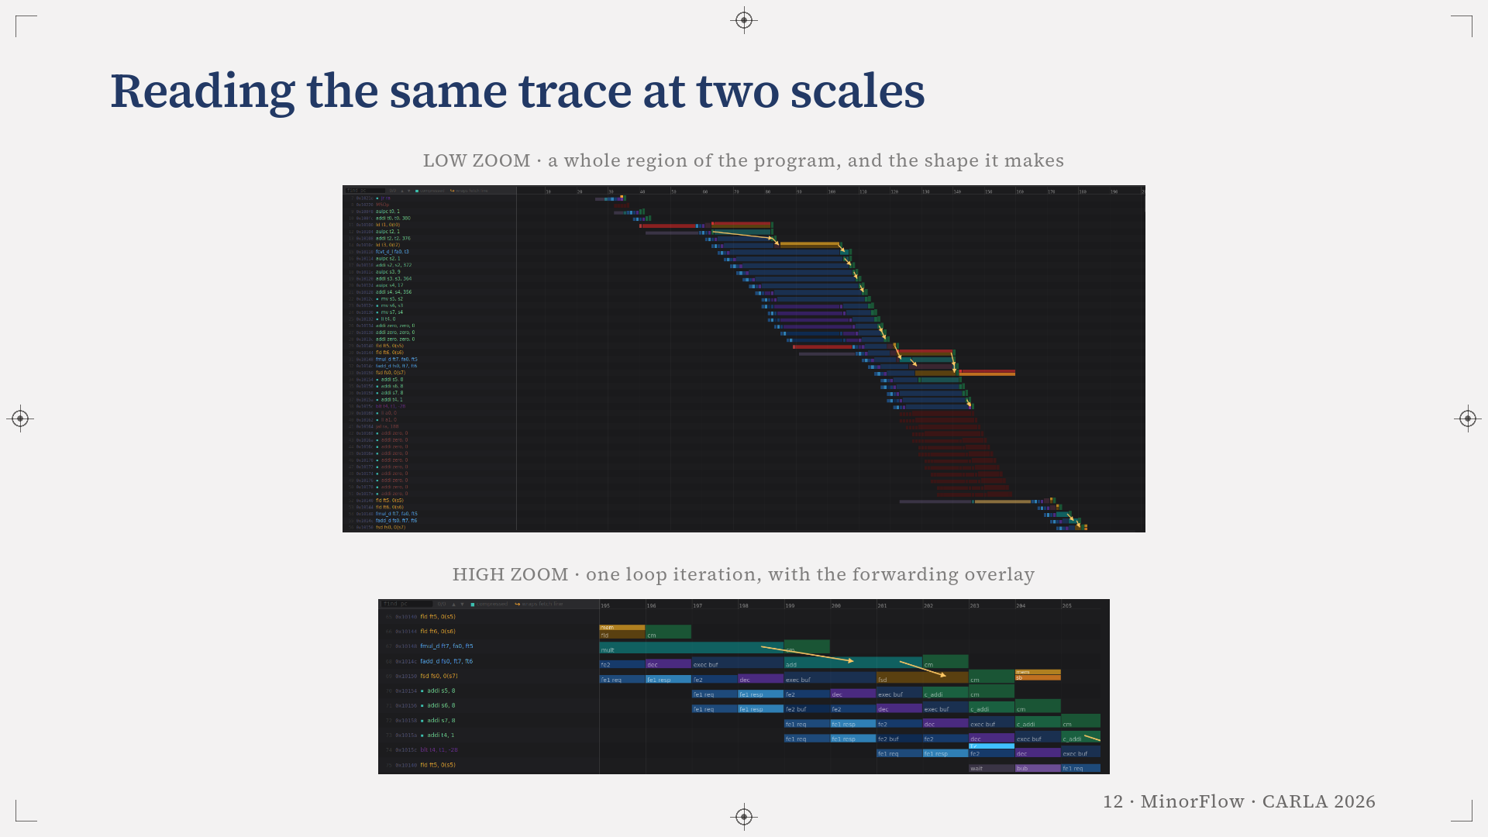
Notes:
The same document read at two zoom levels. At low zoom hundreds of cycles are compressed into one screen, so the staircase of the program and the point where it breaks are visible at a glance. At high zoom each cell widens until the stage labels fit inside their own bar and individual cycles can be counted.

Slide 13
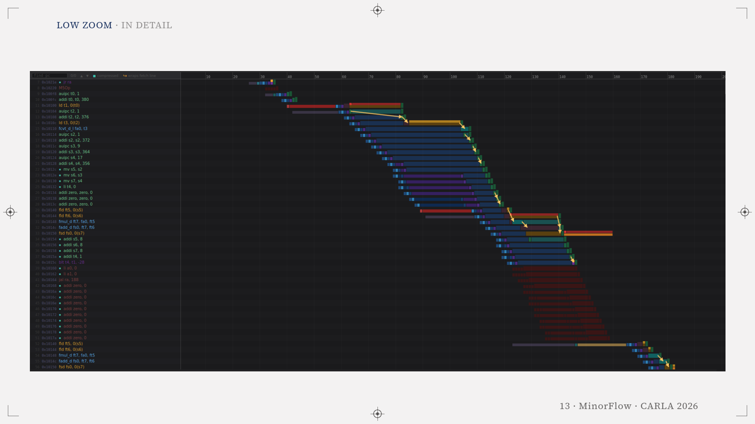
Notes:
Enlarged view of the previous figure: Low zoom.

Slide 14
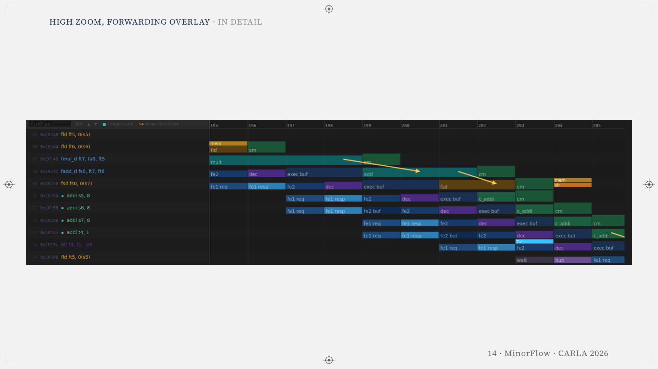
Notes:
Enlarged view of the previous figure: High zoom, forwarding overlay.

Slide 15
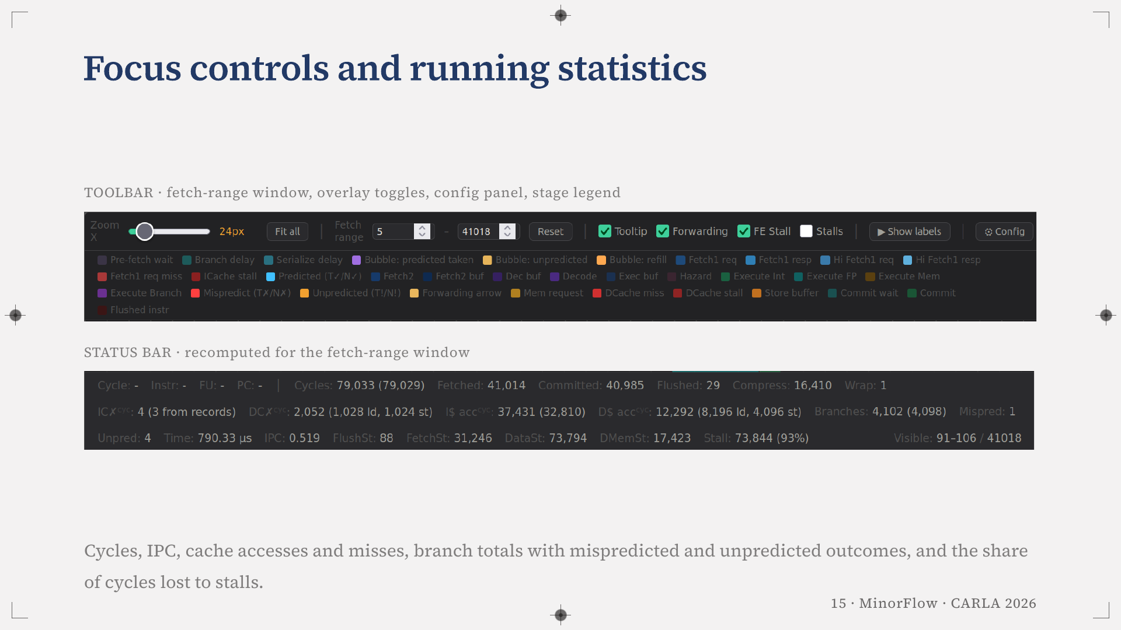
Notes:
Two things keep the viewer usable on traces with tens of thousands of instructions. The toolbar, with a fetch range that limits the rows, the forwarding and tooltip toggles, and a config panel holding the MinorCPU parameters the tracer recovered from the trace. And the status bar, which recomputes for the visible region. It is the same bar we validate against gem5 on the next slide.

Slide 16
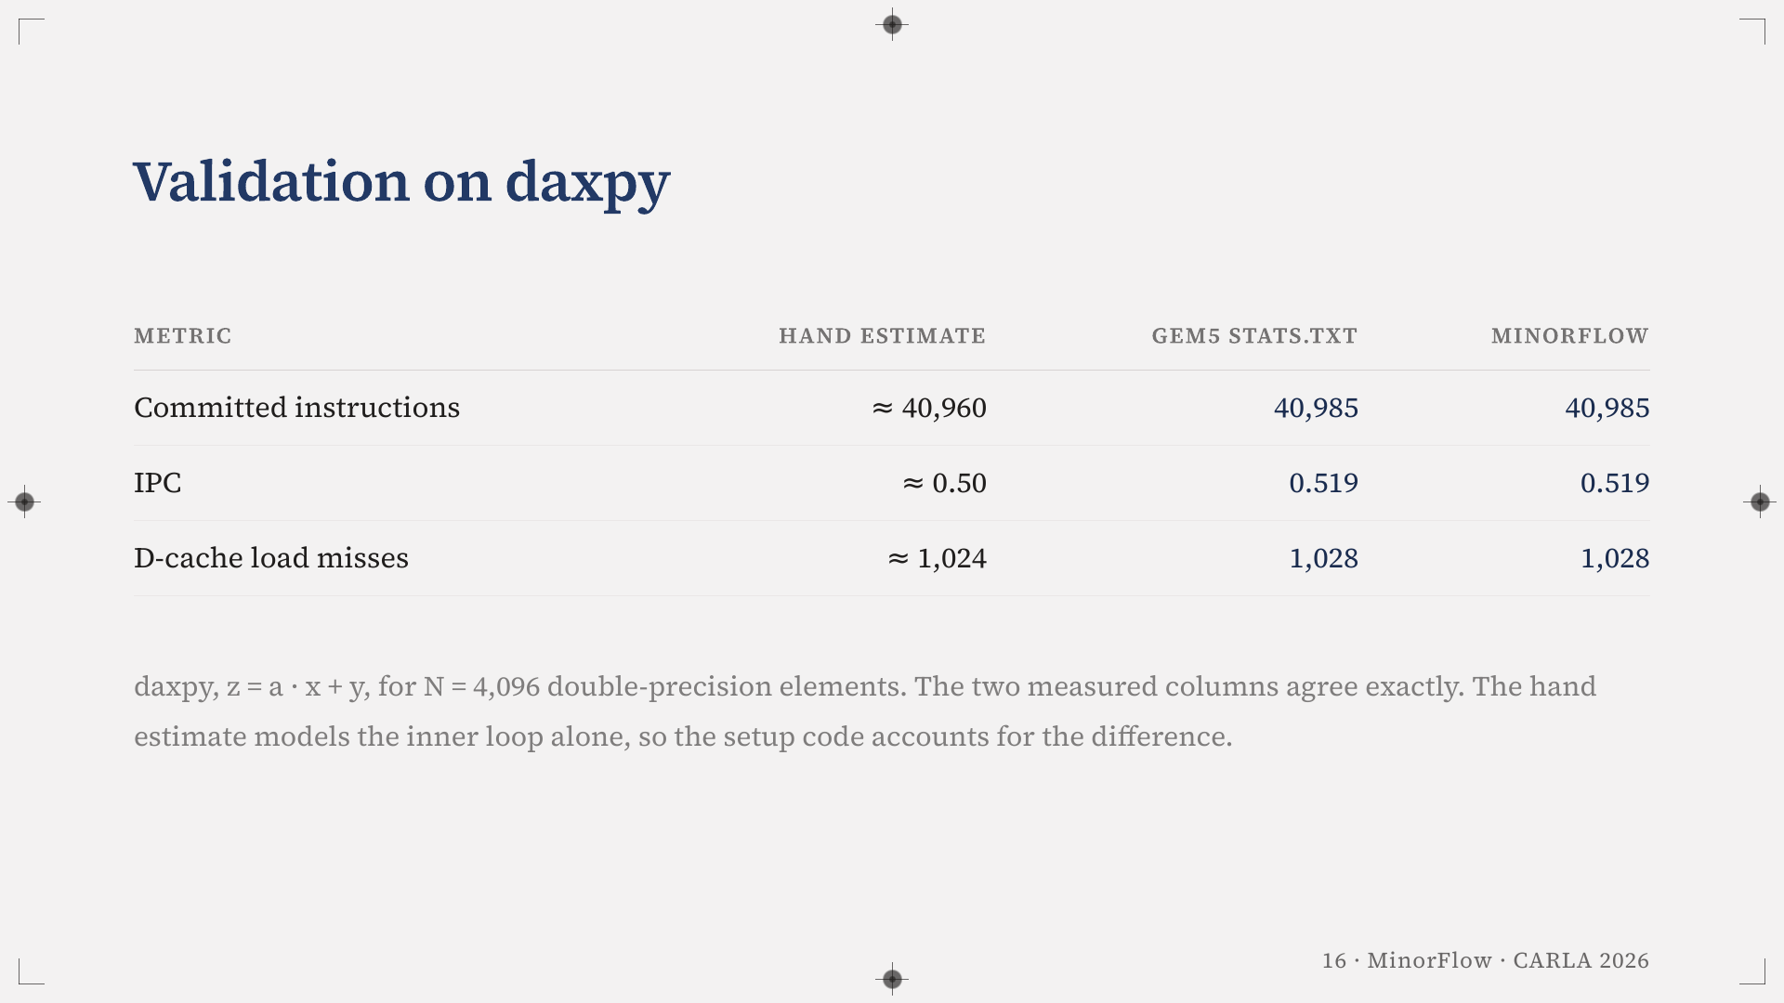
Notes:
We validate the viewer three ways on daxpy with N equal to 4096. A hand estimate from the code, gem5's own stats.txt, and MinorFlow's status bar. The inner loop retires ten instructions per iteration, load-use and floating-point stalls roughly double the per-iteration cost, and the two arrays of 4096 doubles touch 1024 distinct 64-byte lines. The two measured columns agree exactly, which is what the validation is after. The hand estimate models the inner loop only, so the setup code accounts for the difference.

Slide 17
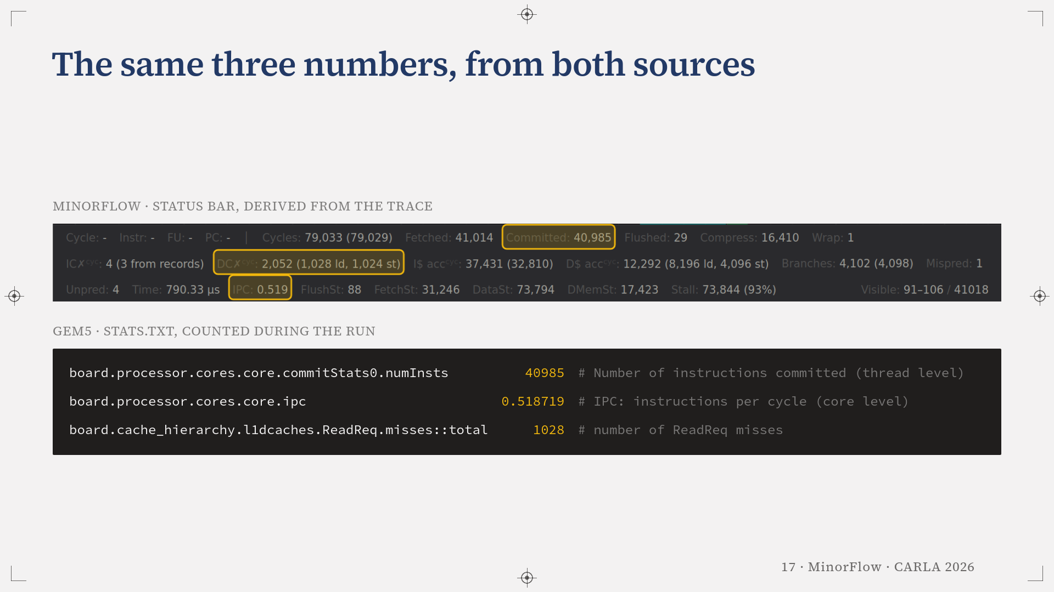
Notes:
Where those two measured columns actually come from. The ringed readings in MinorFlow's status bar are the same three numbers gem5 writes into stats.txt: 40,985 committed instructions, an IPC of 0.519, and 1,028 data-cache read misses. The viewer derives them from the trace, gem5 counts them during the run, and the two agree without adjustment. That is the whole claim of the validation, and it is why the timeline can be trusted for the three cases that follow.

Slide 18
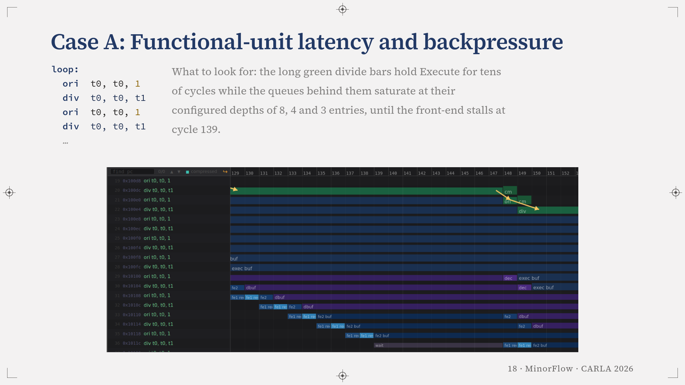
Notes:
Case A, a sequence of consecutive integer divisions. MinorCPU is strictly in-order, so a long-latency unit generates backpressure toward the front-end. You can follow the exact cycle each buffer fills, the Execute queue at eight entries, the Decode buffer at four and Fetch2 at three, and the fetch stall that follows, the grey wait bar at cycle 139. None of this appears in stats.txt.

Slide 19
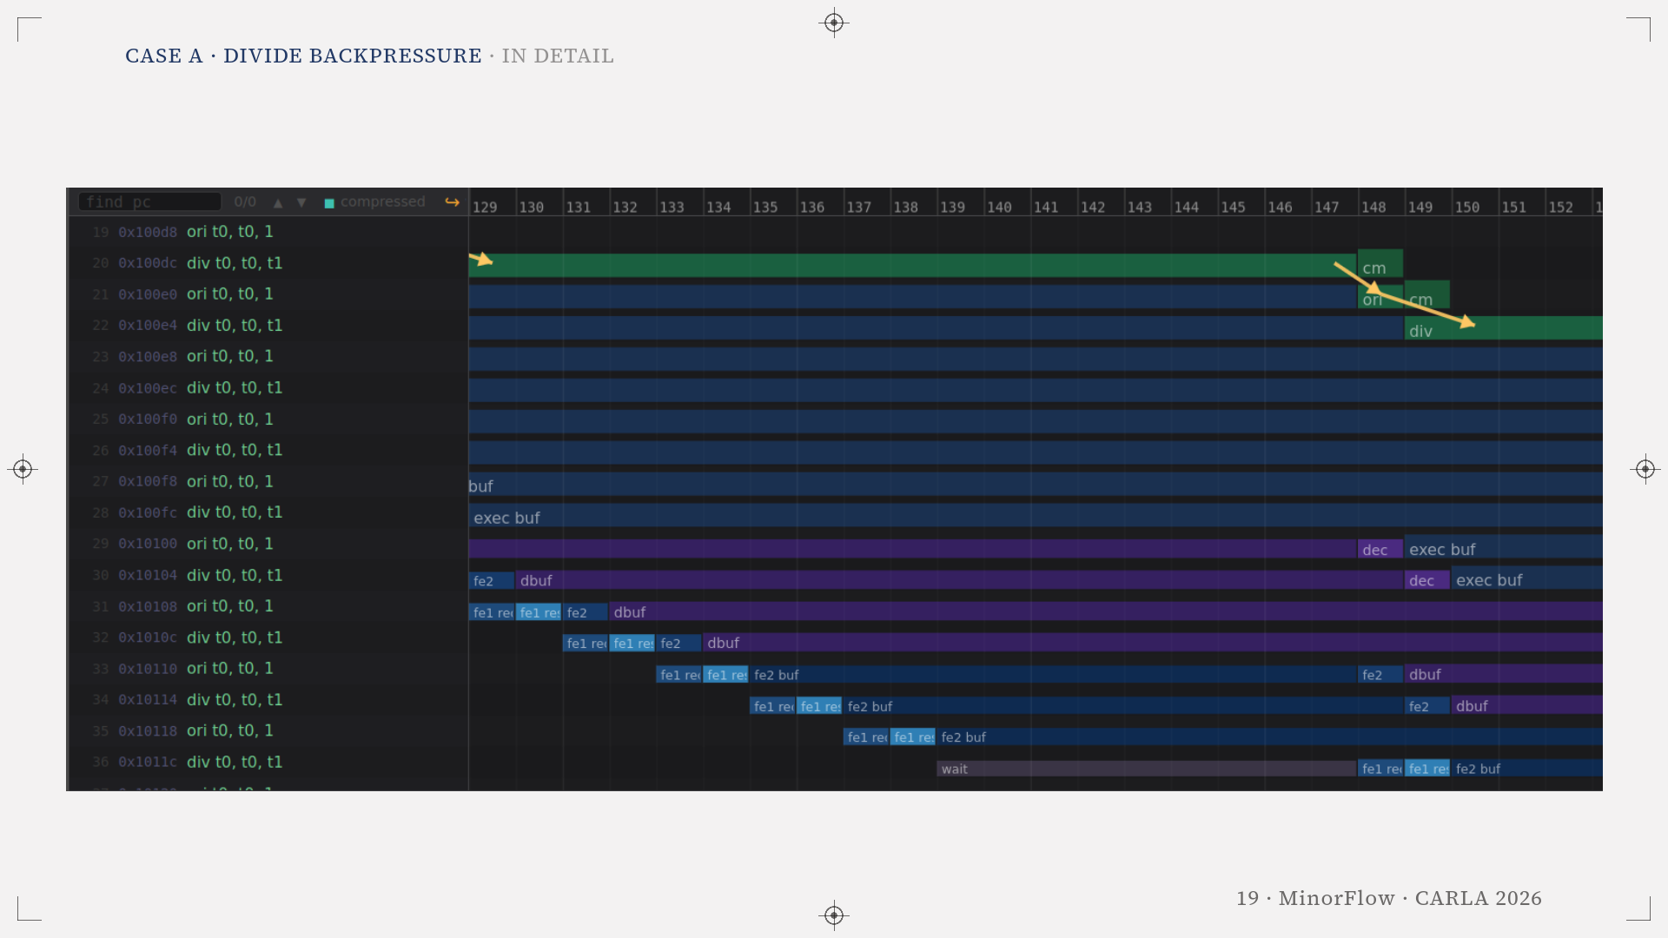
Notes:
Enlarged view of the previous figure: Case A · divide backpressure.

Slide 20
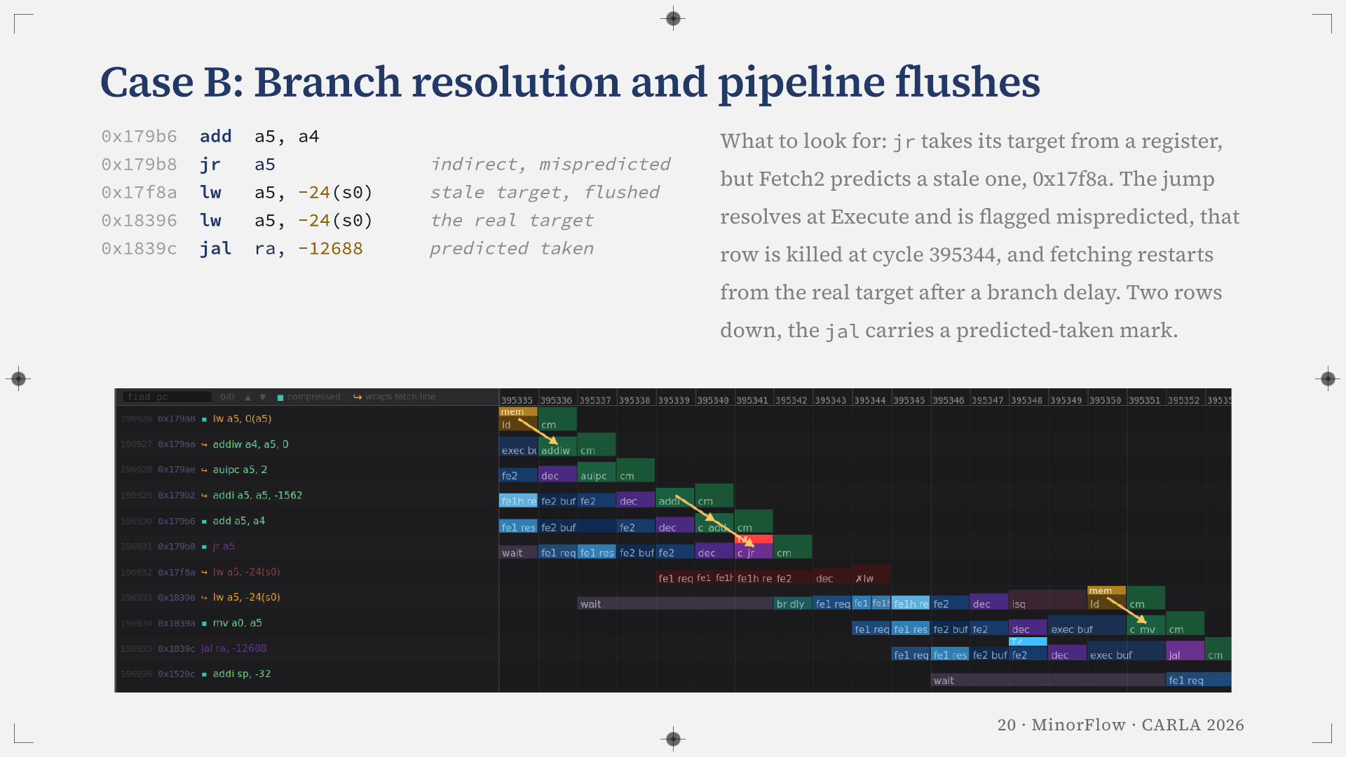
Notes:
Case B, an indirect jump. The target of jr a5 is computed in a register, but the predictor at Fetch2 still holds an earlier target for it, 0x17f8a, and fetch goes there. At Execute the jump resolves to 0x18396, and the red flag marks a prediction that fired and was wrong. The row fetched from the stale target is discarded at cycle 395344, marked with a cross, and fetching restarts from the real target after a branch delay. Two rows below it, the jal at 0x1839c carries a correct predicted-taken flag. MinorFlow colours a wrong prediction red and a missing one orange, so the two kinds of flush can be told apart.

Slide 21
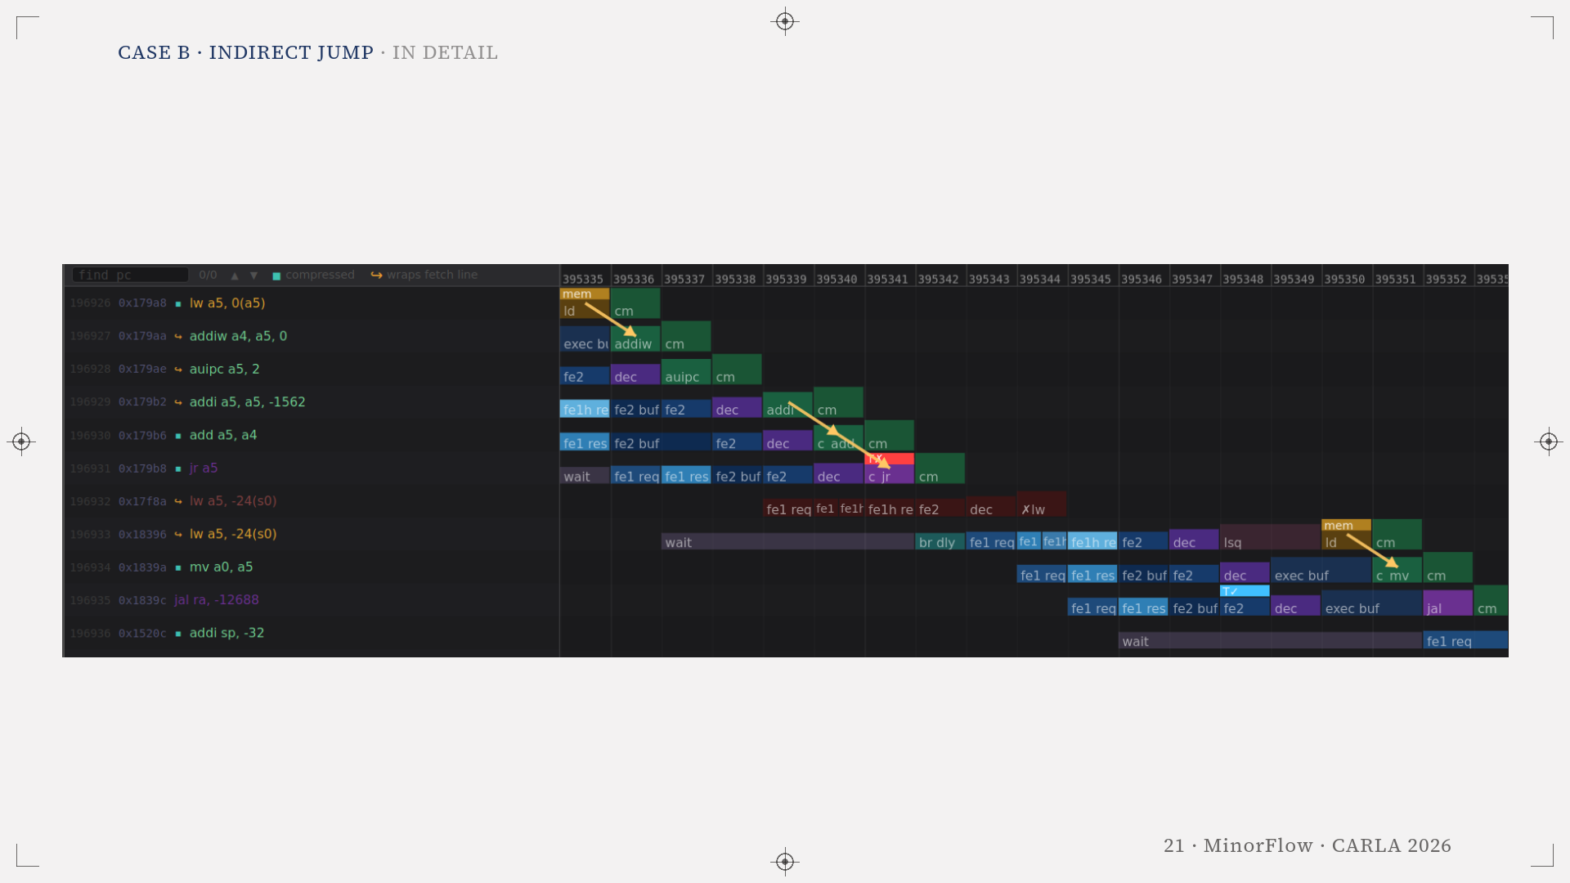
Notes:
Enlarged view of the previous figure: Case B · indirect jump.

Slide 22
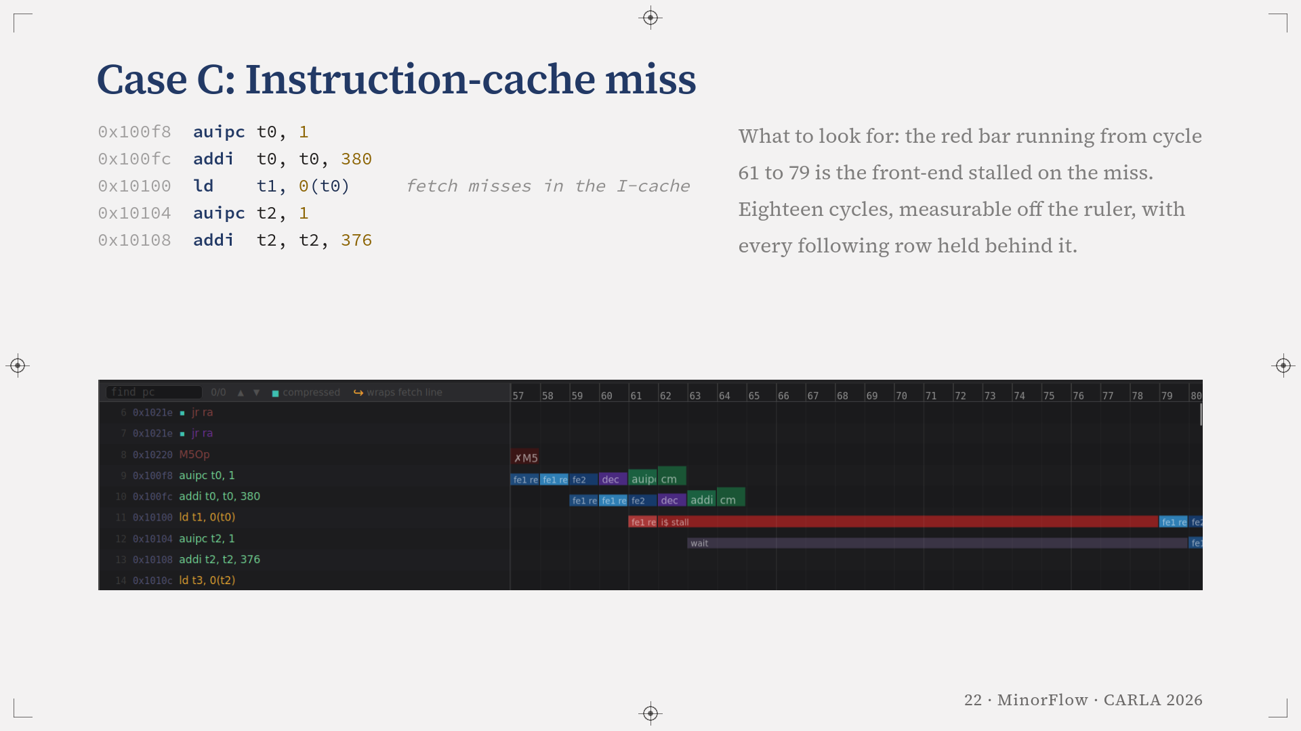
Notes:
Case C is the simplest and the one students read fastest. Fetch1 requests the instruction at 0x10100 in cycle 61 and misses in the L1 instruction cache. The red bar is the stall. The line arrives at cycle 79, eighteen cycles later, and every row below waits behind it. The point is that the duration is measured off the diagram rather than inferred from a miss counter.

Slide 23
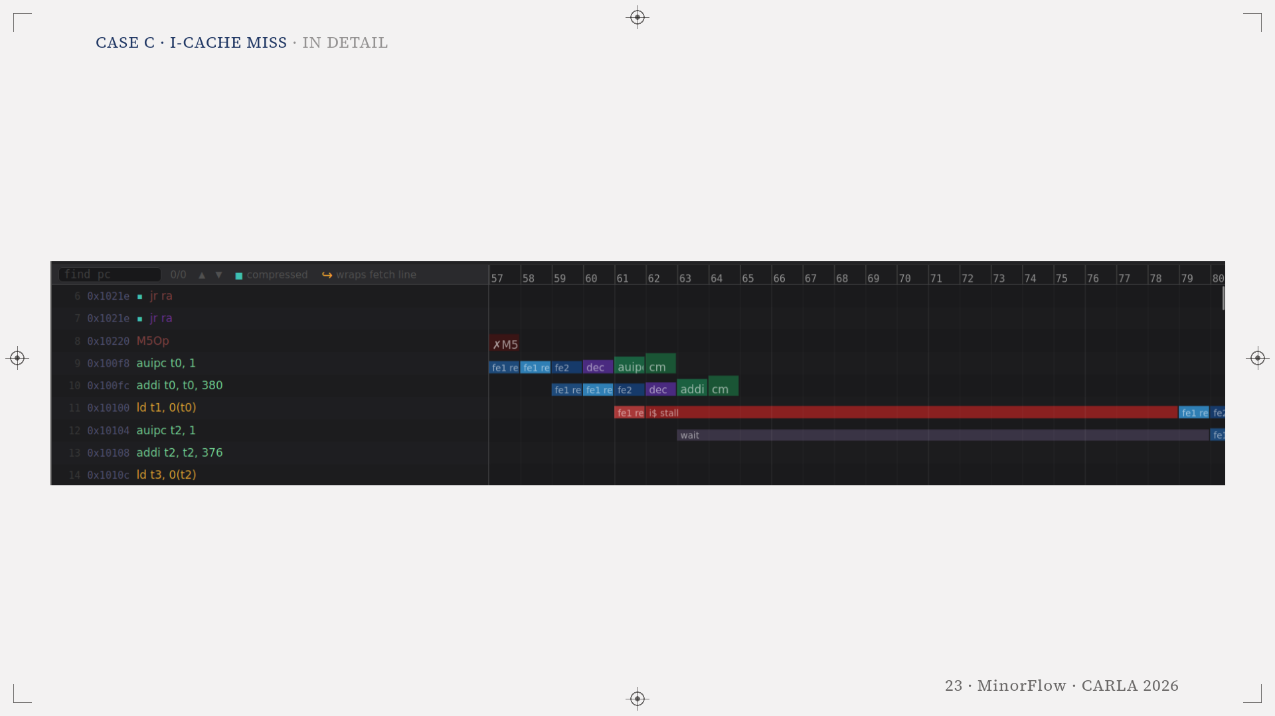
Notes:
Enlarged view of the previous figure: Case C · I-cache miss.

Slide 24
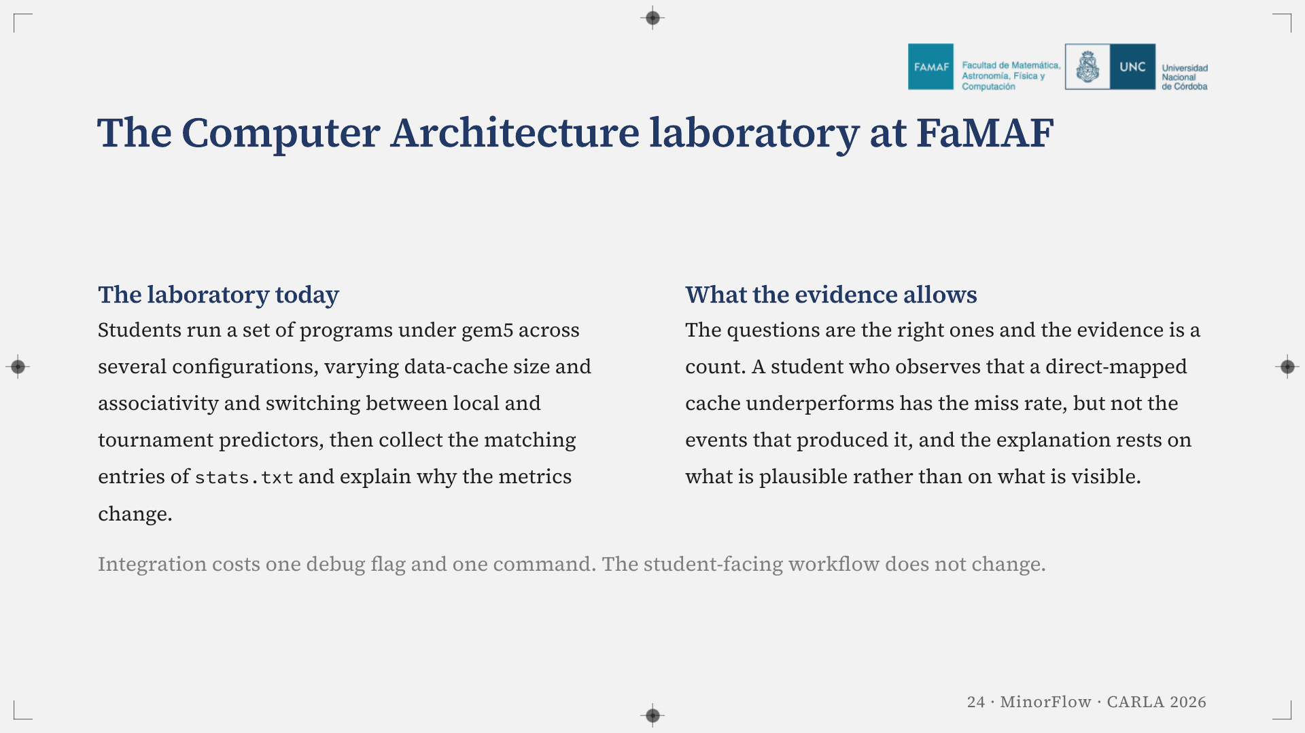
Notes:
The second laboratory of the Computer Architecture course at FaMAF already asks the right question, not which configuration is faster but why the metrics change. What students have to answer it with is a pair of numbers. Integration costs one debug flag and one command, and the student-facing workflow does not change.

Slide 25
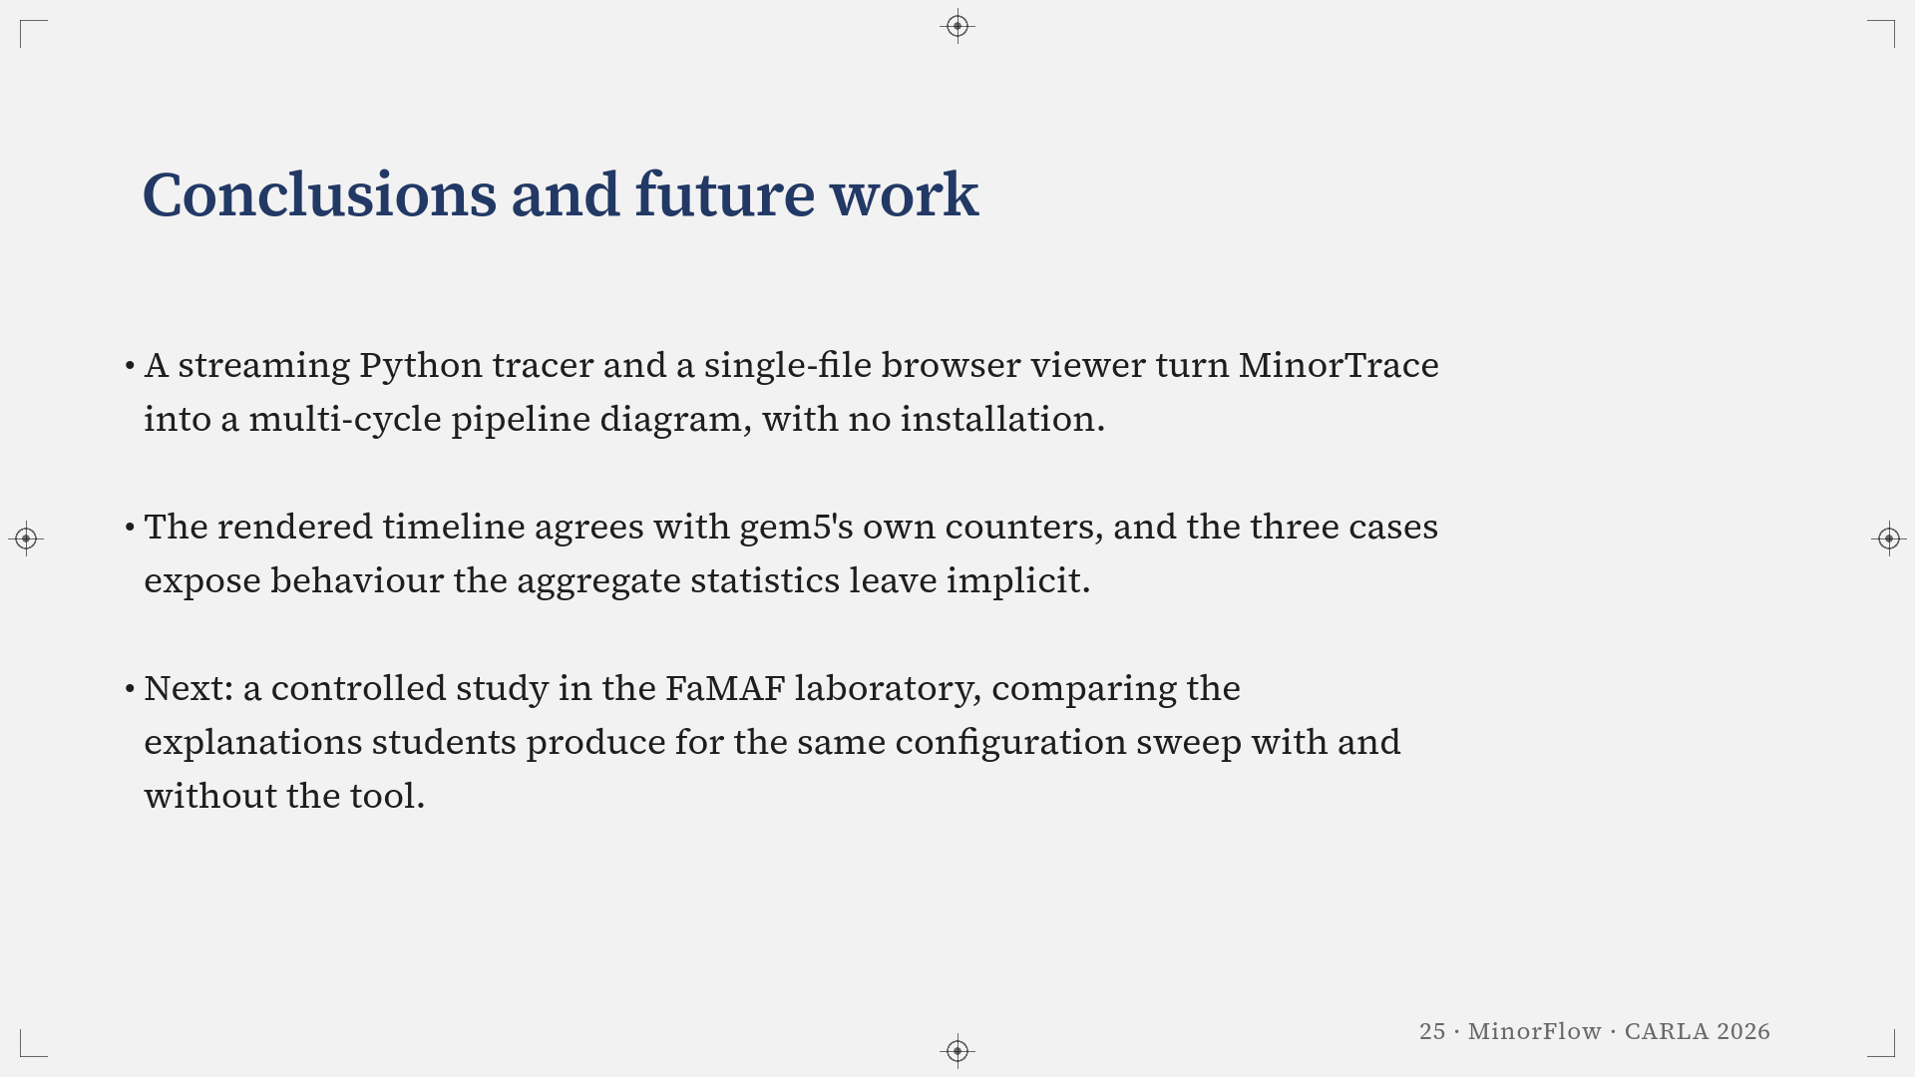
Notes:
MinorFlow is a streaming Python tracer plus a single-file viewer that runs in the browser, with no installation and no dependencies (assuming gem5 is already installed). Its metrics match gem5's counters and the three cases show behaviour the aggregates leave implicit.
What we want to do next is measure the pedagogical claim rather than assert it. A controlled study in that laboratory, comparing the explanations students produce for the same configuration sweep with and without the tool.

Slide 26

Notes:
Thank you. The tool is open source and the repository is on screen. We are happy to take questions.

