Slide 1
AI bracelet for health monitoring
Gladkykh Daria, Fateme Hosseini

Slide 2
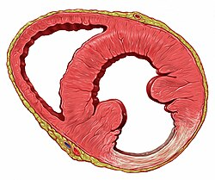
Definition of Heart Sclerosis (Cardiosclerosis)
Heart sclerosis (or cardiosclerosis) is a pathological condition characterized by the replacement of healthy heart muscle (myocardium) with fibrous or scar tissue.
It commonly results from:
Myocardial infarction (heart attack)
Chronic ischemia
Myocarditis (inflammation)
Degenerative aging processes
This scarring impairs the heart’s mechanical and electrical functions, leading to serious clinical manifestations.
What We’ve Done So Far

Slide 3
Main Objective
To develop an AI-powered system that can detect early signs of heart sclerosis using continuous, non-invasive physiological data collected from a smart bracelet.
What We’ve Done So Far
The system will analyze patterns in heart rate variability (HRV), pulse waveform morphology, activity levels, and other biosignals to identify anomalies associated with myocardial fibrosis.

Slide 4
Secondary Objectives
Develop software to collect and stream real-time sensor data from the smart bracelet (T-Watch S3 Plus + MAX30102 PPG sensor).
Conduct a pilot study to gather a dataset from volunteers (including healthy individuals and those with known cardiac conditions).
Train and validate an AI/ML model capable of flagging potential indicators of heart sclerosis based on wearable-derived metrics.
Correlate clinical symptoms of cardiosclerosis with measurable biosignals from wearable sensors (see next slide).
What We’ve Done So Far

Slide 5
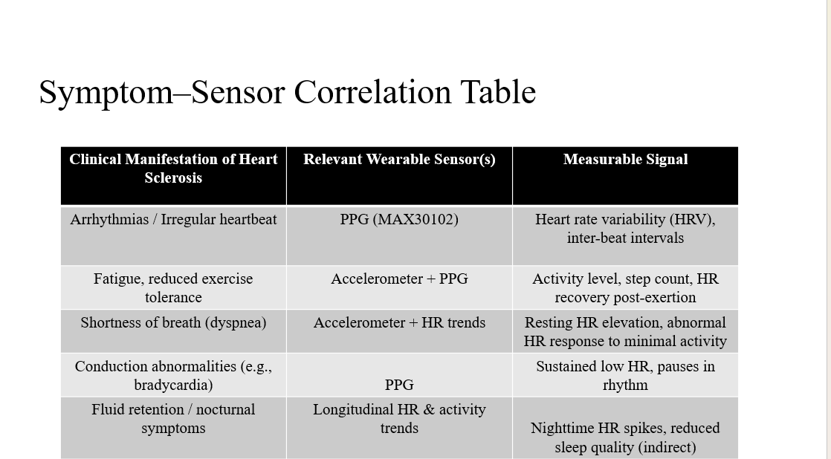

Slide 6
Relevance & Societal Impact
Early detection: Enables timely intervention before heart failure develops.
Accessibility: non-invasive monitoring for at-risk populations (e.g., post-MI patients, elderly).
Preventive healthcare: Continuous monitoring supports proactive management of cardiac health.
What We’ve Done So Far

Slide 7
What We’ve Done So Far
Ordered the T-Watch S3 Plus (main device)(link)
Received the MAX30102/20 PPG heart sensor (ready to go!)
Planned hardware integration:
→ Connect sensor to watch via I²C (community examples available)
→ Watch supports custom modules → ideal for our use case
What We’ve Done So Far
What We’ve Done So Far
We’re confident we can interface these two — sensor outputs I²C-compatible data, and the T-Watch has accessible GPIO pins + Arduino support.

Slide 8
How It Will All Work Together
Hardware Layer:
Sensor → I²C → T-Watch → Wi-Fi/Bluetooth → Server
Firmware (T-Watch):
Read raw PPG signal
Preprocess: filter noise, average readings
Send cleaned HR data as JSON over network
What We’ve Done So Far
What We’ve Done So Far
Backend & Cloud:
Python Flask/FastAPI server receives data
Store in SQLite/PostgreSQL
AI/ML anomaly detection later
Future Visualization:
Web dashboard (React/HTML+JS) for real-time HR + alerts

Slide 9
What We’re Doing Now (While Waiting for Bracelet)
Immediate Next Steps:
Set up development environment: PlatformIO / Arduino IDE for T-Watch
Test sensor with breadboard + Arduino Uno (validate I²C comms)
Write basic firmware to read sensor → display on watch screen
Mock data transmission to local server (test API endpoints)
What We’ve Done So Far

