Slide 1
AI bracelet for health monitoring
Gladkykh Daria, Fateme Hosseini

Slide 2
Definition of Heart Sclerosis (Cardiosclerosis)
Heart sclerosis is a pathological condition characterized by the replacement of healthy heart muscle (myocardium) with fibrous or scar tissue
Commonly results from: Myocardial infarction (heart attack), Chronic ischemia, Myocarditis (inflammation), Degenerative aging processes
This scarring impairs the heart's mechanical and electrical functions, leading to serious clinical manifestations

Slide 3
Main Objective
- To develop an AI-powered system that can detect early signs of heart sclerosis using continuous, non-invasive physiological data collected from a smart bracelet.
- The system will analyze patterns in heart rate variability (HRV), pulse waveform morphology, activity levels, and other biosignals to identify anomalies associated with myocardial fibrosis.

Slide 4
Secondary Objectives
Develop software to collect and stream real-time sensor data from the smart bracelet (T-Watch S3 Plus + MAX30102 PPG sensor)
Conduct a pilot study to gather a dataset from volunteers (including healthy individuals and those with known cardiac conditions)
Train and validate an AI/ML model capable of flagging potential indicators of heart sclerosis based on wearable-derived metrics
Correlate clinical symptoms of cardiosclerosis with measurable biosignals from wearable sensors

Slide 5
Relevance & Societal Impact
Early detection: Enables timely intervention before heart failure develops
Accessibility: Non-invasive monitoring for at-risk populations (e.g., post-MI patients, elderly)
Preventive healthcare: Continuous monitoring supports proactive management of cardiac health

Slide 6
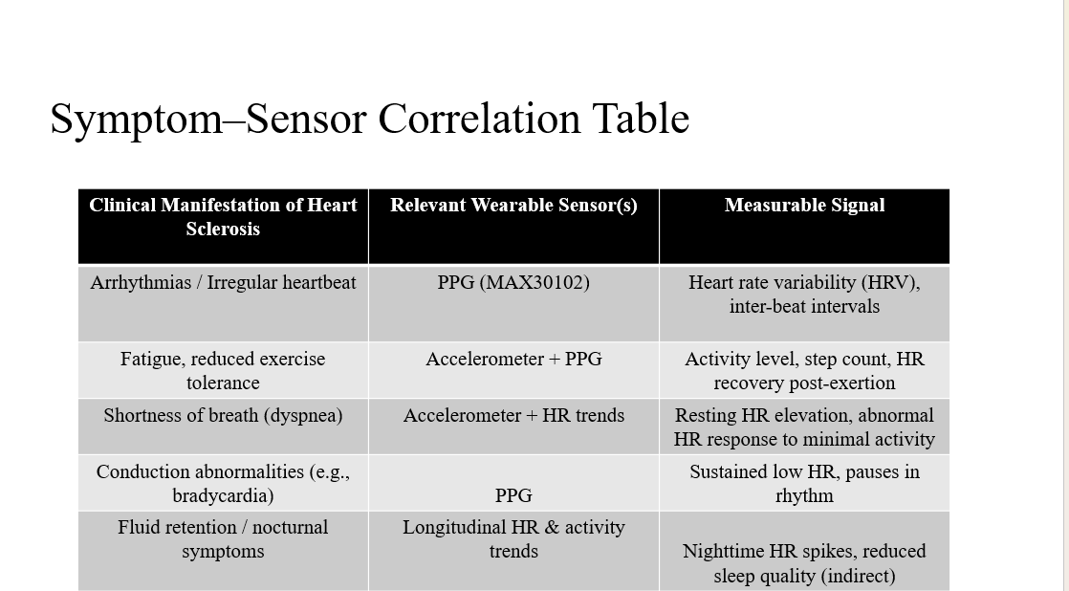

Slide 7
What We've Done This Week

Slide 8
Dataset Research & AI Development
Conducted extensive research on publicly available PPG, HRV, and Accelerometer datasets.
Identified a multi-tier strategy prioritizing Foundation Training PulseDB followed by Motion Artifact Handling PPG-DaLiA.
Began setup and preprocessing of the PulseDB foundation dataset in parallel with hardware integration to maximize model training efficiency.
Plan to transition to our own collected data once the wrist-worn hardware is operational to fine-tune the final classification model.

Slide 9
AI/ML DATASET STRATEGY
Category | Dataset | Size / Key Feature | Justification for Use
Foundation Training (Phase 1) | PulseDB (MIMIC-III/VitalDB Derivative) | 5,361 subjects / 5.2 Million pre-cleaned 10-s segments of ECG, PPG, ABP. | ML-Ready Baseline: Used to train the initial feature extractor and the first disease classifier using linked MIMIC-III heart failure labels.
Motion Artifact Handling (Phase 2) | PPG-DaLiA + WESAD/WildPPG | 136+ subjects with synchronized wrist PPG and 3-axis ACC. | Noise Resilience: Enables the implementation of synthetic augmentation to adapt the baseline model to the high motion noise of our wrist-worn device.
Disease Labels & Validation (Phase 3) | MIMIC-III Derived Cohort + Our Pilot Data | Clinical labels for 682 Heart Failure patients and 954 controls. | Ground Truth Proxy: Provides a proven clinical endpoint Heart Failure as the best available proxy for detecting early-stage myocardial fibrosis.

Slide 10
IMPLEMENTATION ROADMAP: THE 3-PHASE PIPELINE
Phase | Focus & Goal | Key Task & Dataset(s) | Deliverable
Phase 1: Foundation & Classification (Current Focus) | GOAL: Establish the ideal feature extraction and initial disease detection logic. | Train on PulseDB and label a subset using the MIMIC-III Derived HF Cohort. | Initial Disease Classifier & Feature Extractor
Phase 2: Motion Artifact Handling | GOAL: Adapt the Phase 1 model for real-world wrist-worn usage. | Implement Synthetic Augmentation using ACC data from PPG-DaLiA. | Motion Artifact Removal Module (Model is now wrist-robust)
Phase 3: Final Validation & Deployment | GOAL: Test the motion-robust model against custom data and finalize performance metrics. | A) Collect Our Pilot Data. B) Fine-tune and validate against the HF cohort. | Final Binary Classification Algorithm for Heart Sclerosis Risk

Slide 11
Hardware Progress
T-Watch S3 Plus - Received & Setup in Progress
Successfully received the T-Watch devices
Configuring the built-in accelerometer for activity tracking and movement detection(in progress)
Integrating external MAX30102 PPG sensor for heart rate monitoring (in progress)
Sensor placement: Mounted on wrist underside (radial artery position) via I²C connection with proper shielding and strain relief for 48-hour continuous wear (only on paper)

Slide 12
Power Management Solution
Extended Battery Life Strategy
Challenge: Continuous WiFi transmission drains battery too quickly for 48-hour monitoring
Solution: Local data storage on device memory during the entire monitoring period
Data transfer: After 48 hours, patient uses WiFi to upload all collected data to server in one session
Result: Bracelet operates for full 48 hours without recharging, ensuring uninterrupted diagnostic data collection

