Slide 1
AI bracelet for health monitoring
Gladkykh Daria, Fateme Hosseini

Slide 2
Our Main Objective
To develop an AI-powered system that can detect early signs of heart sclerosis using continuous, non-invasive physiological data.
The system will analyze patterns in Heart Rate Variability (HRV), pulse waveform, and activity levels from a smart bracelet to identify anomalies.
Today's Update: We will show you the results of our foundational AI model and our hardware progress.

Slide 3
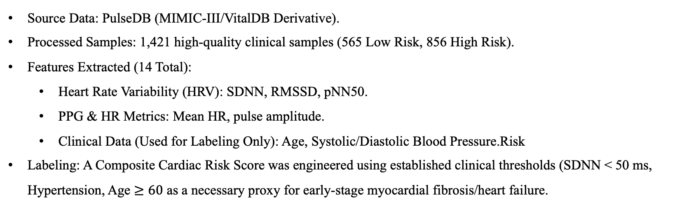
AI Development: What We Accomplished
Source Data: PulseDB (MIMIC-III/VitalDB Derivative).
Processed Samples: 1,421 high-quality clinical samples (565 Low Risk, 856 High Risk).
Features Extracted (14 Total):
  Heart Rate Variability (HRV): SDNN, RMSSD, pNN50.
  PPG & HR Metrics: Mean HR, pulse amplitude.
  Clinical Data (Used for Labeling Only): Age, Systolic/Diastolic Blood Pressure.Risk
Labeling: A Composite Cardiac Risk Score was engineered using established clinical thresholds (SDNN < 50 ms, Hypertension, Age $≥60$ as a necessary proxy for early-stage myocardial fibrosis/heart failure.

Slide 4
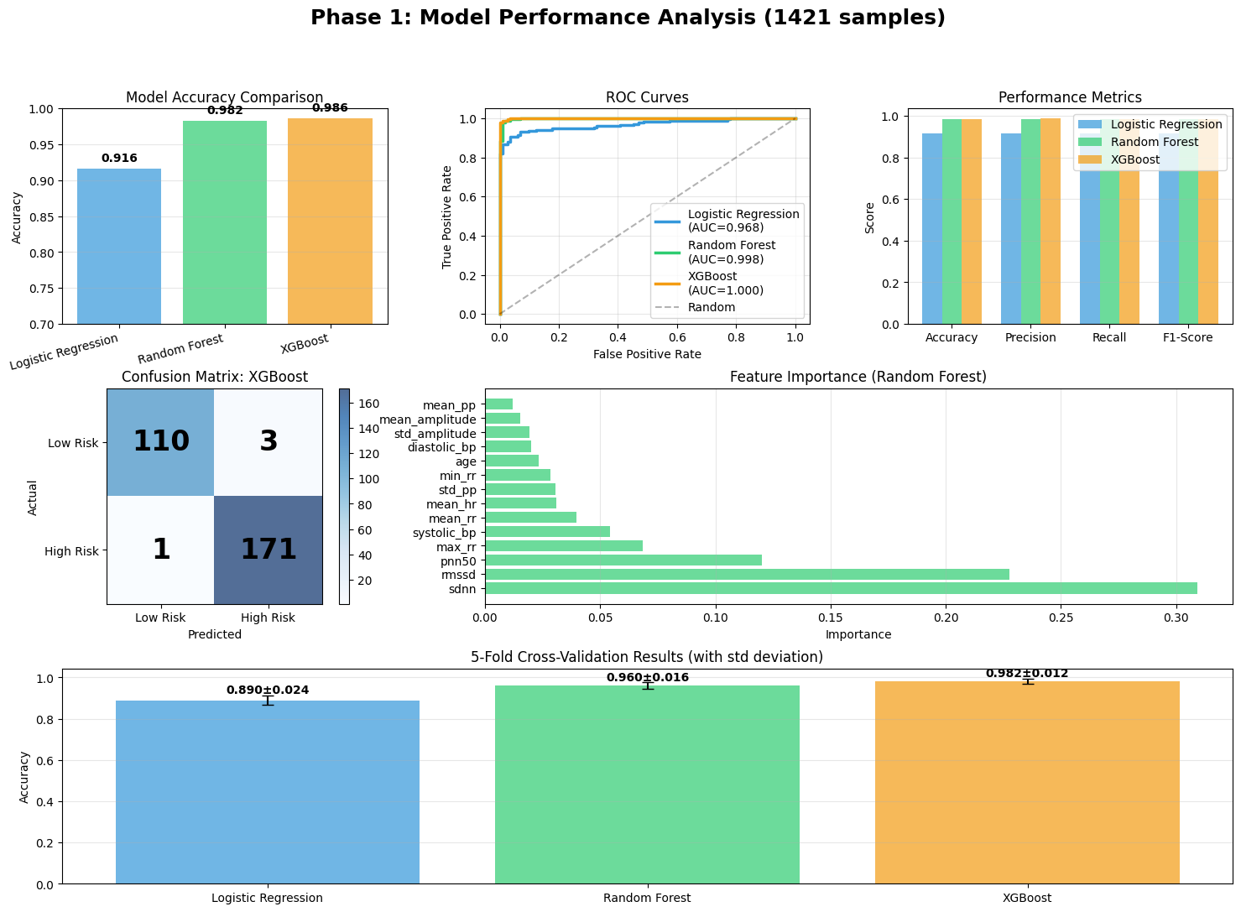
Model Performance: Selecting the Best Algorithm
We evaluated three models based on their performance on the held-out test dataset. XGBoost was selected for its superior performance and stability.
Model | Accuracy (on Test Data)
Logistic Regression | 91.6%
Random Forest | 98.2%
XGBoost (Selected) | 98.6%
Conclusion: We are moving forward with the XGBoost model as our foundational classifier.

Slide 5
Clinical Validation & Error Analysis
Focus: High Sensitivity is critical for a screening tool to minimize missed cases.
XGBoost Metrics (on Unseen Test Set, n=285):
  Sensitivity: 99.4% (171 True Positives / 172 Actual High-Risk Cases).
  Specificity: 97.3% (110 True Negatives / 113 Actual Low-Risk Cases).
Error Breakdown (Confusion Matrix):
  Only one False Negative (a missed high-risk case) was observed out of 172.
Implication: This low false-negative rate confirms a strong potential for reliably flagging at-risk individuals for further clinical review.

Slide 6
Validation: Testing for Generalization
Objective: To ensure the model is stable and not biased by the original clinical sensor setup.
Test 1: K-Fold Cross-Validation (Stability):
  Accuracy: 0.982 ± 0.012. Low standard deviation confirms high stability and reproducibility.
Test 2: Cross-Dataset Generalization (Invariance):
  Trained on MIMIC -> Tested on VitalDB. Maintained high performance (~92.0% accuracy).
Implication: The model learned fundamental physiological markers, not just measurement artifacts, making it a viable candidate for the wrist sensor.

Slide 7
Critical Test: Separating Wearable Features from Clinical Data
Objective: Validate that the model is not dependent on the clinical features (Age/BP) that the bracelet cannot measure.
Circular Reasoning Test: We trained a new XGBoost model EXCLUDING all clinical metadata (Age, BP, and all HRV features that defined the label). We used only the independent PPG morphology features.
Result:
  Accuracy (Full Model): 98.6%
  Accuracy (Independent PPG Features Only): 94.4%
Implication: The core PPG-derived features alone remain highly predictive, losing only 4.2% accuracy. This validates our focus on the wrist-sensor data.

Slide 8
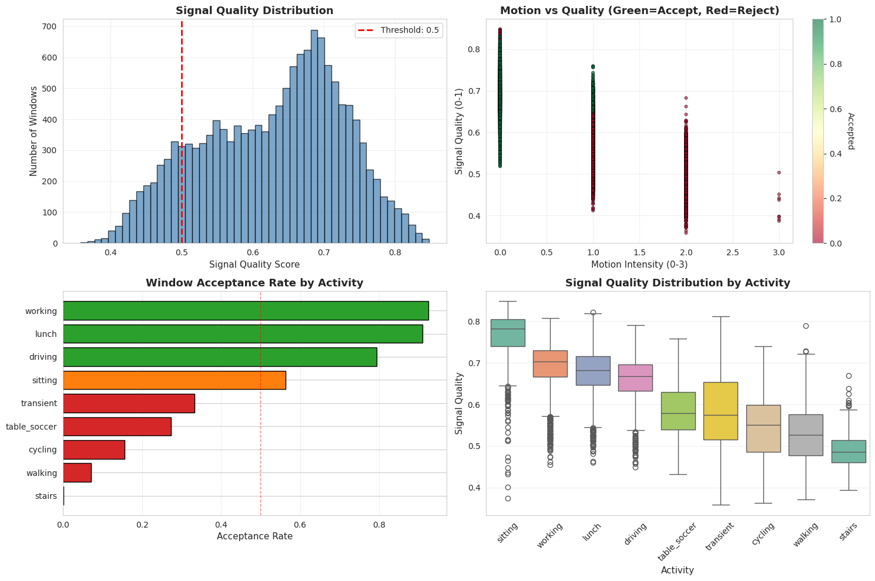
Phase 2 Dilemma: The Challenge of Real-World Motion
Goal of Phase 2: Make the model robust to motion artifacts.
New Finding (PPG-DaLiA Exploration): Our current high-quality filtering rejects 44.6% of data windows due to motion.
The Dilemma: Option 1 (Current):
  Reject all motion. Keeps 98% accuracy for sedentary times.
  Option 2 (Desired): Accept all motion. Achieves 24/7 coverage, but severely compromises HRV validity and lowers accuracy.
Solution: Hybrid (Dual-Model) ArchitectureWe will train two specialized models and use the accelerometer to smartly switch between them, ensuring high confidence when stationary and continuous coverage when moving.

Slide 9
Next Steps
Task 1: Finish High-Confidence Model (Current Focus)
  Complete processing all 15 subjects using strict quality filtering.
  Deliverable: A model with >97\% accuracy used only during stationary periods (e.g., sitting, sleeping).
Task 2: Build Motion-Robust Pipeline
  Relax quality filtering using the PPG-DaLiA dataset.
  Train a second model using motion-safe features (basic HR, PPG morphology) and exclude unreliable HRV features.
Task 3: Implement Smart Switching
  Develop logic to use accelerometer data to select the appropriate model and assign a Confidence Score to every prediction.
Final Goal: Combine the motion-robust AI with our custom hardware to create the final, deployable system3

Slide 10
Hardware Progress Update
Accelerometer + Heart Rate Sensor (PPG – MAX30102)
They did obtain clean, synchronized data
tried to connect the heart rate sensor directly to the T-Watch S3 Plus - devices detect each other but still we need to have improvements on this, because its not possible to wear for now. Most probably we will work with the constractions.
Server Side (Data Collection):
Developing starts for the a lightweight app running on laptop to act as a temporary server. So we r able to have the watch connects (one-time pairing) and sends buffered data when enough samples are collected.
Next Steps:
Optimize connection communication for smooth, automatic reconnection.
To create a user friendly design for the watches so they could really be wearable.
Implement buffering and timestamp synchronization between accelerometer and PPG.
Clean and structure signals for later correlation (e.g., HRV, activity trends, HR spikes).

