Slide 1
AI bracelet for health monitoring
Gladkykh Daria, Fateme Hosseini

Slide 2
Main Objective
To develop an AI-powered system that can detect early signs of heart sclerosis using continuous, non-invasive physiological data collected from a smart bracelet.
The system will analyze patterns in heart rate variability (HRV), pulse waveform morphology, activity levels, and other bio-signals to identify anomalies associated with myocardial fibrosis.
Today’s Update: We started implementing the flutter app and finding solutions for the server and data transition

Slide 3
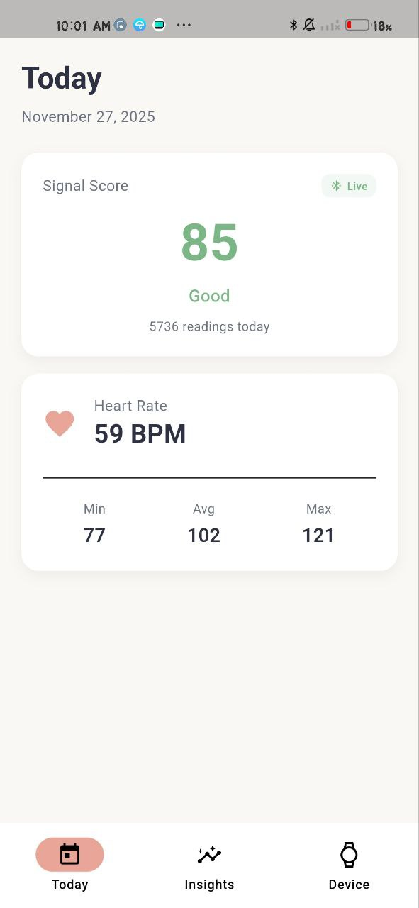
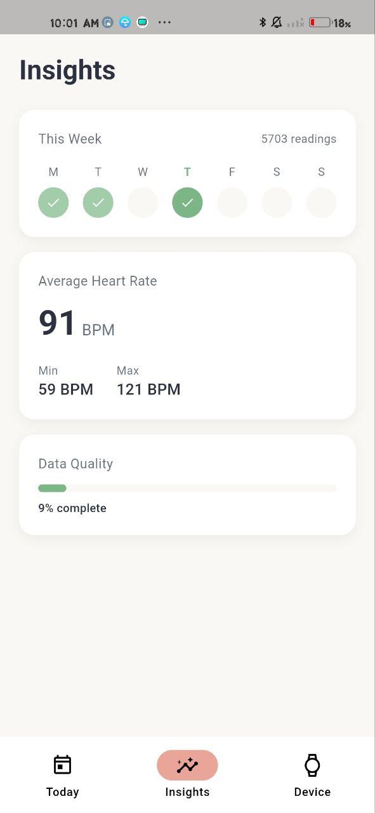
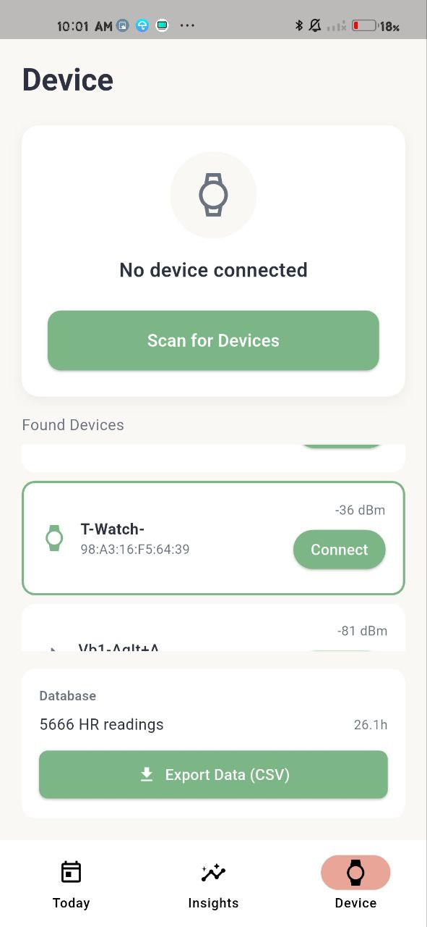
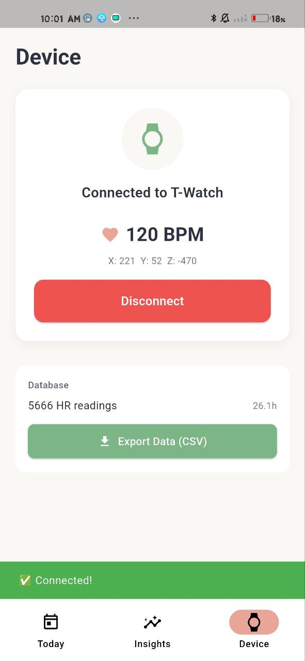
The flutter app

Slide 4
Server solution
[Bracelet]
→ (via phone app or direct)
→ HTTPS POST/GET to Flask server (hosted in Romania)
→ Flask saves data to PostgreSQL / MySQL
Optional solution here: Use Supabase backend (self-hosted or managed)

