Slide 1
AI bracelet for health monitoring
Gladkykh Daria, Fateme Hosseini

Slide 2
Main Objective
To develop an AI-powered system that can detect early signs of heart sclerosis using continuous, non-invasive physiological data collected from a smart bracelet.
The system will analyze patterns in heart rate variability (HRV), pulse waveform morphology, activity levels, and other bio-signals to identify anomalies associated with myocardial fibrosis.
Today’s Update: We started implementing the flutter app and finding solutions for the server and data transition

Slide 3
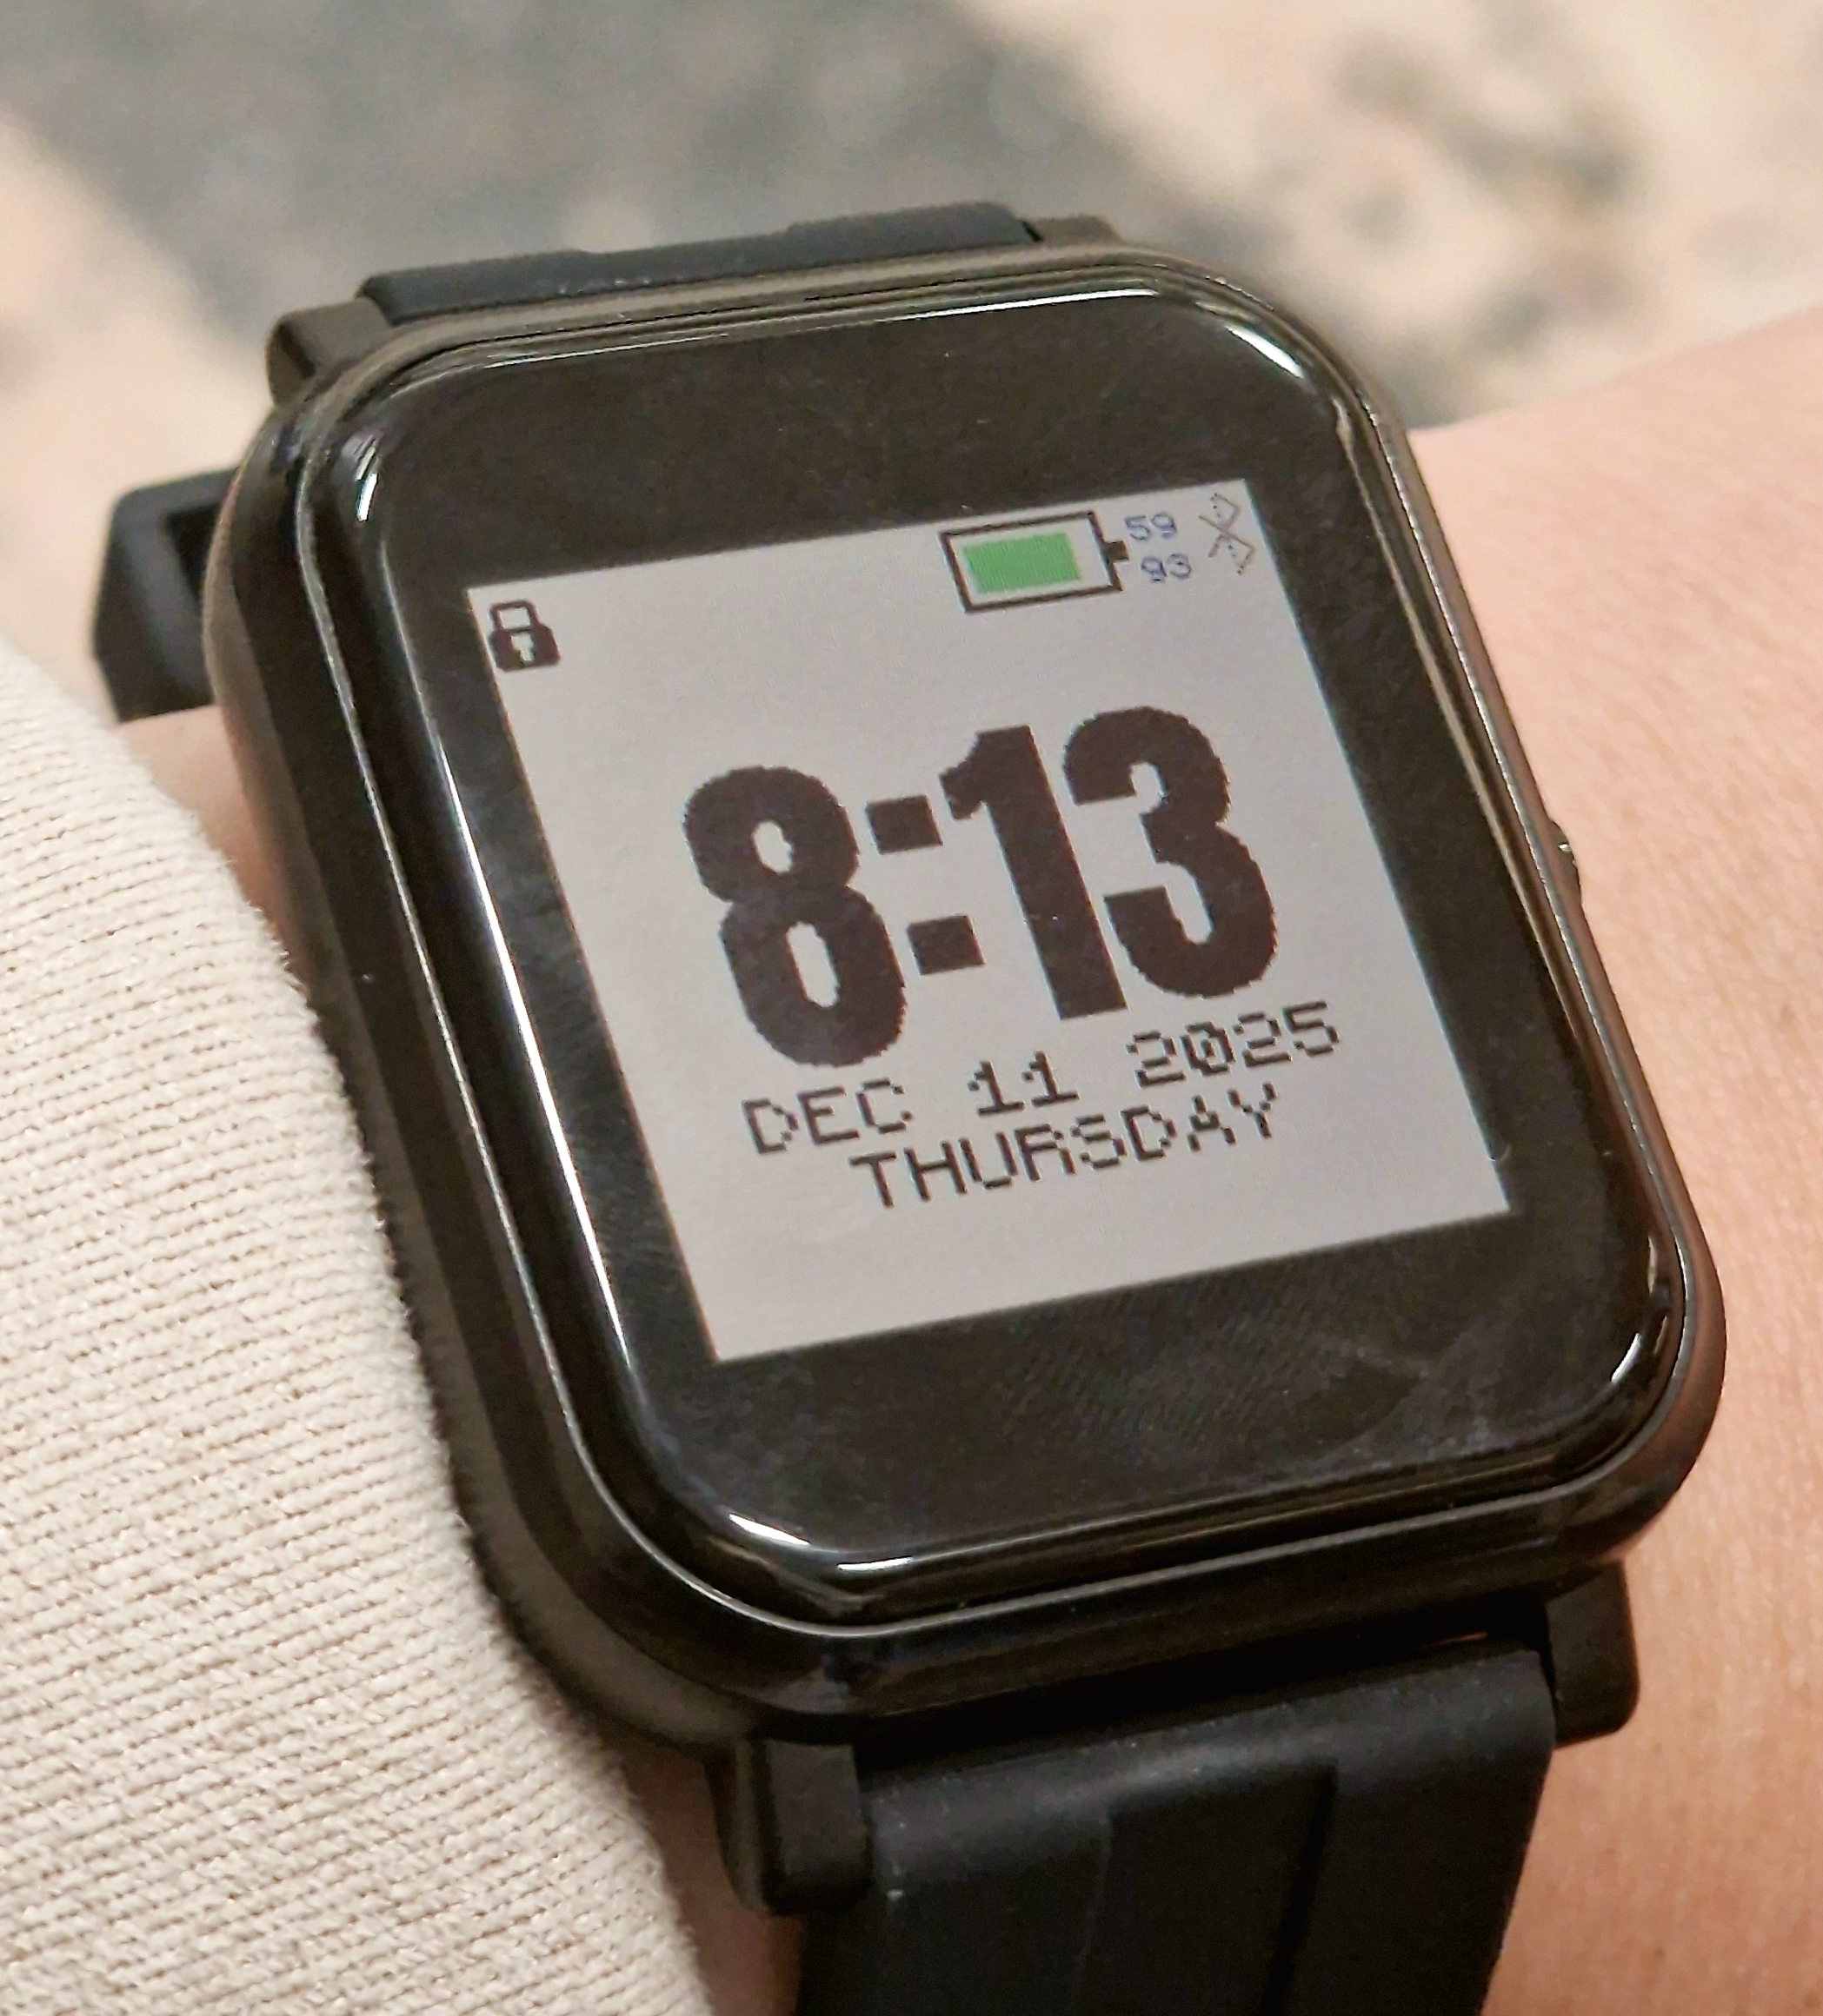
We received bangle.js
The watch is connected to the flutter app and can record and send data we need (HR and Accel)
For now we store them as CSV files on our laptop for testing and development

