Slide 1
Mise
Household Cooking Assistant
Fatemeh Hosseini • Ana Teodora Cârjilă • Nour Al Houda Mahfood
Less waste. Better meals. Together.

Slide 2
The Problem
Households waste food because they don’t know what they have
People buy duplicates, forget expiring items, and can’t coordinate cooking
There’s no tool that connects your pantry to what you can actually cook today

Slide 3
Mise — What It Does
Scan or manually add items to a shared household pantry
Get recipe suggestions ranked by what you already have
Full matches: cook now. Partial matches: see what’s missing
Shared real-time shopping list across all household members
Works offline. Syncs automatically when back online.

Slide 4
Technical Architecture
Flutter — cross-platform mobile
BLoC — state management (PantryBloc, ShoppingBloc, CookBloc)
Drift (local SQLite) — offline-first data layer
Firebase Auth — email/password authentication
Cloud Firestore — real-time sync across devices
Spoonacular API — recipe suggestions by ingredient
OpenFoodFacts API — barcode product lookup

Slide 5
State Management with BLoC
3 BLoCs: PantryBloc, ShoppingBloc, CookBloc
PantryBloc events: PantryStarted, PantryItemAdded, PantryItemRemoved
PantryBloc states: PantryInitial, PantryLoading, PantryLoaded, PantryError
UI never talks to data directly: only sends events, reacts to states
CookBloc: triggered automatically by a BlocListener on PantryBloc — pantry changes instantly refresh recipe suggestions
ShoppingBloc: checking off an item removes it from shopping AND adds it to pantry automatically

Slide 6
Offline-First Data with Drift
All data is written to local SQLite (Drift) first — app works with no internet
Every item has an isSynced flag (default: false)
When online: item is pushed to Firestore → isSynced set to true
When offline: item stays with isSynced = false
On reconnect: syncPending() finds all isSynced=false rows and retries
Items arriving from Firestore are inserted with isSynced = true
Tables: Users, Households, PantryItems, ShoppingListItems

Slide 7
Authentication & Cross-Device Data
Firebase Auth: email/password sign up and sign in
On login: MainShell loads householdId from Firestore users/{uid}
All pantry and shopping data is scoped to households/{householdId}/
Logging in on a new device automatically loads all household data from Firestore
Households are created or joined via invite code
Auth routing: no auth → AuthScreen | auth + no household → HouseholdSetupScreen | auth + household → main app

Slide 8
Real-Time Collaboration
Firestore uses persistent WebSocket connections for real-time listeners
PantryRepository.listenToFirestore() streams all pantry changes across devices
ShoppingRepository.listenToFirestore() handles added, modified, and removed events
Full flow: User A adds "tomato" → Drift insert + Firestore push → User B’s listener fires → Drift upsert → PantryBloc rebuilds UI → CookBloc auto-fetches new recipes
HomeScreen shows a live shopping list preview that updates instantly

Slide 9
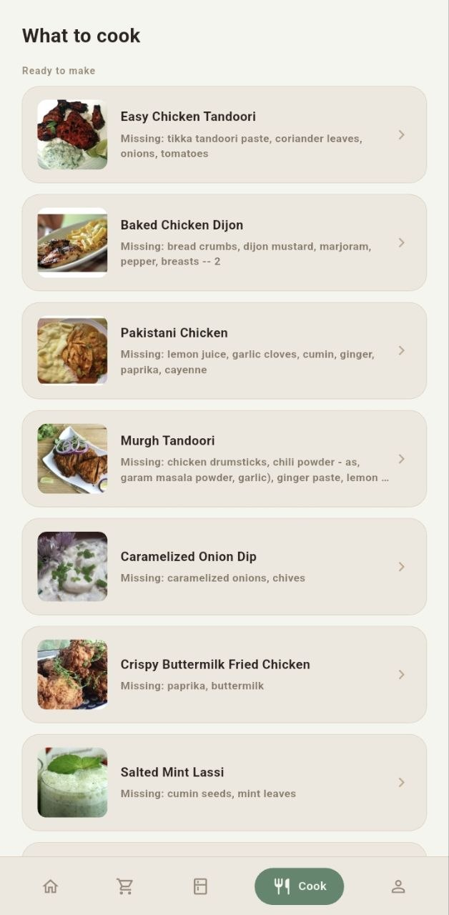
Smart Recipe Suggestions
API: Spoonacular /recipes/findByIngredients
Two-call strategy: ranking=1 (maximize used ingredients) + ranking=2 (minimize missed)
ignorePantry=true: to avoid false matches on staples like salt and water
Full matches: missedIngredientCount = 0 → "Ready to make"
Partial matches: missedIngredientCount > 0 → "Almost there" with missing items listed
Tap any recipe: detail sheet with ingredients and cooking instructions (HTML rendered)

Slide 10
Barcode Scanning
Library: mobile_scanner
Flow: User scans barcode → app calls OpenFoodFacts API to get product name
Pre-fill: Product name pre-fills the "Add Item" sheet — user confirms quantity and expiry
Context: Works for both pantry and shopping list (ScanContext enum)
Fallback: Manual search available as fallback

Slide 11
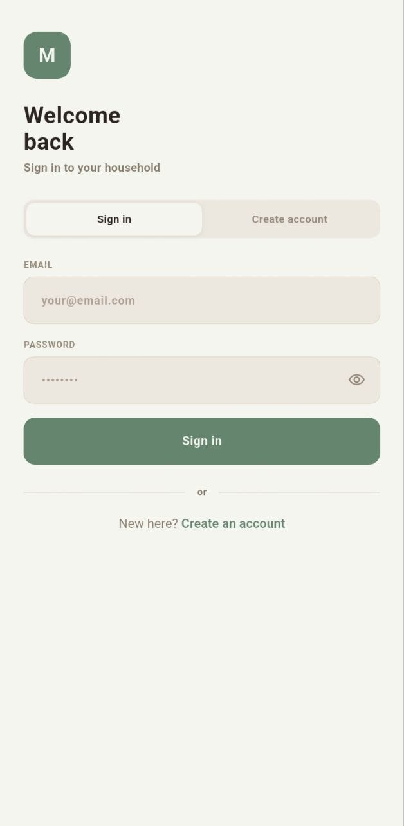
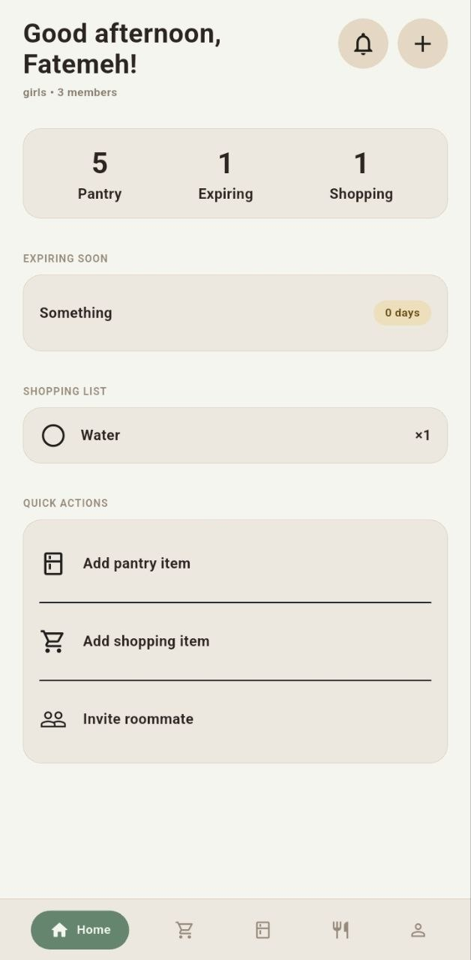
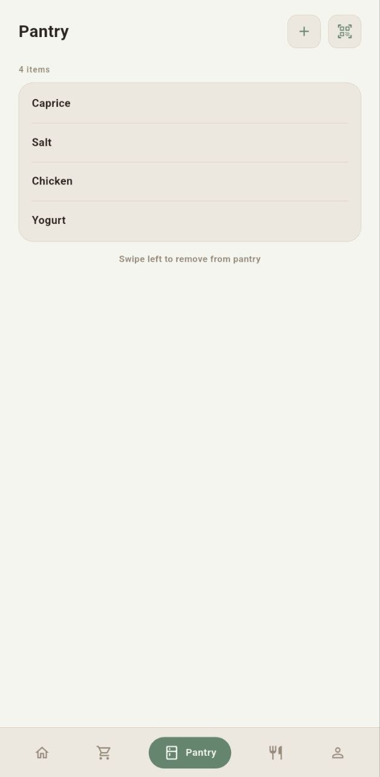
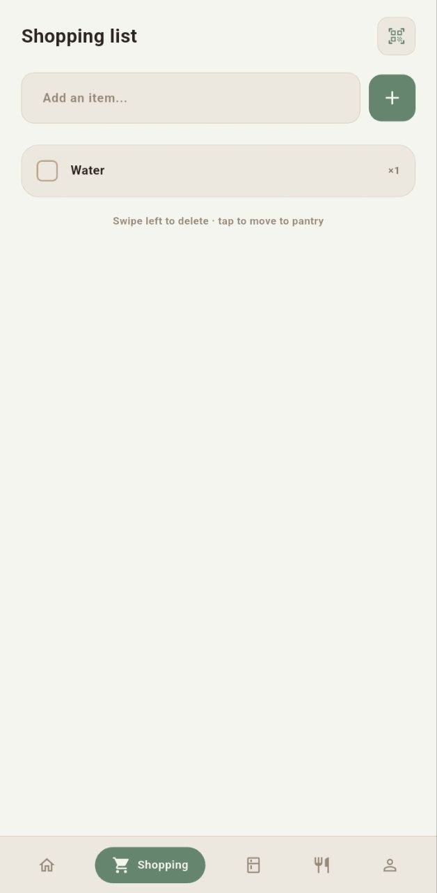
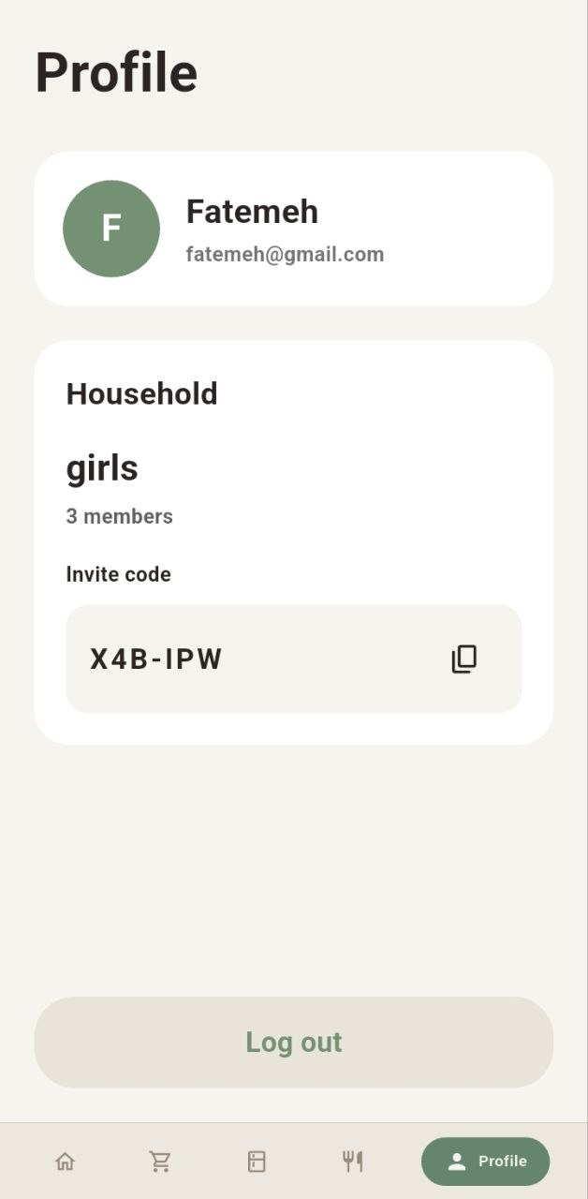
The 5 Screens
Login / Household Setup: sign in, create or join household via invite code
Home: greeting, pantry overview, expiring items, shopping preview, quick actions
Pantry: full item list, expiry pills, swipe to delete, scan or manual add
Cook Suggestions: recipe cards ranked by pantry match, detail sheet with instructions
Shopping List: shared list, check off moves item to pantry, scan to add

Slide 12
Who Built What
Fatemeh Hosseini: app architecture, service locator, barcode scanning integration, session handling, Pantry and ShoppingBLoC
Ana Teodora Cârjilă: Firebase Auth backend, household create/join/invite system, home screen UI and quick actions
Nour Al Houda Mahfood: Drift database schema, CookBloc with Firestore sync, Cook screen with Spoonacular API integration

Slide 13
Live Demo
Scan an item
See pantry update
Watch recipe suggestions refresh
Check off shopping item
See it move to pantry

Slide 14
Thank You
github.com/FaMaHo/mise

