Slide 1
Hyperion Steward
Challenge 1 · HYPER-AI | says done only once it has seen it done
Notes:
Hyperion Steward is our Hyperion agent for the HYPER-AI IDE. One sentence: it only tells you something happened once it has seen it happen in your workspace.

Slide 2
GitHub repo
GitHub repo: github.com/Faadil1/veles-hack-2026
Docker image: faadil12/hyperion:latest (exposes :8000/chat)
Run: docker run -p 8000:8000 --add-host host.docker.internal:host-gateway -e API_KEY=<key> faadil12/hyperion:latest
Licence: Apache-2.0, as in the official hyperion-starter
Evidence: CI reports on the ci-evidence branch (official IDE images, digests recorded)
Notes:
Repo, image, how to run it. Defaults match the starter: legion1, llama3.1, API_KEY.

Slide 3
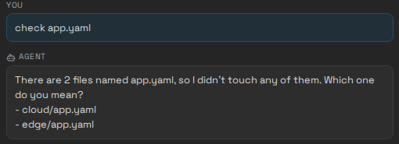
Summary
A drop-in /chat microservice for the HYPER-AI IDE: answers HYPER-AI questions from the official documents and turns plain language into IDE actions.
We read the IDE the judges run, not only its tutorial. Its actions are fire-and-forget: a naive agent says done when nothing happened.
Steward checks every profile with an exact copy of the IDE validator, then reads the workspace back and only claims what it saw. Deletes always ask; overwrites ask unless you named the file or Steward created it; file changes can be undone (a folder delete cannot).
The official IDE (organisers' GUI and backend images), a browser typing into the Hyperion panel in CI.
Notes:
What it is, what we found, what it does about it. The screenshot is the official IDE, run from the organisers' images in CI, with a browser typing into the Hyperion panel.

Slide 4
Highlights
0
9/9
0
6/6
disagreements with the IDE's own validator, over 5,536 test profiles
safety scenarios handled correctly (same tool calls, stub mirroring the IDE). Naive agent: 1/9
false "done" claims in the same scenarios. Naive agent: 5
live steps against the official backend image, every change verified by read-back
Also: works without a model for the official example requests (create, delete, check, undo); plain-text replies because the panel does not render markdown; per-session memory sized to the provided 8k-token model.
Notes:
Four numbers. Zero disagreements with the real validator. Nine out of nine safety scenarios against one out of nine for a naive agent, with identical tool calls. Zero false claims against five. Six of six steps live against the official backend image.

Slide 5
What we found in the shipped IDE
1
2
3
Actions are fire-and-forget
Many actions silently do nothing
Nothing checks a profile unless asked
The GUI starts each action and never reports back. Failures only reach the status log.
A name shared by two files, creating a file that exists, a closed IDE tab: no change, no signal. The tutorial says "first match"; the shipped GUI refuses instead.
Under YAML 1.2, isHighlyAvailable: no is a string and schemaVersion: 1.1 a number. Both are saved as is.
Source: the GUI bundle and backend code inside donmichael/ide-gui:latest and donmichael/ide-backend:latest.
Notes:
We ran the organisers' images and read their code. Three facts. One: actions are fire-and-forget. Two: plenty of them silently do nothing, and the tutorial even describes a behaviour the shipped GUI does not have. Three: nothing validates a profile unless someone asks. So a straightforward agent tells users it did things it did not do.

Slide 6
How Steward handles every change
1
Scope guard
2
Look up the target
3
Check with the validator copy
4
Ask when it matters
5
Send the action
6
Read the workspace back
7
IDE validator, rollback if rejected
The model handles language. It extracts intent and parameters; a builder emits the full profile, so it never hand-writes 40 typed fields.
Every change goes through one gate. Whatever the model says, these steps run in this order.
Answers are grounded. Retrieval over the official tutorial, cookbook and D3.3/D4.2/D4.3 deliverables, with citations.
Receipts. /receipts/<user>/view shows each lookup, action, read-back, validator and model call.
Notes:
One gate for every change. The two highlighted steps are what we added after reading the IDE: a validator copy proven identical to the real one, and a read-back that turns a fire-and-forget action into a verified one.

Slide 7
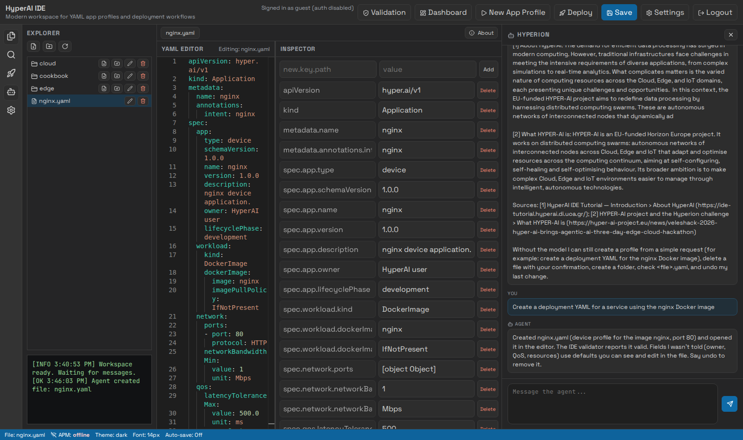
Live in the official IDE
Off-topic: declined before any model call.
Check: the cookbook native example is valid but will not run (uvicorn in an nginx image).
Ambiguous name: lists both files and asks.
Create, fix, undo: each change is read back before Steward says it happened.
Shown: the official create example, file opened in the editor. CI run with llama3.1 8B, 7/7.
Notes:
Live demo in the official IDE (or this recording from CI).

Slide 8
The five criteria
Criterion | Steward | Proof
1 /chat microservice: answers + NL to IDE actions | SSE contract of the starter; builder; read-back | CI: official images, browser-driven
2 Guardrails | Scope check before any model call | Tests; off-topic scenario
3 RAG on HYPER-AI docs | Official tutorial, cookbook, deliverables; cited | "What is HyperAI?" scenario
4 Session memory | Per user_id, sized to the 8k model | Tests
5 Human-in-the-loop (optional) | Deletes always confirmed; overwrites unless path named or self-created; undo for file changes | Live slice: undo restores identical bytes
Notes:
Each official criterion, how Steward meets it, and where it is proven.

Slide 9
What is proven, and what is not yet
Proven
Validator parity with the real code (CI, official image)
Create, 409 ambiguity, invalid profile stopped, delete, undo against the official backend image
The official GUI in a browser: guardrail, check, ambiguity
llama3.1 8B (the model family the organisers serve) in the official GUI, CI
Not yet
Answer quality on the organisers' server (legion1) not measured before submission
Runnability findings are rules, not a deployment on HYPER-AI
Steward cannot deploy; the IDE's Deploy button does
Built during the hackathon by an autonomous agent; every claim is labelled in the repo
Notes:
What is proven and what is not. Every claim in the repo carries its evidence class.

