Slide 1
Hyperion Steward
Challenge 1 · HYPER-AI | says done only once it has seen it done
Notes:
Hyperion Steward is our Hyperion agent for the HYPER-AI IDE. One sentence: it only tells you something happened once it has seen it happen in your workspace.

Slide 2
GitHub repo
GitHub repo: github.com/Faadil1/veles-hack-2026
Docker image: faadil12/hyperion:latest (exposes :8000/chat)
Run: docker run -p 8000:8000 --add-host host.docker.internal:host-gateway -e API_KEY=<key> faadil12/hyperion:latest
Licence: Apache-2.0, as in the official hyperion-starter
Evidence: CI reports on the ci-evidence branch (official IDE images, digests recorded)
Notes:
Repo, image, how to run it. Defaults match the starter: legion1, llama3.1, API_KEY.

Slide 3
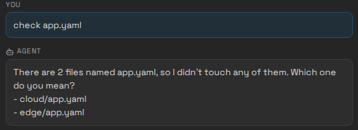
Summary
A drop-in /chat microservice for the HYPER-AI IDE: answers HYPER-AI questions from the official documents and turns plain language into IDE actions.
We read the IDE the judges run, not only its tutorial. Its actions are fire-and-forget: a naive agent says done when nothing happened.
Steward checks every profile with an exact copy of the IDE validator, then reads the workspace back and only claims what it saw. Deletes always ask; overwrites ask unless you named the file or Steward created it; file changes can be undone (a folder delete cannot).
The official IDE (organisers' GUI and backend images), a browser typing into the Hyperion panel in CI.
Notes:
What it is, what we found, what it does about it. The screenshot is the official IDE, run from the organisers' images in CI, with a browser typing into the Hyperion panel.

Slide 4
Highlights
0
9/9
0
6/6
disagreements with the IDE's own validator, over 5,536 test profiles
safety scenarios handled correctly (same tool calls, stub mirroring the IDE). Naive agent: 1/9
false "done" claims in the same scenarios. Naive agent: 5
live steps against the official backend image, every change verified by read-back
Also: works without a model for the official example requests (create, delete, check, undo); plain-text replies because the panel does not render markdown; per-session memory sized to the provided 8k-token model.
Notes:
Four numbers. Zero disagreements with the real validator. Nine out of nine safety scenarios against one out of nine for a naive agent, with identical tool calls. Zero false claims against five. Six of six steps live against the official backend image.

