Slide 1


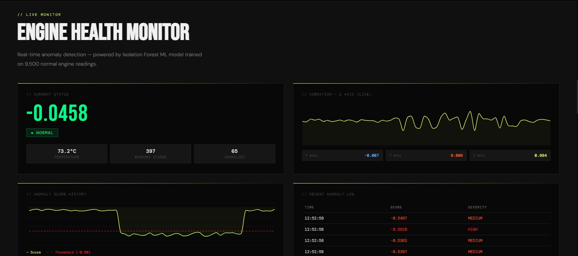
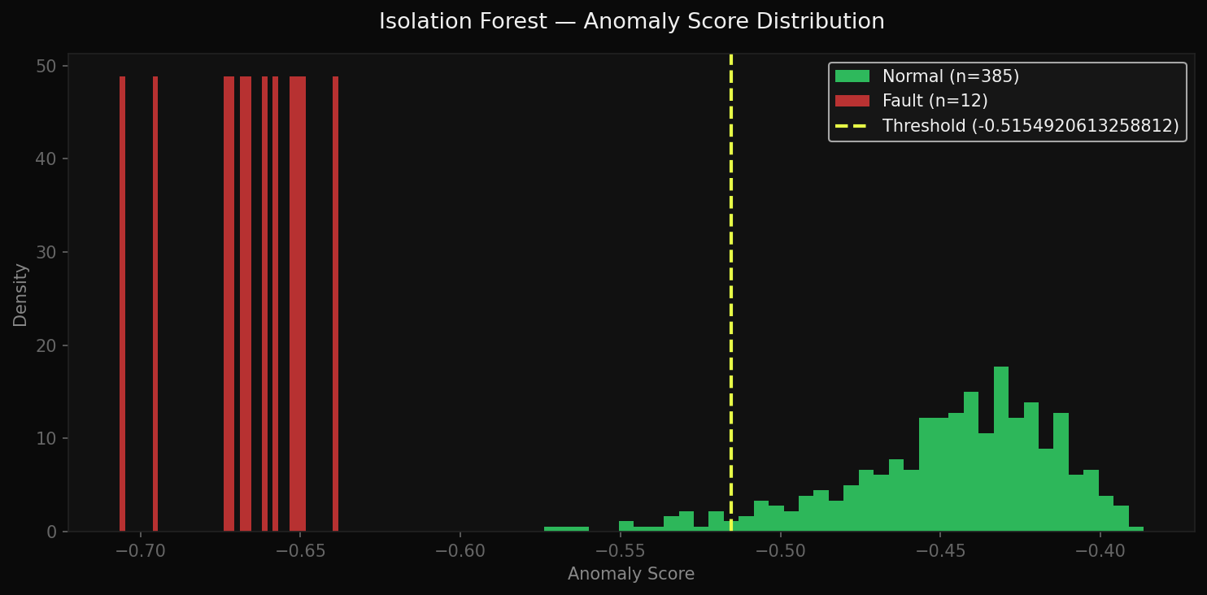
EngineIQ
An IoT and Machine Learning Based Predictive Car Engine Health Monitoring System
Iddrisu Faadila Wumpini • Lartey-Mensah Emmanuel Tetteh
Supervisor: Dr. R.O.M Gyening
Department of Computer Science | College of Science | Kwame Nkrumah University of Science and Technology
1 ABSTRACT
4 AIM AND OBJECTIVES
7 METHODOLOGY, TOOLS & STACK
Sudden engine failure imposes a heavy financial burden on car owners and on the taxi, trotro and ride-hailing operators who carry much of Ghana's transport. Maintenance is almost entirely reactive: a driver visits a fitter only after the vehicle has already stopped. On-Board Diagnostic (OBD-II) systems, the dominant technology, log a fault code only once a threshold has been crossed inside the Engine Control Unit, and commercial telematics platforms charge USD 25–70 per vehicle per month in foreign currency, indefinitely.
This project designed, implemented and evaluated EngineIQ, a low-cost predictive engine health monitoring system. An ESP32 microcontroller carrying an MPU6050 accelerometer and a DS18B20 temperature probe streams vibration and surface-temperature data over Bluetooth Low Energy, where a Butterworth filter, fixed-length windowing and an unsupervised Isolation Forest score each window against the engine's own learned baseline rather than a fixed threshold. Every scored window is logged to Supabase and presented on a secure web dashboard with real-time charts, severity-classified alerts and CSV export. The complete build costs under GHS 400 in one-time hardware with no recurring subscription.
Aim: To design, implement and evaluate a low-cost IoT and machine learning system that continuously monitors car engine vibration and surface temperature, detects developing anomalies against a learned baseline, and alerts the driver or mechanic before catastrophic engine damage occurs.
Objectives:
• Review literature on vehicle diagnostics, IoT sensor networks and unsupervised machine learning models used for anomaly detection.
• Assemble a low-cost sensor node from an ESP32 microcontroller, an MPU6050 accelerometer and a DS18B20 digital temperature sensor.
• Develop a preprocessing pipeline that cleans, normalises and extracts statistical features from raw vibration and temperature streams.
• Train an unsupervised Isolation Forest model capable of separating a normal engine baseline from developing mechanical faults.
• Deploy a secure web dashboard with user authentication, real-time sensor metrics and instant anomaly alerts.
• Evaluate the complete architecture for detection accuracy, response latency and network stability under simulated fault conditions.
EngineIQ follows a six-stage pipeline: sensing on the engine block, BLE transmission, filtering and windowing, feature extraction, unsupervised scoring, then logging and dashboard presentation. The detector is trained only on normal-operation windows, and its decision threshold is auto-tuned from the contamination percentile of the model's own training scores rather than hardcoded.
Layer | Technology
Sensor node | ESP32 · MPU6050 3-axis accelerometer · DS18B20 probe
Transmission | Bluetooth Low Energy, GATT notify, bonded + encrypted link
Preprocessing | Butterworth low-pass filter, fixed-length windowing
Features | 9 statistics per channel (time domain), NumPy / SciPy
ML model | Isolation Forest, 200 estimators, 5% contamination (scikit-learn)
Datastore | Supabase (PostgreSQL) with row-level security
Dashboard | Streamlit real-time monitor; GitHub Pages front-end
Authentication | Supabase Auth — email confirmation, password reset
Validation set | AI4I 2020 Predictive Maintenance Dataset
Version control | GitHub
2 INTRODUCTION
Ghana's transport sector depends heavily on private cars, taxis, ride-hailing vehicles and trotros. For many households the vehicle is the income-generating asset, so engine failure removes the vehicle and the income it produces at the same moment.
Engines rarely fail without warning. Bearing wear, misfire and loose mounts all alter an engine's vibration signature, and developing faults raise surface temperature — both long before the ECU records a diagnostic code. That interval is the prediction window this project sets out to exploit.
EngineIQ places affordable physical sensing directly on the engine block and learns what that particular engine's normal operation looks like, so deviation can be flagged early without a scanner, a subscription, or an internet connection at the point of data acquisition.
5 LITERATURE REVIEW
OBD-II, mandated on virtually all vehicles built after 1996, taps the ECU to read a fixed set of parameters. It is universally supported and needs no hardware modification, but it is architecturally reactive: it triggers only once a fault threshold has been crossed and cannot observe gradual wear.
Zhang and Ji (2019) built an IoT engine health monitor using a MEMS accelerometer and FFT analysis transmitted over Wi-Fi, demonstrating that low-cost accelerometers are viable for engine monitoring — but their reliance on static frequency thresholds made the system prone to false positives as engine load varied.
Malhotra et al. (2016) proposed an LSTM encoder-decoder for multi-sensor time-series anomaly detection, which excels at contextual anomalies but is computationally heavy, unsuitable for resource-constrained edge devices such as the ESP32, and was validated only in a laboratory setting.
Kanawaday and Sane (2017) applied Isolation Forest to IoT predictive maintenance and showed effective detection at low computational overhead — but on industrial-grade hardware priced far beyond an individual vehicle owner in Ghana.
Gap: no reviewed system combines low-cost physical telemetry, an unsupervised per-engine baseline and deployment affordable to individual owners in a low-resource setting. That intersection — cost and prediction and accessibility together — is what EngineIQ targets.
8 RESULTS AND EVALUATION
The AI4I 2020 dataset (10,000 rows — 9,661 normal, 339 fault) yielded 385 normal and 12 fault feature windows. An Isolation Forest with 200 estimators and 5% contamination was fitted on the 385 normal windows only, giving an auto-tuned threshold of −0.5155.
Class | Precision | Recall | F1 | Support
Normal | 1.00 | 0.95 | 0.97 | 385
Fault | 0.38 | 1.00 | 0.55 | 12
Overall accuracy |  |  | 0.95 | 397
3 PROBLEM STATEMENT
• Maintenance in Ghana is overwhelmingly reactive — drivers visit a fitter only after a failure has already occurred, when the vehicle, its income and the repair cost are lost together.
• OBD-II is reactive by design. It reports a threshold already crossed, cannot observe mechanical wear developing, and needs a scanner most drivers do not own.
• Commercial telematics platforms work well, but at USD 25–70 per vehicle per month in foreign currency with no end date — beyond the reach of the operators who most need early warning.
• Labelled engine-fault data for Ghanaian vehicles does not exist and cannot be affordably produced, which rules out supervised learning as a practical method.
• No existing system combines continuous physical telemetry, a learned per-engine baseline and early anomaly warning on hardware an individual owner can actually buy.
All 12 fault windows were correctly flagged — 100% recall against a 5.2% false-positive rate (20 of 385 normal windows) — satisfying NFR-02, which specifies a true-positive rate of at least 85%. In total 5,122 scored windows, normal as well as anomalous, were logged to Supabase.
Reported honestly. On the cumulative simulation run the same detector gave 84% overall accuracy but only 25% fault recall (256 of 1,017). AI4I rows are independent tabular samples rather than a true time series, so windows built from a shuffled stream mix fault and normal rows and dilute the fault signature. Both figures are reported rather than only the favourable one.
The BLE baseline was collected from the prototype at rest on a bench (7,579 readings at 50 Hz, producing 302 windows) and every window returned an identical score of −0.5000. The live path is therefore a validated pipeline, not yet a validated detector — re-collecting that baseline from a running mechanical source is the primary recommendation.
6 CONTRIBUTIONS
• A price point that changes who can participate — under GHS 400 of one-time hardware, against a recurring foreign-currency subscription with no end date.
• Prediction rather than reaction — active physical telemetry finds developing mechanical wear before the ECU ever logs a fault code.
• A dynamic baseline rather than fixed thresholds — the model learns each engine's own normal signature instead of applying rigid limits that misfire under changing load and road conditions.
• Reproducible on open-source tools — the architecture can be replicated, scaled or commercialised by other developers at no licensing cost.
9 SYSTEM ARCHITECTURE AND IMPLEMENTATION
EngineIQ uses a four-layer architecture. The perception layer mounts an MPU6050 accelerometer and a DS18B20 probe on the engine block. The network layer runs on an ESP32, which advertises a GATT service over Bluetooth Low Energy with bonding and link-layer encryption; the sensor characteristic itself requires an encrypted link, so the GATT layer refuses unencrypted reads rather than relying on the security mode alone.
BLE was chosen over Wi-Fi and MQTT because it removes two dependencies at once — the router and the broker. A car parked anywhere can be monitored with no internet connection at the point of acquisition. The cost of that choice is roughly 10 metres of range and one central device per sensor unit at a time, a constraint inherited from the BLE standard rather than from the implementation.
The processing layer applies a Butterworth low-pass filter, splits the stream into fixed-length windows, extracts nine statistics per channel and scores each window with the Isolation Forest. Every scored window — not only the anomalies — is written to Supabase with its score, severity class, source and originating device identifier, so a technician reading an exported CSV sees the engine's healthy baseline as well as its exceptions.
The application layer presents live vibration and temperature charts, severity-classified anomaly alerts and date-range CSV export behind Supabase Auth with row-level security on every read.
LAYER 01
LAYER 02
LAYER 03
LAYER 04
Perception
· MPU6050 accelerometer
· DS18B20 temperature probe
· Engine-block mount
›
Network
· ESP32 microcontroller
· Bluetooth Low Energy
· Bonded, encrypted GATT
›
Processing
· Butterworth filter
· 9 features per channel
· Isolation Forest scoring
›
Application
· Streamlit dashboard
· Severity alerts
· CSV export · Supabase
Figure 1 — Four-layer system architecture, sensor node to dashboard.
Figure 2 — Live monitor: anomaly score, vibration and temperature.
Figure 3 — Anomaly scores against the auto-tuned threshold.
10 REFERENCES
[1] Analog Devices (Maxim Integrated). (2019). Programmable Resolution 1-Wire Digital Thermometer DS18B20.
[2] Espressif Systems. (2023). ESP32 Series Datasheet. Espressif Systems.
[3] Gao, Z., Cecati, C., & Ding, S. X. (2015). Fault diagnosis and fault-tolerant techniques — survey part I. IEEE Transactions on Industrial Electronics, 62(6), 3757–3767.
[4] InvenSense (TDK). (2013). MPU-6000/MPU-6050 Product Specification, Revision 3.4.
[5] Kanawaday, A., & Sane, A. (2017). Use of machine learning in predictive maintenance of industrial machines with IoT sensor data. ICCUBEA, Pune, India.
[6] Liu, F. T., Ting, K. M., & Zhou, Z. H. (2008). Isolation Forest. IEEE 8th International Conference on Data Mining (ICDM), Pisa, Italy, 413–422.
[7] Malhotra, P., Ramakrishnan, A., Anand, G., Vig, L., Agarwal, P., & Shroff, G. (2016). A multi-sensor anomaly detection using LSTM based encoder-decoder. arXiv:1607.00148.
[8] Scikit-learn Developers. (2023). sklearn.ensemble.IsolationForest.
[9] Shimpi, P., Agrawal, S., & Kaul, A. (2021). Survey of Bluetooth Low Energy (BLE) based IoT systems. International Journal of Computer Applications, 174(12), 1–6.
[10] Streamlit Inc. (2024). Streamlit Documentation.
[11] Supabase. (2024). Supabase Documentation.
[12] Zhang, Y., & Ji, S. (2019). Vibration based engine health monitoring system using IoT. Journal of Physics: Conference Series, 1187(4).

