Slide 1
IOT · MACHINE LEARNING · PREDICTIVE MAINTENANCE
EngineIQ
An IoT and Machine Learning Based Predictive Car Engine Health Monitoring System
Iddrisu Faadila Wumpini · Lartey-Mensah Emmanuel Tetteh
Group 11
Supervisor: Dr. R.O.M Gyening
Department of Computer Science · KNUST

Slide 2
// THE PROBLEM
Ghana's roads, and a reactive repair culture
2,949
ROAD DEATHS
GHANA, 2025
35 yrs
HIGHEST TOLL
IN 35 YEARS
14,743
CRASHES
RECORDED
1,009
DEATHS
JAN–APR 2026
Vehicle defects are a documented contributing factor — research attributes more than 35% of crashes in Ghana to some form of vehicle defect, linked to inadequate maintenance and overaged imported vehicles.
But the sharper problem is economic.
Maintenance here is almost entirely reactive — the driver visits a fitter after the car has already stopped. When an engine seizes, the owner loses the vehicle, the income it generates and the repair money at once. For a taxi, trotro or Bolt driver, the vehicle is the household's income-generating asset.
EngineIQ · Group 11 · Department of Computer Science, KNUST
2

Slide 3
// SCOPE
Why the engine?
01
COST
The single most expensive component to replace. Early detection therefore carries the highest financial payoff of anything we could have monitored.
02
PREDICTABILITY
Engines fail gradually. Bearing wear, misfire and loose mounts all change the vibration signature long before the ECU trips a fault code — that is the prediction window a model can exploit.
03
LOCAL RELEVANCE
In Ghana the vehicle is frequently the household's income-generating asset. Engine down means income zero. A missed fault is not inconvenience — it is loss of livelihood.
EngineIQ · Group 11 · Department of Computer Science, KNUST
3

Slide 4
// LITERATURE
What already exists — and what it misses
OBD-II
Reactive by design. Reports a threshold already crossed; cannot see wear developing. Needs a scanner most drivers do not own.
Zhang & Ji (2019)
Static frequency thresholds — prone to false positives as engine load varies.
Malhotra et al. (2016)
Powerful LSTM encoder-decoder, but lab-only validation and too heavy for edge deployment.
Kanawaday & Sane (2017)
Proved Isolation Forest works for predictive maintenance — on industrial hardware, impractical for one vehicle owner.
Samsara / Geotab
Work perfectly well — at $25–70 per vehicle per month, in foreign currency, indefinitely.
Each system solves one axis. None solve cost AND prediction AND accessibility together — the gap is the intersection.
EngineIQ · Group 11 · Department of Computer Science, KNUST
4

Slide 5
// CONTRIBUTION
What this project contributes
A price point that changes who can participate
Under GHS 400 in one-time hardware, against a recurring foreign-currency subscription with no end date.
Prediction rather than reaction
Active physical telemetry — vibration and surface temperature — finds developing mechanical wear before the ECU ever logs a code.
A dynamic baseline rather than fixed thresholds
The model learns each engine's own normal signature instead of applying rigid limits that misfire under changing load and road conditions.
Reproducible on open-source tools
The architecture can be replicated, scaled or commercialised by other developers with no licensing cost. That reproducibility is part of the contribution.
EngineIQ · Group 11 · Department of Computer Science, KNUST
5

Slide 6
// ARCHITECTURE
Four layers, hardware to handset
LAYER 01
Perception
· MPU6050 accelerometer
· DS18B20 temp sensor
· Engine block mount
LAYER 02
Network
· ESP32 microcontroller
· Bluetooth Low Energy
· GATT notify characteristic
· Encrypted BLE pairing
LAYER 03
Processing
· Butterworth filter
· Feature extraction
· Isolation Forest ML
· Supabase logger
LAYER 04
Application
· Web dashboard
· Real-time charts
· Anomaly alerts
· CSV export
›
›
›
Each layer is replaceable in isolation — the sensor node can change without touching the model, and the model without touching the dashboard.
EngineIQ · Group 11 · Department of Computer Science, KNUST
6

Slide 7
// HARDWARE
The sensor node
COMPONENTS
ESP32 — microcontroller · BLE radio · under GHS 100 locally
MPU6050 — 3-axis accelerometer, vibration on X, Y and Z
DS18B20 — digital probe, engine surface temperature
WHY BLE, NOT WI-FI / MQTT
Removes two dependencies at once — the Wi-Fi router and the MQTT broker. A car parked anywhere can be monitored, with no internet connection needed for data acquisition.
THE COST OF THAT CHOICE
Roughly 10 metres of range, and BLE's single-central-device model means one supervising device per sensor unit at a time. We state this openly in Chapter 5.
Total build cost: under GHS 400
EngineIQ · Group 11 · Department of Computer Science, KNUST
7

Slide 8
// SIGNAL PIPELINE
From raw samples to a score
RAW
accX, accY, accZ
temperature
FILTER
Butterworth
low-pass
WINDOW
fixed-length
sample windows
FEATURES
9 statistics
per channel
MODEL
Isolation Forest
anomaly score
LOG
Supabase
Postgres row
›
›
›
›
›
Every scored window is logged — not only the anomalies.
A deliberate design decision. An engine-health history is only interpretable if it records what normal operation looked like, not only the exceptions. Without it, a technician reviewing an exported CSV sees a list of alarms with no context for the engine's healthy baseline. 5,122 records were logged over the testing period.
EngineIQ · Group 11 · Department of Computer Science, KNUST
8

Slide 9
// METHOD
Why unsupervised, and why this model
WHY NOT SUPERVISED?
Labelled fault data from a real Ghanaian engine does not exist and cannot be affordably produced. Nobody will let us destroy a bearing to generate training labels.
Isolation Forest learns only what normal operation looks like — the only data we can actually collect. Everything deviating from that baseline is flagged.
That constraint drove the method choice, not the other way round.
WHY NOT LSTM OR AN AUTOENCODER?
Malhotra's LSTM encoder-decoder is more powerful for contextual anomalies — but computationally heavy, and validated lab-only.
Isolation Forest is distribution-free, trains on a few hundred windows, and runs on a laptop with no GPU and no cloud bill.
We traded some sensitivity to contextual faults for the ability to deploy at all in a resource-constrained setting — a deliberate engineering trade-off, not a limitation of ambition.
EngineIQ · Group 11 · Department of Computer Science, KNUST
9

Slide 10
// RESULTS
Detector performance — AI4I path
100%
RECALL ON 12 HELD-OUT
FAULT WINDOWS
89.5%
OVERALL DETECTION
ACCURACY
5.2%
FALSE POSITIVE
RATE
−0.5155
AUTO-TUNED
THRESHOLD
On the contamination parameter — be direct.
Contamination = 5% sets the percentile at which the threshold is auto-tuned from the model's own training scores. 5% was a design choice, not a value derived from engine physics — and an observed FPR of 5.2% falling out of a 5% setting is close to circular.
What we defend is the mechanism: auto-tuning from the contamination percentile proved more robust than hardcoding a value, and it meant the BLE model received a threshold suited to its own score distribution rather than inheriting the AI4I model's.
EngineIQ · Group 11 · Department of Computer Science, KNUST
10

Slide 11
// THE HONEST SLIDE
Why one number says 100% and another says 25%
100% RECALL
Section 4.4.1 — a clean, purpose-built split. This measures THE DETECTOR.
25% RECALL
Section 4.4.3 — the cumulative run. This measures THE DATASET'S UNSUITABILITY FOR WINDOWING.
The two numbers measure different things.
AI4I 2020 rows are independent tabular samples, not a true time series. A 50-sample window built from a shuffled simulation stream mixes fault rows and normal rows together, diluting the fault signature the feature extractor depends on. This does not affect the live BLE path, where consecutive samples are genuine, temporally-ordered data.
We reported both numbers rather than selecting the flattering one. Detection metrics for this class of system are highly sensitive to how test windows are constructed — we consider that a finding in its own right.
EngineIQ · Group 11 · Department of Computer Science, KNUST
11

Slide 12
// VALIDATION STATUS
Did we test on a real running engine? No.
The BLE baseline was collected from the prototype at rest on a bench
7,579 raw readings over 2.5 minutes, producing 302 feature windows.
Every one of those windows returned an identical score of −0.5000
A saturated distribution — the signal had no meaningful variance to learn from.
So the BLE path is a validated pipeline, not yet a validated detector
Stated explicitly in Section 4.4.2 and carried into our recommendations.
The baseline must be re-collected from a running mechanical source
An actual engine, or a substitute such as a small motor or fan with an induced imbalance fault, before the live path matches the AI4I standard.
EngineIQ · Group 11 · Department of Computer Science, KNUST
12

Slide 13
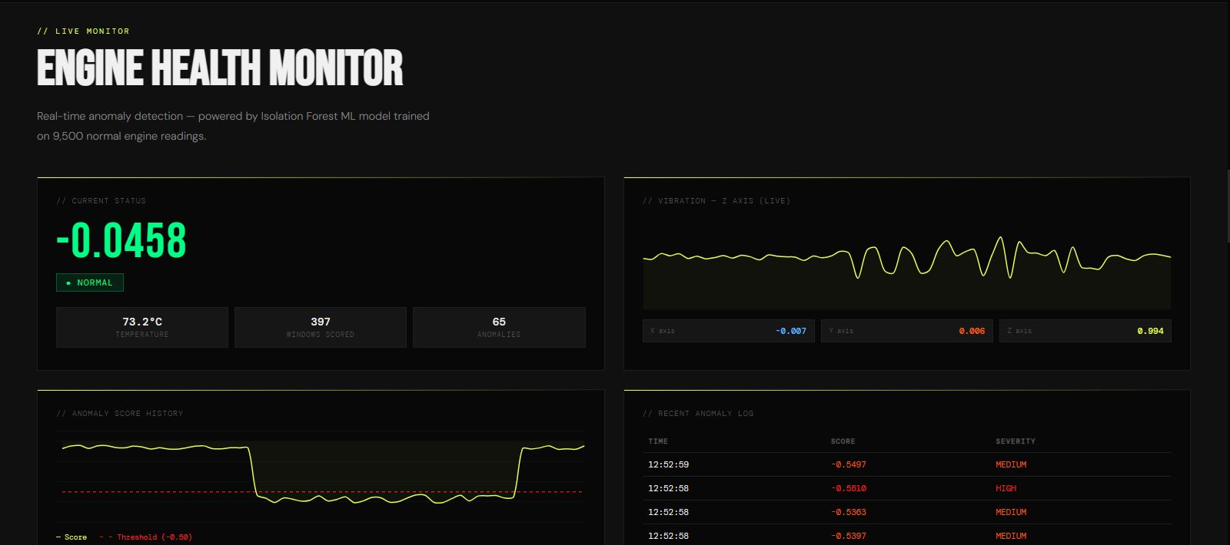
// THE SYSTEM
What a driver actually uses
Secure authentication
Email confirmation, password recovery, Supabase Auth with row-level security on every read.
Live engine monitor
Real-time anomaly score, vibration chart across X/Y/Z, temperature, and a running window count.
Anomaly log and severity
Recent events with timestamp, score and severity class — normal, low, medium, high.
Live monitor — deployed on GitHub Pages
Download engine history
Export any date range to CSV to hand to a mechanic or keep as a service record.
EngineIQ · Group 11 · Department of Computer Science, KNUST
13

Slide 14
// LIVE DEMONSTRATION
Demo
Sign in with the pre-made account · live monitor · anomaly log · CSV export

Slide 15
// LIMITATIONS
What this system does not yet do
The live detector is not validated on a running engine
Bench-rest baseline only — a validated pipeline, not a validated detector.
Fault-class precision is 0.38
12 fault windows against 385 normal ones; precision collapses under that imbalance by construction. Recall is the operative metric for early warning.
BLE range is roughly 10 metres, one central device at a time
Inherited from the BLE standard, not from our implementation.
Pairing uses the Just Works model
The node has no display or keypad. Protects against passive eavesdropping — not an active man-in-the-middle present at the moment of pairing.
Simulation testing used shuffled tabular rows
AI4I 2020 is not a true time series, which is what produced the 25% figure.
EngineIQ · Group 11 · Department of Computer Science, KNUST
15

Slide 16
// FUTURE WORK
Where this goes next
Re-collect the BLE baseline from a running mechanical source
The single highest-priority item — it converts the pipeline into a detector.
Build realistic fault time series for simulation testing
Rather than shuffling independent AI4I rows.
Add frequency-domain features
FFT peak frequency and spectral energy, to complement the current time-domain statistics — better separability for faults that appear as frequency shifts rather than amplitude changes.
BLE mesh or a BLE/Wi-Fi hybrid gateway
Lifts the single-central-device constraint for fleet-scale deployment.
Push and SMS notification
So a driver is alerted without keeping the dashboard open.
EngineIQ · Group 11 · Department of Computer Science, KNUST
16

Slide 17
// IN CLOSING
Prediction, at a price this market can reach.
Under GHS 400 of open-source hardware, learning each engine's own normal signature — instead of a foreign-currency subscription that reports faults after they have already happened.
Thank you · Questions
EngineIQ · Group 11 · Department of Computer Science, KNUST
17

Slide 18
// BACKUP
BLE security
Pairing with bonding and link-layer encryption
ESP_LE_AUTH_REQ_SC_BOND.
The sensor characteristic requires an encrypted link
ESP_GATT_PERM_READ_ENCRYPTED — the GATT layer itself refuses unencrypted reads and subscriptions, rather than relying on the security mode alone.
Limitation, stated before they raise it: Just Works pairing
The node has neither display nor keypad. Protects against passive eavesdropping — the threat that matters here — but not an active man-in-the-middle present at the exact moment of pairing.
The 128-bit UUIDs are not access control
Broadcast in the advertising packet and readable by any scanner. They identify the stream; they do not protect it.
EngineIQ · Group 11 · Department of Computer Science, KNUST
19

Slide 19
// BACKUP
Scalable, yet one device at a time?
Both are true, and the distinction matters.
Scaling is per vehicle unit, not multi-user per unit. Multiple ESP32 units can be paired to separate laptops or phones for multi-vehicle deployment with no architectural change — which is exactly what NFR-04 specifies.
Each ESP32 advertises with its own DEVICE_ID — EngineIQ_Sensor_ESP32-01 — and every logged record carries that identifier, so units remain distinguishable in the database.
The single-central-device constraint is inherited from the BLE standard itself, not from our implementation. Overcoming it for fleet scale is our future-work recommendation: a BLE mesh, or a BLE/Wi-Fi hybrid gateway.
EngineIQ · Group 11 · Department of Computer Science, KNUST
20

