Slide 1
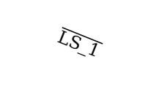



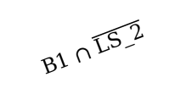
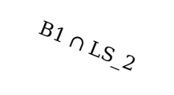
Z₀
B1 $∩$ $\overline{LS_2}$
$$\overline{LS_1}$$
B1 $∩$ (sus==1)
B1 $∩$ (sus==3)
Z₁
Z₄
Z₃
B2
B2
LS_2
B1 $∩$ (sus==2)
B2
T_5
B1 $∩$ LS_2
Z₂

