Slide 1
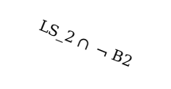
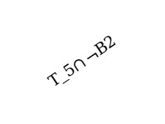
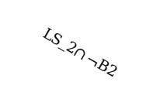


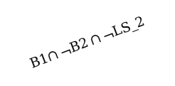
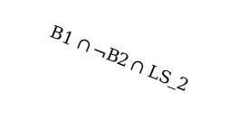
Z₀
B1$∩¬B2∩¬LS_2$
LS_2 $∩ ¬ B2$
B1$∩¬B2∩$ (sus==1)
B1$∩¬B2$ $∩$ (sus==3)
Z₁
Z₄
Z₃
B2
B2
LS_2$∩¬B2$
B1 $∩¬B2∩$(sus==2)
B2
T_5$∩¬B2$
B1 $∩¬B2∩$ LS_2
Z₂

