Slide 1
MPC based Path Tracking Using Potential Field for Autonomous Mobile Robot
Faizudeen Olanrewaju Kajogbola
Lehrstuhl für Regelungssysteme

Slide 2
Motivation
Navigation is essential for the success of any Mobile Robot
Ability to avoid obstacles is paramount for any AMR
Navigation entails path planning, trajectory generation, and successful tracking of planned trajectory
Planned trajectories should be modifiable online to accommodate unknown and dynamic obstacles
An Artificial Potential Field (APF) based approach is a gentle and intuitive introduction to path planning and trajectory generation
Model Predictive Control is drawing a lot of research attention
2

Slide 3
Aims & Objectives
Aims
Investigate Artificial Potential Field based path planning in presence of known static obstacles
Explore how Model Predictive Control can be used for path tracking for AMRs
Objectives
Generate collision-free trajectory from initial point to goal point using APF-based approach
Design a Model Predictive Controller based on a SISO linearized model
Design a Model Predictive Controller based on a SIMO linearized model
Tune a PID controller based on the simulation model
Compare the performance of the 3 controllers in different simulation scenarios
3

Slide 4
Assumptions
The following assumptions were made about the AMR in this study:
3 degree-of-freedom bicycle model- 1 front wheel and 2 rear wheels
Constant forward velocity of 1m/s
Front wheel controlled
Motion in x-y plane only (ignore rolling and pitching motions)
Constant model parameters
Indoor environment with smooth and flat surface (ignore gravitational and aerodynamic side forces)
Configuration space of 50m x 50m
Rounded obstacles of known sizes and positions
4

Slide 5
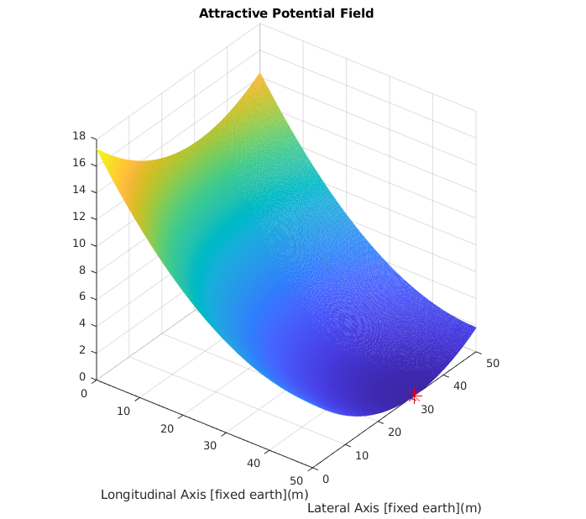


Artificial Potential Fields
Attractive Potential
$$U_{A}=\frac{1}{2}K_{att}{\left\|\vec{X}−\right.\left.{\vec{X}}_{goal}\right\|}^{2}$$
Attractive Force
$$F_{A}=−K_{att}(\vec{X}−{\vec{X}}_{goal})$$
5
Notes:
Path planning was carried out using Artificial Potential Fields (APFs)
Trajectory generation was performed by assuming the AMR has a constant velocity
APFs were first introduced by Khatib in 1986
Attractive potential tends to draw the AMR towards it goal position
Repulsive potentials deflect the AMR away from obstacles
Globally planned path and trajectory can be easily updated with real-time information from local sensors
Major drawback of APFs is the possibility of getting stuck at local minima

Slide 6
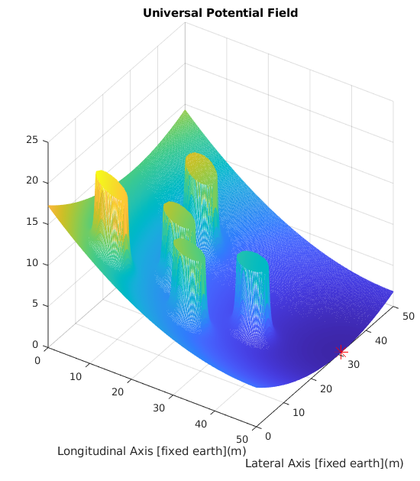
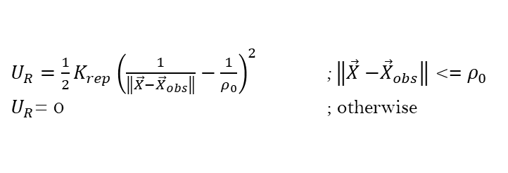


Artificial Potential Fields
Repulsive Potential
$U_{R}=\frac{1}{2}K_{rep}{\left(\frac{1}{\left\|\vec{X}−\right.\left.{\vec{X}}_{obs}\right\|}−\frac{1}{ρ_{0}}\right)}^{2}$ ;$\left\|\vec{X}−\right.\left.{\vec{X}}_{obs}\right\|$ <= $ρ_{0}$
$U_{R}$= 0 ; otherwise
Repulsive Force
$$F_{R}=K_{rep}\left(\frac{1}{\left\|\vec{X}−\right.\left.{\vec{X}}_{obs}\right\|}−\frac{1}{ρ_{0}}\right)\frac{1}{{\left\|\vec{X}−\right.\left.{\vec{X}}_{obs}\right\|}^{3}}(\vec{X}−{\vec{X}}_{obs})$$
Obstacle influence region
$$ρ_{0}=\frac{V_{MAX}}{2∗A_{MAX}}$$
6
Notes:
If AMR is within the influence range of an obstacle($ρ_{0}$), the repulsive force pertaining to the obstacle is computed and added to the attractive force towards the goal

Slide 7
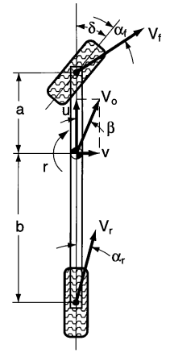
AMR Model for MPC Design
2 DOF bicycle model
α_{f}- front tyre slip angle
α_{r}- rear tyre slip angle
ẟ- front wheel angle
β- side-slip angle
r- yaw velocity
a- distance of front wheel from center of mass (CoM)
b- distance of rear wheel from CoM
V₀- velocity of CoM
V_{f}- velocity of front tyre
V_{r}- velocity of rear tyres
v
u
7
Notes:
Model Predictive Control (MPC) has become very popular in recent years due to advancements in computational technologies and newer more-effective MPC algorithms
MPC allows consideration of system constraints during controller design
Control signals can be restricted within physically realizable limits
Controllers designed based on linear approximations can be used to control non-linear systems

Slide 8

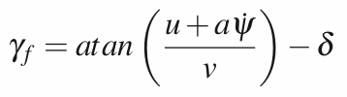



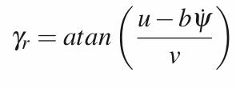



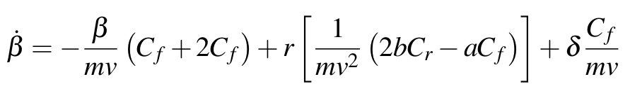
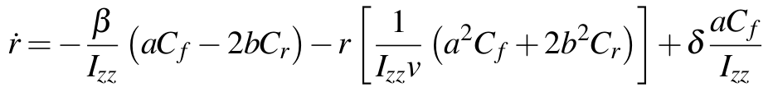
AMR Model for MPC Design
Equations of motion:
Lateral tyre forces:
Tyre angles:
With small angles approximations,
The equations of motion then yeild the following differential equations,
8

Slide 9
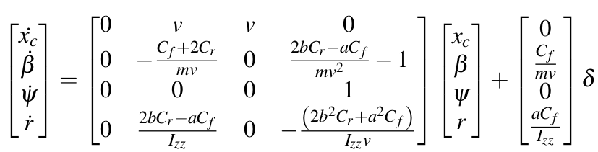
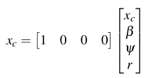
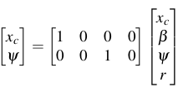
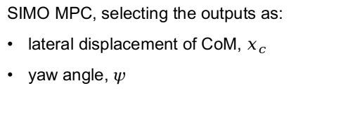
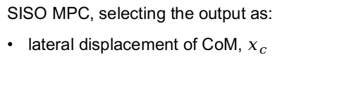
AMR Model for MPC Design
With the input as the front wheel angle (ẟ), selecting state variables as:
lateral displacement of CoM, x_{c}
side-slip angle, β
yaw angle, ψ
yaw velocity, r
SISO MPC, selecting the output as:
lateral displacement of CoM, $x_{c}$
SIMO MPC, selecting the outputs as:
lateral displacement of CoM, $x_{c}$
yaw angle, ψ
9

Slide 10
Simulation
Simulations were carried out on MATLAB and Simulink
Vehicle Body 3DOF Single Track model from Simulink's Vehicle Dynamics Blockset was used for simulations
Perfect tracking of the AMR's longitudinal position is assumed since this study focuses on lateral displacement control
Controllers:
PID controller- pidTuner (MATLAB)
SISO MPC
SIMO MPC
Performance of the three controllers were compared on a basis of a scaled error norm
10
Notes:
Reference signal is lateral position trajectory produced in the path planning step
Yaw angle reference is also provided for the SIMO-based MPC controller- obtained by computing the angle between an AMR mounted frame and the fixed earth frame at every time-step

Slide 11
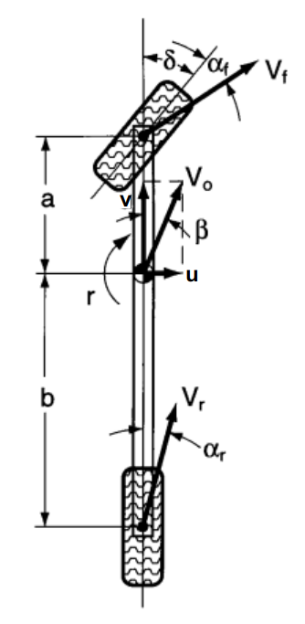
Simulation
AMR Parameters
Mass (kg): 505
Yaw mass moment of inertia (kg.m^2): 808.5
Distance of front wheel from CoM, a(m): 0.35
Distance of rear wheels from CoM, b(m): 0.4125
Path Planning Parameters
K_{att}: 0.01
K_{rep}: 10
AMR size allowance (m): 0.35
Obstacle radius (m): 1
AMR initial position: (0, 0)
Goal position: (50, 31)
Obstacle locations: (14.87, 33.28); (10, 8); (26, 12); (19, 19); and (34, 23)
11

Slide 12
Simulation
PID Controller
Simulation sampling time (seconds): 0.01
MPC Controllers
Simulation sampling time (seconds): 0.05
Prediction horizon (time-steps): 25
Control horizon (time-steps): 4
Maximum front wheel angle: ±40 degrees
Maximum front wheel angular velocity: ±30 degrees/second
12

Slide 13
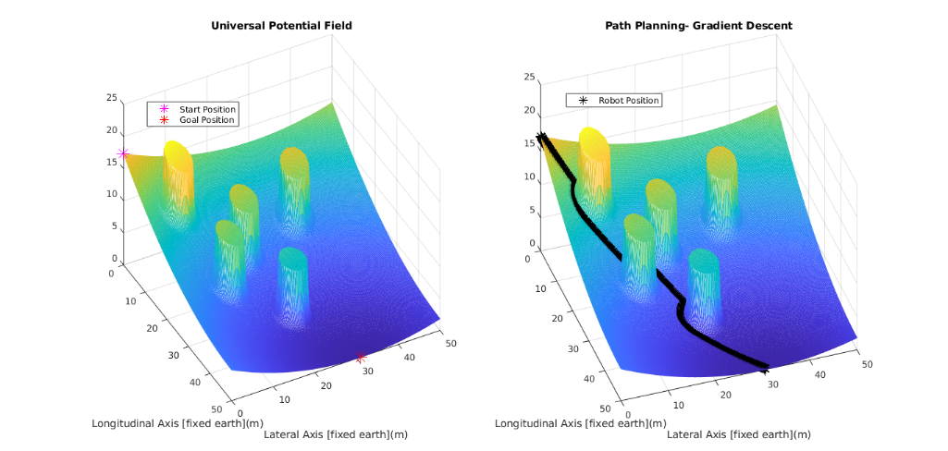
Scenario 1
13

Slide 14
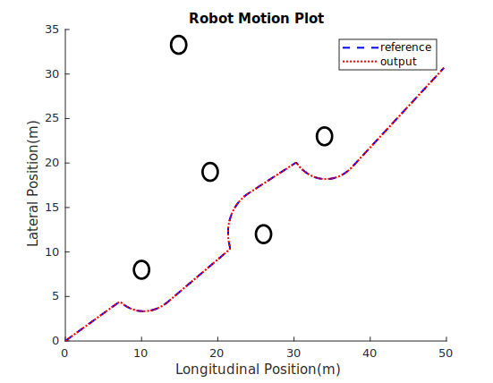
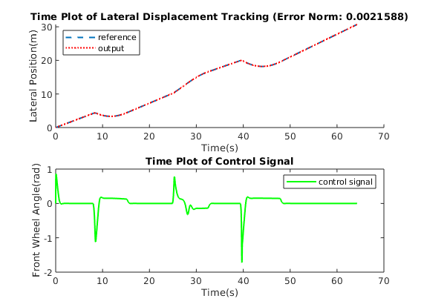
Scenario 1 PID
Start point
End point
14
Notes:
Perfect Tracking
Maximum wheel angle within physical limits

Slide 15
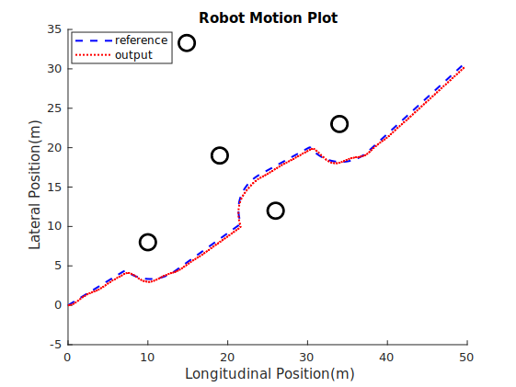
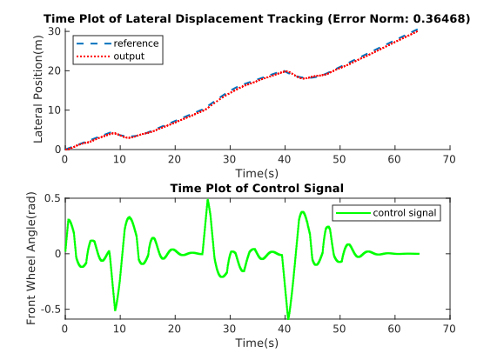
Scenario 1 SIMO MPC
Start point
End point
15
Notes:
Tracking not as good as PID

Slide 16
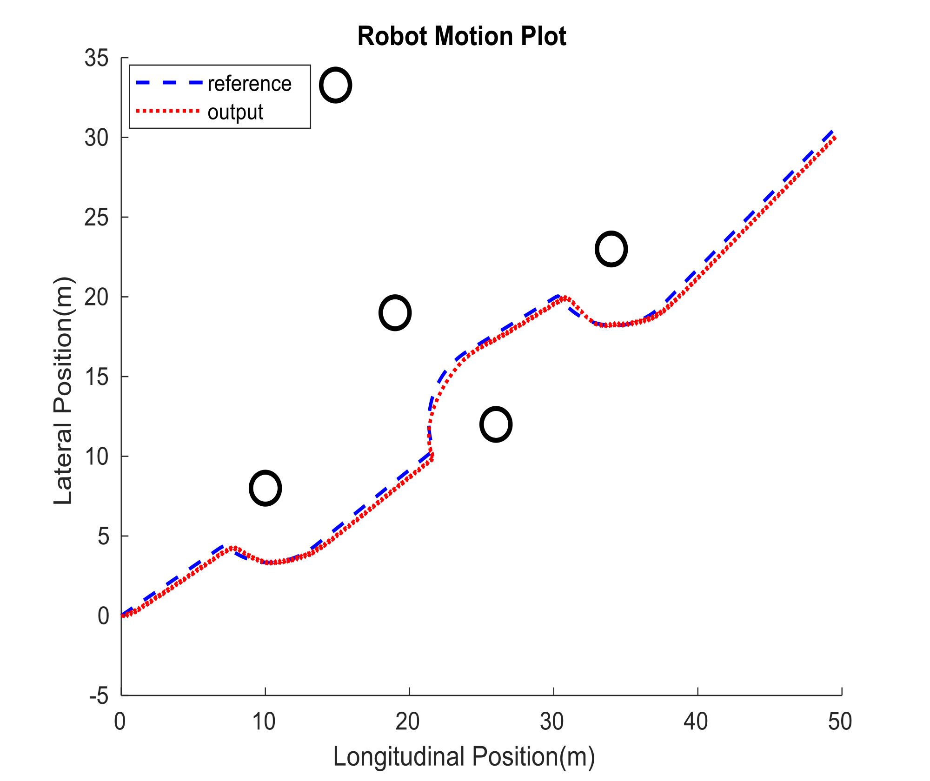
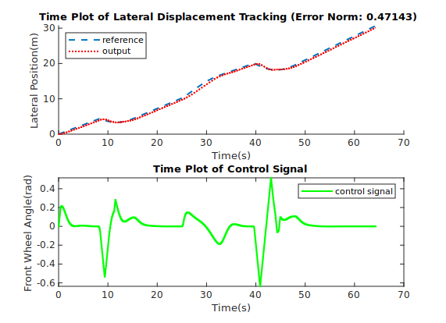
Scenario 1 SISO MPC
Start point
End point
16
Notes:
Tracking not as good as other 2
Sharper changes in wheel angle

Slide 17
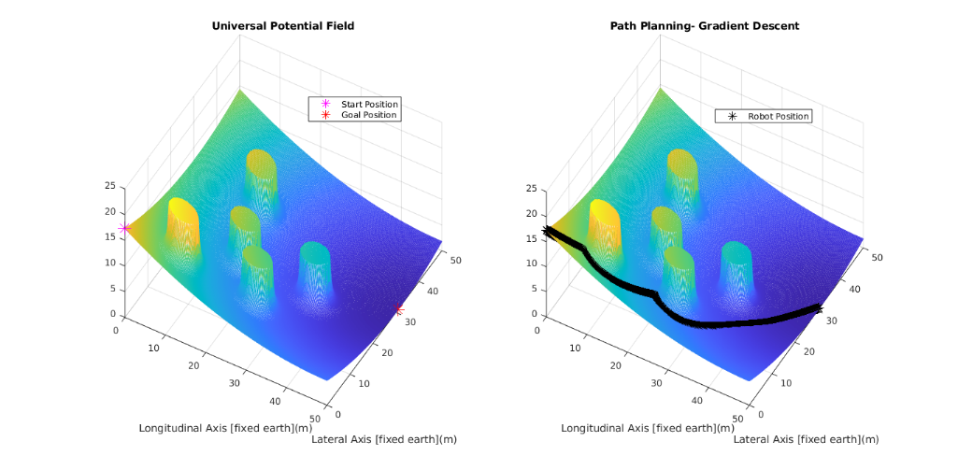
Scenario 2
17
Notes:
Path planning parameters altered to increase obstacle region of influence

Slide 18
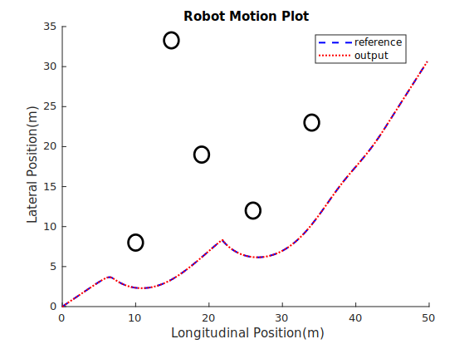
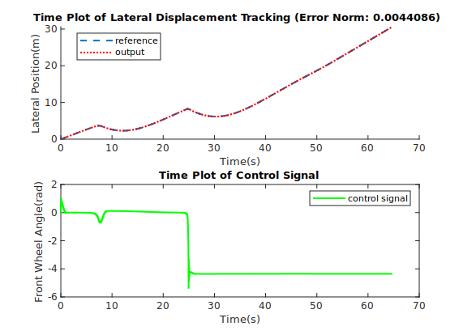
Scenario 2 PID
Start point
End point
18
Notes:
Perfect tracking
COntrol signal not physically realizable- about -5 radians at osme point

Slide 19
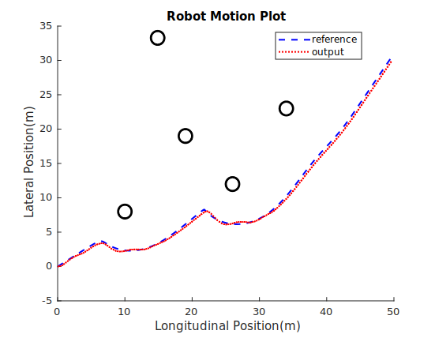
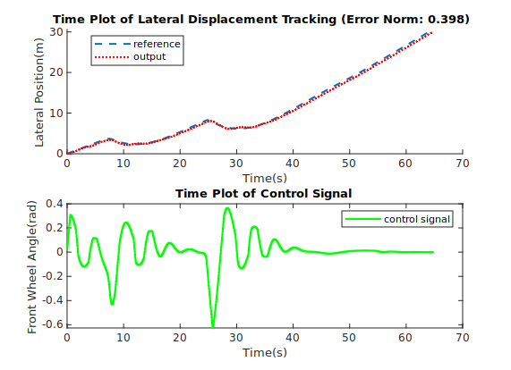
Scenario 2 SIMO MPC
Start point
End point
19
Notes:
Good tracking
Control signal is physically realizable

Slide 20
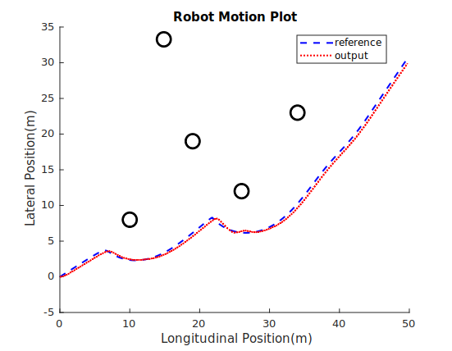
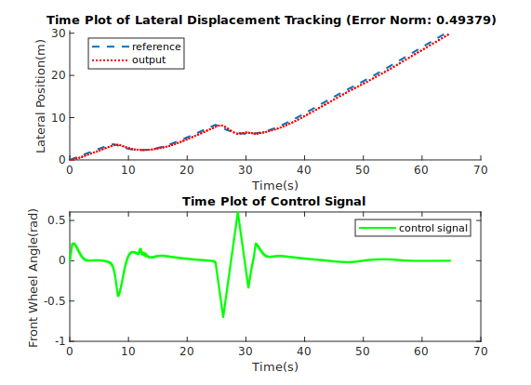
Scenario 2 SISO MPC
Start point
End point
20
Notes:
Not so good tracking
COntrol signal within bounds

Slide 21
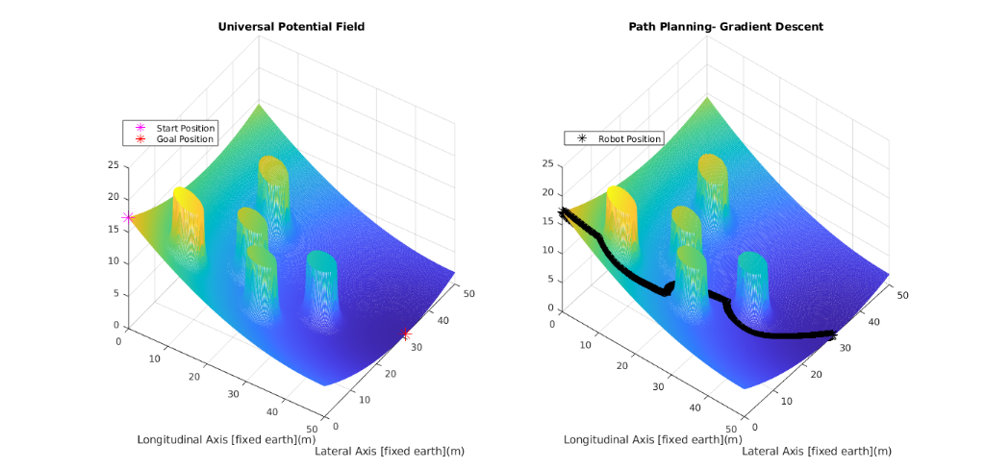
Scenario 3
21
Notes:
Further alterations to path planning parameters to change planned path

Slide 22
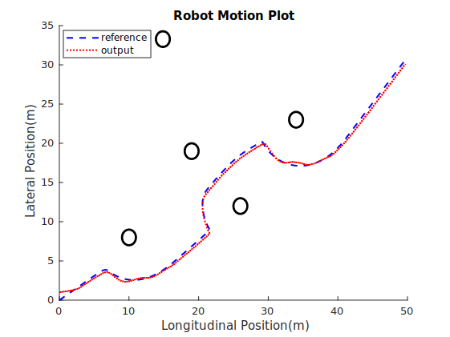
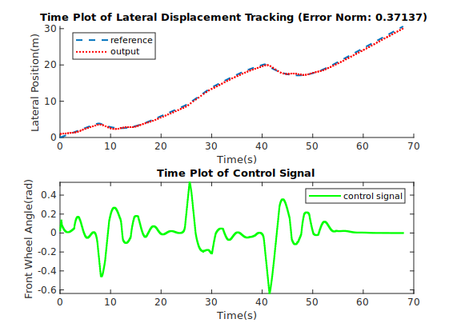
Scenario 3 SIMO MPC
Start point
End point
22
Notes:
Good tracking

Slide 23
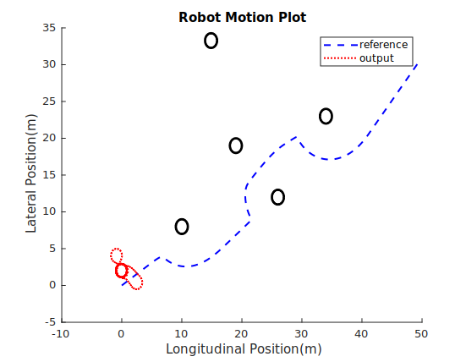
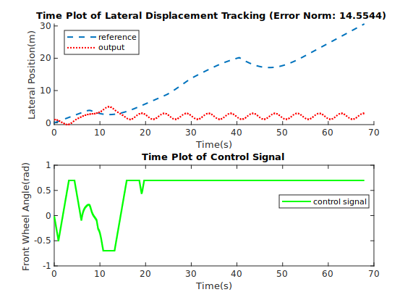
Scenario 3 SISO MPC- 25
23
Notes:
Perfect longitudinal tracking is omitted in this plot, such that the circular motion of the AMR is evident
System becomes unstable

Slide 24
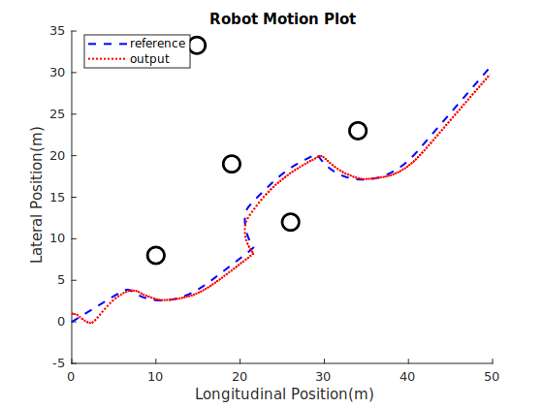
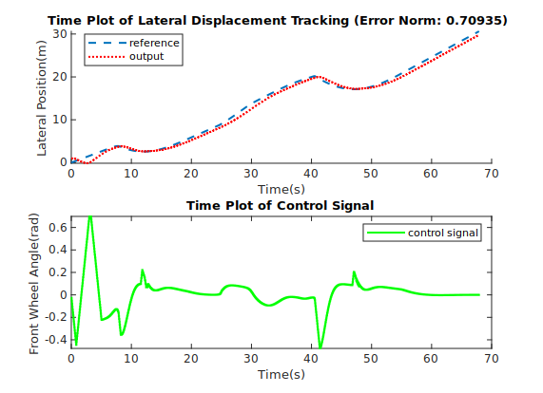
Scenario 3 SISO MPC- 35
Start point
End point
24
Notes:
Increasing the prediction horizon restores stability

Slide 25
Conclusion & Future Works
Conclusion
In an indoor environment with an accurate mapping and localization scheme, path planning and obstacle avoidance for AMRs moving at relatively slow velocity can be successfully carried out using APFs and MPC.
Future Works
Extend obstacle avoidance scheme to include longitudinal position tracking
Investigate global and local mapping of AMR configuration space
Study AMR localization techniques based on Ultra Wide Band technologies
25
Notes:
Indoor environment- Aerodynamic and gravitational side forces can be neglected

Slide 26
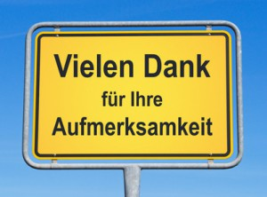

26

