Slide 1
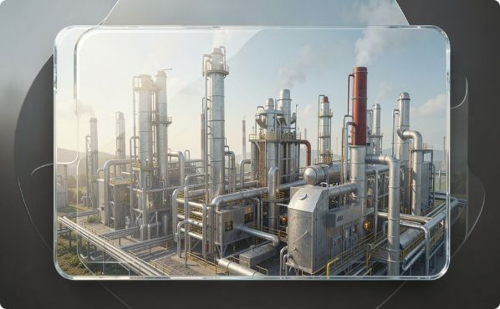

ReLoop AI
Turning Industrial Waste into Intelligent Value
Team
Brand
Blip Core — Product, AI & Industrial Ops
Project Jarvis — Hackathon build, investor-ready prototype
Glassmorphism hero: dark navy gradient backdrop, frosted cards, emerald & cyan accents — designed to create an immediate "wow" for investors and judges.

Slide 2
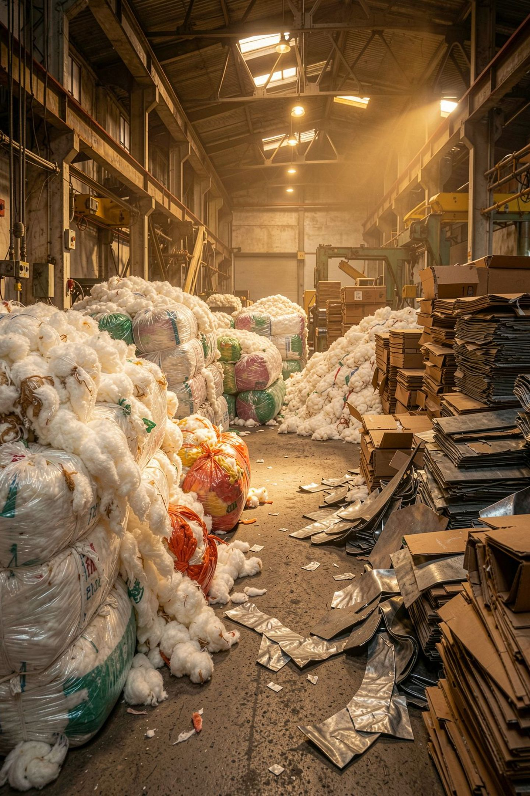





Why Current Industrial Waste Management Fails
COPILOT
DECISION GRIDLOCK
Manager lacks visibility — real-time quality and quantity are unknown
Unclear whether to reuse, recycle, or sell — financials hidden
TRANSPORT RISK
SUSTAINABILITY GAP
Logistics costs often outweigh marginal scrap value
CO₂ reductions not quantified — missed compliance / credits
The real challenge is not identifying waste — it's choosing the most practical and profitable pathway.

Slide 3

How ReLoop AI Solves It
ReLoop AI is an AI Decision Engine that turns raw waste data into executable, profitable disposal plans — with economic and CO₂ forecasts.
Waste Generated
Upload Data
AI Analysis
Decision & Report
Outcome: actionable recommendations like “Sell 500kg cotton to Buyer X tomorrow — est. profit ₹6,000; CO₂ saved 1.2t”.

Slide 4








Technology Behind ReLoop AI
Factory
React + Tailwind
Each component is containerized for rapid deployment; integrations use secure ETL to import ERP, weighbridge and invoice records.
Node.js + Express
Python AI Engine
React + Tailwind
Node.js + Express
Python AI Engine
PostgreSQL
Fast, accessible UI for managers and operators
Lightweight API layer, secure integrations with ERPs
YOLOv8 for detection, EasyOCR for invoices, XGBoost for decisions
Time-series and relational storage for traceability
Reports
PDF sustainability reports and executive dashboards

Slide 5
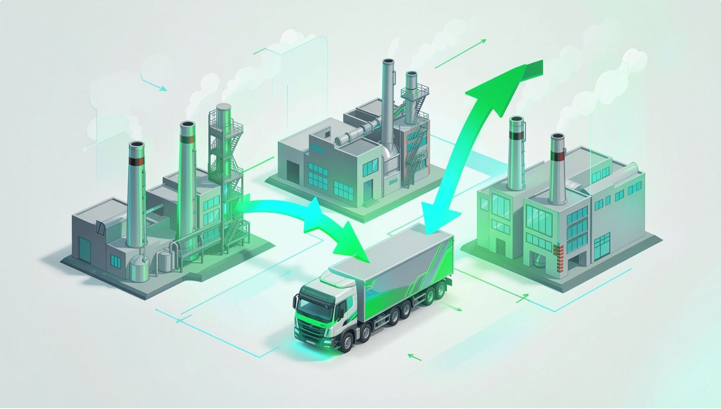

What Makes ReLoop AI Different?
1
Existing Solutions
2
ReLoop AI
Classify waste
Suggest recycling
Manual buyer selection
Analyze waste quality
Compare market demand & transport
Predict profitability and CO₂ impact
Recommend executable buyer + logistics
EcoLink AI — coordinated logistics across Factory A (300kg), Factory B (250kg), Factory C (200kg). Shared truck reduces transport cost, increases margin, lowers CO₂.
Benefits
Lower transport cost · Higher profit · Reduced emissions
Signature innovation: EcoLink AI — demand-aware pooling and route-aware profitability optimization.

Slide 6
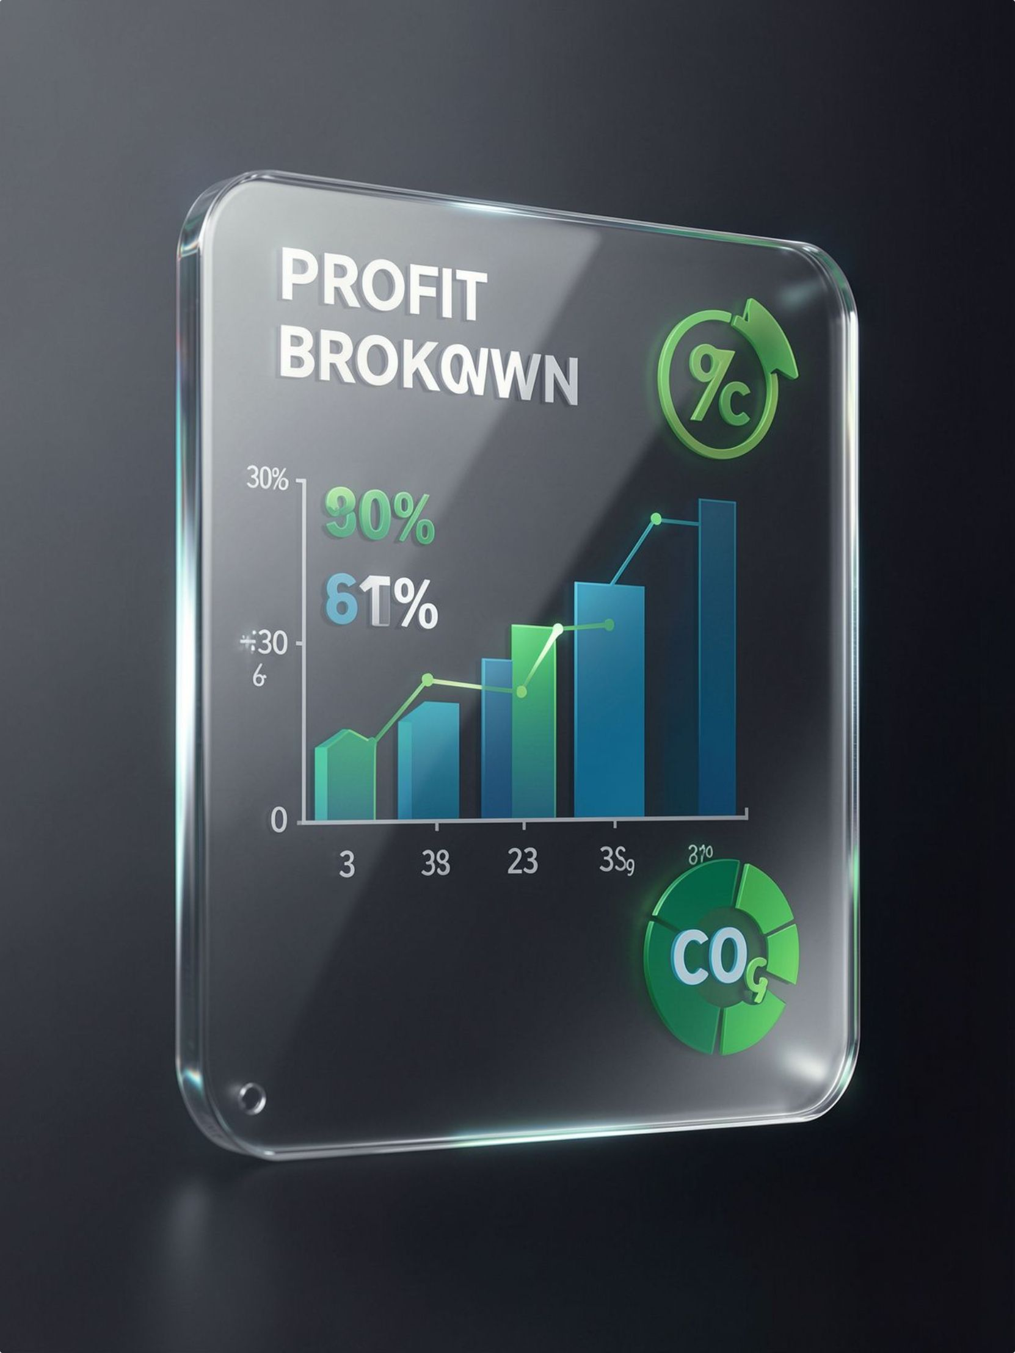

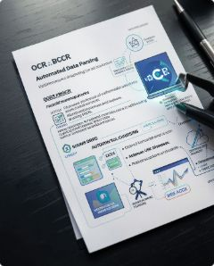

Practical Implementation
No extra hardware. Imports existing ERP, Excel, weighbridge slips and scrap invoices to produce immediate recommendations.
Demo Scenario
Input: Cotton waste · 500kg
Output
Best Buyer: GreenTex Recycling · Revenue: ₹8,500 · Transport: ₹1,800 · Processing: ₹700 · Profit: ₹6,000 · CO₂ Saved: 1.2 T
Inputs
Processing
ERP logs · Excel sheets · Weighbridge slips · Invoices
OCR + Vision + Market sync — zero hardware needed
Ready for pilot — 2-week integration timeline with typical ERP connectors and CSV ingestion.

Slide 7

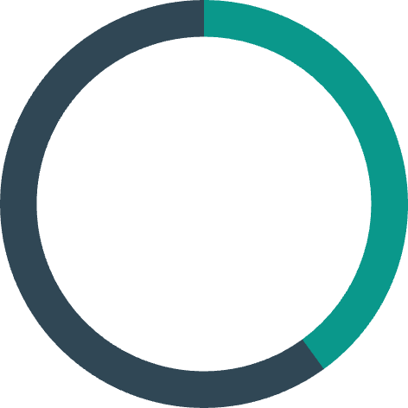



Turning Waste into Intelligent Value
₹6K
40%
Revenue / Batch
Landfill Reduction
Incremental revenue unlocked per typical scrap batch
Estimated avoided landfill share in pilots
1.2t
A
CO₂ Saved
Circular Score
Per optimized sale (example)
Operational circularity index
Future Scope
Live Recycling Marketplace
Carbon Credit Integration
Deep ERP & Logistics Provider Integrations
Predictive Waste Forecasting
Closing line: ReLoop AI transforms industrial waste into intelligent business decisions by combining AI, economics, and sustainability.
QR: [Prototype Access — placeholder]
Export-ready: high-resolution PDF + fully clickable multi-page prototype (Landing, Dashboard, Waste Analysis, Market Intelligence, EcoLink AI, Reports, Settings) — prototype includes realistic data, animated transitions, and glassmorphism UI components.

