Slide 1
92173
A Data Science Perspective

Slide 2
Scope: Visualization and Machine Learning
We will start by doing a real estate analysis of the 92173 Zip code.
This is a Zip code very dear to me as I have lived here for more than 10 years.
Code will be provided on a GitHub link.

Slide 3
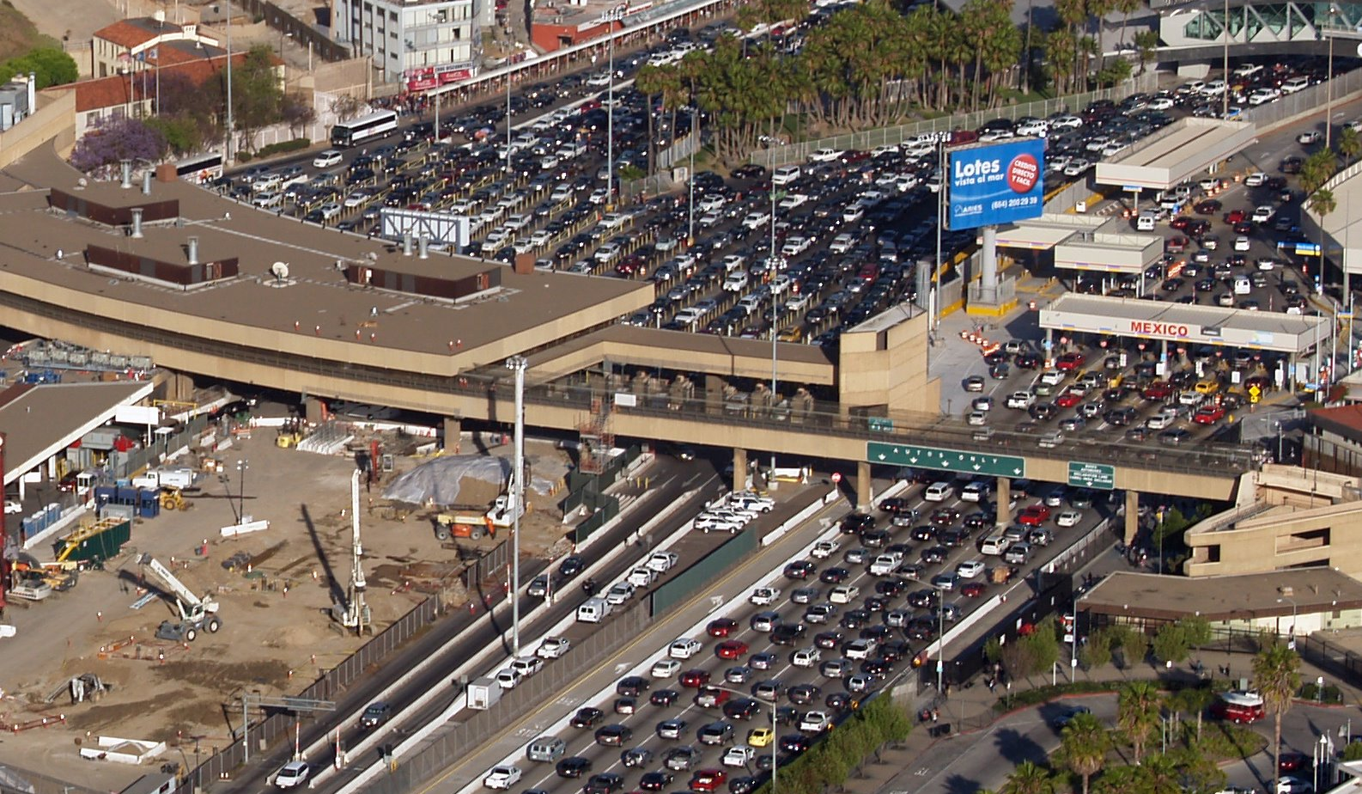
Between Two Worlds
The city of San Ysidro has been around since the 1900’s.
Serves as a gate between Mexico and the United States.
Also a rich community with a 93.8% Hispanic demographic makeup.
Source:https://statisticalatlas.com/neighborhood/California/San-Diego/San-Ysidro/Race-and-Ethnicity

Slide 4
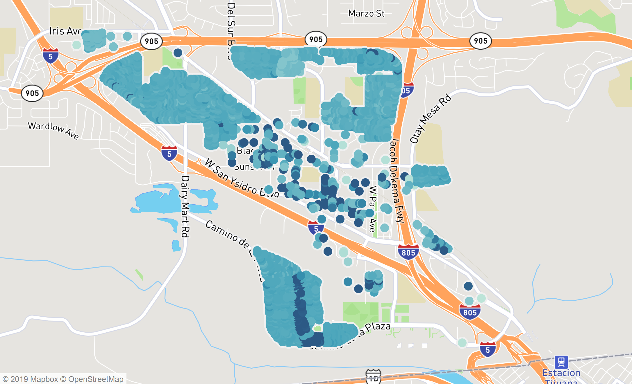
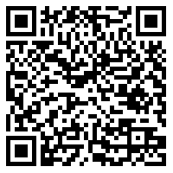
Initial Look at Housing
San Ysidro House Map by Prices
After connecting to the Zillow Api I managed to scrap data for 2415 residencies.
They are color coded by price, the darker the color the higher the price.
Full interactive map can be found here:
https://qrgo.page.link/tGB89

Slide 5
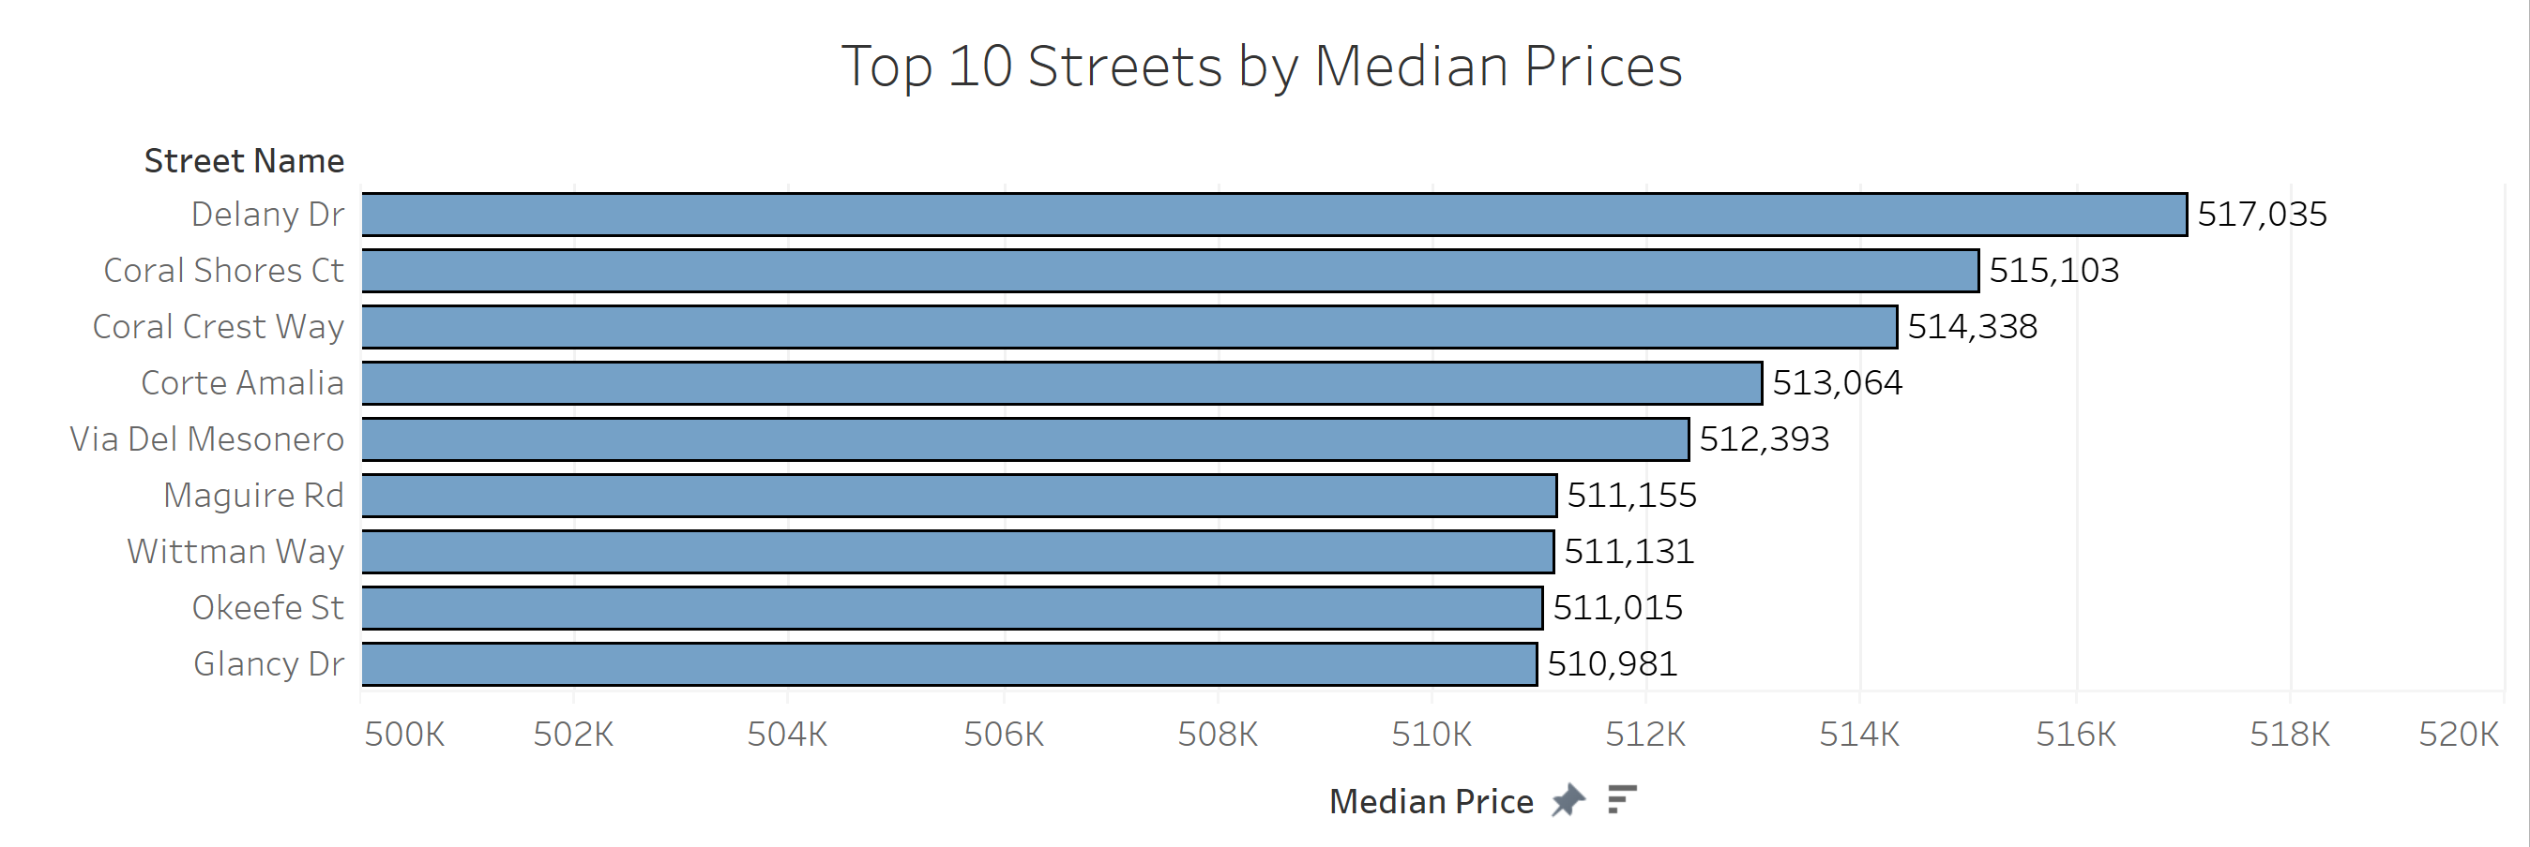
Most Valued Streets

Slide 6
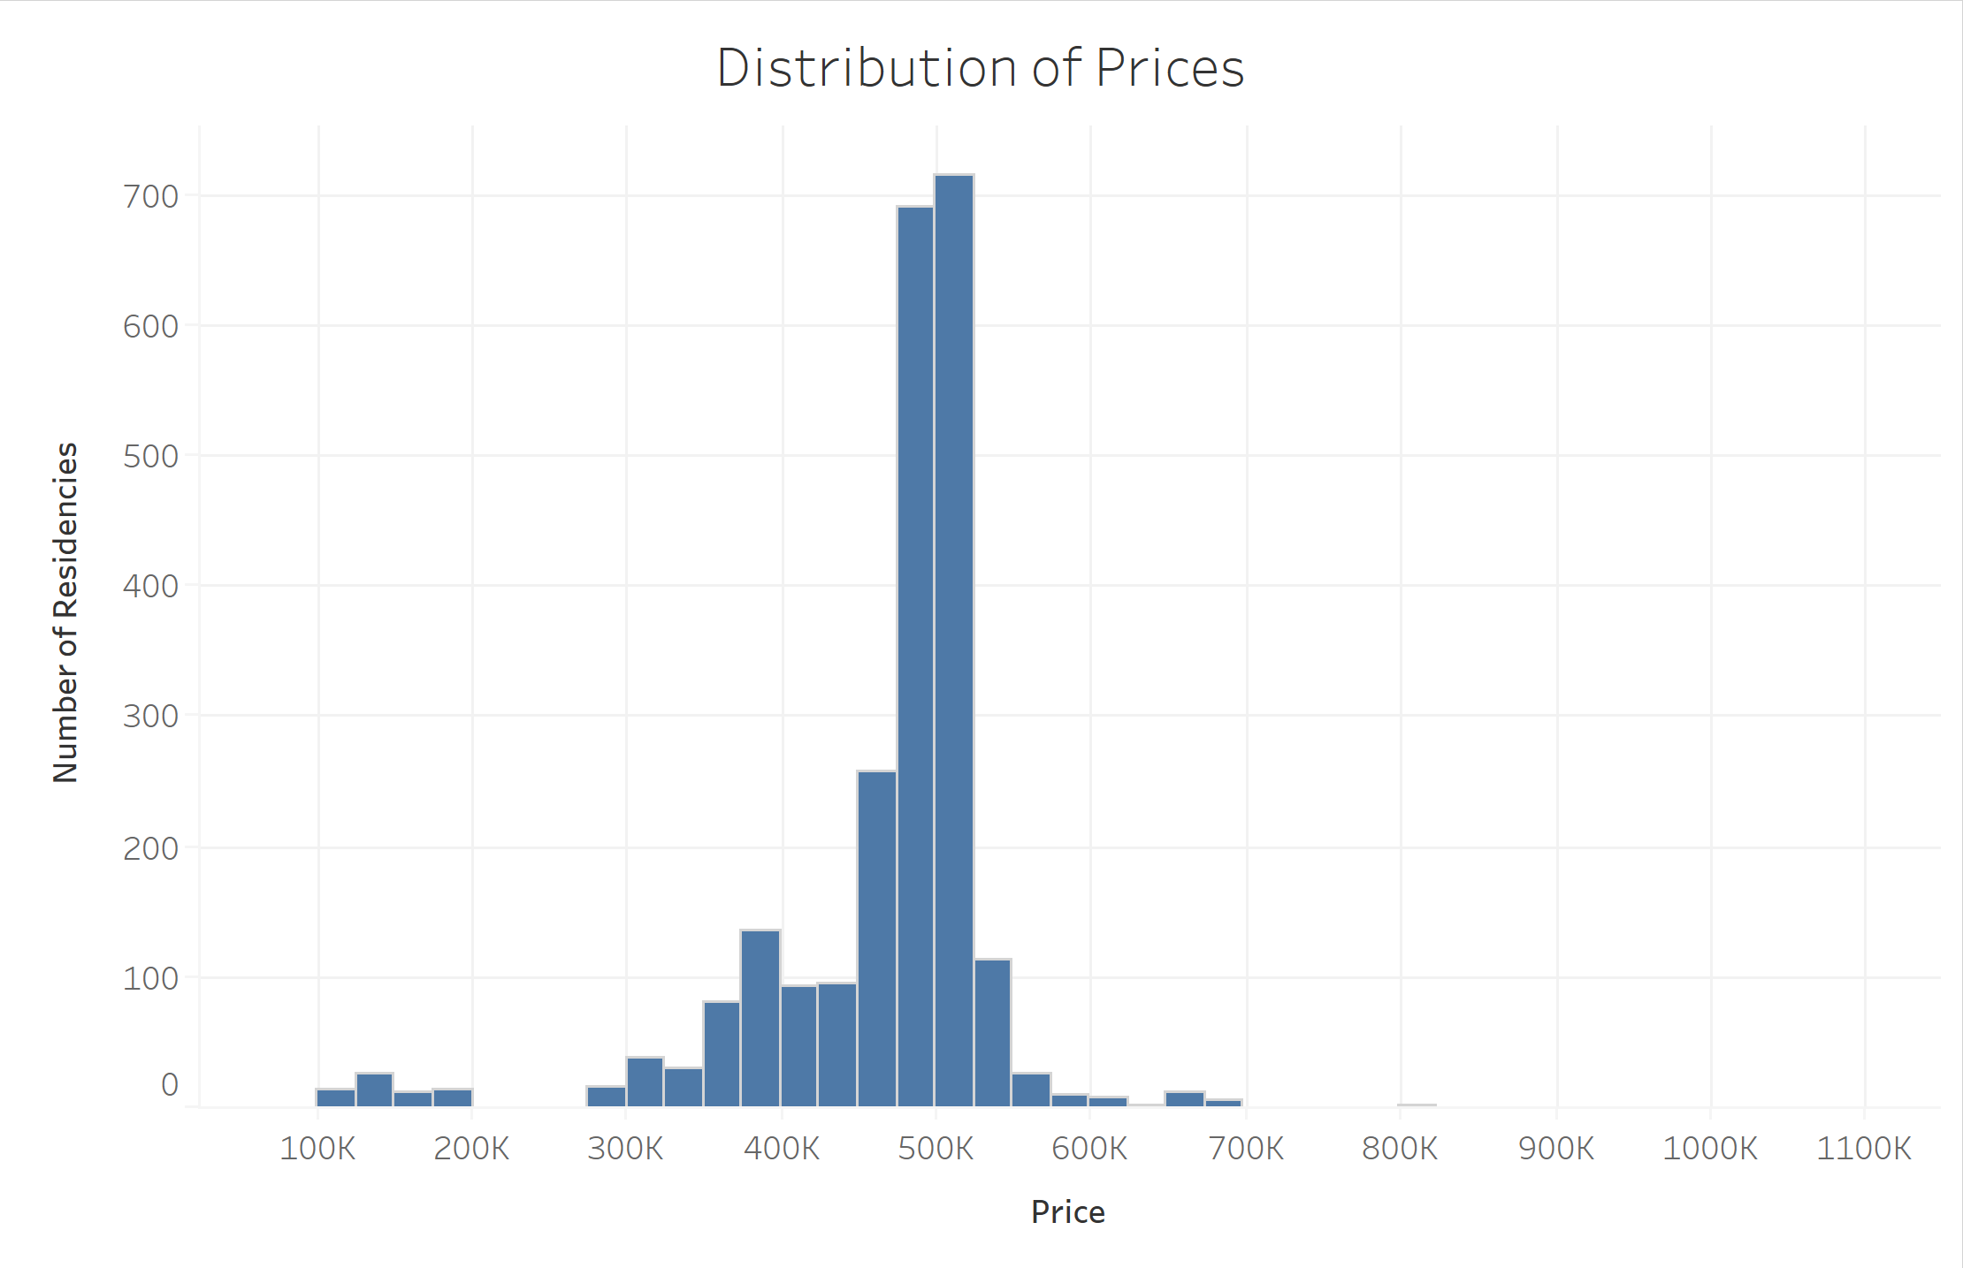
Distribution
Constructing a histogram we can take away the following.
Most houses are between 450K – 550K USD.
There is a small cluster of residencies from 100K to 200K USD.
This is follows a normal distribution.

Slide 7
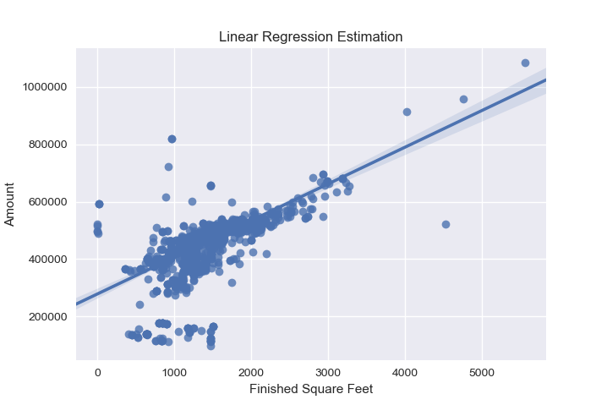
Regression Models (Price)
This type of continuous data on Prices requires regression techniques to make estimates.
On the right we can see a method known as Linear Regression minimized by OLS.
We draw the line of best fit and predict values based on that.

Slide 8
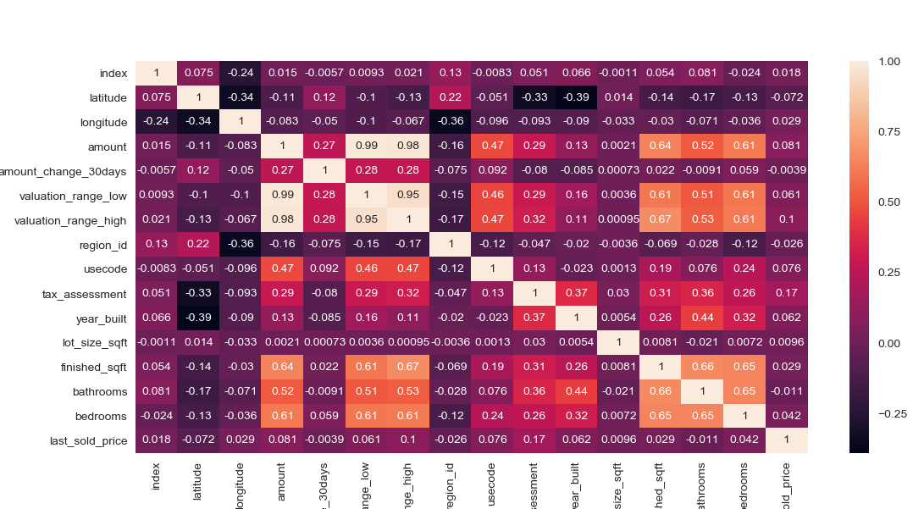
Feature Selection and Correlation
Correlation Matrix
Before we perform regression techniques for prediction, we have to pick which features are most important.
A good step is to draw a correlation matrix and choose
We chose:
Usecode
Finished_sqft
Bathrooms
Bedrooms

Slide 9
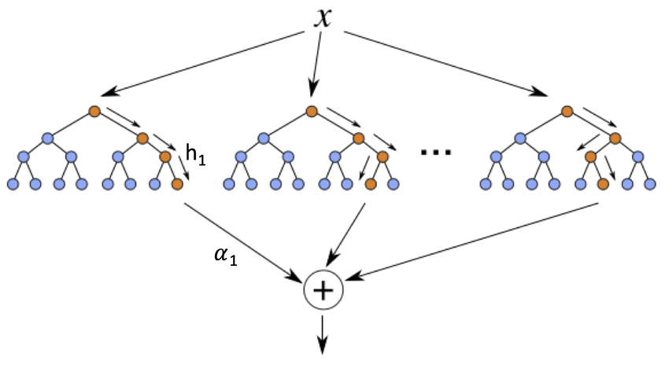
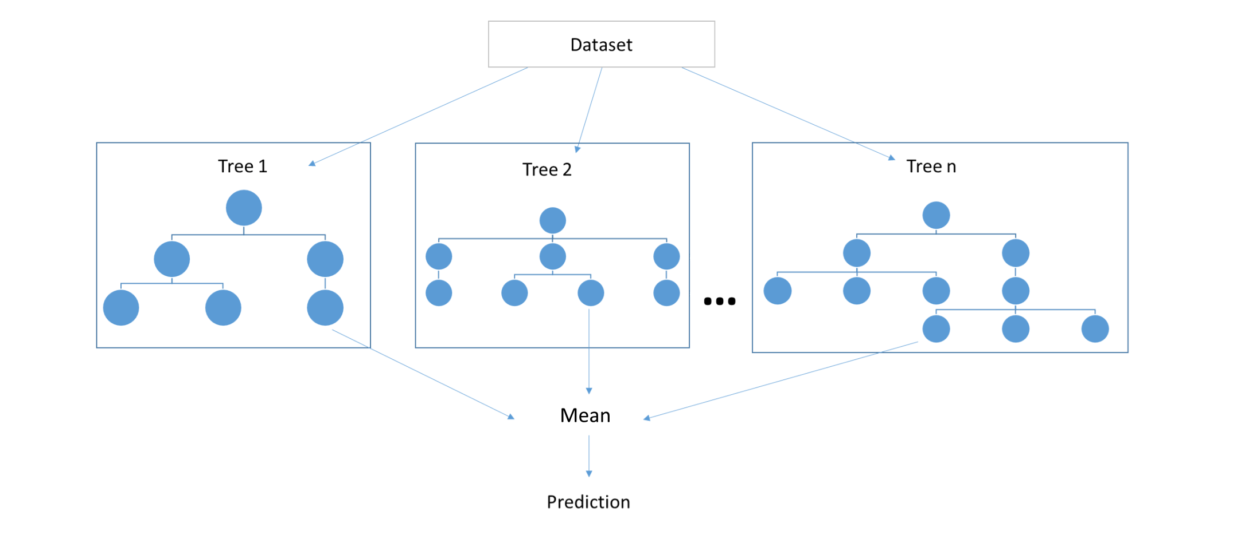
Machine Learning Selection
Linear Regression
XGBoost
We want to now guess and be able to predict the log(price) of a home with our selected features.
We Will use three different models and see how they each compare.
Three models:
Linear Regression
Random Forest
XGBoost
Random Forest

Slide 10
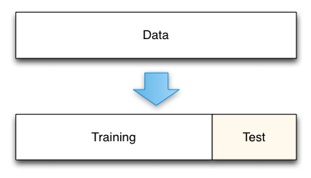
Training and Testing
We split our data into two data sets training and testing, 70% and 30% respectively.
This is done to test our machine learning model on observations it theoretically has not seen before.

Slide 11
Machine Learning Results
Target Variable | Log(Amount)
Model | Linear Regression | Random Forest | XGBoost
MAE | 0.105 | 0.090 | 0.102
After our results we can see that the lowest absolute error comes from a random forest regression of 0.090. We will interpret this in the next slide

Slide 12
Interpretation
Our best performing model was our Random Forest Regressor which scored a Mean Absolute Error of about 0.09 being the smallest error.
This mean that our model was approximately 9% off from the geometric mean.
This is an alright score and we theoretically should have scored higher ,but there are some issues within our data gathering process.

Slide 13
Analysis Problems
To improve further models we can think about our data gathering. The Zillow API was constantly missing observations of mobile homes and apartment complexes.
These two types make up a great deal of the San Ysidro community and not including them raised the overall mean of the zip code.
There was a systematic bias in our data collection which in turn is reflected in our models.

