Slide 1
Property Market Seattle
Insights and Charactericts

Slide 2
Dataset
Dataset
20.000+ sold houses and 22 characterictics
Target variable: Price = target variable
Feature engineering:
House age – Age of the house since built
Renovated – Binary: whether the house was renovated
Time to last renovation – Years since last renovation
Living space per floor – Average living area per floor
Living-to-lot ratio – Ratio of living area to lot size
Above-to-basement ratio – Ratio of above-ground area to basement
Beds per bathroom – Bedrooms divided by bathrooms
Lot type – Categorized as none / terrace / garden
Basement presence – Binary: whether a basement exists
Hot encoding applied to prepare categorical variables for ML
Outliers !!! (e.g. House with 33 bedrooms, most expensive house of almost 8M (Avg House 550k)

Slide 3
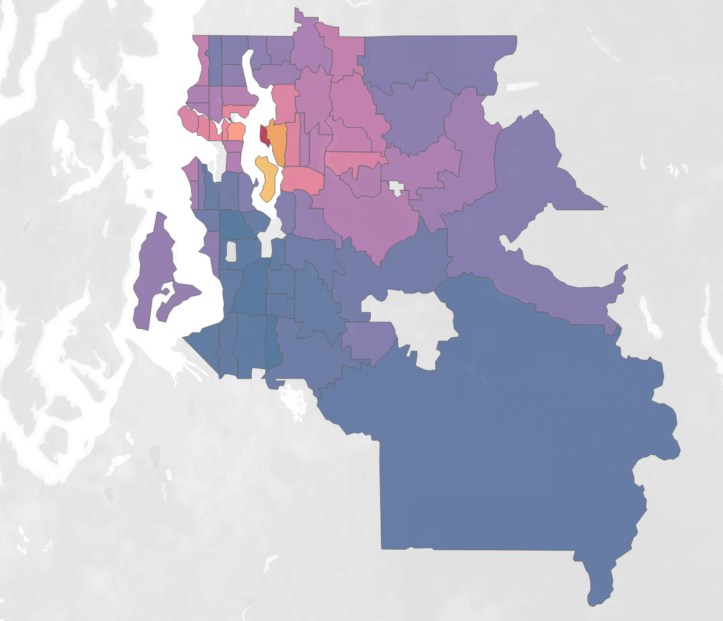
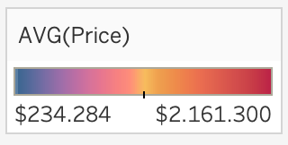
House Prices Vary Strongly by Location

Slide 4
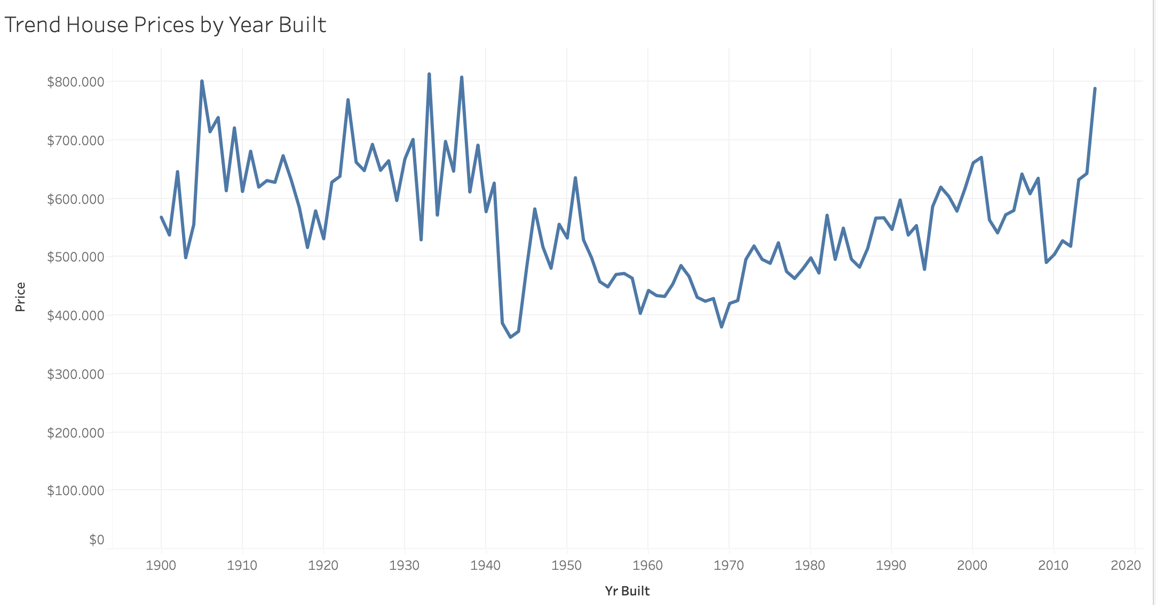
Year Built Drives Housing Price

Slide 5
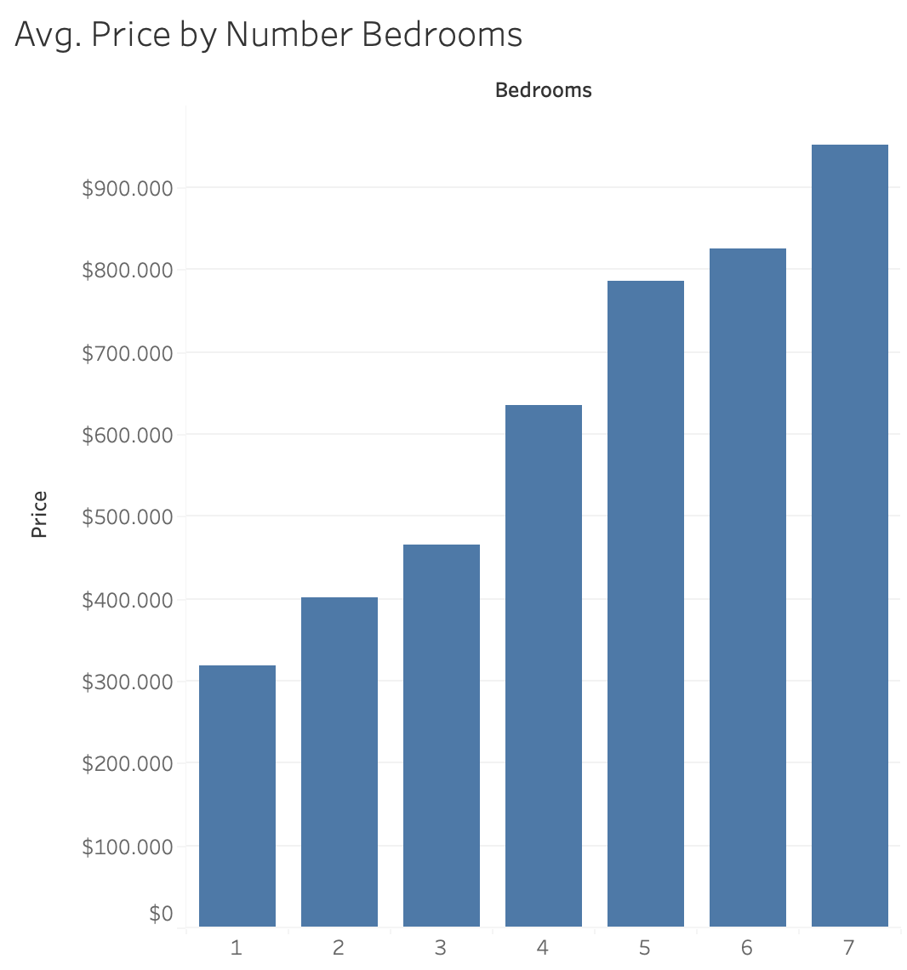
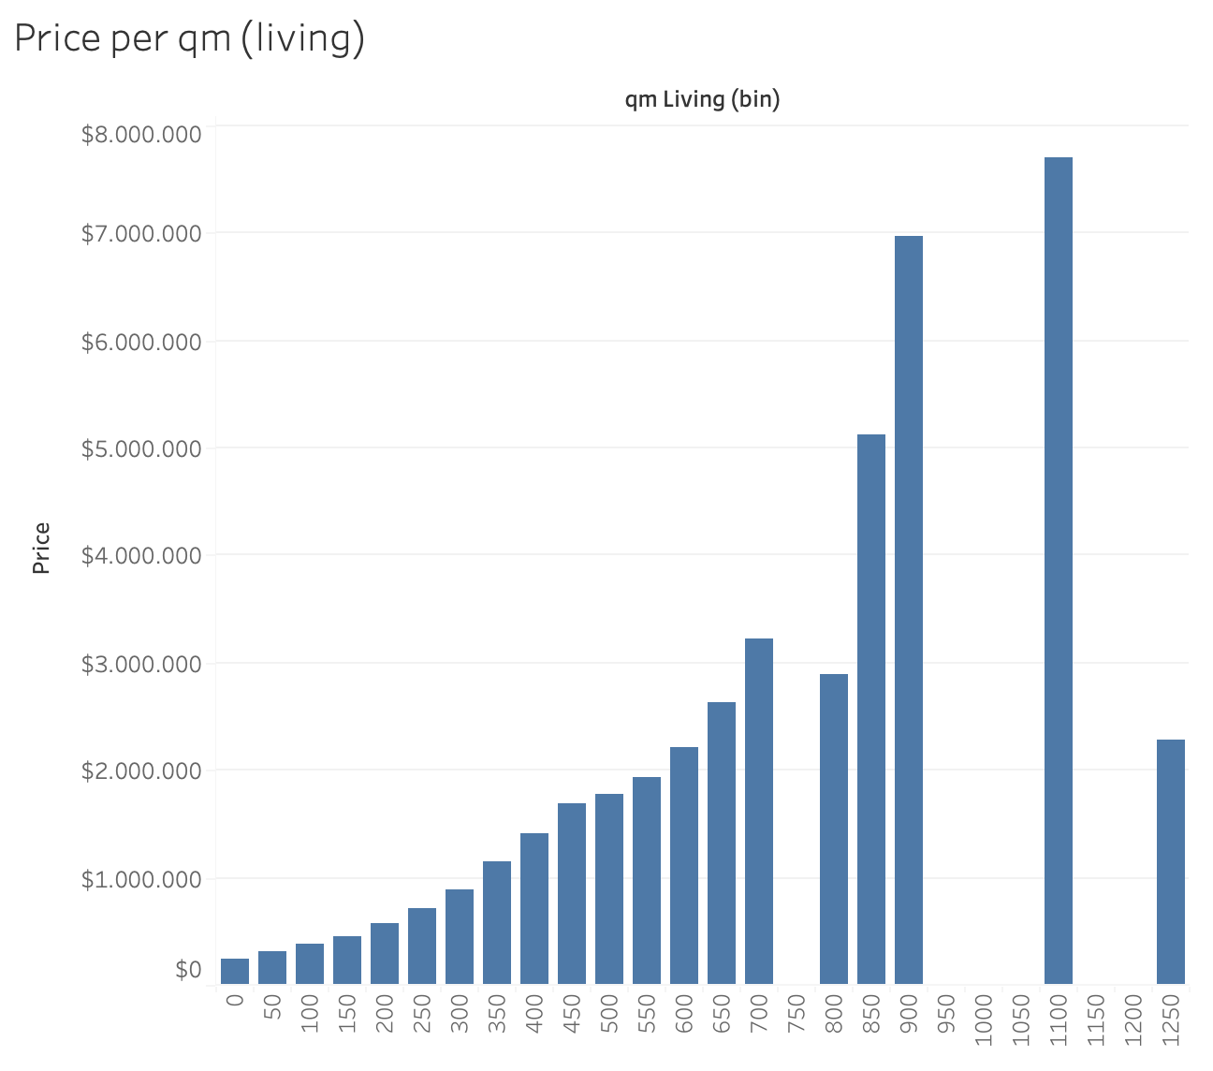
More Space, Higher Price

Slide 6
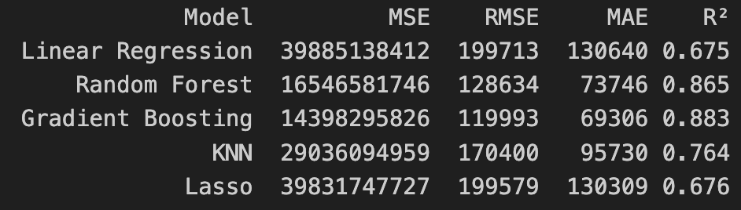
ML comparison: Regression models and performance
Best parameter by GridSearchCV:
n_estimtors = 300, max_depth = 500
n_estimtors = 500, max_depth = 5
KNN = 6
Alpha = 100

Slide 7

Conclusion
Why do GB and RF perform best?
→ handle nonlinear relationships + feature interactions effectively and are robust to outliers
LR and Lasso underperformed due to their linear nature and sensitivity to outliers
KNN showed moderate results, limited by high-dimensional data.
Treebased models are most effective for predicting housing prices!

