Slide 1
My first reinforcemt learning algorithm
Mini Project by Fee Pieper

Slide 2
Problem Introduction
Taxi-v3 problem: a taxi agent must pick up and drop off passengers at the correct locations in a grid world.
Goal: maximize total reward by completing tasks efficiently while avoiding illegal moves.

Slide 3
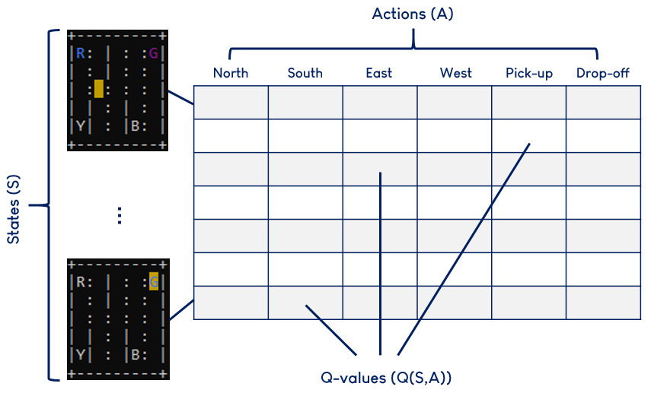
Phase 1 – Set up
Initialize environment
Provides a grid-world simulation with passenger pickup/dropoff tasks
Predefined actions (6x)
Create Q-table
Q-Learning (method enabling agents learning decision based on trial and error)
Shape (500,6)
500 States = 25 (taxi positions) x 5 (passenger locations) x 4 (destinations)

Slide 4
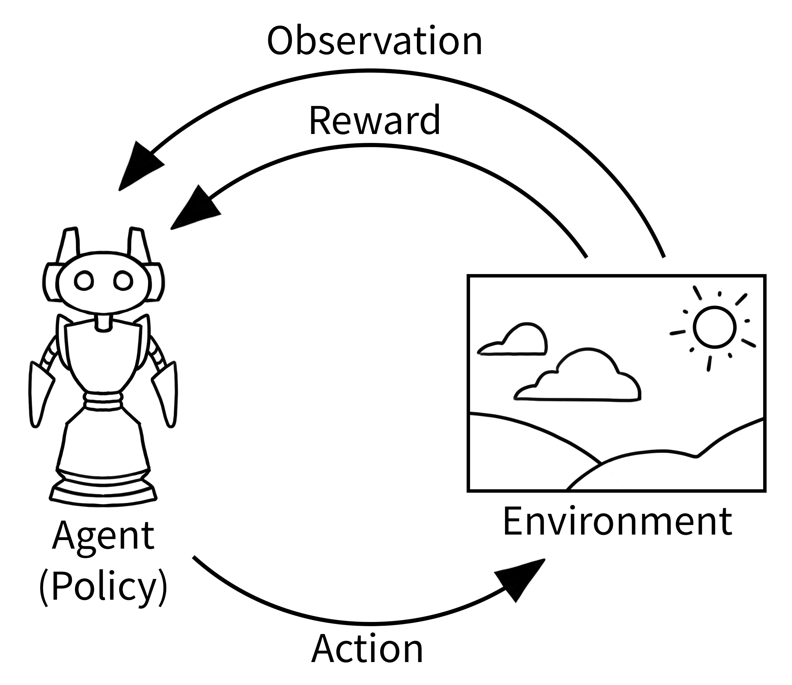
PHASE 2 - Training
Definition of hyperparameters
Key parameters:
Learning rate (α): 0.7 (overwriting of old knowledge)
Exploration rate (ε): 1.0 → decays to min_epsilon 0.05 with decay factor 0.9999
Episodes: 200,000
Episode initialization
Agent starts off at random state, performs random action in environment and gets reward. Loop.
Q-values are updated
Epsilon Decay after each episode

Slide 5
Example:
State 230 = taxi position (2,1) x passenger locations (2) x destination (2)
State 230
0
0
0
0
0
+20
Action | Reward
Valid move (N, S, E, W) | -1
Wrong pickup or dropoff | -10
Correct dropoff at destination | +20

Slide 6
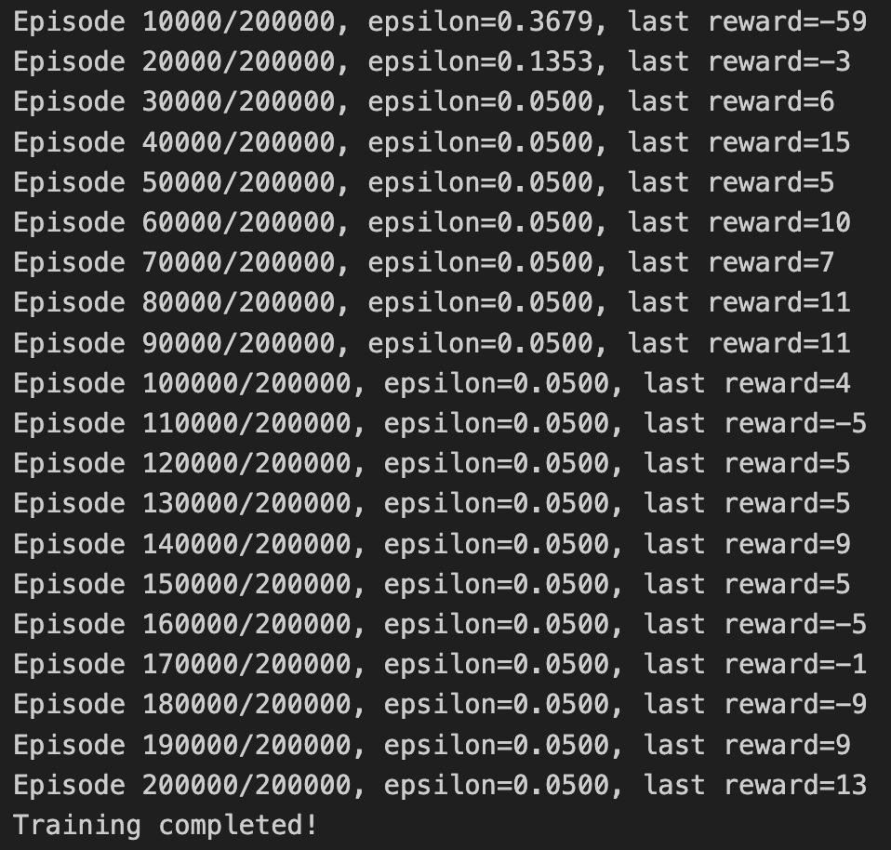
Output of Training Phase:
Phase 1: Early Exploration
(Episodes 0 – 30,000)
Epsilon: High, decaying from 1.0 to ~0.1353.
Behavior: Agent explores the environment a lot.
Rewards: Very negative at first (-59), improving slowly (-3 → 6).
Interpretation: Agent is still learning the basics—where passengers are and how to move efficiently.

Slide 7
Output of Training Phase:
Phase 2: Learning
(Episodes 30,000 - 50,000)
Epsilon: Reaches minimum 0.05.
Behavior: Exploration mostly done, agent starts exploiting learned Q-values.
Rewards: Positive and steadily improving (6 → 15).
Interpretation: Agent has learned reliable pickup/dropoff strategies and is increasingly successful.

Slide 8
Output of Training Phase:
Phase 3: Exploitation & Fine-tuning (Episodes 50,000 – 200,000)
Epsilon: Constant at 0.05 → mostly exploitation, occasional exploration.
Behavior: Agent uses learned policy efficiently.
Rewards: Mostly positive with minor fluctuations (4 → 13).
Interpretation: Agent is now proficient; occasional negative rewards are just edge cases.

Slide 9
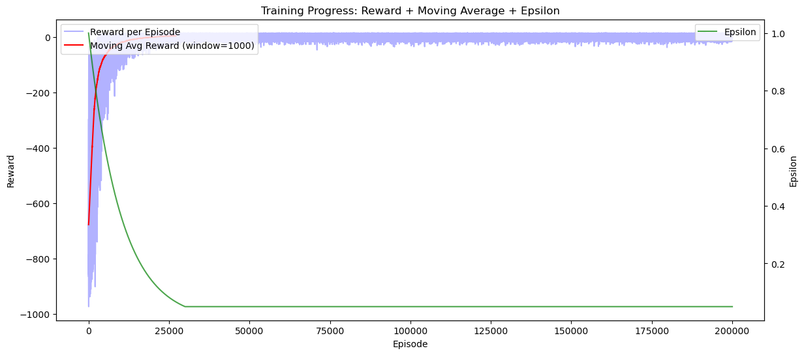

Slide 10
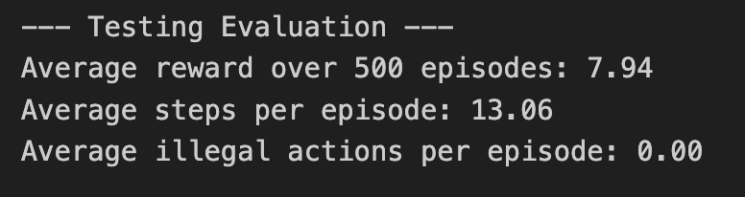
PHASE 3 - TESTING
Interpretation
Achieving rewards around 7–8 (best would be 11-13).
Taking ~13 steps instead of the minimum 7-9. Route efficiency could still be improved.
Consistently solving the task with no rule violations.

Slide 11
Key takeaway
Q-Learning
Exploration vs Exploitation (fuels learning, exploitation drives success)
Not yet perfect results – better algorithms?

