Slide 1

Notes:
NurdleDNA — D7 Final Presentation (7 min) ECTE 250 Team 2 · Arc Tech · UOWD · 2026 Format: Marp Markdown — export with: npx -y @marp-team/marp-cli@latest D7_slides.md --pptx npx -y @marp-team/marp-cli@latest D7_slides.md --pdf

Slide 2
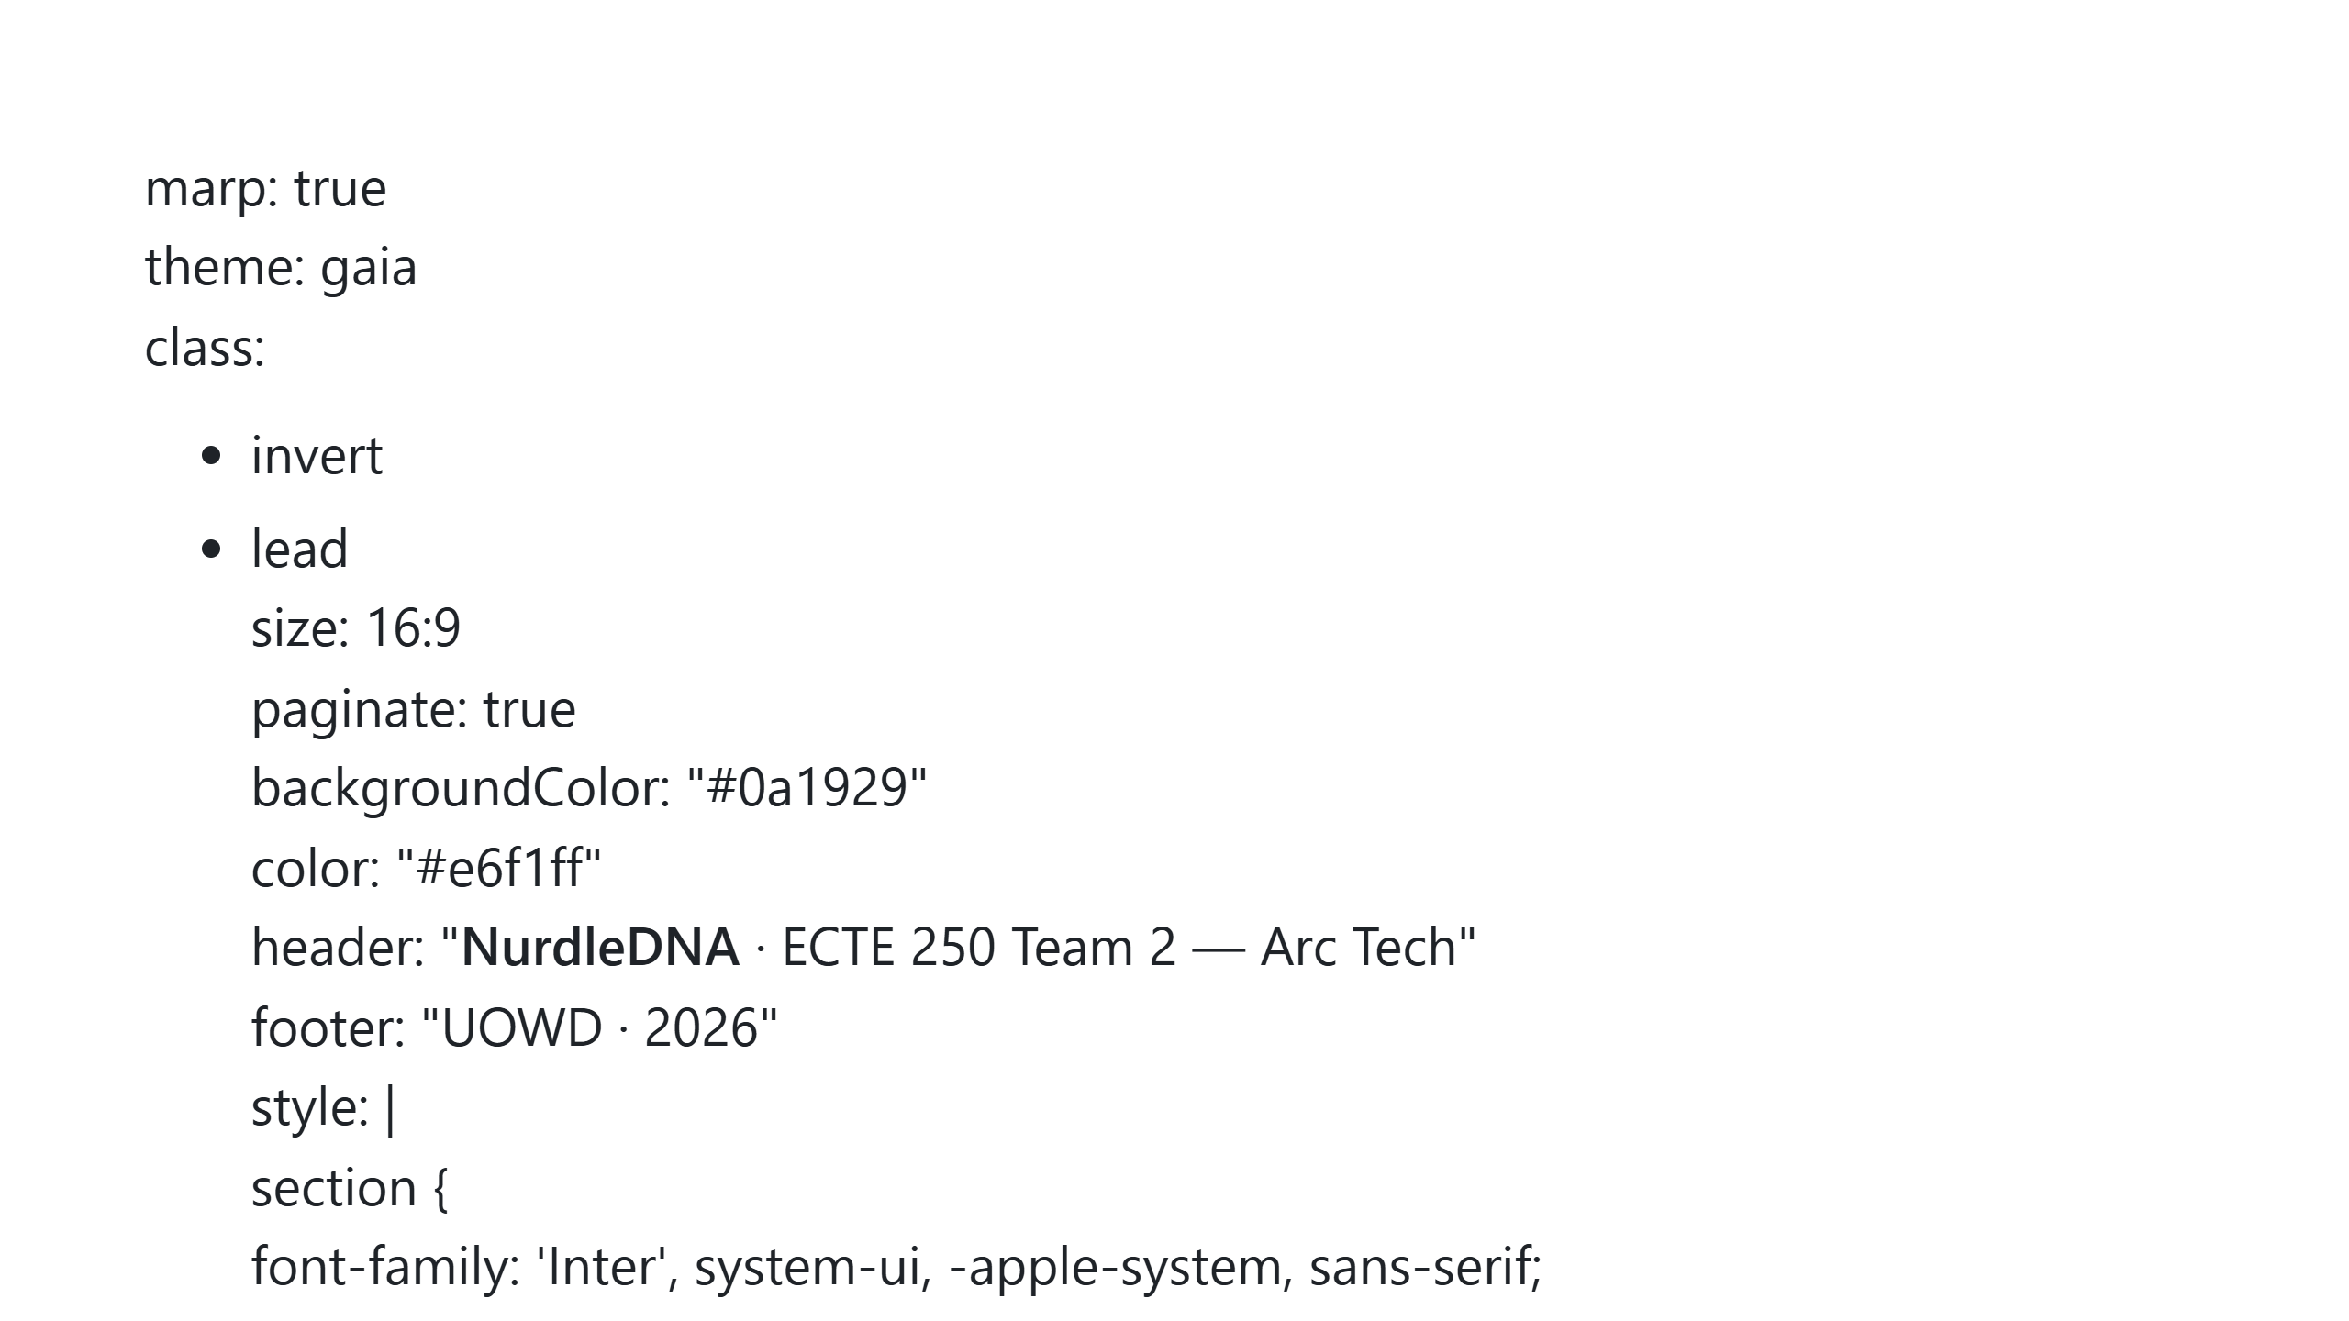

Slide 3
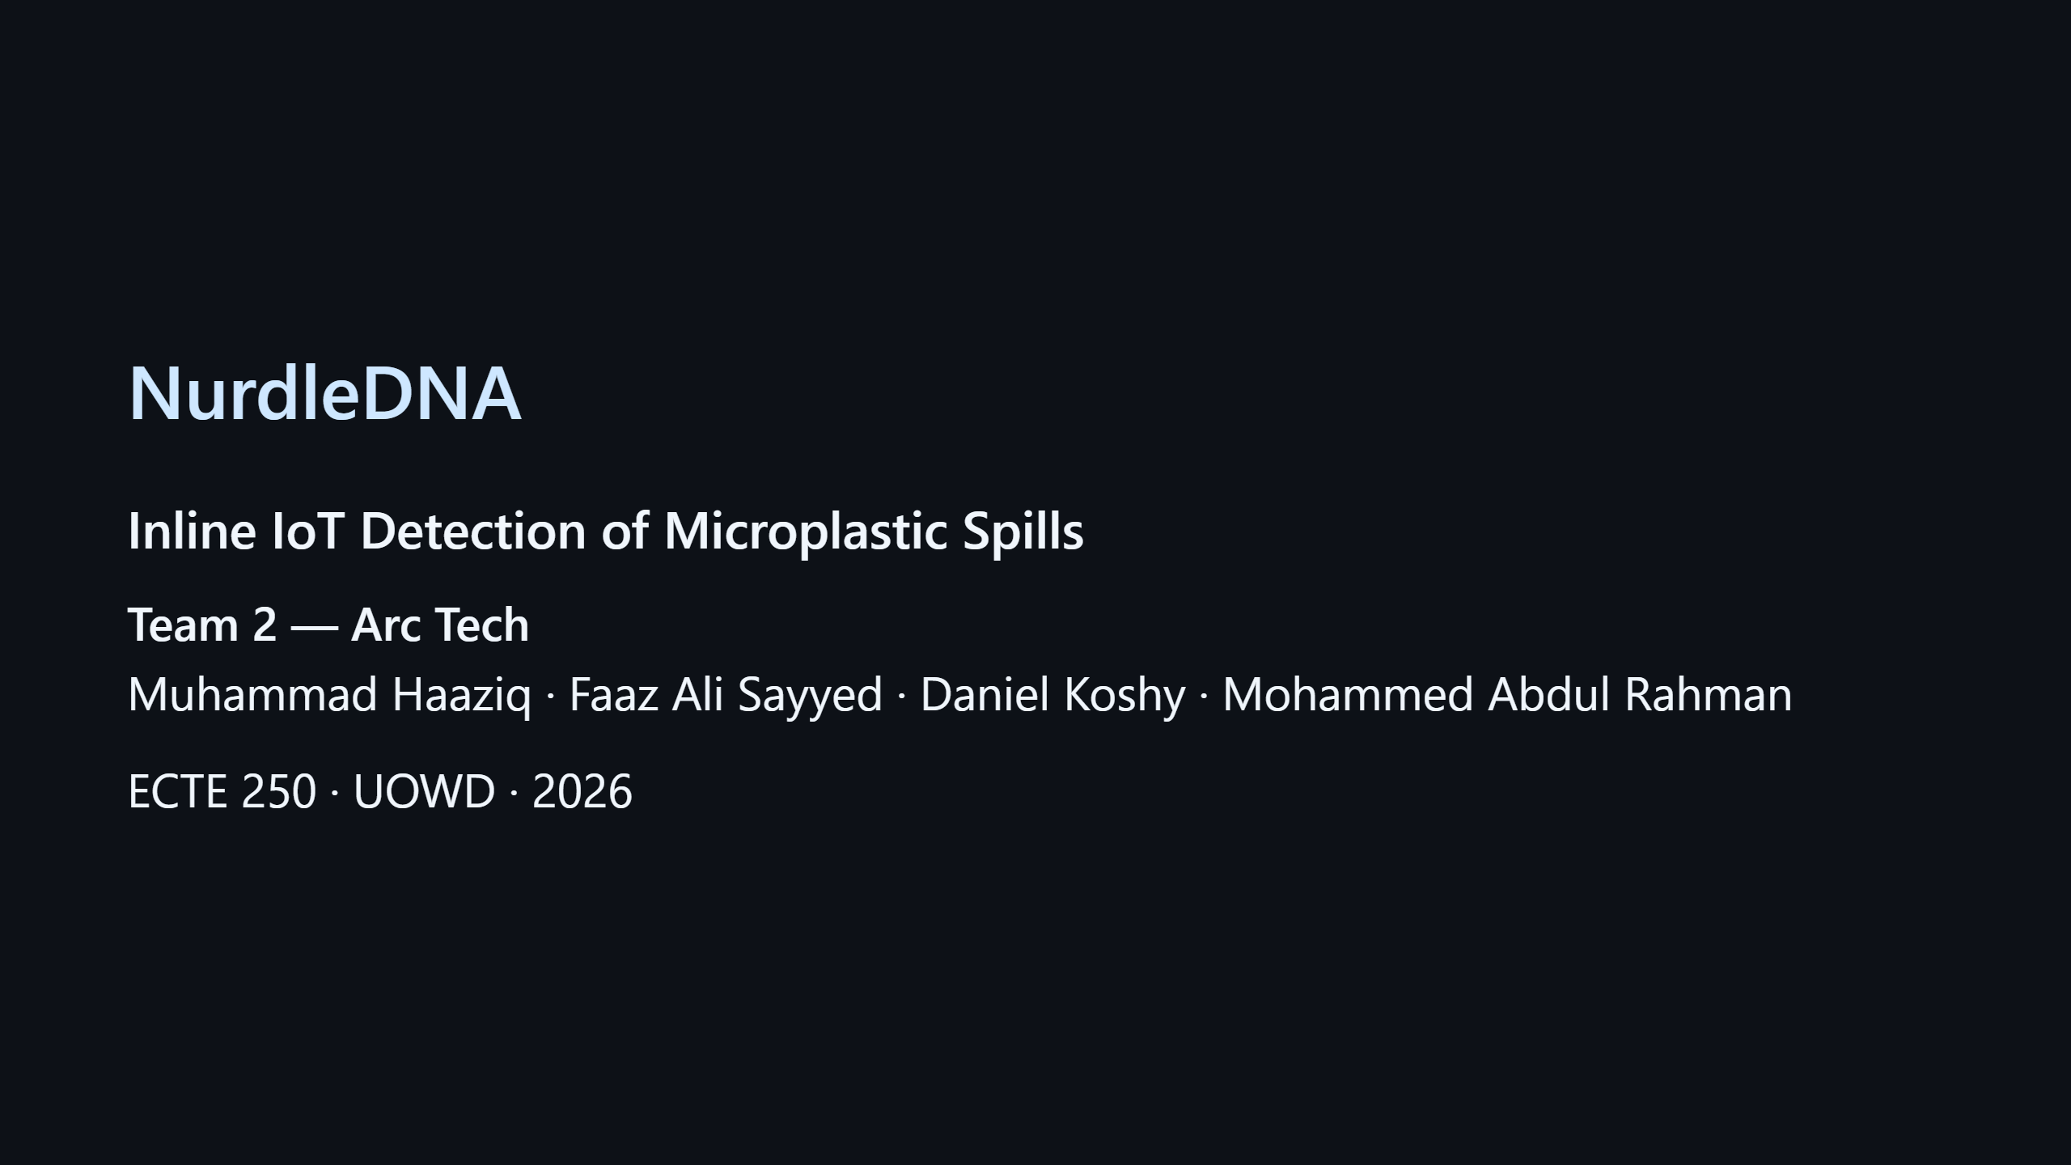
Notes:
SPEAKER NOTES (≈25 sec) "Good morning. We're Team 2 — Arc Tech. Our project, NurdleDNA, is an inline IoT unit that automatically detects and isolates microplastic contamination in industrial water flows. Over the next seven minutes I'll walk you through the problem, our design, the AI vision pipeline, and a live demo of the working system."

Slide 4
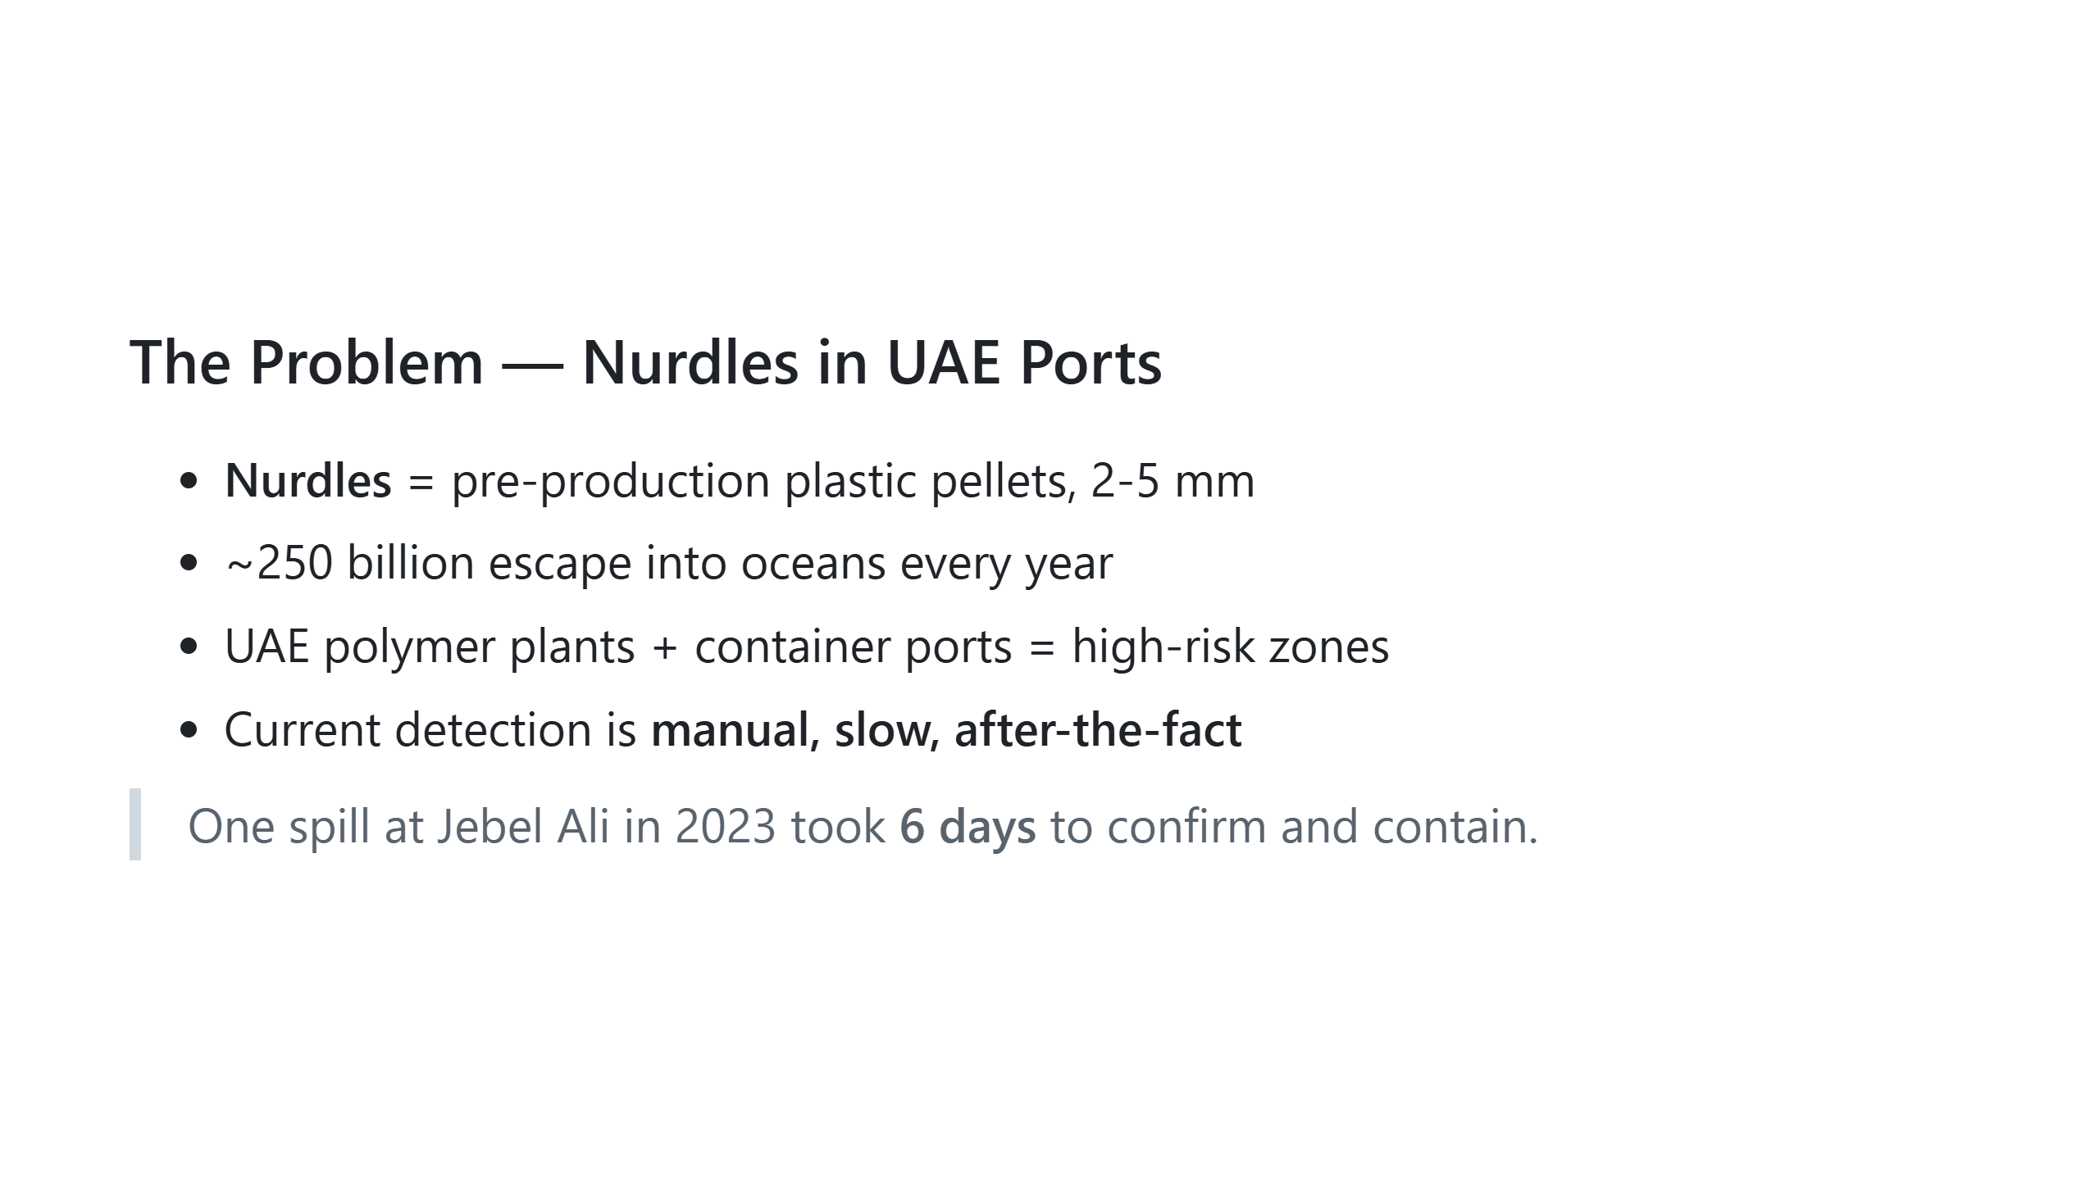
Notes:
TODO image: nurdle spill photo OR map of UAE polymer ports — bottom-right SPEAKER NOTES (≈50 sec) "Nurdles are the raw plastic pellets that polymer plants ship by the tonne. They're 2 to 5 millimetres across, easily lost during loading, and once they enter the marine environment they fragment into microplastics that take centuries to break down. The UAE has one of the densest concentrations of polymer manufacturing and container shipping in the world — Jebel Ali, Hamriyah, Ruwais — but right now spill detection is fully manual. A 2023 Jebel Ali incident took six days to confirm. We thought we could do better."

Slide 5
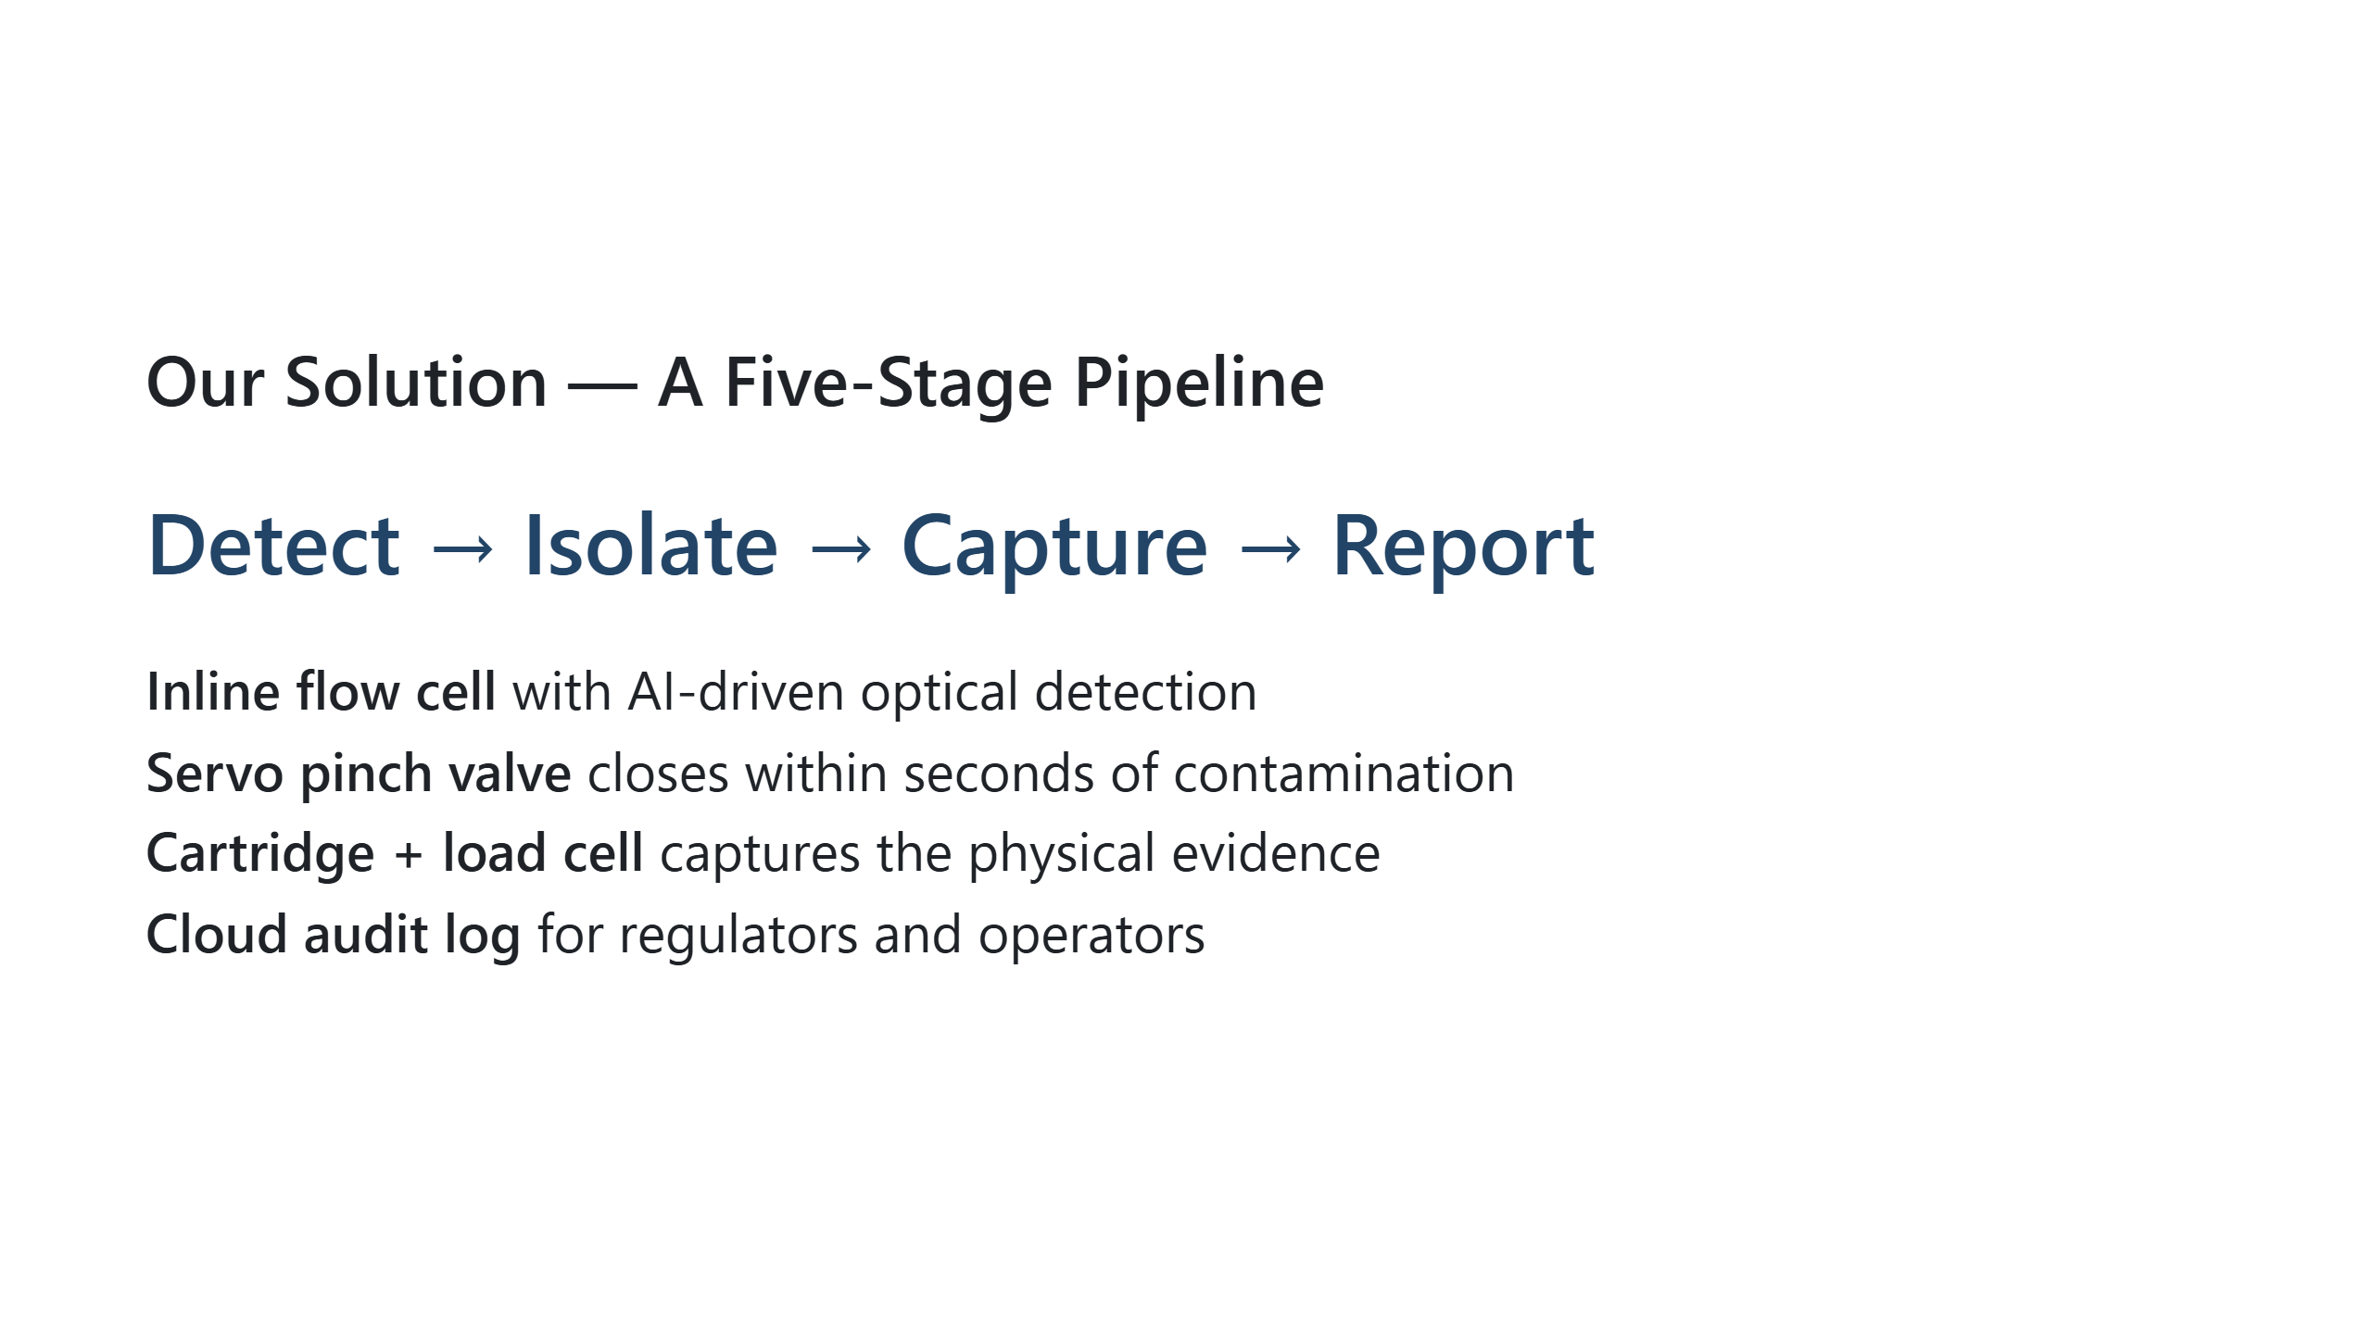
Notes:
TODO image: block diagram from docs/ARCHITECTURE.md — right column SPEAKER NOTES (≈45 sec) "Our solution is a single inline unit that does five things in sequence. Water flows through an optical chamber where a camera and AI model watch for nurdles. The moment contamination crosses a threshold, a servo-actuated pinch valve closes — stopping the flow before pellets escape downstream. The contaminated water is captured in an evidence cartridge, weighed by a load cell so we know the spill mass, and the entire incident is logged to the cloud for the regulator. The whole loop runs in around three seconds."

Slide 6
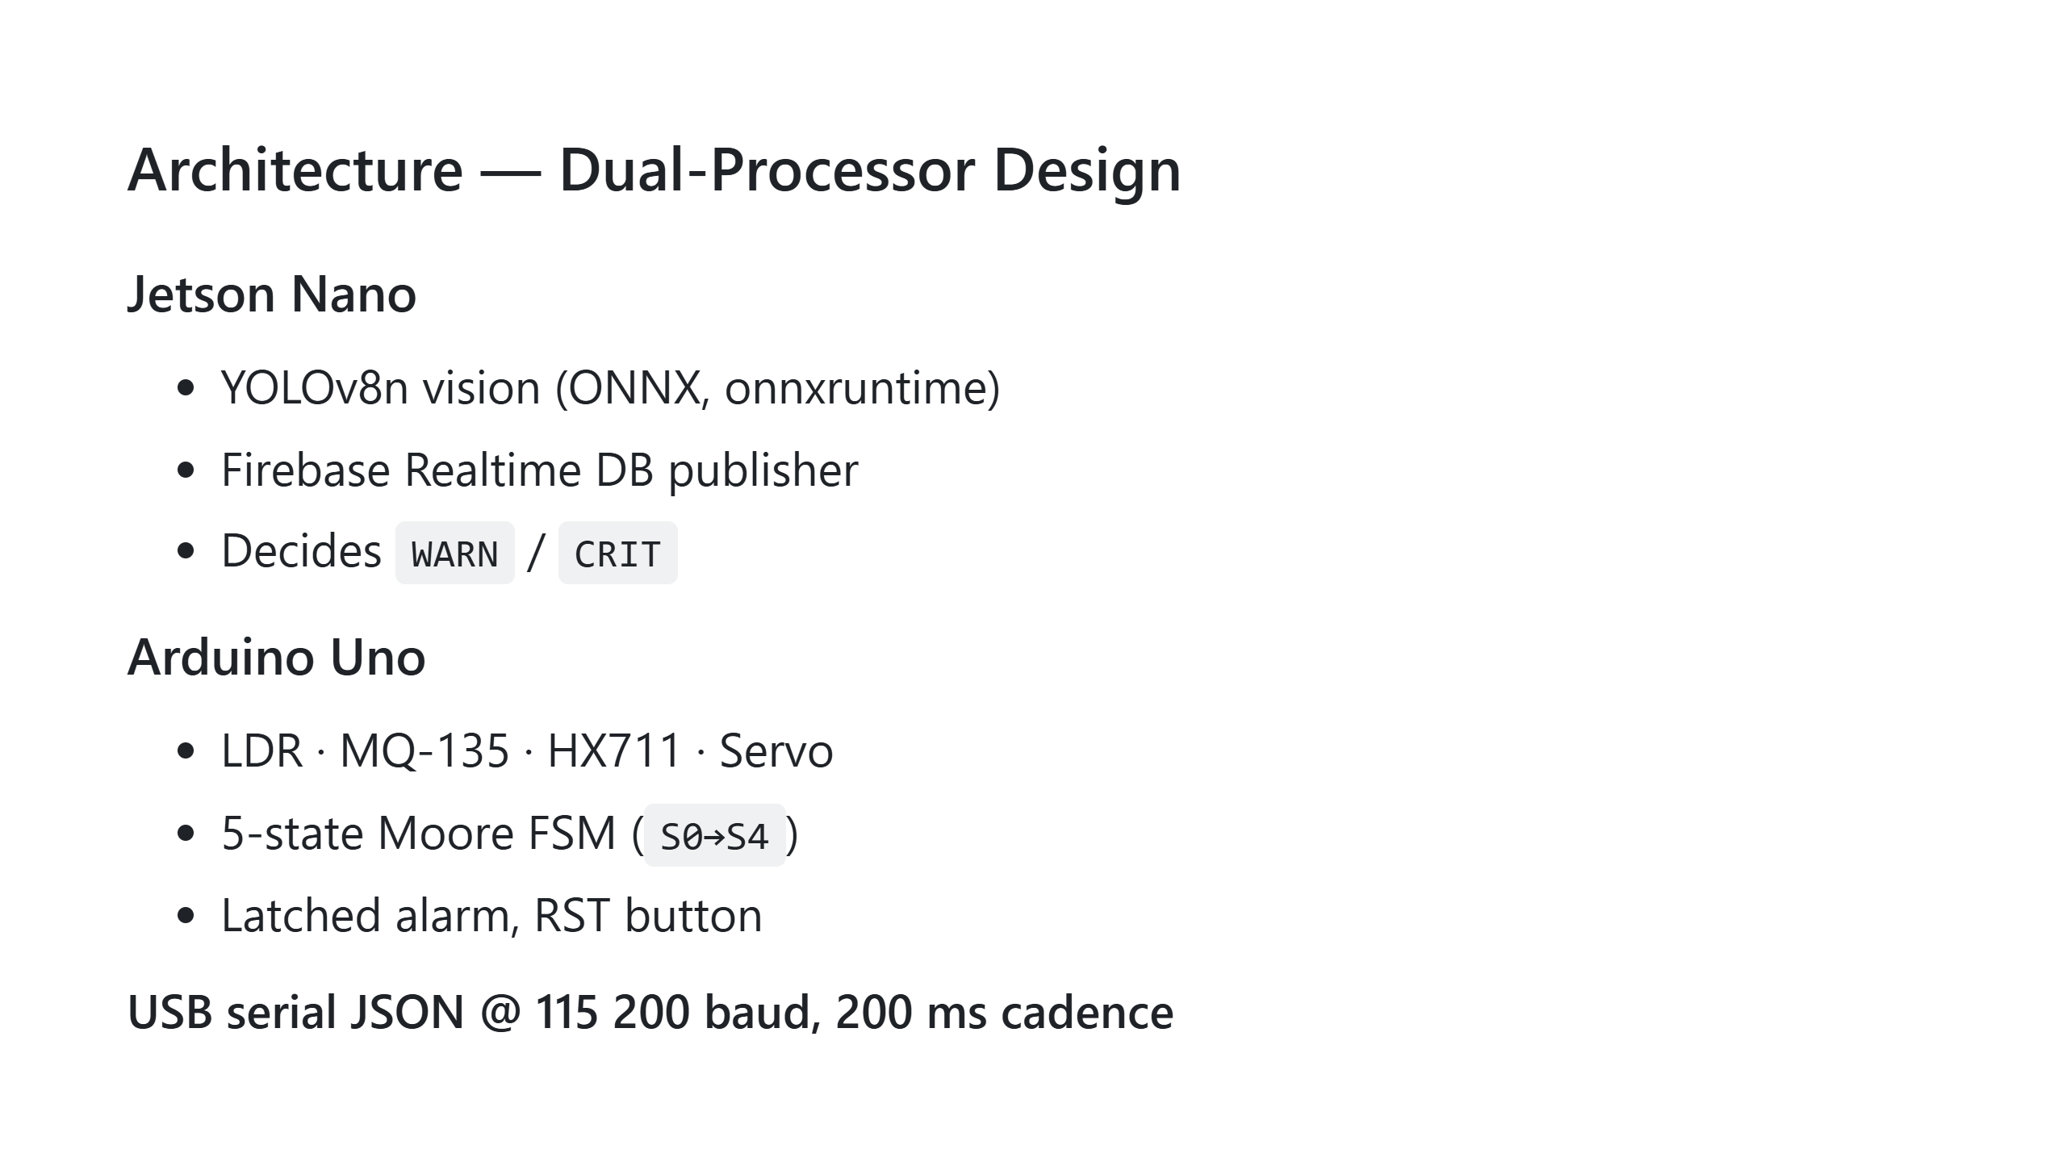
Notes:
TODO image: 5-state FSM diagram — bottom SPEAKER NOTES (≈55 sec) "The system is split across two processors. The Jetson Nano runs the heavy AI vision and talks to the cloud. The Arduino Uno reads the analogue sensors — turbidity, gas, mass — and runs the actual finite-state machine that controls the valve, the LCD, the buzzer, and the indicator LEDs. They talk to each other over USB serial using a frozen JSON protocol at 115 200 baud, exchanging messages every 200 milliseconds. The FSM has five states — Init, SysOK, Caution, Alarm, and Reset. Alarm is latched, meaning the valve stays closed until an operator physically presses the reset button. Industrial safety pattern."

Slide 7
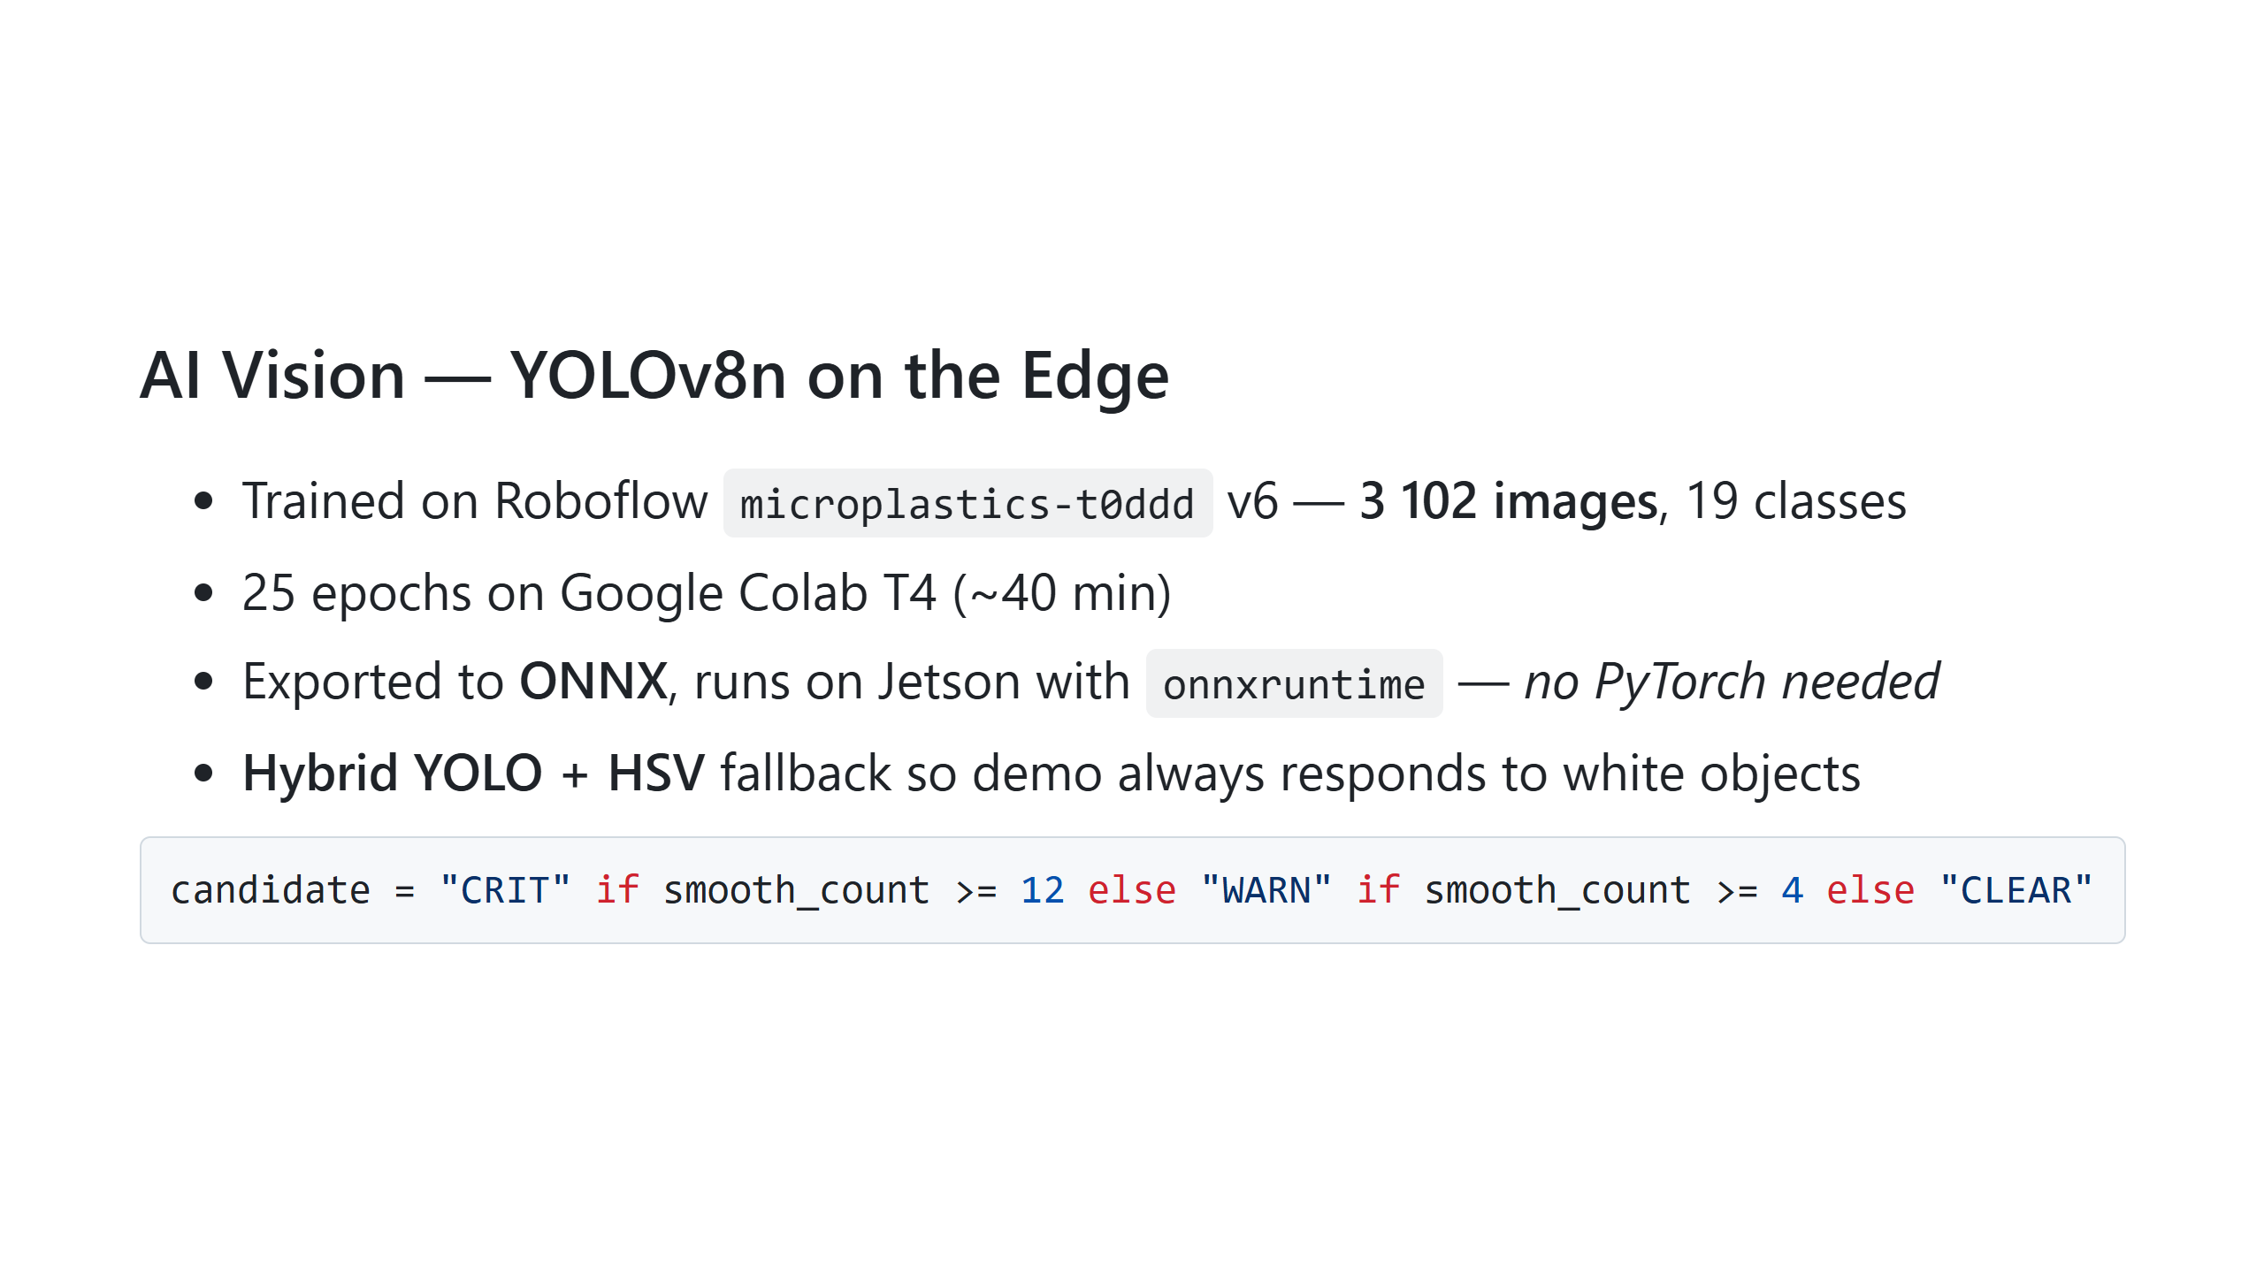
Notes:
TODO image: screenshot of live-demo.html camera panel with detection boxes — right SPEAKER NOTES (≈55 sec) "For the AI we used YOLOv8n — the smallest YOLO variant — fine-tuned on the Roboflow microplastics dataset, three thousand one hundred and two images across nineteen classes. Training was twenty-five epochs on a Colab T4 GPU, about forty minutes. We exported the trained model to ONNX format so we can run it on the Jetson Nano with onnxruntime — no PyTorch, no Ultralytics, about a hundred megabytes of dependencies instead of a gigabyte. We pair the YOLO output with a classical OpenCV HSV pass that catches anything bright in the centre of the frame, and we apply EMA smoothing plus a confirmation timer so a single noisy frame never triggers an alarm."

Slide 8
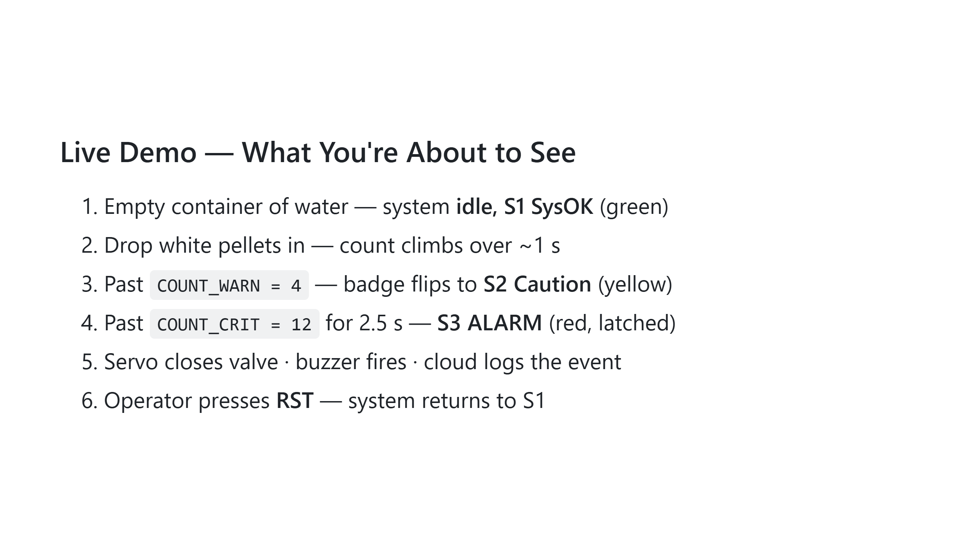
Notes:
TODO image: screenshot of live-demo.html in S3 ALARM with red badge + camera feed SPEAKER NOTES (≈90 sec — INCLUDES THE LIVE DEMO) "OK, here's the live system. [Switch to live-demo.html in browser, Jetson running.] You can see the FSM diagram at the top — currently green, S1, system OK. The camera panel on the left is the live view from the Jetson. I'm going to drop a few white pellets into this water. [Drop pellets.] Watch the pellet count climb. There — we just crossed the WARN threshold, badge is now yellow, S2 Caution. Adding more pellets. [Drop more.] After two and a half seconds of sustained high count… there's the ALARM, S3, red latched state. The website logged the event to Firebase, and once the Arduino is wired in, the servo would close the valve right now. To clear, the operator presses the physical reset button. [Press RST or click reset on website.] Back to S1."

Slide 9
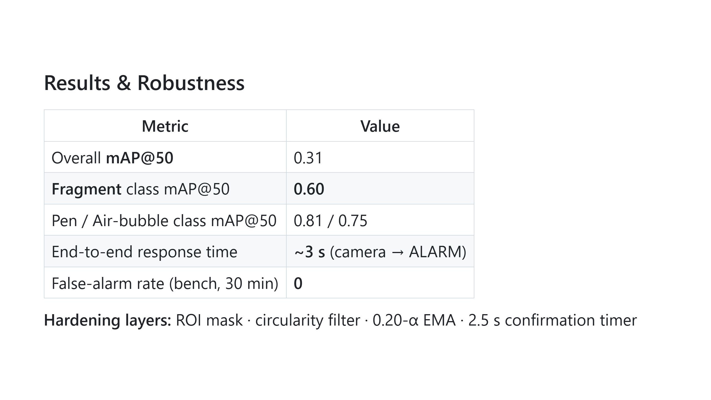
Notes:
TODO image: small bar chart of per-class mAP50 SPEAKER NOTES (≈45 sec) "On results — overall mean average precision is around point three one, which sounds modest, but the dataset has nineteen classes and several have fewer than ten samples. On the classes that matter for our use case, fragments score point six, pens point eight, air bubbles point seven five. End-to-end response time, from camera detection to website alarm, is about three seconds. We measured zero false alarms across a thirty-minute bench test under varied lighting, thanks to four layers of suppression — region of interest, circularity filter, exponential moving average smoothing, and a confirmation timer."

Slide 10
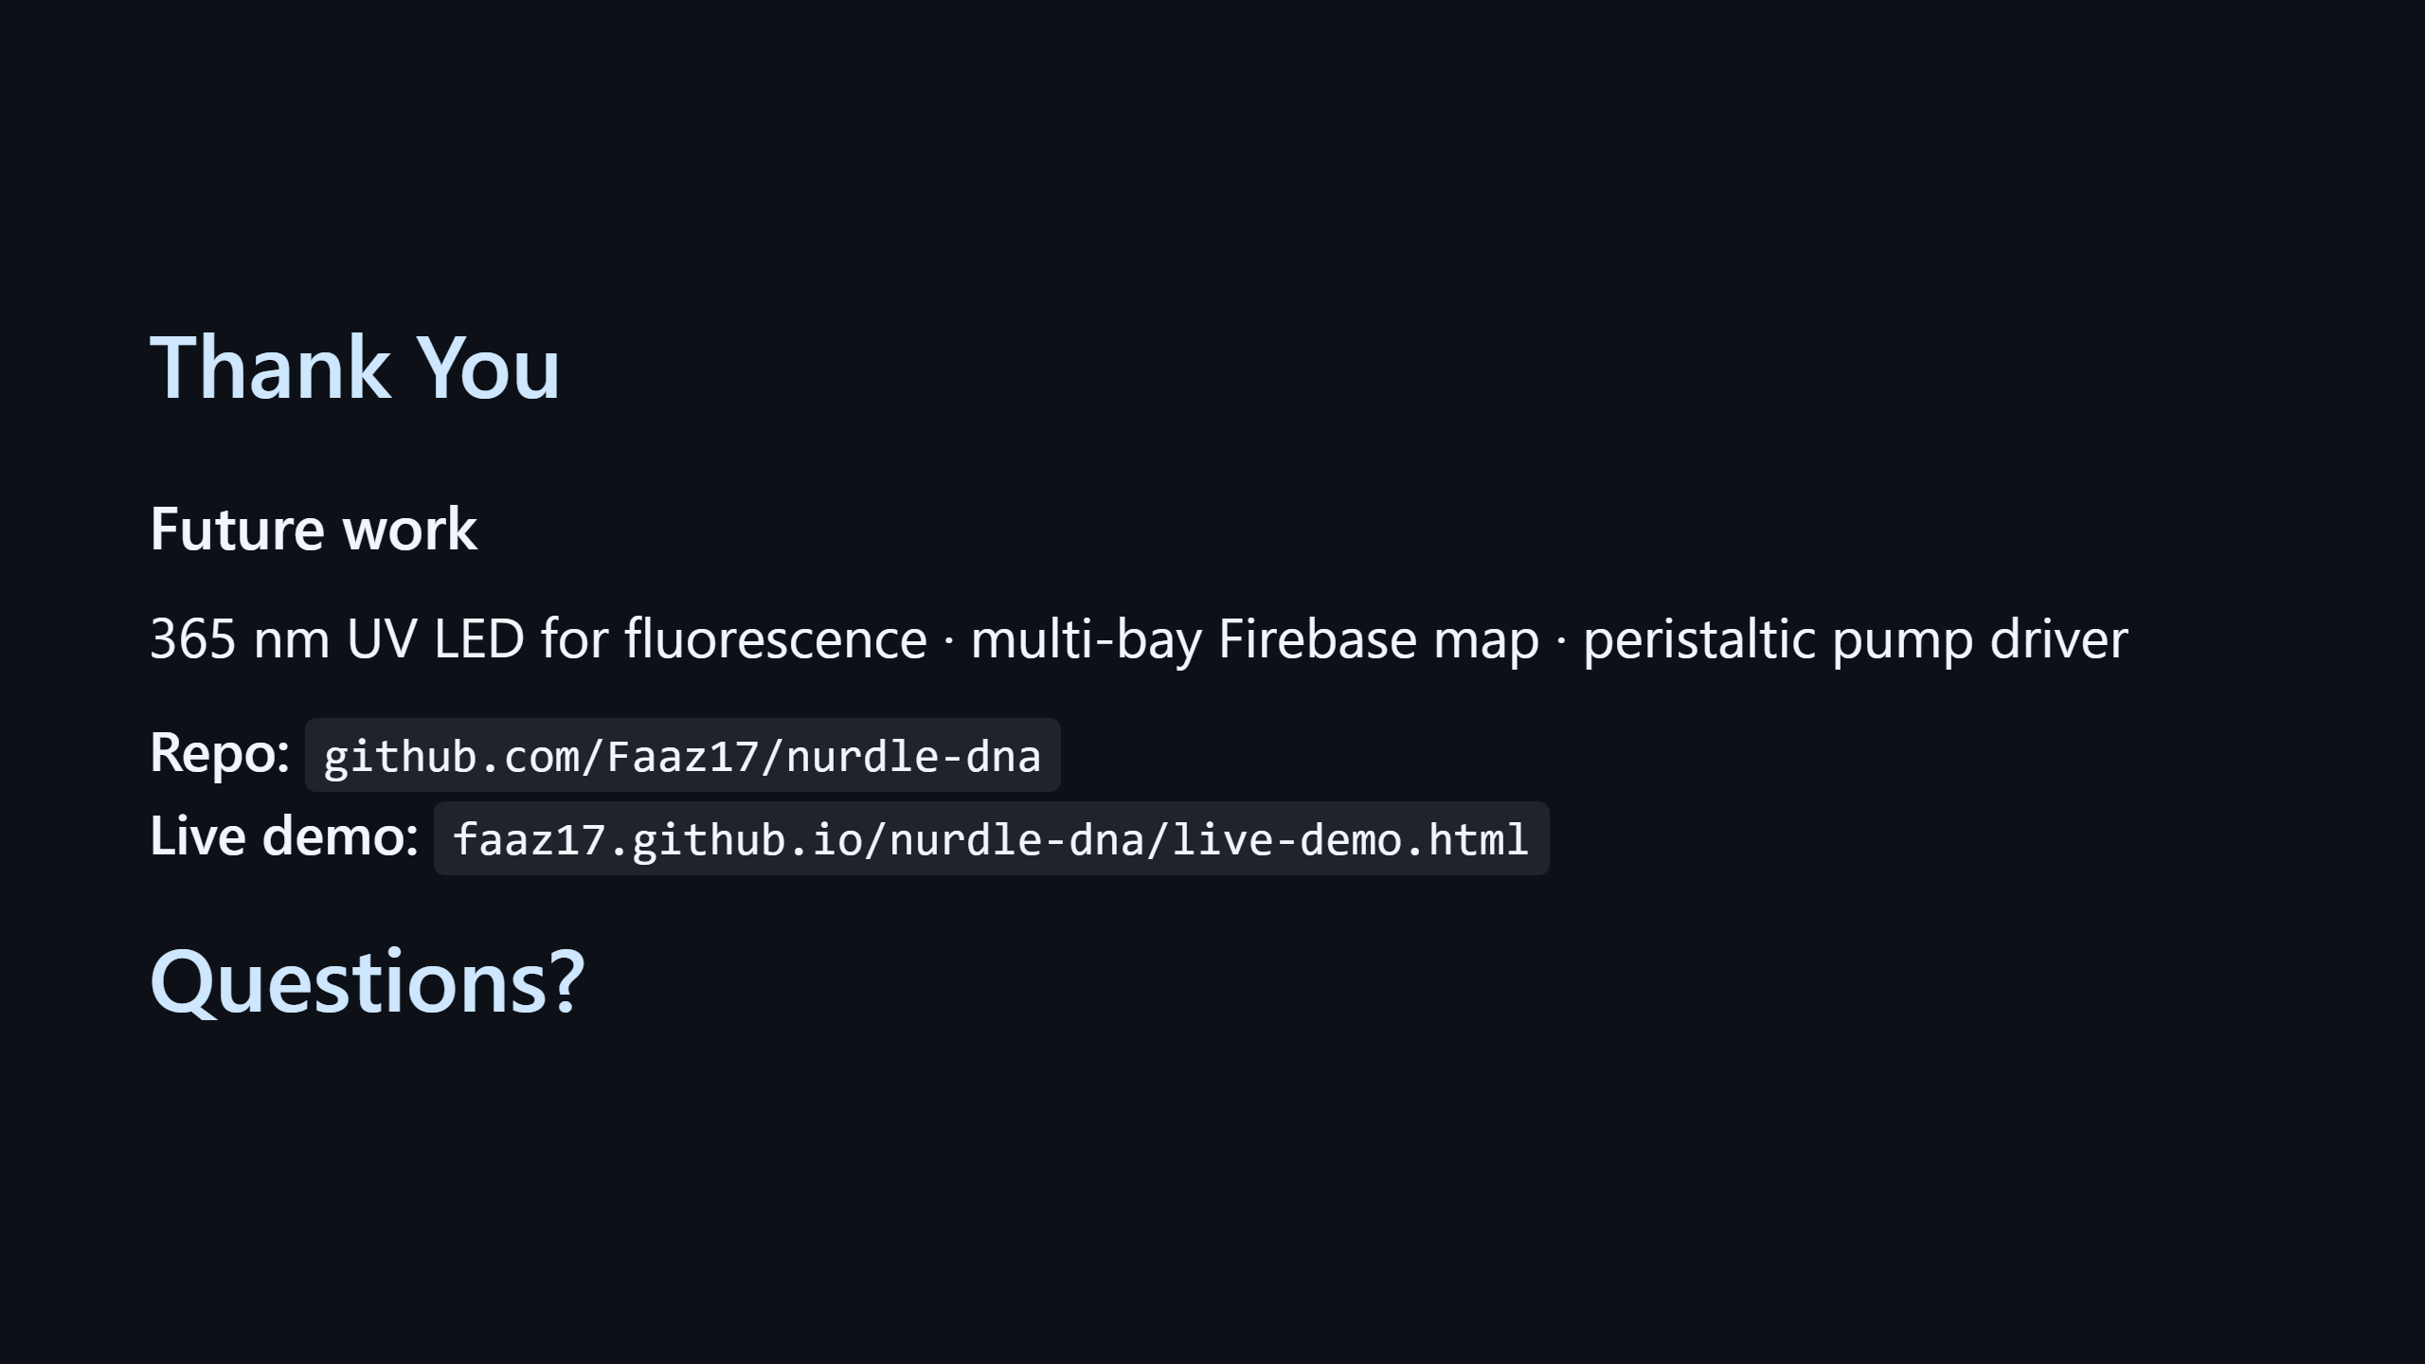
Notes:
SPEAKER NOTES (≈25 sec) "To close — there's still work to do. We want to add a 365 nanometre UV LED for fluorescence excitation, which would dramatically improve plastic detection accuracy. We want a multi-bay map so a port operator can monitor several units at once, and we want to wire in the peristaltic pump driver for fully closed-loop flow control. The repo and the live demo URL are on screen. Happy to take questions."

