Slide 1
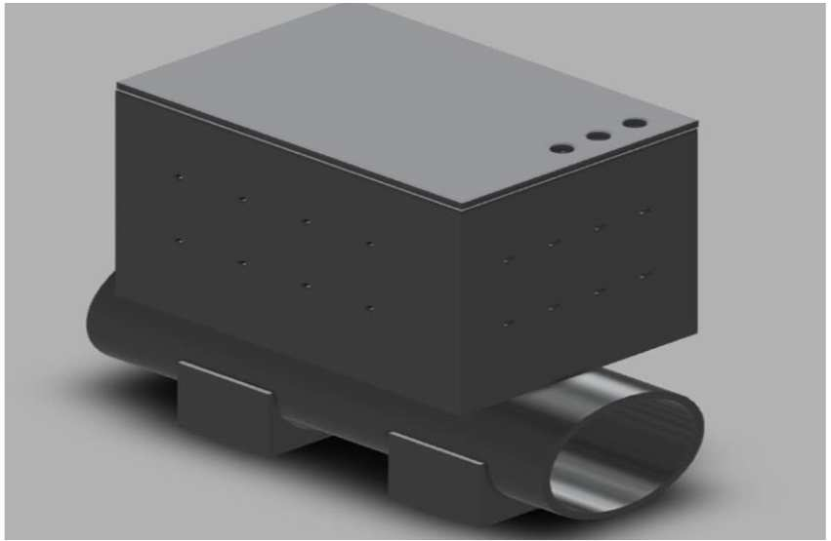
ICSIMA2026
NurdleDNA: An Edge-AI and Smart IoT Inline System for Source-Level Microplastic Detection
Faaz Ali Sayyed, Muhammad Haaziq, Daniel Joseph Koshy, Mohammed Abdul Rehman, Syed Hasan Ali, Razveen Kashif, and Mohd Fareq Abd Malek
University of Wollongong in Dubai
Backup presentation video: 12 minutes maximum, followed by live Q&A
ICSIMA2026 backup video | NurdleDNA
1 / 12

Slide 2
Industrial nurdle leaks need source-level response
The problem is not only detecting pellets. It is intercepting them before they leave the discharge point.
3-5 mm
Real time
Source level
Core gap
typical pre-production pellet size
required before downstream spread
where containment still works
Existing approaches can often detect or document contamination, but they do not physically arrest the flow and preserve an audit trail at the source.
- Manual inspection and passive filters are too slow for active discharge streams
- Turbidity or particle counters confuse nurdles with bubbles, sand, and bio-particles
- Laboratory FTIR and Raman methods are accurate, but not inline containment systems
- Industrial drains may also carry VOC or hydrocarbon contamination
NurdleDNA targets that gap.
ICSIMA2026 backup video | NurdleDNA
2 / 12

Slide 3
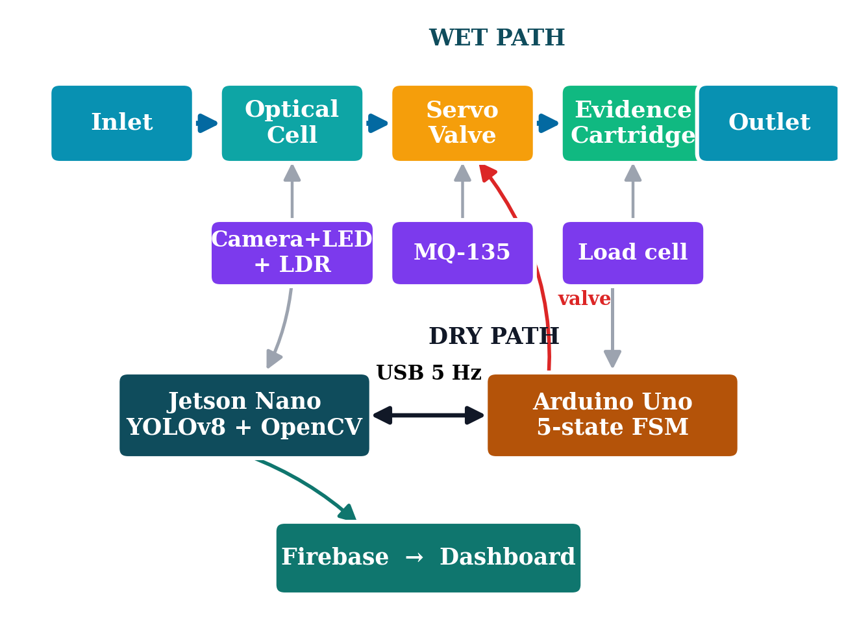
NurdleDNA closes the loop from detection to evidence
The system couples AI perception with deterministic actuation and cloud logging.
Detect
Classify
Actuate
Capture
Log
- Camera and optical chamber detect candidate pellets
- LDR, MQ-135, and temporal logic validate the hazard
- Arduino FSM closes the servo pinch valve during alarm
- Load cell measures captured evidence while Firebase stores the event
ICSIMA2026 backup video | NurdleDNA
3 / 12

Slide 4
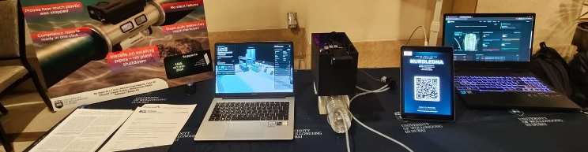
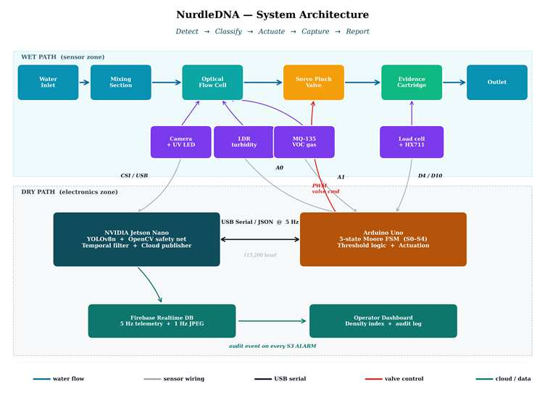
The prototype separates probabilistic AI from safety control
Jetson handles inference and cloud publishing; Arduino owns deterministic containment.
Jetson Nano
Arduino Uno
- YOLOv8n and OpenCV
- JPEG evidence frame
- Firebase publish
- Dashboard feed
- LDR and MQ-135
- Load cell via HX711
- Moore FSM
- Servo pinch valve
Design intent: if AI confidence is uncertain or cloud connectivity fails, physical containment still remains under deterministic local control.
ICSIMA2026 backup video | NurdleDNA
4 / 12

Slide 5
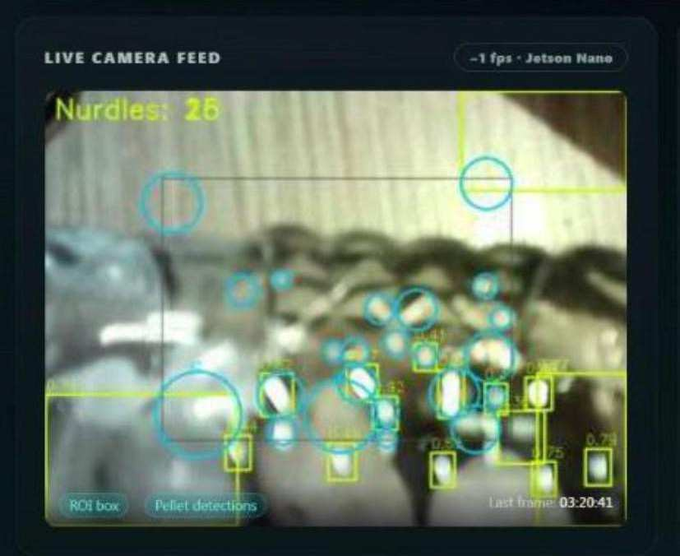
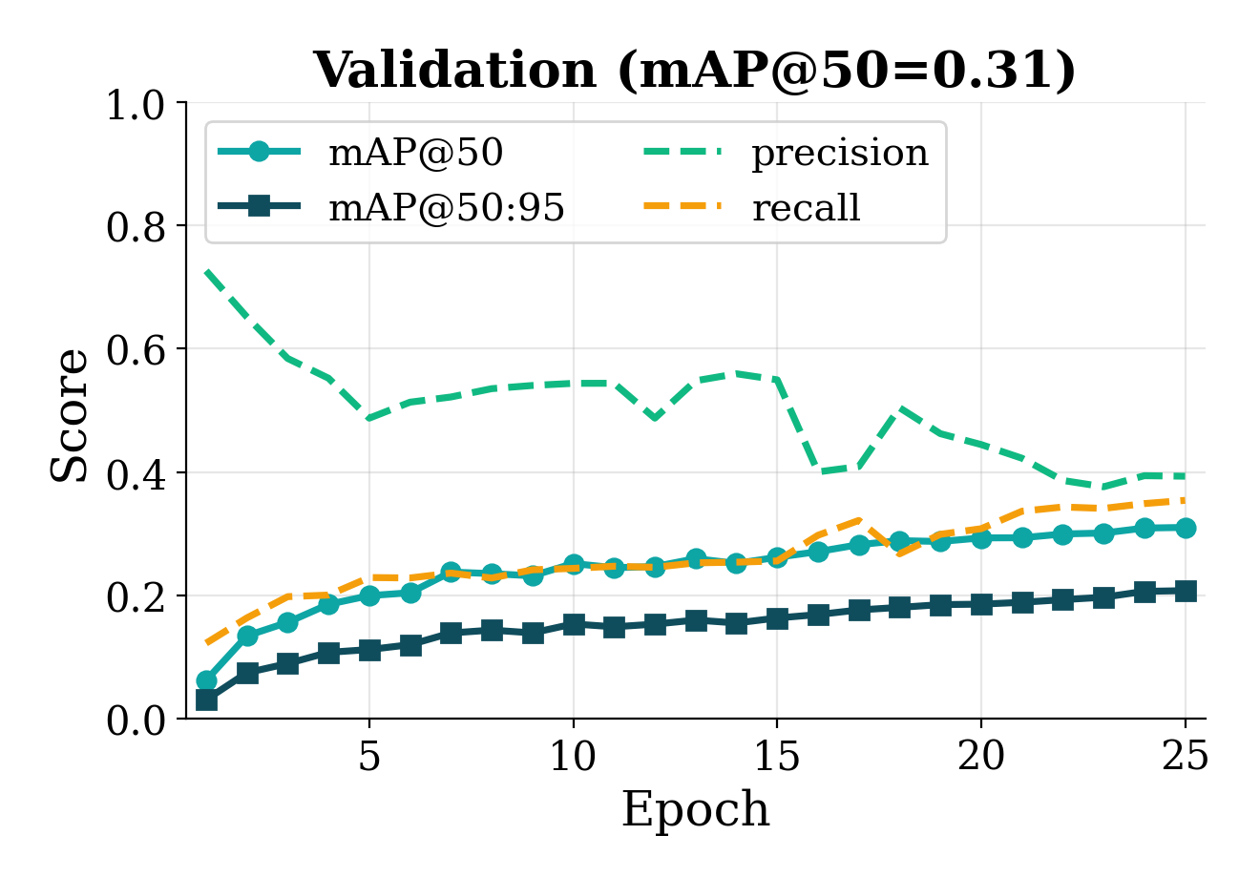
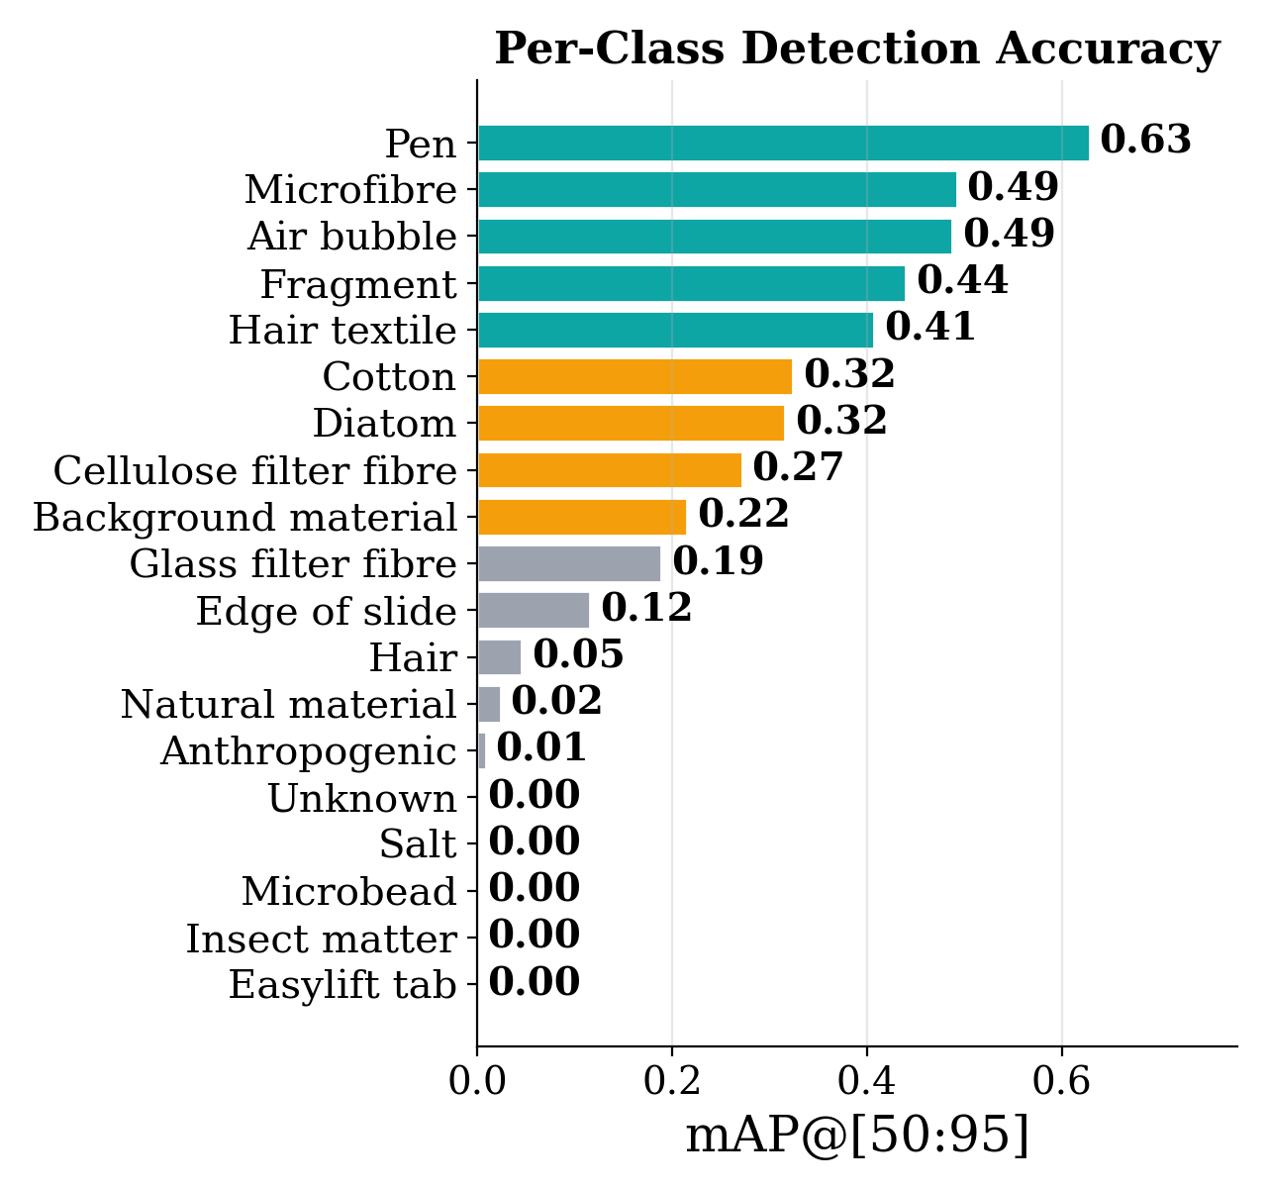
The vision model is useful, but it is not trusted alone
The paper treats YOLO as one probabilistic signal inside a wider sensor-fusion decision.
0.31
25
19
overall mAP@50 on the public validation split
training epochs on YOLOv8n
public dataset classes, with severe imbalance
Interpretation: the model can detect pellets and visual candidates, but bubbles, glare, and dataset imbalance make temporal and sensor confirmation necessary.
ICSIMA2026 backup video | NurdleDNA
5 / 12

Slide 6
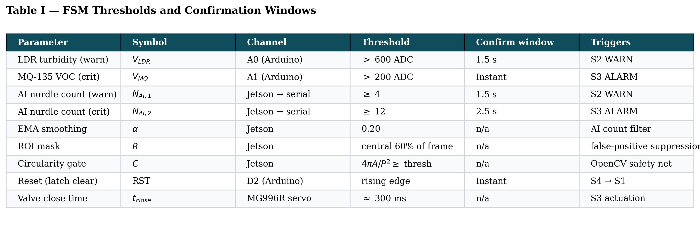
Multi-sensor confirmation suppresses false alarms
The alarm decision requires persistence across optical, gas, and AI-derived evidence.
Filtering strategy
- Region-of-interest masks the active frame
- Circularity filter rejects linear reflections
- EMA smoothing reduces sensor spikes
- Confirmation timers prevent single-frame alarms
- LDR warning threshold: above 600 ADC
- MQ-135 critical threshold: above 200 ADC
- AI warning: count >= 4 for 1.5 s
- AI critical: count >= 12 for 2.5 s
Bench false-positive tests produced no false S3 alarms before contamination was introduced.
ICSIMA2026 backup video | NurdleDNA
6 / 12

Slide 7
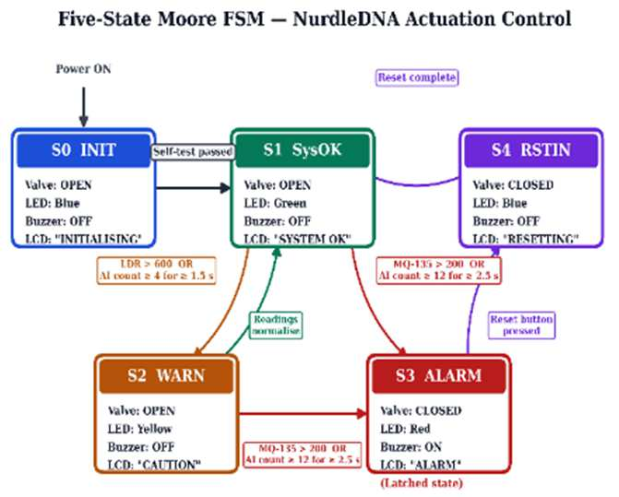
The finite-state machine makes containment deterministic
S3 alarm is latched and can only clear through an operator reset.
Normal
S1 opens the valve and reports safe operation.
Warning
S2 keeps flow open while evidence is confirmed.
Alarm
S3 closes the valve, turns on the alarm, and remains latched until reset.
ICSIMA2026 backup video | NurdleDNA
7 / 12

Slide 8
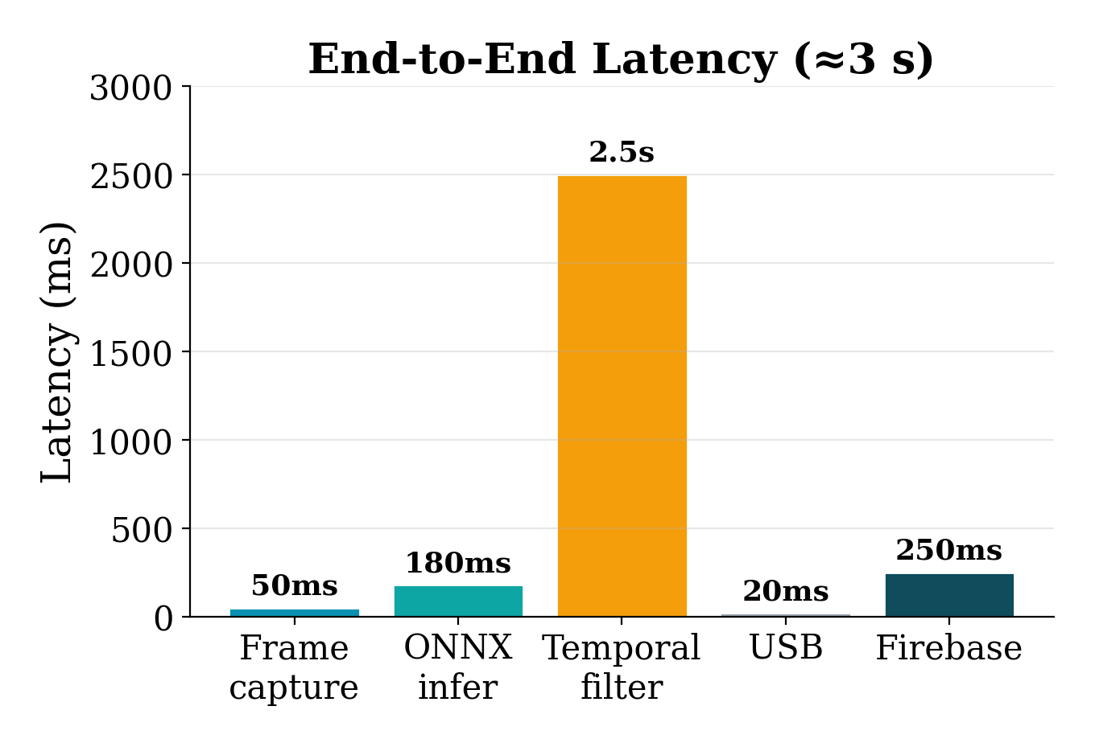
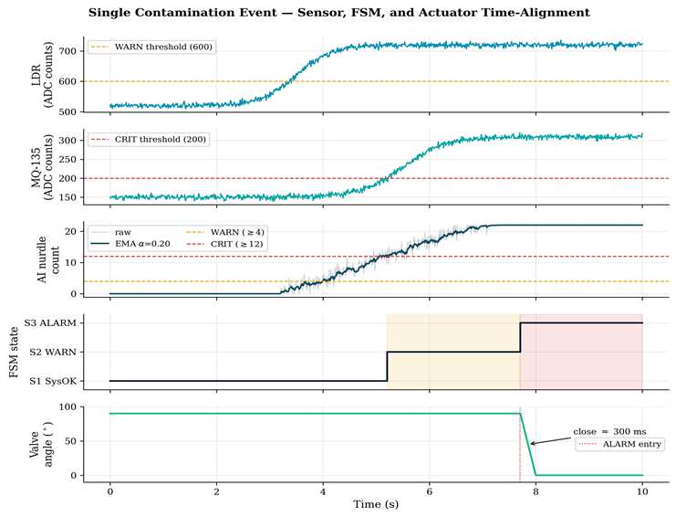
The response is dominated by confirmation, not actuation
The system waits long enough to avoid false alarms, then closes the valve quickly.
The latency trade-off is intentional: a shorter window would respond faster, but would increase false alarms in bubbles, glare, and turbulent flow.
3.0 s
2.5 s
300 ms
average end-to-end alarm response
temporal confirmation window
valve seated after S3 activation
ICSIMA2026 backup video | NurdleDNA
8 / 12

Slide 9
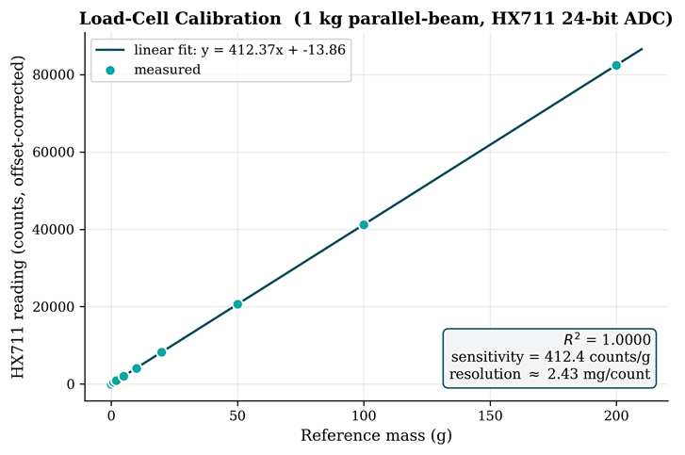
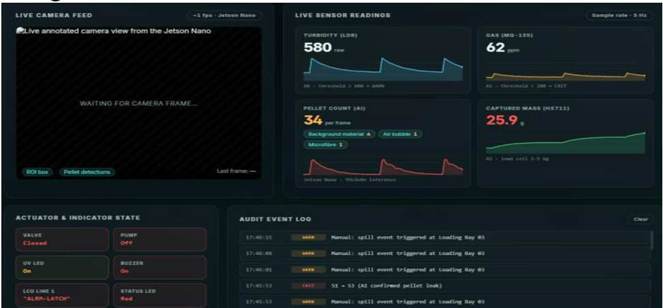
Each alarm creates physical and digital evidence
The system does not just signal a hazard; it preserves data that can support source-level accountability.
- Evidence cartridge mass is recorded through HX711 calibration
- Cloud packets include state, sensor values, classified source, and valve state
- Dashboard provides a remote audit view during S3 alarm events
R2=1
5 Hz
3 data
load-cell calibration linearity
sensor recording and telemetry cadence
frame, captured mass, and VOC log
ICSIMA2026 backup video | NurdleDNA
9 / 12

Slide 10
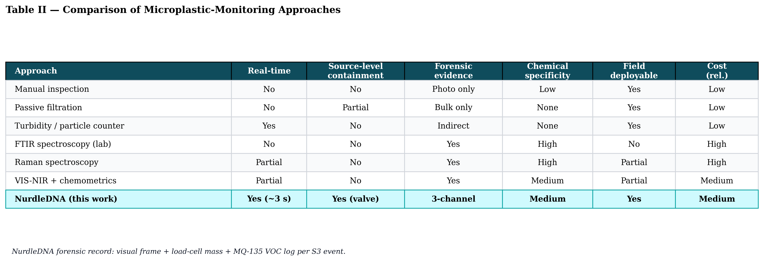
The contribution is containment plus auditability
Compared with conventional methods, NurdleDNA combines field response with traceable evidence.
What changes
- Real-time source-level containment
- Physical capture, not only detection
- Cloud audit trail tied to each alarm
The table's point is not that NurdleDNA replaces laboratory chemistry. It fills the operational gap between industrial discharge and later laboratory confirmation.
Yes
Valve
Field
real-time response
source-level containment
deployable bench prototype
ICSIMA2026 backup video | NurdleDNA
10 / 12

Slide 11
The next step is field hardening and better classification
The accepted paper is honest about limits and turns them into a roadmap.
1
Field hardening
2
Model improvement
3
Polymer ID
IP-rated enclosure, multi-bay deployment, SCADA compatibility, and quantified maintenance intervals.
Curated weathered-nurdle dataset, class balancing, and YOLOv8s/m on Jetson Orin Nano.
Miniature Raman or VIS-NIR sensing at the evidence cartridge to complete the NurdleDNA paradigm.
The roadmap preserves the architecture: detect locally, contain physically, and log evidence in a way that scales from one bay to many.
ICSIMA2026 backup video | NurdleDNA
11 / 12

Slide 12
NurdleDNA turns microplastic monitoring into a closed-loop response system.
Detect
Contain
Prove
AI vision and sensor fusion identify a persistent hazard.
A deterministic Arduino FSM closes the physical flow path.
Captured mass, frames, and cloud logs create an audit trail.
Thank you. I am happy to take questions.
ICSIMA2026 backup video | NurdleDNA
12 / 12

