Slide 1
DIPARTIMENTO DI INGEGNERIA ELETTRICA E TECNOLOGIE DELL’INFORMAZIONE
SCUOLA POLITECNICA E DELLE SCIENZE DI BASE
LAUREA MAGISTRALE IN INGEGNERIA DELL’AUTOMAZIONE E ROBOTICA
Robotics Lab Technical Project
Academic Year 2022/23
Professor
Mario Selvaggio Fabio Cuccaro P38000060

Slide 2

Contents
Goal of the Project
Simulation scene and Simulated Robots
External Packages
Mapping the Environment
Navigation Stack
  Code Details
Manipulator’s Motion Control
Results
Issues and Improvements
Robotics Lab Technical Project

Slide 3
Goal of the Project
Simulation of a multi-robot system with perception and autonomous capabilities in Gazebo Specifically:
  a diff-drive robot must be able to navigate the environment avoiding obstacles;
  an industrial robot must be able to implement simple motions with its end-effector.
Robotics Lab Technical Project

Slide 4
Goal of the Project
Simulation of a multi-robot system with perception and autonomous capabilities in Gazebo Specifically:
  a diff-drive robot must be able to navigate the environment avoiding obstacles;
  an industrial robot must be able to implement simple motions with its end-effector.
Pipeline:
The mobile robot must search for a particular tool in the rooms of a warehouse. Each room contains a tool, like a hammer or screwdriver, associated with an ArUco marker. The tool to be found is chosen by an operator through the keyboard;
After that the tool has been taken, it must be brought to the industrial manipulator.
Once the mobile robot has arrived, the industrial robot will simulate to release this tool on a region of its workspace detected using another landmark.
Robotics Lab Technical Project

Slide 5
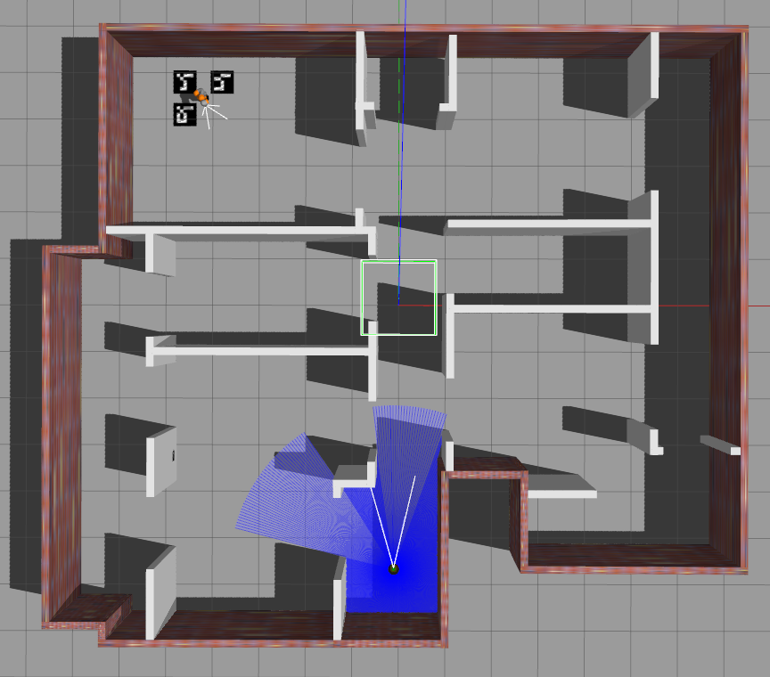



Simulation scene and simulated robots (1/2)
The scenario is a warehouse (9⨯11 m² ) with four rooms;
The world file was built with the world editor provided by Gazebo.
SCREWDRIVER
HAMMER
Scenario in Gazebo
DRILL
Robotics Lab Technical Project

Slide 6
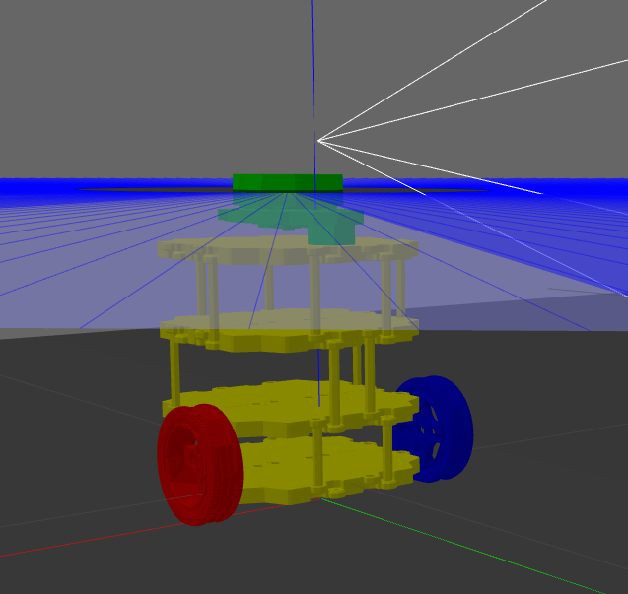
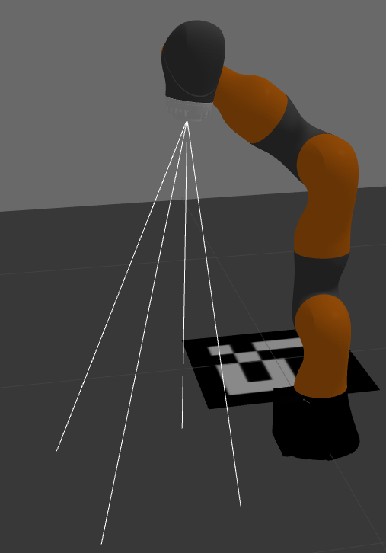
Simulation scene and simulated robots (1/2)
The scenario is a warehouse (9⨯11 m² ) with four rooms;
The world file was built with the world editor provided by Gazebo.
The robots are a Turtlebot3 Burger and a Kuka Iiwa;
SCREWDRIVER
Turtlebot3 Burger
HAMMER
Scenario in Gazebo
Scenario in Gazebo
Kuka Iiwa
DRILL
Robotics Lab Technical Project

Slide 7
Simulation scene and simulated robots (1/2)
The scenario is a warehouse (9⨯11 m² ) with four rooms;
The world file was built with the world editor provided by Gazebo.
The robots are a Turtlebot3 Burger and a Kuka Iiwa;
The Turtlebot is endowed with:
an RGB camera with resolution 800⨯600, to detect ArUco markers on the walls;
a laser scanner to perform Localization and Mapping.
The Kuka Iiwa is endowed with the same RGB camera, pointing along the approach direction of the end effector, to detect ArUco markers on the ground.
Turtlebot3 Burger
Kuka Iiwa
Robotics Lab Technical Project

Slide 8
External Packages
aruco_ros: used to estimate the pose of an ArUco Marker framed by a camera;
amcl: used to localize the mobile robot in a known map;
gmapping: used to map the environment;
move_base: used to perform the mobile robot navigation;
MoveIt!: used for the motion control of the manipulator.
Robotics Lab Technical Project

Slide 9
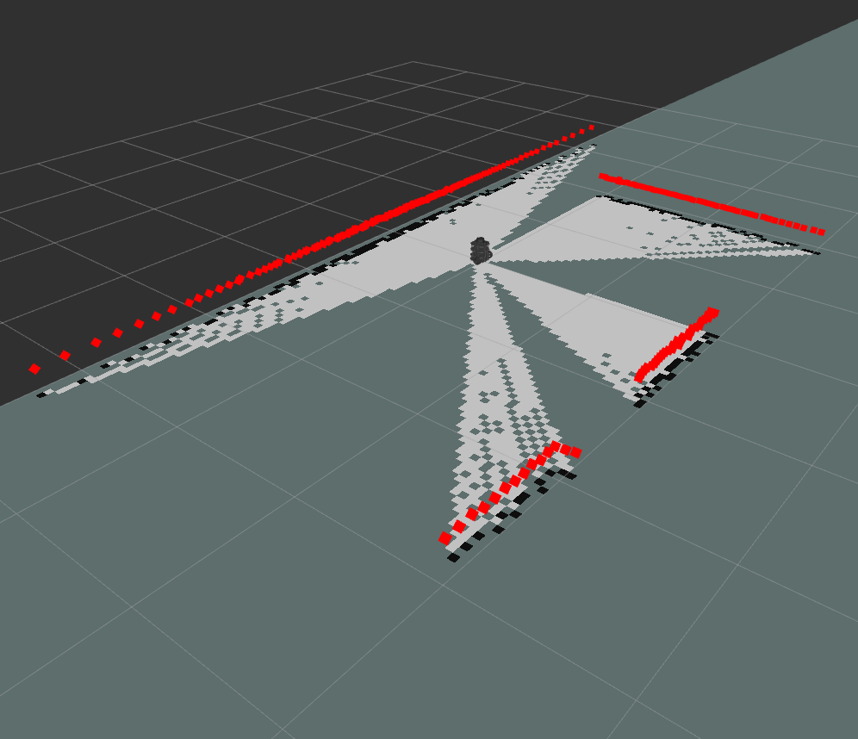
Mapping the Environment
The mapping of the environment was done with gmapping package and the key_teleop node, which allows to control the robot motion with the keyboard.
Initial map seen by the robot in Rviz
Robotics Lab Technical Project

Slide 10
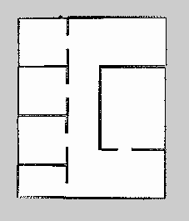
Mapping the Environment
The mapping of the environment was done with gmapping package and the key_teleop node, which allows to control the robot motion with the keyboard.
Initial map seen by the robot in Rviz
Completed map
Robotics Lab Technical Project

Slide 11
Navigation Stack (1/2)
the operator chooses the tool to be found by the Turtlebot;
Robotics Lab Technical Project

Slide 12
Navigation Stack (1/2)
the operator chooses the tool to be found by the Turtlebot;
the Turtlebot moves towards the center of the first room;
Robotics Lab Technical Project

Slide 13
Navigation Stack (1/2)
the operator chooses the tool to be found by the Turtlebot;
the Turtlebot moves towards the center of the first room;
for each room:
if ( requested tool not found ) {
    the Turtlebot inspects the remaining rooms
  }
else
    the Turtlebot goes to the Kuka’s room and informs the Kuka about the requested tool, so that it can reach the corresponding marker on the floor.
Robotics Lab Technical Project

Slide 14
Navigation Stack (2/2)
Code details
the /cmd_vel topic and the yaw angle were used to perform a 360° rotation of the Turtlebot on the spot: the yaw angle is obtained by elaborationg odometry data streamed on the topic /odom;
Robotics Lab Technical Project

Slide 15
Navigation Stack (2/2)
Code details
the /cmd_vel topic and the yaw angle were used to perform a 360° rotation of the Turtlebot on the spot: the yaw angle is obtained by elaborationg odometry data streamed on the topic /odom;
the markers’ information (id and absolute coordinates) comes from the topic /markers;
Robotics Lab Technical Project

Slide 16
Navigation Stack (2/2)
Code details
the /cmd_vel topic and the yaw angle were used to perform a 360° rotation of the Turtlebot on the spot: the yaw angle is obtained by elaborationg odometry data streamed on the topic /odom;
the markers’ information (id and absolute coordinates) comes from the topic /markers;
The goal positions are collected into a waypoints vector, used by move_base to generate and execute the trajectories;
Robotics Lab Technical Project

Slide 17
Navigation Stack (2/2)
Code details
the /cmd_vel topic and the yaw angle were used to perform a 360° rotation of the Turtlebot on the spot: the yaw angle is obtained by elaborationg odometry data streamed on the topic /odom;
the markers’ information (id and absolute coordinates) comes from the topic /markers;
The goal positions are collected into a waypoints vector, used by move_base to generate and execute the trajectories;
when the Turtlebot reaches the Kuka’s room, it streams the marker’s id on a custom topic named /diff_drive_topic.
Robotics Lab Technical Project

Slide 18
Manipulator’s Motion Control
the Kuka reaches a default position, with the end-effector pointing downwards;
Robotics Lab Technical Project

Slide 19
Manipulator’s Motion Control
the Kuka reaches a default position, with the end-effector pointing downwards;
once the Turtlebot has arrived, the third joint starts to move, allowing the camera to inspect the ground;
Robotics Lab Technical Project

Slide 20
Manipulator’s Motion Control
the Kuka reaches a default position, with the end-effector pointing downwards;
once the Turtlebot has arrived, the third joint starts to move, allowing the camera to inspect the ground;
when the requested tool marker is found, its center’s coordinates are used to move the end-effector towards the marker
Robotics Lab Technical Project

Slide 21
Manipulator’s Motion Control
the Kuka reaches a default position, with the end-effector pointing downwards;
once the Turtlebot has arrived, the third joint starts to move, allowing the camera to inspect the ground;
when the requested tool marker is found, its center’s coordinates are used to move the end-effector towards the marker
Code details
In the MoveIt! Wizard a position_controllers/JointTrajectoryController was chosen, in accordance with the <hardwareInterface> tag of the Kuka’s URDF file
Motion Planner: OMPL + RRTConnect
Robotics Lab Technical Project

Slide 22
Results
Motion of the Turtlebot (sped up video, 8x)
Robotics Lab Technical Project

Slide 23
Results
Motion of the Kuka (sped up video, 2x)
Robotics Lab Technical Project

Slide 24
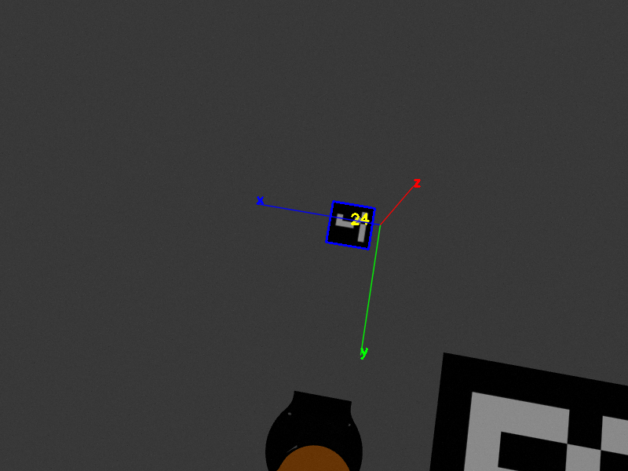
Issues and Improvements (1/3)
There is a not constant offset between the center of the marker and the center of the elaborated frame, which seems to be big (small) when the dimension of the markers are small (big);
Marker size: 10 cm
Robotics Lab Technical Project

Slide 25
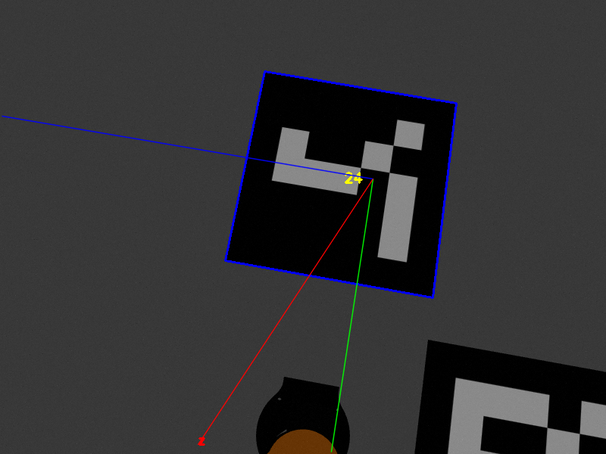
Issues and Improvements (1/3)
There is a not constant offset between the center of the marker and the center of the elaborated frame, which seems to be big (small) when the dimension of the markers are small (big);
As a workaround, the ground markers’ dimensions were taken significantly bigger than the ones of the walls markers.
Marker size: 10 cm
Marker size: 50 cm
Robotics Lab Technical Project

Slide 26
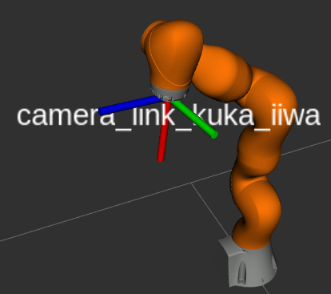
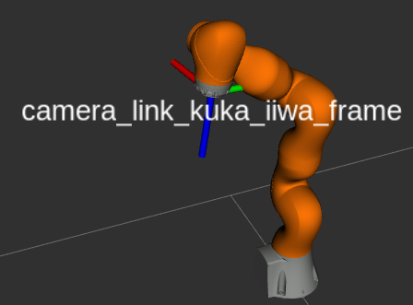
Issues and Improvements (2/3)
To have the actual coordinates of the centers of the markers in the fixed frame (map), a static tf transformation was considered for the Kuka’s camera:
<node pkg="tf" type="static_transform_publisher" name="kuka_iiwa_camera_tf" args="0 0 0 -1.5707 0 -1.5707 /camera_link_kuka_iiwa /camera_link_kuka_iiwa_frame 100"/>
tf
Robotics Lab Technical Project

Slide 27
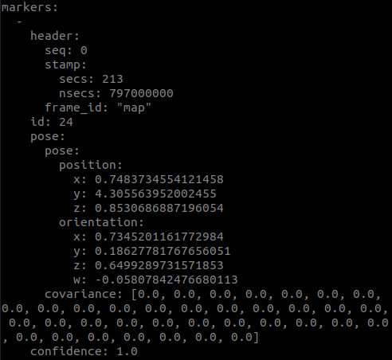
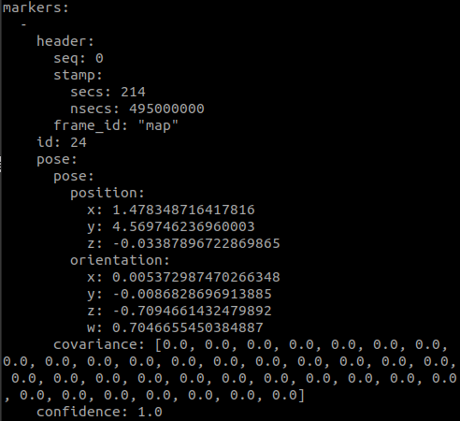
Issues and Improvements (2/3)
To have the actual coordinates of the centers of the markers in the fixed frame (map), a static tf transformation was considered for the Kuka’s camera:
<node pkg="tf" type="static_transform_publisher" name="kuka_iiwa_camera_tf" args="0 0 0 -1.5707 0 -1.5707 /camera_link_kuka_iiwa /camera_link_kuka_iiwa_frame 100"/>
$rostopic echo /kuka_iiwa/aruco_marker_publisher_kuka_iiwa/markers
tf
tf
Actual coordinates:
[x y z] = [1.5 4.5 0]
Robotics Lab Technical Project

Slide 28
Issues and Improvements (3/3)
Making the mapping of the environment autonomous (i.e. not using key_teleop);
Robotics Lab Technical Project

Slide 29
Issues and Improvements (3/3)
Making the mapping of the environment autonomous (i.e. not using key_teleop);
The actionlib protocol would be a more sophisticated and efficient solution for the communication between the robots, as they have to accomplish cooperative tasks;
Robotics Lab Technical Project

Slide 30
Issues and Improvements (3/3)
Making the mapping of the environment autonomous (i.e. not using key_teleop);
The actionlib protocol would be a more sophisticated and efficient solution for the communication between the robots, as they have to accomplish cooperative tasks;
The recovery behaviour makes the robot rotate on the spot quite rapidly when it is close to an obstacle.
Robotics Lab Technical Project

Slide 31
Issues and Improvements (3/3)
Making the mapping of the environment autonomous (i.e. not using key_teleop);
The actionlib protocol would be a more sophisticated and efficient solution for the communication between the robots, as they have to accomplish cooperative tasks;
The recovery behaviour makes the robot rotate on the spot quite rapidly when it is close to an obstacle.
  as a result, the robot rotates many times before it manages to get out of the rooms
Robotics Lab Technical Project

Slide 32
Issues and Improvements (3/3)
Making the mapping of the environment autonomous (i.e. not using key_teleop);
The actionlib protocol would be a more sophisticated and efficient solution for the communication between the robots, as they have to accomplish cooperative tasks;
The recovery behaviour makes the robot rotate on the spot quite rapidly when it is close to an obstacle.
  as a result, the robot rotates many times before it manages to get out of the rooms
  to prevent this delay, an upper limit was imposed to the wheels’ angular velocities
Robotics Lab Technical Project

Slide 33
Issues and Improvements (3/3)
Making the mapping of the environment autonomous (i.e. not using key_teleop);
The actionlib protocol would be a more sophisticated and efficient solution for the communication between the robots, as they have to accomplish cooperative tasks;
The recovery behaviour makes the robot rotate on the spot quite rapidly when it is close to an obstacle.
  as a result, the robot rotates many times before it manages to get out of the rooms
  to prevent this delay, an upper limit was imposed to the wheels’ angular velocities
  this however limits also the max linear velocity, resulting in a slow forward motion
Robotics Lab Technical Project

Slide 34
Issues and Improvements (3/3)
Making the mapping of the environment autonomous (i.e. not using key_teleop);
The actionlib protocol would be a more sophisticated and efficient solution for the communication between the robots, as they have to accomplish cooperative tasks;
The recovery behaviour makes the robot rotate on the spot quite rapidly when it is close to an obstacle.
  as a result, the robot rotates many times before it manages to get out of the rooms
  to prevent this delay, an upper limit was imposed to the wheels’ angular velocities
  this however limits also the max linear velocity, resulting in a slow forward motion
Optimizing the recovery behaviour would solve this issue
Robotics Lab Technical Project

