Slide 1

Multiple-Factor Authentication
Cryptography – Project 2
THITEUX Lucas
BODSON Fabrice
Master en Architecture des systèmes informatiques
2022 - 2023

Slide 2
Summary
What is Multiple-Factor Authentication ?
Which problems MFA can solve in practice ?
One Time Password generators
HOTP
TOTP
HOTP vs TOTP

Slide 3
What is Multiple-Factor Authentication ?
Combination of different types of authentication :
What the entity knows (password, pin code, …)
What the entity owns (chip card, OTP generators, …)
What the entity is (facial recognition, fingerprint, …)
What the entity can do or does (voice recognition, handwritten signature, …)
Where the entity is situated (localization)

Slide 4
Which problems MFA can solve in practice ?
Disclosure of login and password
Databases publication
Weakness of login and password
Social engineering, cracking
Notes:
The risks of authentication by login and password are no longer to be proven.
The main risks of this method are the disclosure of these (hacking and massive publication of online databases)
and their weaknesses which allow mean people to use techniques to guess them (cracking, social engineering, ...).

Slide 5
One Time Password Generator
Easy to implement because it is open source
They generate single-use codes which allows them to avoid "replay" attacks
They do not necessarily require the use of the Internet

Slide 6
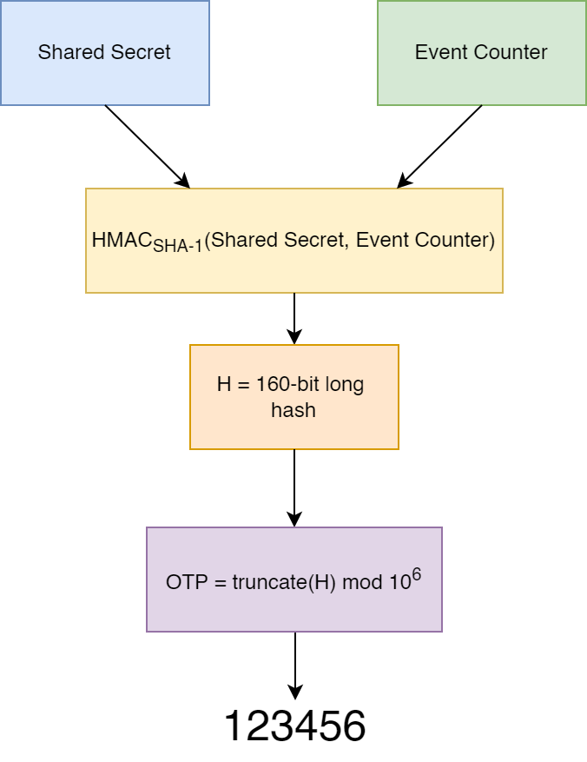
HMAC-based OTP
Event based OTP
Shared secret key + event counter = 160 bits long hash
Truncation to 31 bits
Convertion to human readable integer
Notes:
https://rublon.com/blog/hotp-totp-difference/

Slide 7
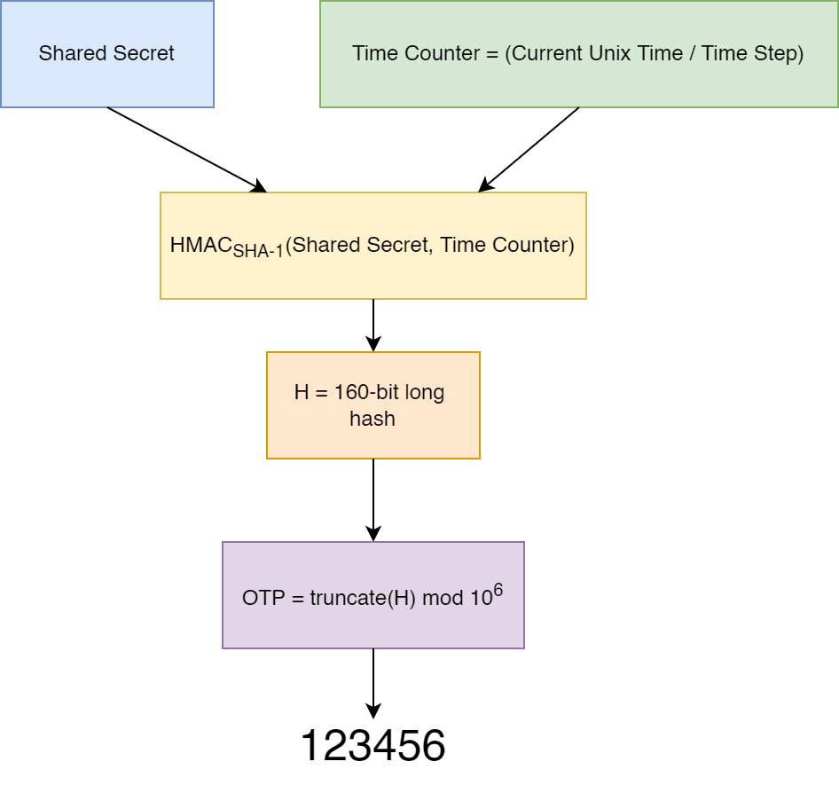
Time-based OTP
Time based OTP
Time step is chosen
Shared secret key + time counter = 160 bits long hash
Truncation to 31 bits
Convertion to human readable integer
Notes:
https://rublon.com/blog/hotp-totp-difference/

Slide 8
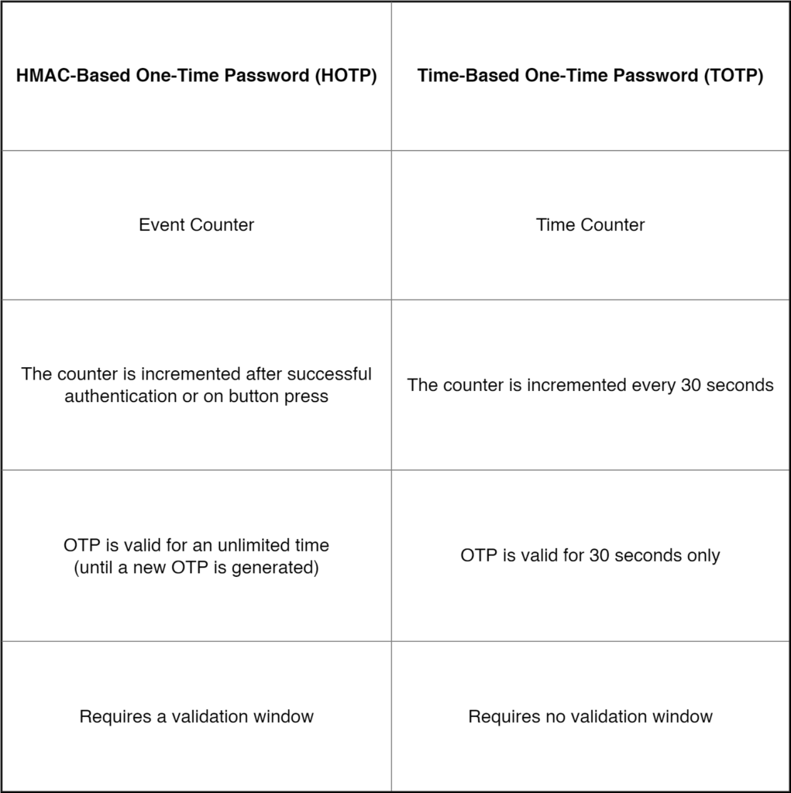
HOTP vs TOTP
Notes:
https://rublon.com/blog/hotp-totp-difference/

Slide 9
Thank you for listening us
Do you have any questions?

