Slide 1
Computer-aided Design and Manufacturing
Adrian Bowyer
A.Bowyer@bath.ac.uk
Fab Academy, 30 September 2009

Slide 2
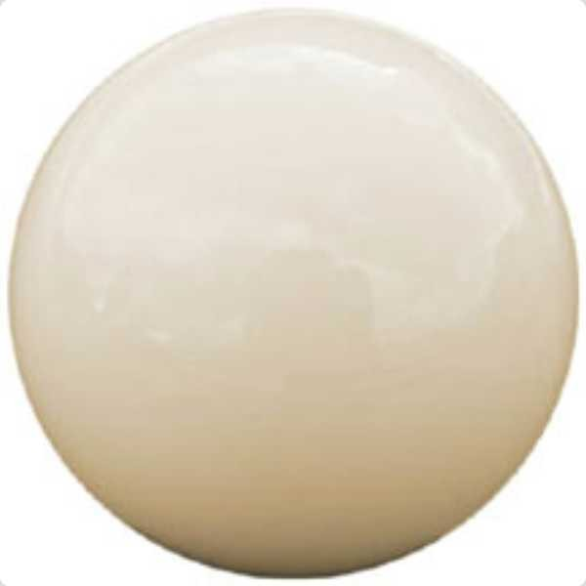

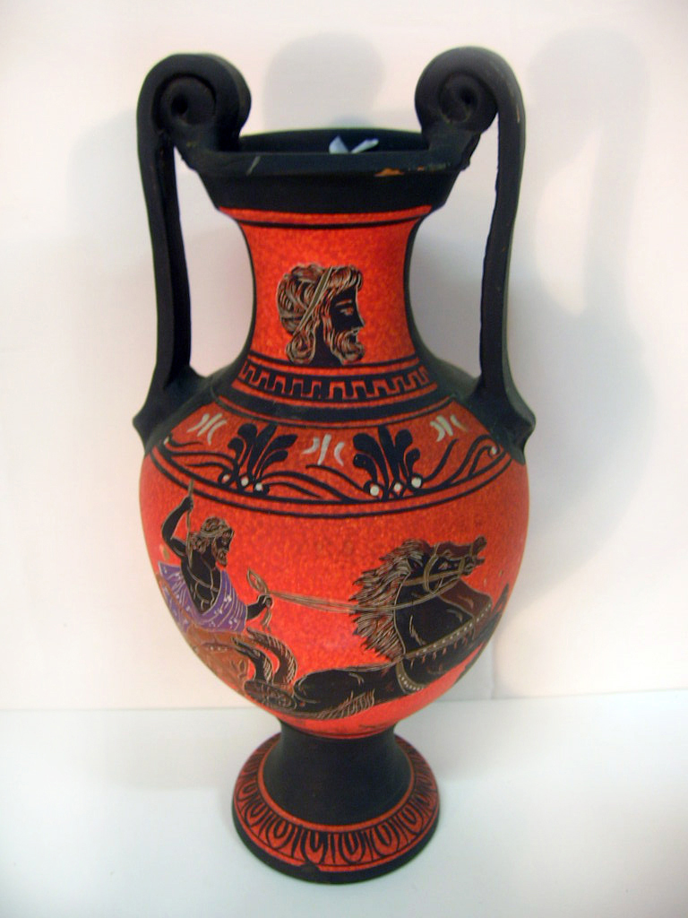
The Polya Urn – seemingly irrelevant...
Place one red and one white ball in the urn
Take a ball out at random
Replace it
Add another ball of the same colour
Go to 2...
When there are, say, 1000 balls in the urn, what is the expected ratio of reds to whites?

Slide 3
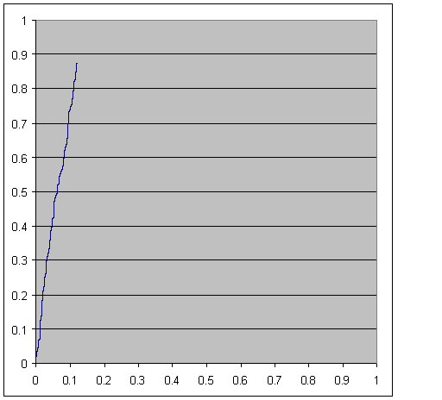
The Polya Urn
A Martingale stochastic process

Slide 4
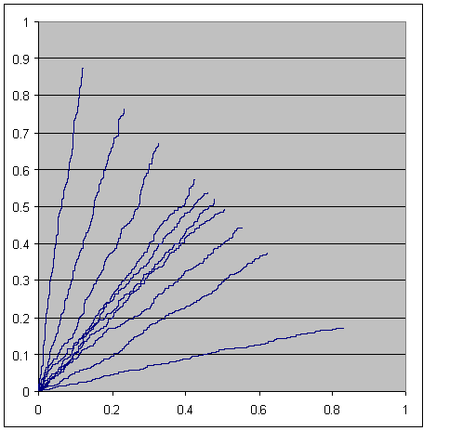
The Polya Urn
The gradient is random

Slide 5
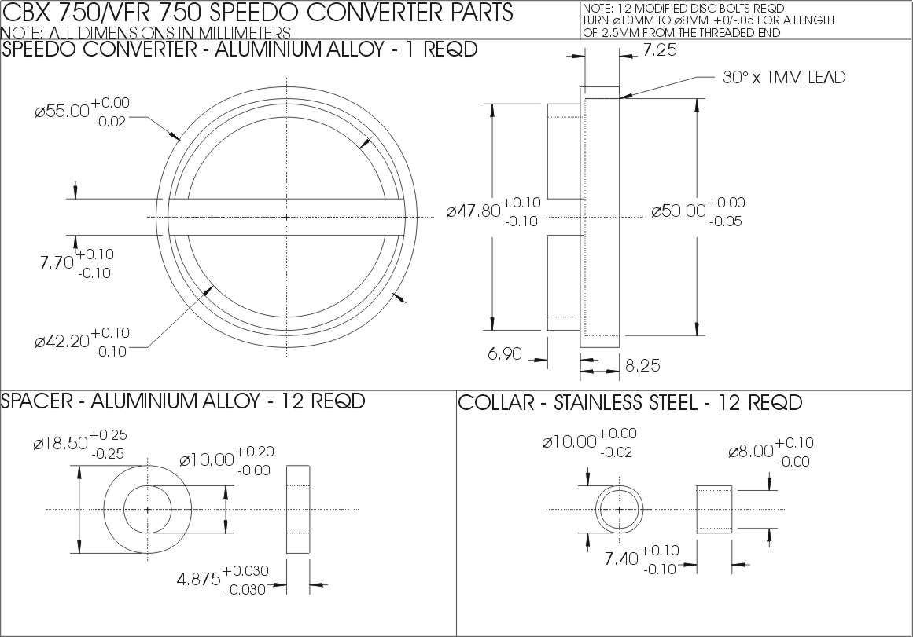
Computer Aided Design
As soon as computer graphics became possible (late 1960s; Evans & Sutherland),
people started to write programs to do engineering drawing:

Slide 6
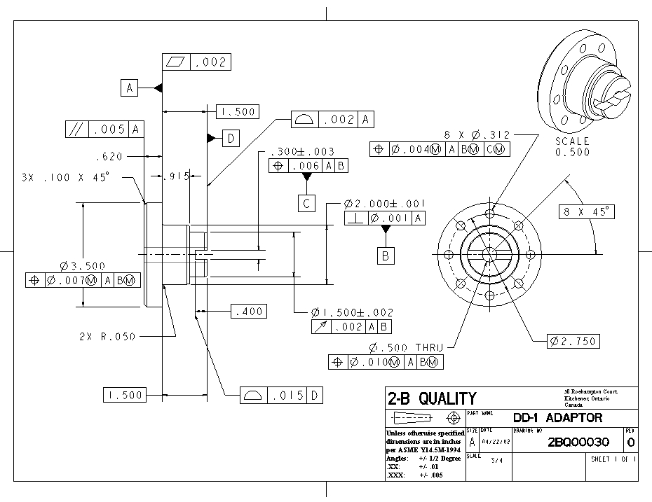
Computer Aided Design
Great! Let's get the program to do the perspective view automatically.
Oh dear! It's impossible...

Slide 7
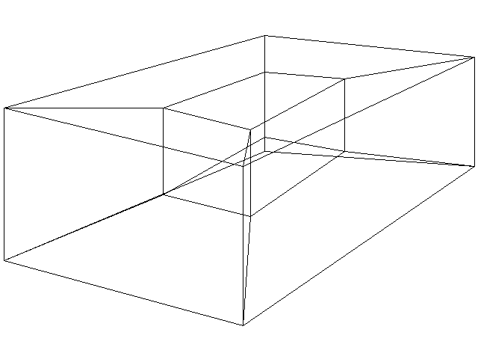
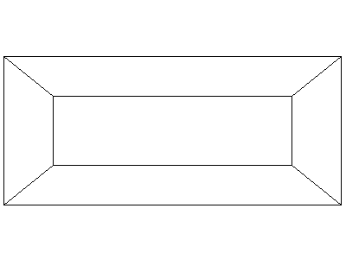
Computer Aided Design
Why is it impossible?
We need an unambiguous 3D representation.

Slide 8
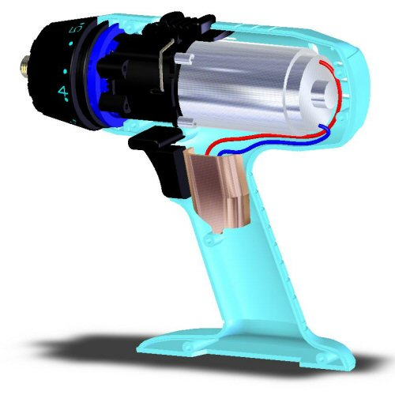
Computer Aided Design
In fact, we need an unambiguous 3D representation for all automated downstream processes such as:
Volume
Mass
Surface area
Moments of inertia
Strength
Flexibility
Heat and fluid flow
Fields, currents and fluxes
Mechanical integrity and fit
Manufacture, and
Pictures

Slide 9
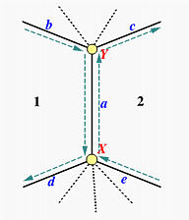
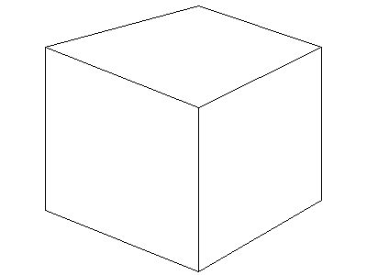
Computer Aided Design
Idea Number One – The Boundary Representation (Ian Braid, Bruce Baumgart et al.)
x
1
2
a
y
Extended Euler-Poincarré formula:
Faces + Vertices – Edges – Rings = 2(Shells - Holes)

Slide 10
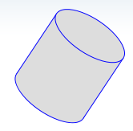
Computer Aided Design
Idea Number One – The Boundary Representation (Ian Braid, Bruce Baumgart et al.)
The extended Euler-Poincarré formula allows us to test the topology for solidity, but...
Faces = 3
Vertices = 0
Edges = 2
It can't do non-polyhedral shapes directly.

Slide 11
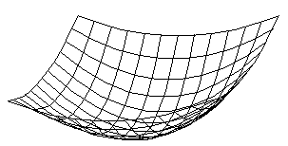
Computer Aided Design
Idea Number One – The Boundary Representation (Ian Braid, Bruce Baumgart et al.)
Curved surfaces: Bi-parametric patches
P(s, t)
s
t
P(s, t) = (x(s, t), y(s, t), z(s, t))
The most common patch is the Non-uniform Rational B-spline: NURBS.

Slide 12
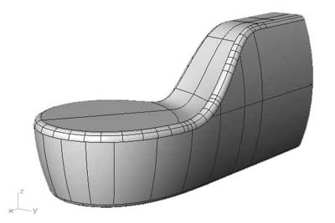
Computer Aided Design
Idea Number One – The Boundary Representation (Ian Braid, Bruce Baumgart et al.)
Curved surfaces: Bi-parametric patches
We can now stitch these together to make objects as a patchwork quilt.

Slide 13
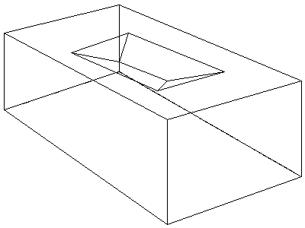
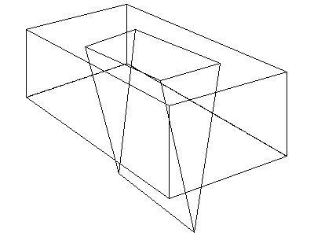
Computer Aided Design
Idea Number One – The Boundary Representation (Ian Braid, Bruce Baumgart et al.)
But, if we change the geometry, the topology can become nonsense.

Slide 14
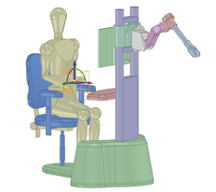
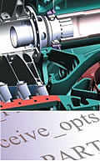
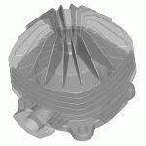
Computer Aided Design
Idea Number One – The Boundary Representation (Ian Braid, Bruce Baumgart et al.)
These problems have been solved (largely...).
Some commercial B-Rep Geometric Modellers:
ACIS (Spatial Corp.)
Parasolid (Siemens PLM Software)
Open CASCADE (Open CASCADE S.A.S.)

Slide 15
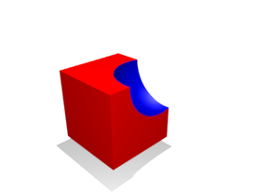
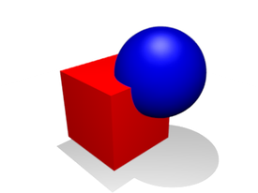
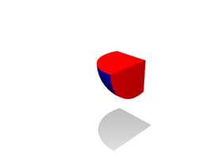
Computer Aided Design
Idea Number Two – The Constructive Solid Geometry Representation (Ari Requicha, John Woodwark et al.)
Union Intersection Difference

Slide 16
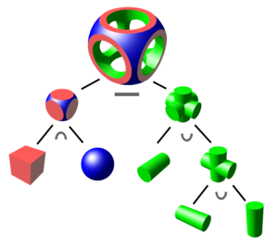
Computer Aided Design
Idea Number Two – The Constructive Solid Geometry Representation (Ari Requicha, John Woodwark et al.)
The design is represented as an operator tree with geometric primitives at the leaves.

Slide 17
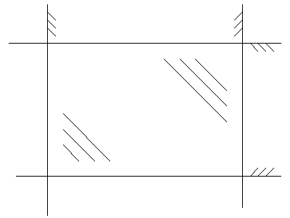
Computer Aided Design
Idea Number Two – The Constructive Solid Geometry Representation (Ari Requicha, John Woodwark et al.)
K
H
J: Ax + By + C <= 0 etc.
(Convention: negative is solid)
Rectangle: J ^ K ^ L ^ M
J
rectangle
L
M

Slide 18
Computer Aided Design
Idea Number Two – The Constructive Solid Geometry Representation (Ari Requicha, John Woodwark et al.)
Infinite cylinder, I: x² + y² – r² <= 0
Infinite planar half-space, P : Ax + By + Cz + D <= 0
Cylinder with ends: I ^ P1 ^ P2
H

Slide 19
Computer Aided Design
Idea Number Two – The Constructive Solid Geometry Representation (Ari Requicha, John Woodwark et al.)
And look! We can mix all the algebra and set-theory up in the tree.
Remembering the convention that negative is solid:
Max ( == ^)
+
+
+
+
* * * *
A x B y C D x E y F
CSG Functional Representation

Slide 20
Computer Aided Design
Idea Number Two - The Functional Representation
We can put in any operations and functions that we like: sin(...), (...)³, ln(...) and so on.
Max ( == ^)
sin()
+
+
+
+
* * * *
A x B y C D x E y F
This gives us all the bendy surfaces that parametric patches gave B-Rep, and more.

Slide 21
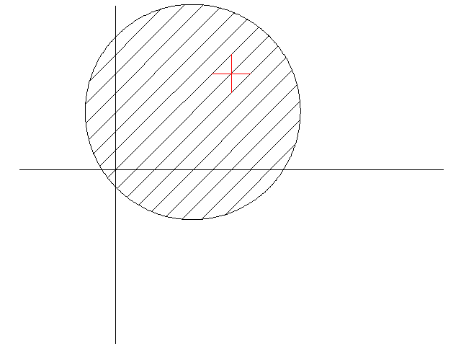
Computer Aided Design
Idea Number Two - The Functional Representation
We will (almost) always have a valid unambiguous solid, but...
We don't know where it is or what it is shaped like.
We have to evaluate it.
y
Disc: (x – a)² + (y – b)² – r² <= 0
Point: (x1, y1)
Evaluate: (x1 – a)² + (y1 – b)² – r²
→ - : inside
→ 0 : on surface (caution: f.p. arithmetic)
→ + : outside
A point membership test.
x

Slide 22
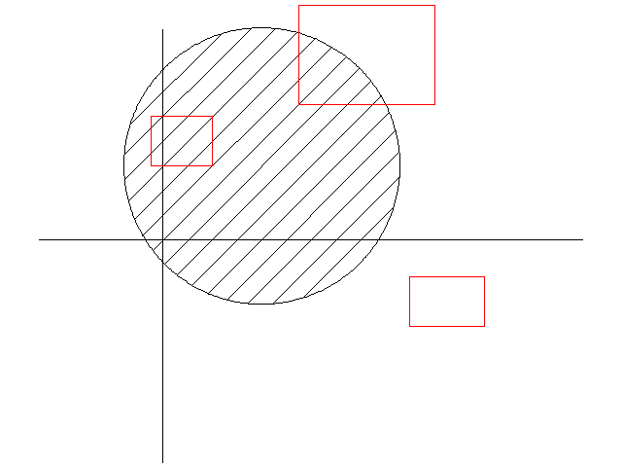
Computer Aided Design
Idea Number Two - The Functional Representation
Evaluating rectangles rather than points.
Disc: (x – a)² + (y – b)² – r² <= 0
Rectangle: ([xlow,, xhigh], [ylow,, yhigh]) = (Xi, Yi)
Evaluate: (Xi – a)² + (Yi – b)² – r²
→ [-, -]: definitely inside
→ [-, +]: May straddle surface
→ [+, +]: definitely outside
An interval membership test.
It is conservative.

Slide 23
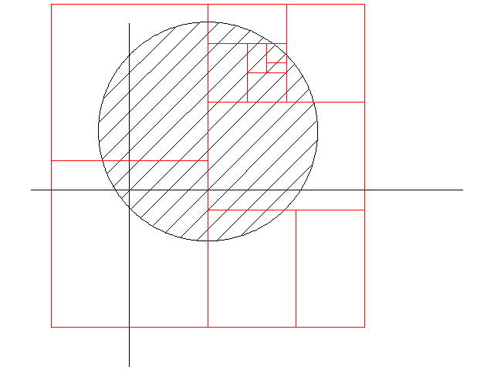
Computer Aided Design
Idea Number Two - The Functional Representation
Evaluating the entire shape using intervals.
C
Recursive spatial division (e.g. a quad tree, or – as here – a binary tree).
Rectangle A is entirely void (= null set).
Rectangle B is entirely solid (= universal set).
Rectangle C contains surface.
B
A

Slide 24
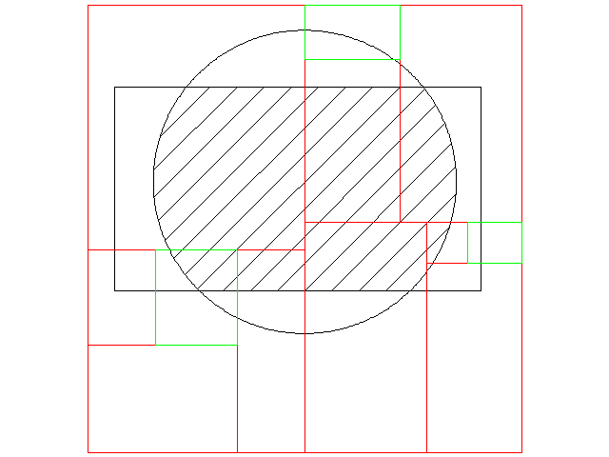
Computer Aided Design
Idea Number Two - The Functional Representation
The hatched area is
C ^ J ^ K ^ L ^ M
In Q: C gives null
→ null ^ J ^ K ^ L ^ M
→ whole thing is null in Q
In P: K gives null
→ whole thing is null in P
In R: J, K, and L give universal
→ C ^ true ^ M
→ we MAY have surface in R
Pruning the tree.
K
J
C
L
M
P
Q
R

Slide 25
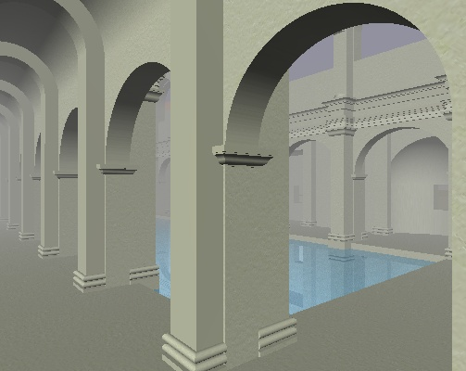
Computer Aided Design
Idea Number Two - The Functional Representation
Pruning the tree.
The Great Bath
Aquæ Sulis
Roman Britain

Slide 26
Computer Aided Design
Boundary Representation vs. Functional Representation
B-Rep
Bad:
Calculating volume (hence mass) is hard
Numerical accuracy problems
The data structures use lots of memory
Input can be messy without
lots of extra software
The model is evaluated
Good:
Easy to triangulate the surface
Making pictures is easy
Calculating surface area is easy
B-rep primitives are local
The model is evaluated
F-Rep
Bad:
Making pictures is hard
Calculating surface area is hard
F-rep primitives are not local
The model is unevaluated
Hard to triangulate the surface
Good:
Calculating volume (hence mass) is easy
Easy(ish) to make numerically robust
Input is pretty straightforward
The model is unevaluated
The data structures are compact

Slide 27
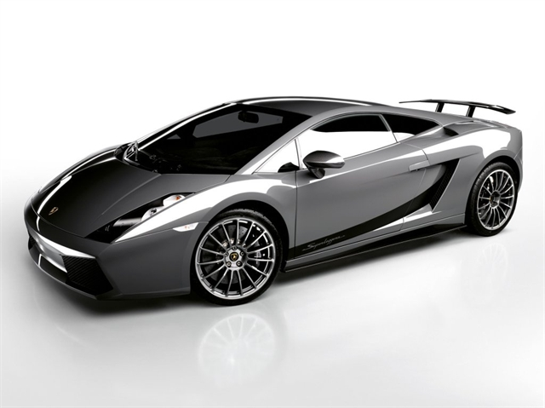
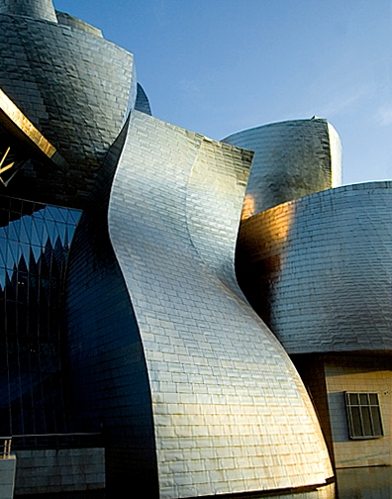
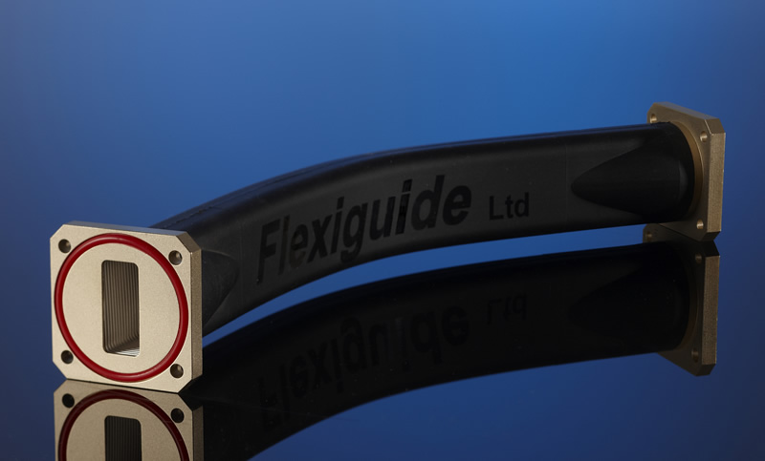
Computer Aided Design
Boundary Representation vs. Functional Representation
Right! We can now take our prefered representation and go away and design Lamborghinis, wave guides and art galleries!
Errr. No. We need a user-interface. And that typically takes much more code and many more person-hours than the geometric modeller.

Slide 28
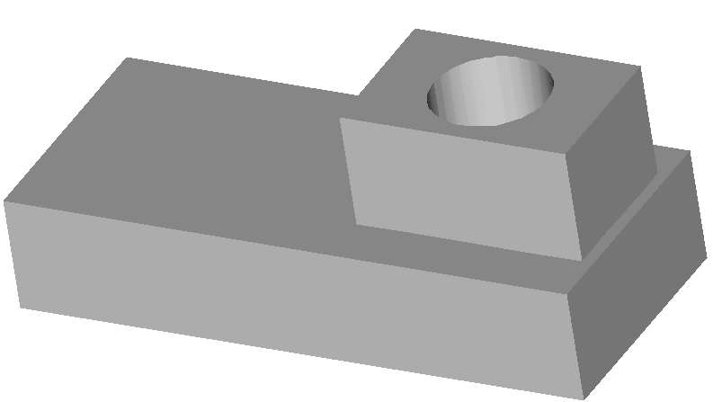
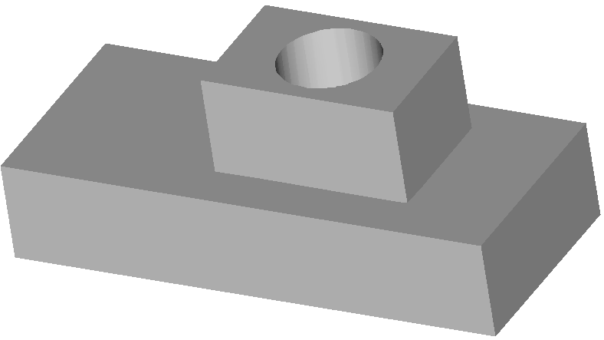
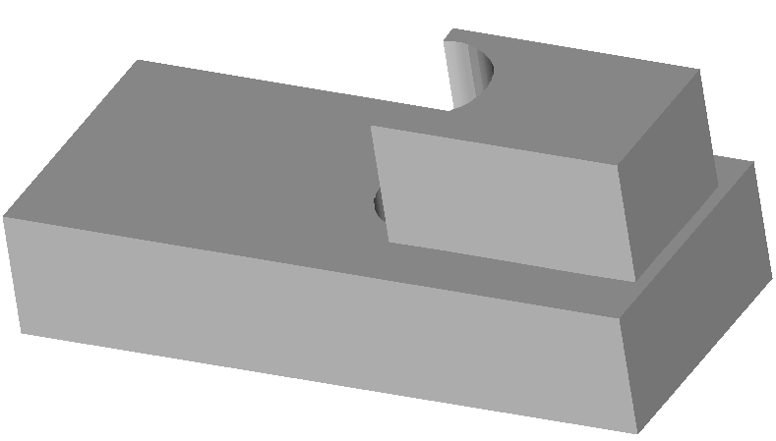
Computer Aided Design
One aspect of the User Interface – Geometric Constraints
yes
no

Slide 29
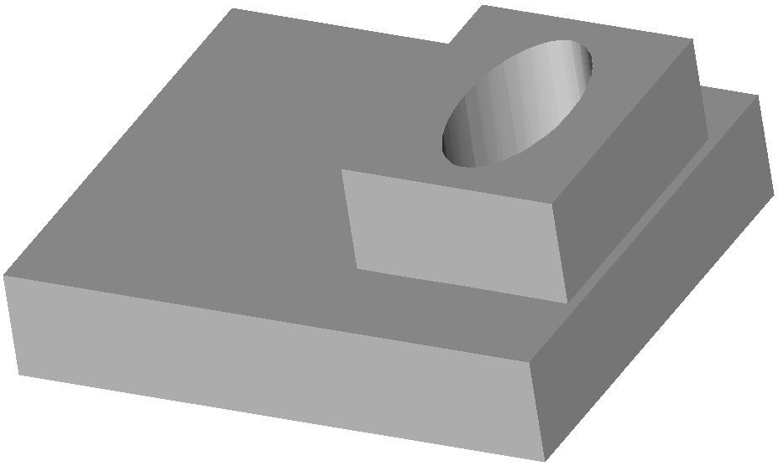
Computer Aided Design
One aspect of the User Interface – Geometric Constraints
very unlikely
maybe

Slide 30
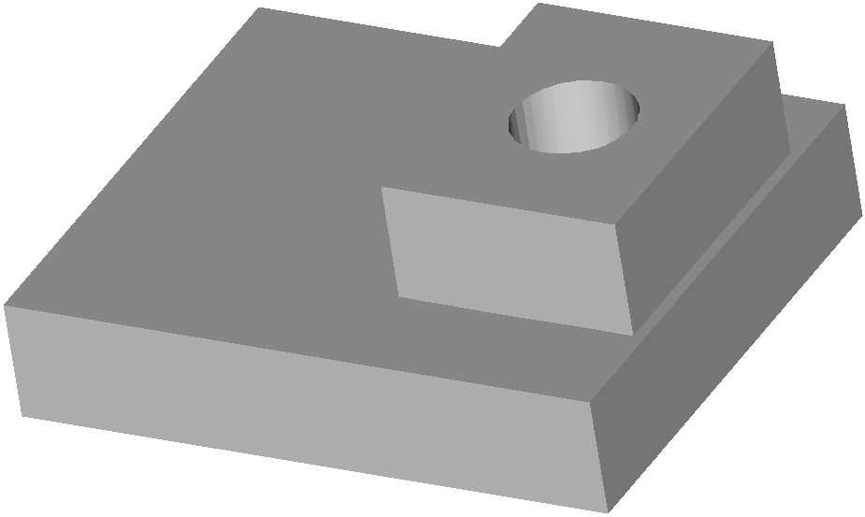
Computer Aided Design
One aspect of the User Interface – Geometric Constraints
We end up with a large hierarchical non-linear geometric system to solve on-the-fly as the user is designing.

Slide 31
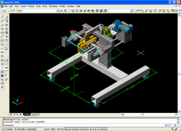
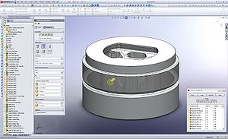
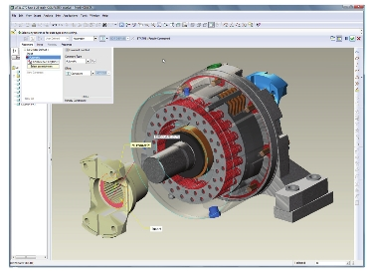
Computer Aided Design
Some commercial systems
AutoCAD (Autodesk Inc.)
SolidWorks (Dassault)
Pro-Engineer (Parametric Technology)

Slide 32
Computer Aided Design
All commercial systems are B-Rep.
They grew out of 2D drafting
B-Rep is quick to render on ancient computers
Neither of these matters today
But the Polya urn started out with more red balls than white...

Slide 33
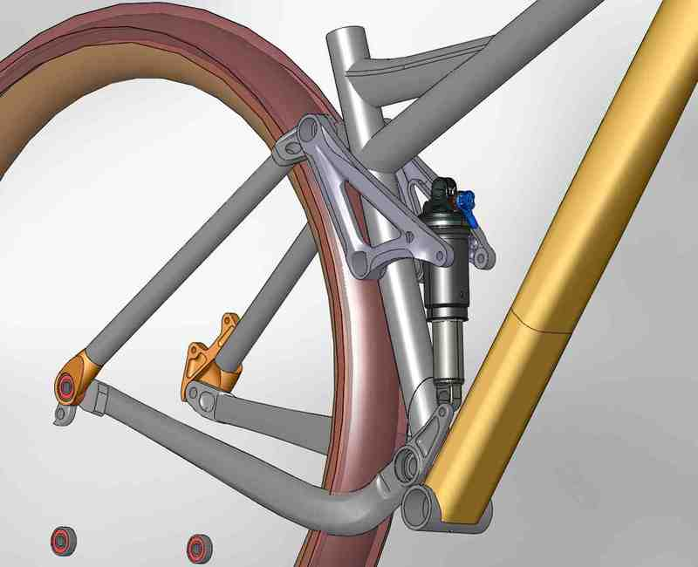
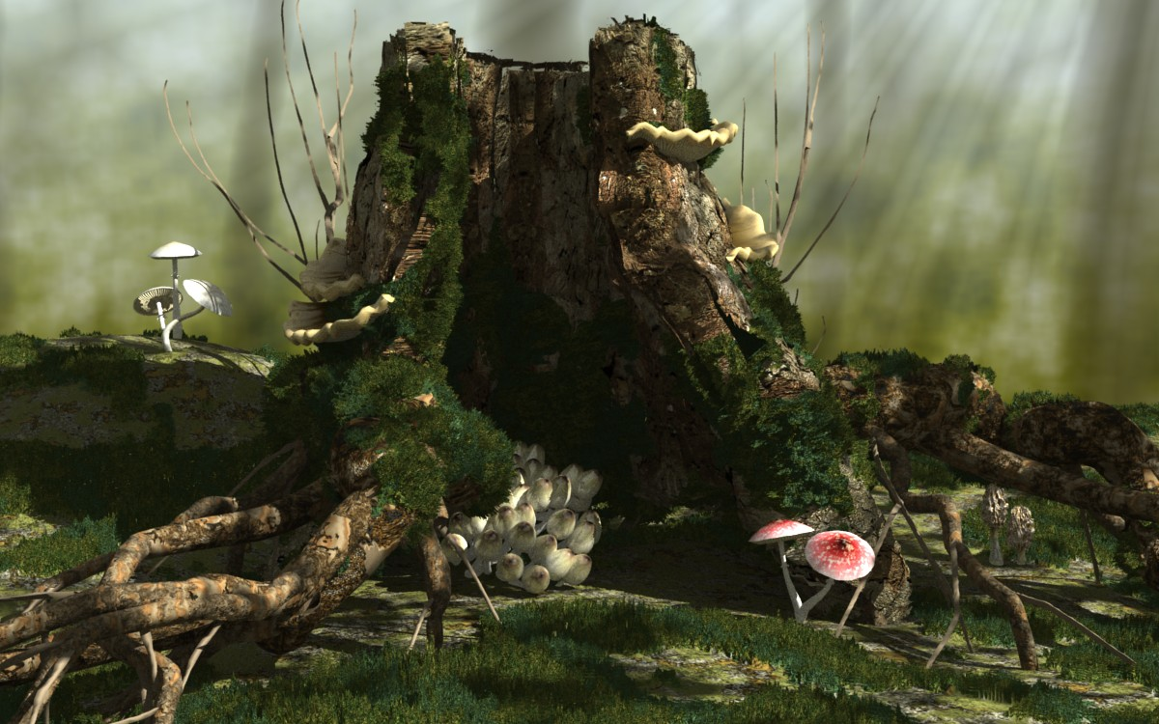
Seeing what's there
There is one predominant technology – the depth buffer.
If everything had been F-Rep, not B-Rep, then the predominant technology would probably be ray-tracing.

Slide 34
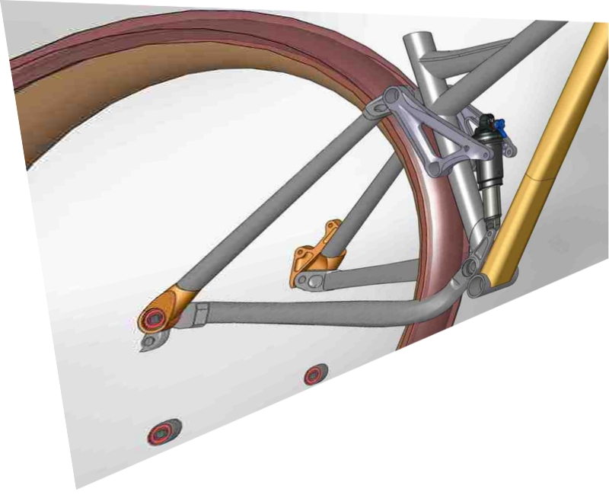
Seeing what's there
The depth buffer.
Entirely implemented in hardware courtesy of:
Silicon Graphics and flight
simulators, then
Computer games
For each pixel store both colour and depth
Send it 3D coloured triangles in any order
Surfaces in front win
depth buffer memory
frame buffer memory
Z(0, 0)

Slide 35
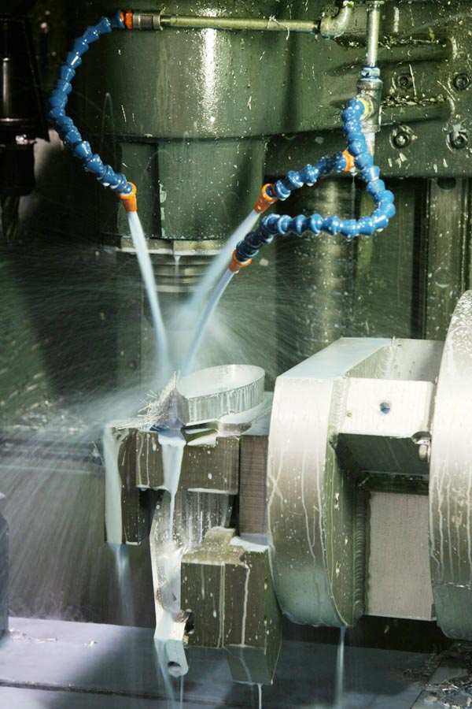
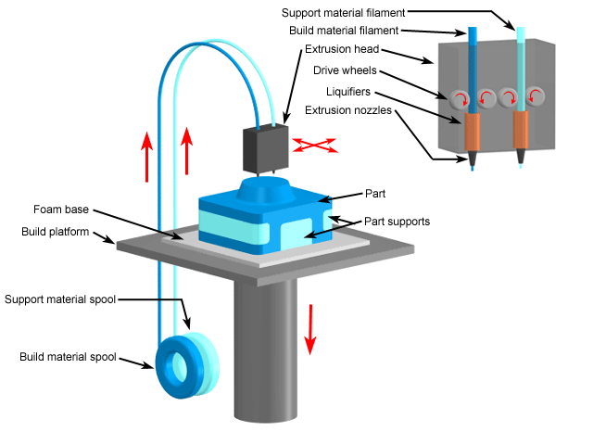
Computer Aided Manufacturing
Cutting away and building up

Slide 36
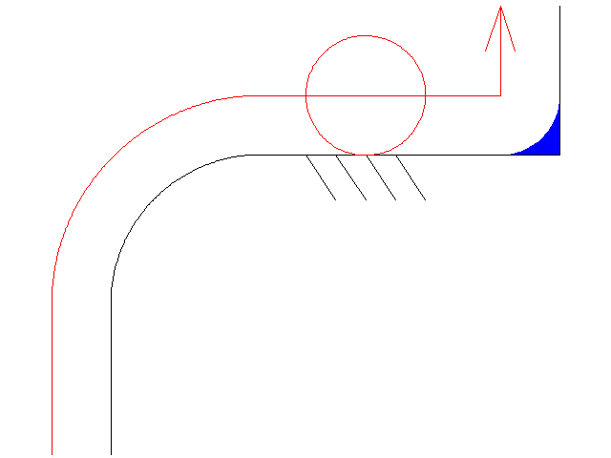
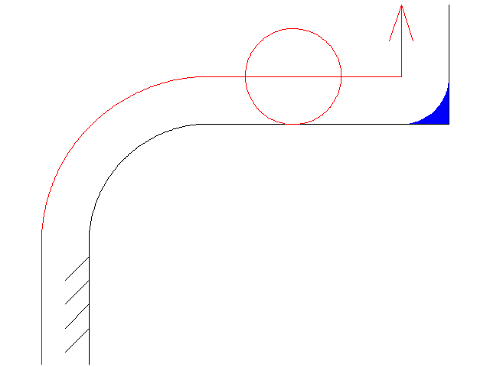
Computer Aided Manufacturing
Cutting away and building up – both need offsetting
cutting tool
Material deposition
Required solid
Offsetting straight lines and circular arcs is pretty straightforward.

Slide 37
Computer Aided Manufacturing
Offsetting flat F-Rep is very easy:
K
H
J: Ax + By + C <= 0 etc.
→
J': Ax + By + C – R <= 0 etc.
Offset rectangle: J' ^ K' ^ L' ^ M'
J
rectangle
L
R
M

Slide 38
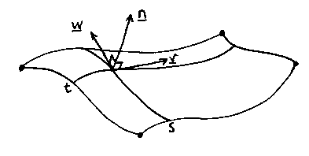
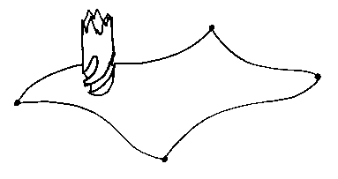
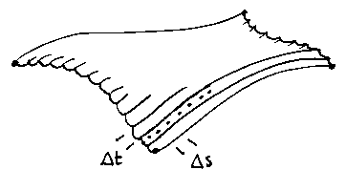
Computer Aided Manufacturing
Offsetting parametric patches in B-Rep is surprisingly easy:
Ball-nosed tool, radius r
H
P(s, t) = (x(s, t), y(s, t), z(s, t))
W(s, t) = ∂P/∂s, V(s, t) = ∂P/∂t
N(s, t) = W x V
Tool centre is at P + r N (N normalised).

Slide 39

Computer Aided Manufacturing
Offsetting pixel data is very easy:
Region growing
Set each white pixel within r of a black one red...
Very memory hungry in 3D
→
Quad/Oct-tree + interval tricks
Now it's not so easy as it was...

Slide 40

Computer Aided Manufacturing
So. Offsetting is pretty much solved. What's the problem?
Toolpath collisions
Not too hard to detect.
But what does the computer do about it?
Using a smaller tool sometimes works, but is inefficient.
And what happens when the tool shaft hits the work?

Slide 41

Computer Aided Manufacturing
3D Toolpath collisions are not a problem at all for additive manufacturing.
This is the main reason that it is considered such a powerful technology.

Slide 42

Data exchange
How do we get data from CAD A to CAD B?
ISO 10303 - STEP
A definition language – Express
Implementation methods
Conformance tests
Etc.
The biggest standard within ISO...
Express-G

Slide 43
Data exchange
How do we get data from CAD to a numerically-controlled machine?
G-Codes
; GCode generated by RepRap Java Host Software
; Created: 2009-09-13:11-29-21
G21 ;metric
G90 ;absolute positioning
T0; select new extruder
G28; go home
M104 S190.0 ;set temperature
;#!LAYER: 1/48
M107 ;cooler off
G4 P20 ;delay
G1 Z0.0 F5.0 ;z move
G1 X1.7 Y2.2 F3000.0 ;horizontal move

Slide 44
Data exchange
How do we get data from CAD to additive-manufacturing machines?
STL files
solid
facet normal n1 n2 n3
outer loop
vertex v11 v12 v13
vertex v21 v22 v23
vertex v31 v32 v33
endloop
endfacet
facet normal 0.0 1.0 0.0
outer loop
Vertex 7.9 -2.63 12.2
Vertex -18.4 -2.63 0.45
Vertex 3.35 -2.63 5.5
endloop
endfacet
endsolid

Slide 45
In Conclusion
Neither CAD nor CAM is like logic or mathematics, but they are like the engineering they serve:
They don't always give the answer you want (nor even the correct answer) even if you put correct data in at the start. But they work almost all the time.
The predominant technologies are not necessarily the best nor the most elegant. They got here today by Polya-urn style historical accident.

Slide 46
References from the Dawn of Time...
Type most of the terms in this lecture into Google Scholar and you'll find all the modern stuff. But where did it all start?
I.C. Braid, l.C.Hillyard and I.A.Stroud, Stepwise Construction of Polyhedra in Geometric Modelling, in K.W.Brodlie, ed., "Mathematical Methods in Computer Grapllics and Design", Academic Press. (1980), 123-141.
Bruce G. Baumgart, Winged edge polyhedron representation., Stanford University, Stanford, CA, 1972
A.A.G. Requicha and H.B. Voelcker, Solid Modelling: Current Status and Research Directions, IEEE Computer Graphics and Applications. Vol. 3, No. 7, October (1983).
John Woodwark, Generating wireframes from set-theoretic solid models by spatial division, Computer-Aided Design, Volume 18 , Issue 6 (July/Aug. 1986) Pages: 307 - 315.

