Slide 1
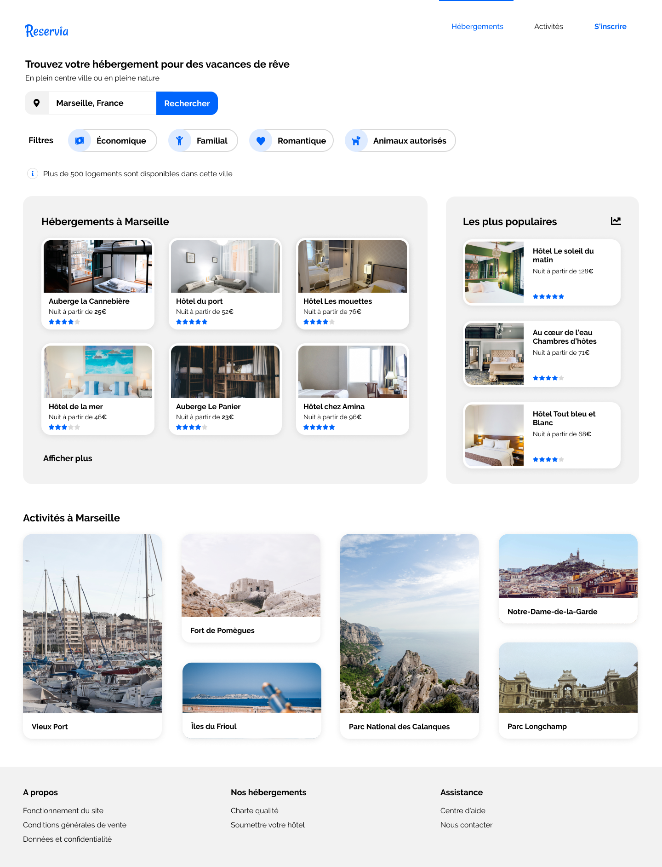
<logo>
<div #header>
<nav>
<ul>
<h1 #title>
<p #description>
<header>
<form #searchbar>
<section #search_area>
<body>
<form #filters>
<p>
<section #results>
<h2>
<article #results>
<aside #popular_results>
<h2>
<div>
<div>
<div>
<div>
<div>
<div>
<div>
<div>
<link>
<div>
<h2>
<section #activities>
<div>
<div>
<div>
<div>
<div>
<div>
<div #activities_results>
<div #about>
<div #our_accomodations>
<div #assistance>
<footer>
<h3>
<h3>
<h3>
<ul>
<ul>
<ul>

