Slide 1
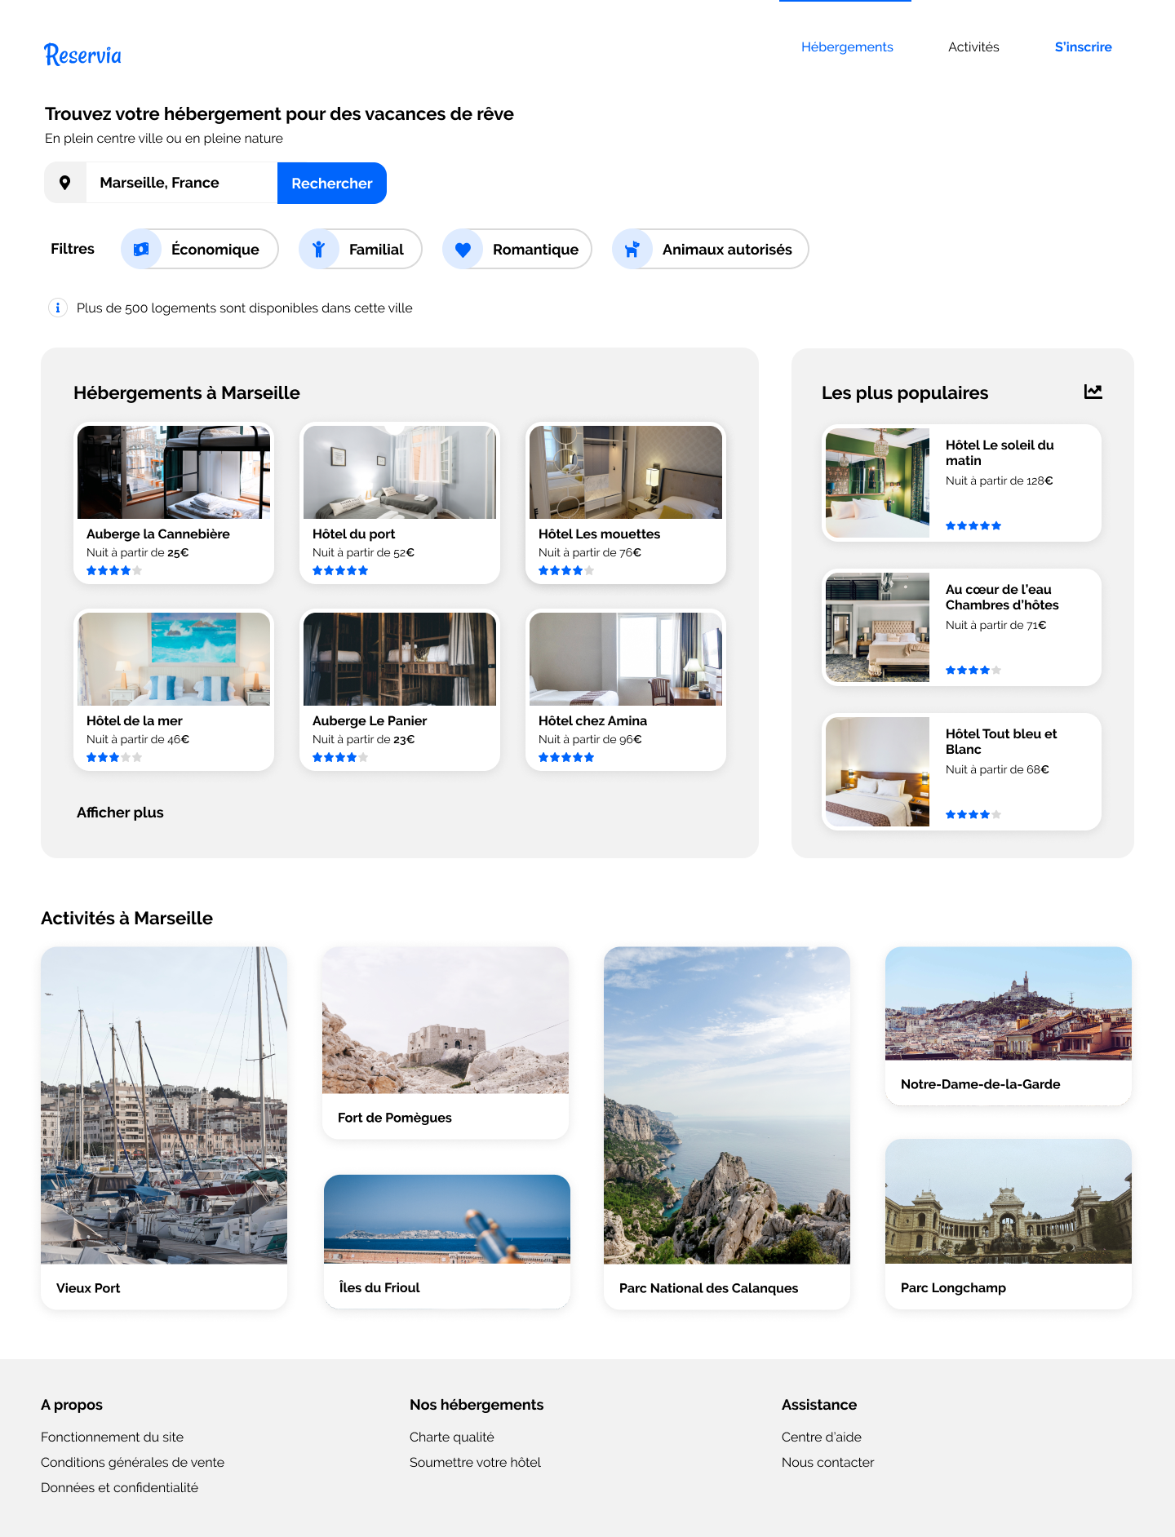
<img>
<div .logo>
<nav>
<ul>
<header>
<.intro>
<main>
<.searchbar>
<section .search>
<.filters>
<.filters__info>
<section #search_results>
<.results>
<.populars>
<.results__ttl>
<populars__ttl>
<div>
<div>
<div>
<div>
<div>
<div>
<div>
<div>
<.more>
<div>
<activities__ttl>
<.activities>
<div>
<div>
<div>
<div>
<div>
<div>
<.activities__btns>
<.footer__links>
<.footer__links>
<.footer__links>
<footer>
<h3>
<h3>
<h3>
<ul>
<ul>
<ul>

