Slide 1
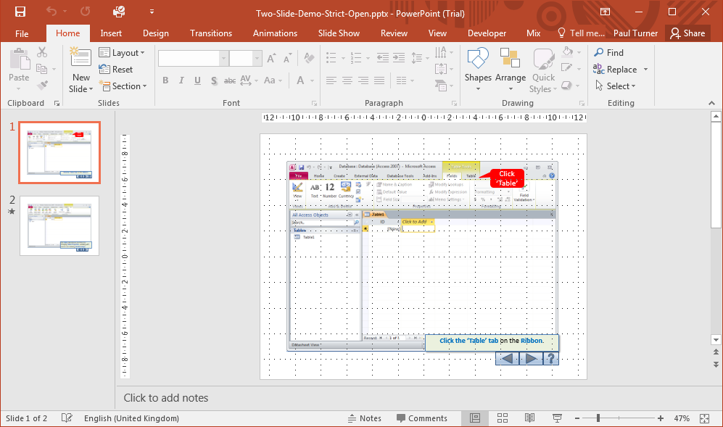
Click Design
Click ‘Table’
Click the ‘Design’ tab on the Ribbon.

Slide 2
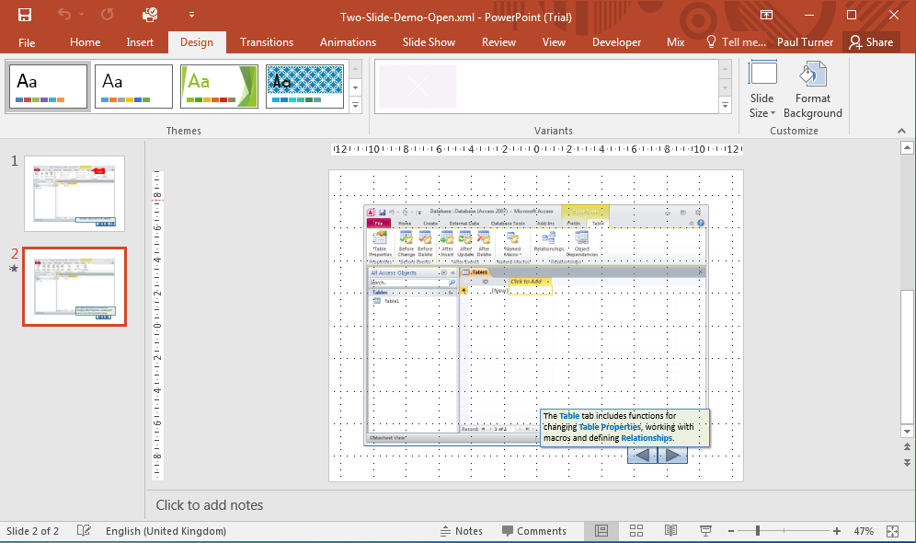
The Design tab includes functions for changing Design Properties, working with the overall presentation or each slide.

