Slide 1
Amazon Review Summarizer
Matteo Dal Zotto
Fabiano Pilia
Emanuele Tinghi

Slide 2
Goal of the project
Create a system capable of summarizing the reviews referring to a single product to be able to give an overview of it without necessarily having to scroll through them all
To have a textual correspondent to the commonly present star rating system
To understand the pros and cons of the product instead of having only a general representation of the quality of the object

Slide 3
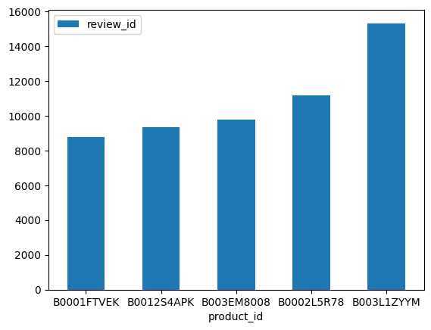
Dataset
Contains over 3 million reviews belonging to 185774 products sold on amazon.com
We've used a sample containing 55k reviews of 5 products

Slide 4
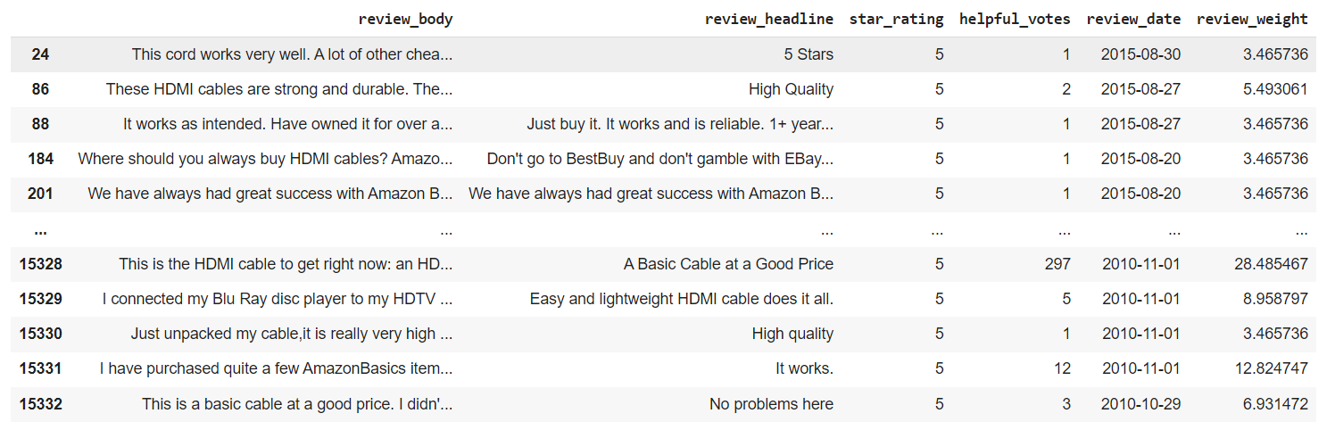
Some elements of the resulting dataset
The following image contains an example of the reduced dataset used with the used attributes:

Slide 5
Text preprocessing
It is then necessary to apply some preprocessing to the dataset to make it usable correctly (lowercasing, tokenization,
stopword/punctuation removal)
It was also decided to not consider the reviews that are too small (1-2 tokens) or too big (more than 300 tokens)

Slide 6
Experiments workflow
For each product:
Compute N batches of reviews
Obtain for each batch a summary
Clean the text to remove the additional information added by the model
If we’ve more reviews than a determined threshold, start again from the point 1
These steps are performed in both the case of
Preprocessed text and full text

Slide 7
BART
Three different models based on BART were used:
BART-base / BART-large-cnn
This model worked in an extractive way, so it was not used
BART-base with fine tuning
The review_headline field was used as label. This model associates to each review a label. Since a review headline doesn’t represent a good summary, this model was also discarded
BART-large-xsum
Model used in the project

Slide 8
BART large xsum
This model is a version of BART-large fine tuned on the Extreme Summarization dataset
The first stage summarizer works on the batches and returns their summaries. To obtain a single summary this stage is repeated k times
To evaluate the goodness of it, sentiment analysis is used to compare its evaluation with and the one from the star-rating of the product (normalized in [0,1])

Slide 9
T5
Four different models based on T5 were used:
T5-base
This model worked in an extractive way, so it was not used
T5-base with fine tuning
This model works as a classifier, in which the labels are the reviews headline
T5-large
No visible difference in using the large version respect to the base: it works as an extractive summarizer
T5-large with fine tuning
Same behavior of the T5-base fine tuned

Slide 10
Pegasus
Two different models based on pegasus were used:
Pegasus-xsum
This model worked in an extractive way, so it was not used
Pegasus-xsum with fine tuning
Works as a classifier using as labels the review headlines, not interesting for our purpose

Slide 11
Result of the experiments
Starting from what we've obtained from the experiments we've selected BART-large-xsum as the final model, due to its capability to work in an abstractive way
We can generate summaries that try to capture the common thought behind each batch of reviews, which are put together in the following stages to capture the common thought behind the summaries
For the final version we've also considered to group the reviews by year to build the batches

Slide 12
Results
Product B003L1ZYYM (Year 2015)
’As part of our series on the best cable products, we take a look at some of the best hdmi cable products on the market.’
Expected rating: 4.6 stars
Observed rating: 5 stars
Confidence: 0.75
Product B0001FTVEK (Year 2009)
’Here are some of the best and worst-selling wireless headphones available on the market.'
Expected rating: 3.9 stars
Observed rating: 5 stars
Confidence: 0.77

Slide 13
Expected vs observed rating
The validation using the sentiment analysis does not provide a reliable instrument to evaluate the quality of the summary as we can see in the previous slide. This is due to:
The generated text captures the most important concepts, and it can use words that does not represent correctly the original reviews’ sentiment
The observed rating is discretized and it cannot represent the intermediate ratings
Bias towards the short reviews

Slide 14
Future works
Use larger models to improve the abstraction power and to handle larger inputs
Gather more accurate labels, that can represent in a better way the thought behind the reviews
Use the helpful votes to weight more the reviews that are validated by other users

