Slide 1

Recipe

Slide 2
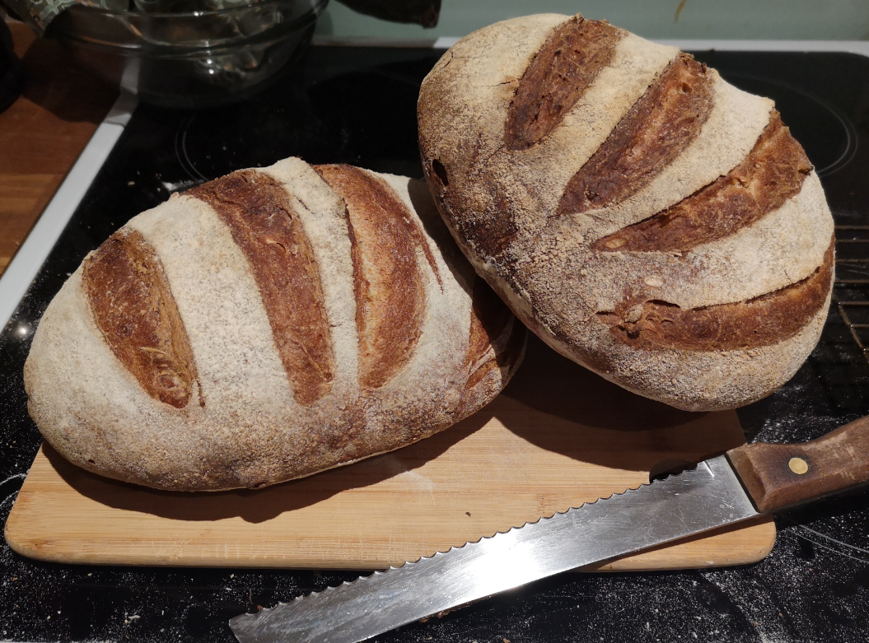
Wholemeal Sourdough Recipe
Ingredients:
100g Sourdough Starter (20 %)
400g White Bread Flour (80 %)
100g Wholemeal Flour (20 %)
350g Water (75 %)
10g Salt (2 %)
Instructions:
Prepare sourdough starter in advance: You will need to prepare 50g of active starter (aka levain) before you begin mixing the dough. To a clean jar add 10g starter + 25g water + 25g flour and let rise until doubled. Depending on the temperature of your kitchen and the maturity of your starter, this can take anywhere from 4-12 hours.
Mix the dough: Transfer the 50g of active starter and 350g water into a large mixing bowl. Stir to distribute the starter evenly. Add 500g bread flour and 10g sea salt to the bowl and use a stiff spatula or your hands to work the ingredients together until it forms a shaggy mass, making sure that there are no dry bits of flour. Cover the bowl and let the dough rest for 1 hour.
Stretch and Fold: Pick up the dough on one side and stretch it up and over itself. Turn the bowl a quarter turn and repeat this step until you have turned the bowl a full circle. The dough should form into a tight ball. (If you have time, let the dough rest 30 minutes and repeat the stretch and fold process 1 to 2 more times. This will help to build volume in the final loaf)
Bulk Fermentation: Cover the bowl and let the dough ferment for 7-10 hours on your kitchen counter or in a 65-70°F (18-21°C) area of your home. The dough should have risen by 50% and show signs of fermentation, bubbles on top and sides of the dough.
Shape and Second Rise: Place the dough on a lightly floured surface. Shape the dough into a ball by pulling 4 sides of the dough into the middle of itself. Turn the dough seam side down and gently cup the dough, pulling and twisting until it forms a tight skin. Center the dough onto a piece of parchment paper, seam-side down. Place the dough, along with the parchment paper into a bowl and cover. Let the dough rise for 30 minutes to 1 hour or until it has risen by about 20%.
Score and Bake: 30 minutes before you're ready to bake, Preheat the dutch oven to 450°F (232°C). Right before baking, use a sharp razor to score the top of the dough. Using the parchment paper as a sling, transfer the dough to the dutch oven. Cover and bake for 20 minutes, uncover and bake an additional 25-30 minutes or until crust is golden brown. The internal temperature of the bread should be around 210°F (99°C). Let the bread cool on a cooling rack until completely cooled before slicing.

Slide 3
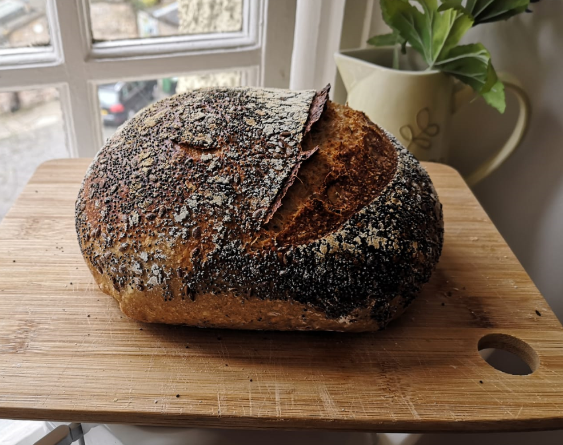
Rye Sourdough Recipe
Ingredients:
100g Sourdough Starter (20 %)
400g White Bread Flour (80 %)
100g Rye Flour (20 %)
350g Water (75 %)
10g Salt (2 %)
Instructions:
Prepare sourdough starter in advance: You will need to prepare 50g of active starter (aka levain) before you begin mixing the dough. To a clean jar add 10g starter + 25g water + 25g flour and let rise until doubled. Depending on the temperature of your kitchen and the maturity of your starter, this can take anywhere from 4-12 hours.
Mix the dough: Transfer the 50g of active starter and 350g water into a large mixing bowl. Stir to distribute the starter evenly. Add 500g bread flour and 10g sea salt to the bowl and use a stiff spatula or your hands to work the ingredients together until it forms a shaggy mass, making sure that there are no dry bits of flour. Cover the bowl and let the dough rest for 1 hour.
Stretch and Fold: Pick up the dough on one side and stretch it up and over itself. Turn the bowl a quarter turn and repeat this step until you have turned the bowl a full circle. The dough should form into a tight ball. (If you have time, let the dough rest 30 minutes and repeat the stretch and fold process 1 to 2 more times. This will help to build volume in the final loaf)
Bulk Fermentation: Cover the bowl and let the dough ferment for 7-10 hours on your kitchen counter or in a 65-70°F (18-21°C) area of your home. The dough should have risen by 50% and show signs of fermentation, bubbles on top and sides of the dough.
Shape and Second Rise: Place the dough on a lightly floured surface. Shape the dough into a ball by pulling 4 sides of the dough into the middle of itself. Turn the dough seam side down and gently cup the dough, pulling and twisting until it forms a tight skin. Center the dough onto a piece of parchment paper, seam-side down. Place the dough, along with the parchment paper into a bowl and cover. Let the dough rise for 30 minutes to 1 hour or until it has risen by about 20%.
Score and Bake: 30 minutes before you're ready to bake, Preheat the dutch oven to 450°F (232°C). Right before baking, use a sharp razor to score the top of the dough. Using the parchment paper as a sling, transfer the dough to the dutch oven. Cover and bake for 20 minutes, uncover and bake an additional 25-30 minutes or until crust is golden brown. The internal temperature of the bread should be around 210°F (99°C). Let the bread cool on a cooling rack until completely cooled before slicing.

Slide 4
Sourdough Recipes
Ingredients:
Wholemeal | Rye | Spelt | Seeded
100g Wholemeal flour | 100g Rye flour | 50g Spelt flour | 20g Sesame/Poppy Seeds
400g White Flour | 400g White Flour | 400g White Flour | 400g White Flour
100g Starter | 100g Starter | 100g Starter | 100g Starter
350g Water | 350g Water | 350g Water | 350g Water
10g Salt | 10g Salt | 10g Salt | 10g Salt
Instructions:
Feed your sourdough starter 12 hours in advance. To a clean jar add 10g starter + 50g water + 50g flour and let rise until doubled.
Mix the dough and Autolyse: Cover the bowl and let the dough rest for 1 hour.
Stretch and Fold, 2-3 sets.
Bulk Fermentation 7-10 hours in 65-70°F (18-21°C)
Shape and Second Rise: Shape the dough into a tight ball on a lightly floured surface. Place the dough, along with a parchment paper seam-side down into a bowl and cover. Let the dough rise for 30 minutes to 1 hour.
Score and Bake: Preheat the dutch oven to 450°F (232°C). Score the top of the dough. Cover and bake for 20 minutes, uncover and bake an additional 25-30 minutes.

