Slide 1

Exploratory Data Analysis
G2M Insight for Cab Investment
20/07/2022

Slide 2

Agenda
Executive Summary
Problem Statement
Approach
EDA
EDA Summary
Recommendations

Slide 3
Executive Summary
Problem statement
US company XYZ, Due to recent growth, and the existence of prominent companies, thinks of investing in the taxi industry.
Objectives
The analysis aims to provide company XYZ useful information so they can choose the best firm to invest in.
Approach
Understanding data
Identifying the most lucrative cab firm
Making investment recommendations.

Slide 4
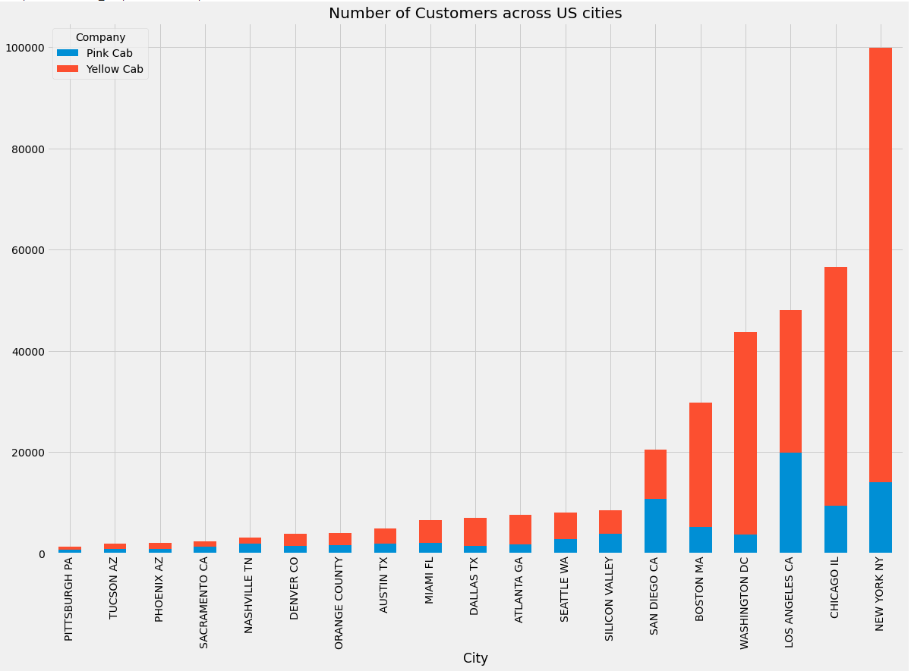
Geographical Analysis
According to the graph, the pink company has the most customers in Los Angeles, CA, and the yellow company has the most customers in New York.
When comparing the two companies' geographical areas in general, the yellow company has a much larger customer base.

Slide 5
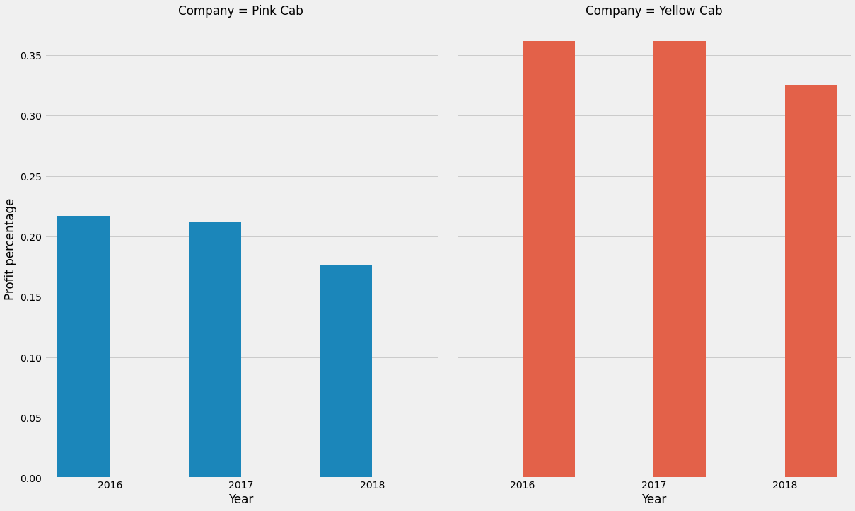
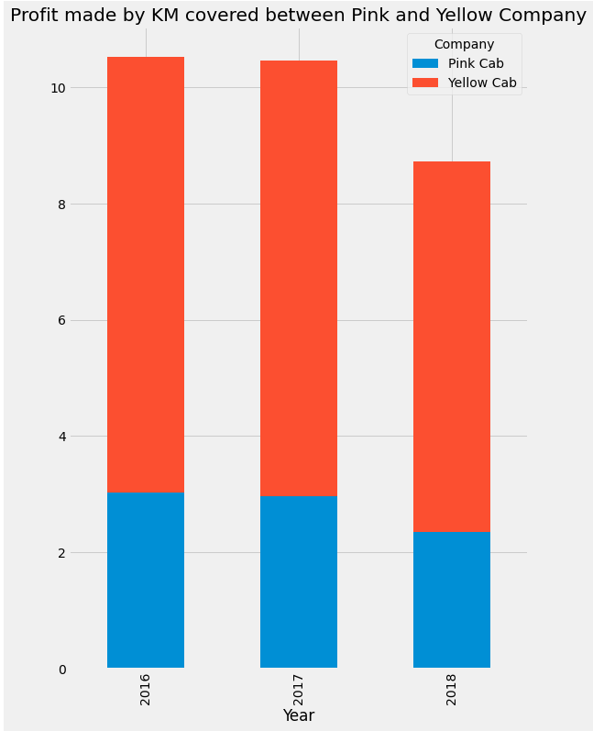
Profit Analysis
Profit per kilometre covered reveals a huge disparity between the two companies, with the yellow company earning far more than the pink company
The profit percentage chart demonstrates that the Yellow Cab Company earns more profit than the Pink Company.

Slide 6
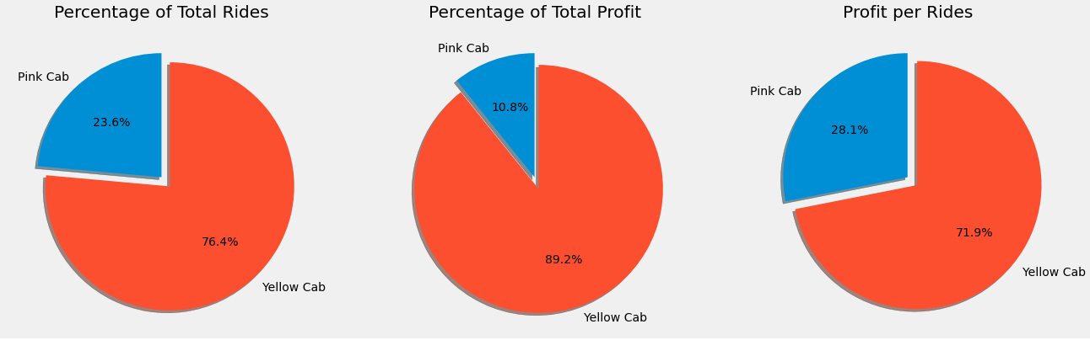
Profit Analysis
The pie chart clearly shows that the yellow company has a larger percentage of total rides, percentage of total profit, and profit per ride..

Slide 7
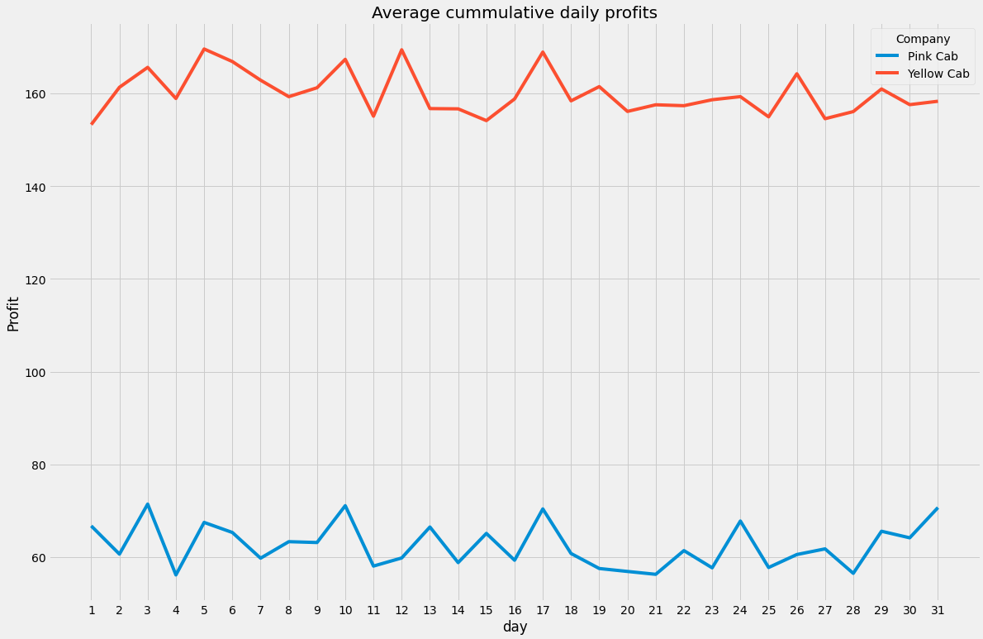
Daily Profit Analysis
The chart shows a significant difference in the averaged daily earnings earned by the two companies, with Yellow company coming out on top.

Slide 8
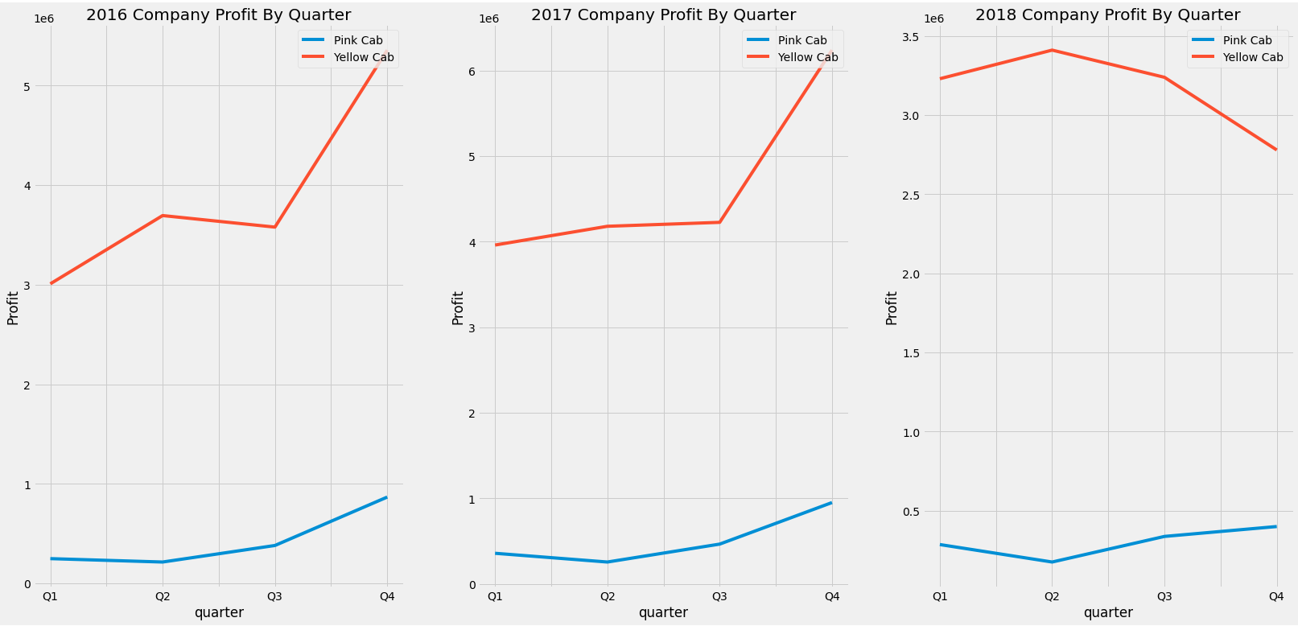
Quarterly Profit Analysis
Higher profit is earned in the fourth quarter of the year, except in the year 2018 for yellow Company.
There is a significant disparity in the profits earned by the two companies, with Yellow faring better.

Slide 9
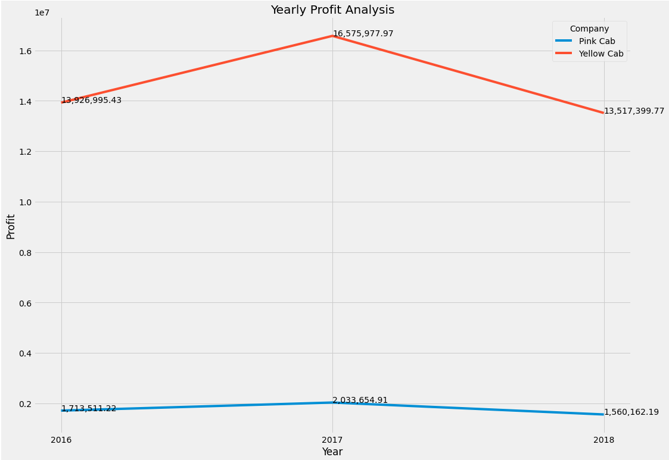
Yearly Profit Analysis
The graphic depicts the supremacy of the Yellow company in terms of profitability.

Slide 10
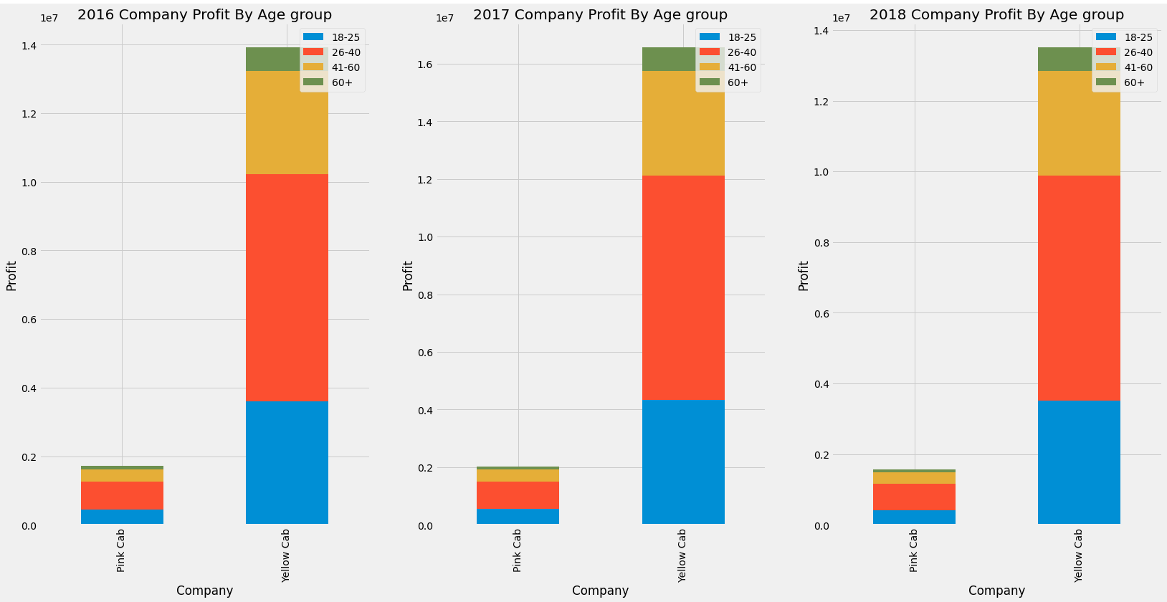
Age segmentation Analysis
Majority of the customers of the two companies fall between the age range of 26 - 40. However, there is no obvious difference between the two aside profit.

Slide 11
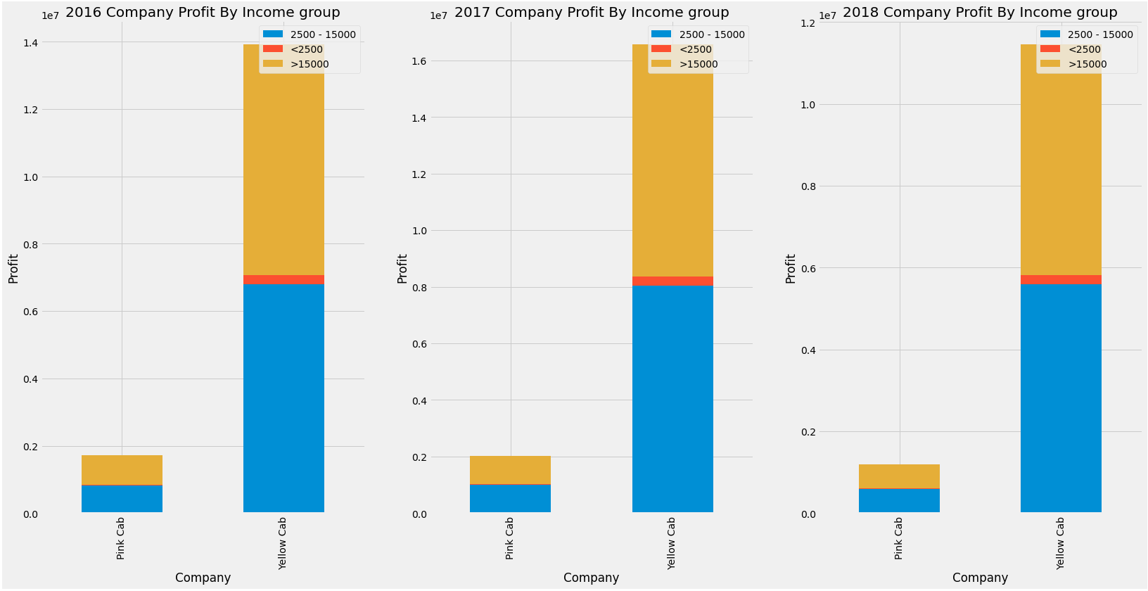
Income class segmentation Analysis
The chart depicts the yellow company's ability to accommodate consumers from all income classes, though lower percentages for lower income classes.

Slide 12
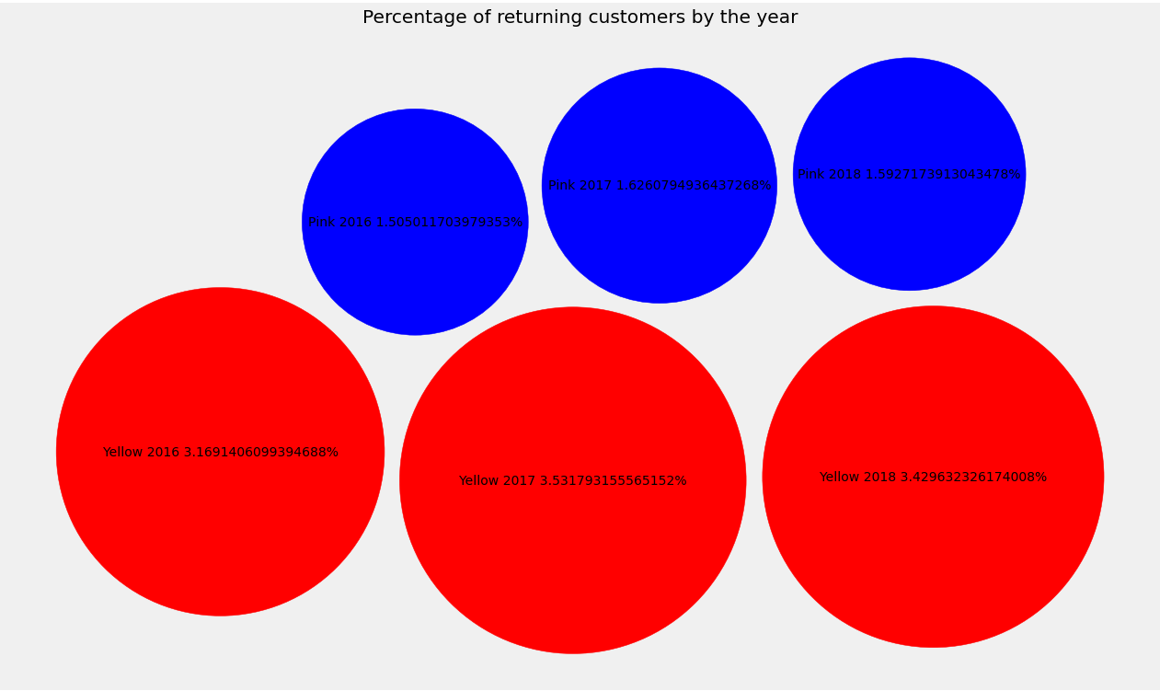
Customer Retention Analysis
The plot shows a significant disparity in the two cab firms' client retention capacities, with Yellow having a greater customer retention rate.

Slide 13
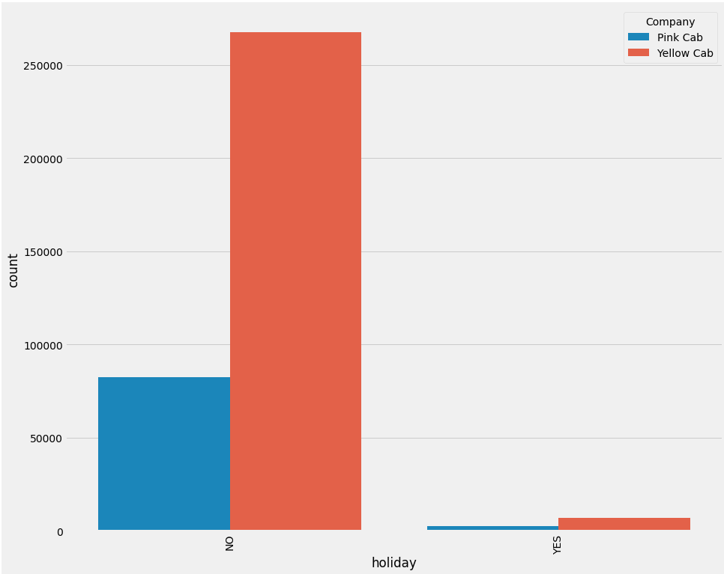
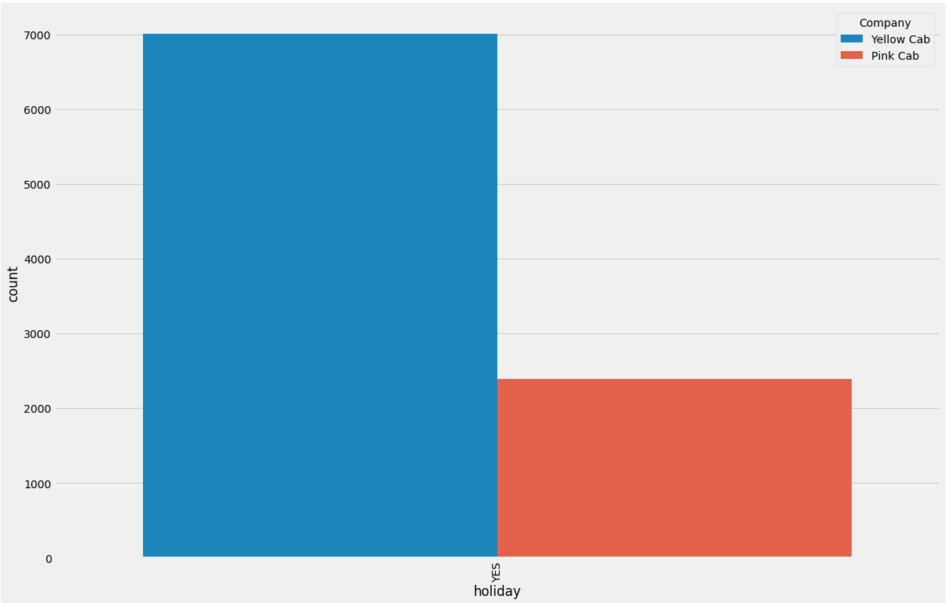
Holiday Analysis
It is clear from the chart that customers are more likely to opt for Yellow company during holiday periods.

Slide 14
Summary and Recommendation
EDA SUMMARY
• Customer Base : Yellow cab has higher customer base in general across the US cities when compared to pink cab.
• Customer Retention Percentage: there are increasing trend in the percentage of customers retainability of the two companies. However, yellow company had a higher percentage (almost two times that of pink cab company).
• Age segment analysis: Both yellow and pink cab company showed similar trend in the age segments, with most of their customers falling between the ages of 26 and 40.
Profit analysis: Yellow cab company compared to pink has a larger percentage of total rides, percentage of total profit, and profit per ride.
• Average Profit per KM: Yellow cab’s average profit per KM is almost 3x times the average profit per KM of the Pink cab.
• Income-based Reach: Yellow Cab Company generally reaches consumers from all income brackets, albeit at a lower rate than Pink Cab Company, which isn't the most popular option for lower income class.
• Holiday analysis: Records show that Yellow Cab Company is more popular with customers than Pink Cab Company during holiday times.
Based of the derived insights above, Yellow cab will be a good choice for investment.

Slide 15
Analysis
By
Fabian Umeh
Thank You

