Slide 1
Health Condition 0 Source domain
Health Condition 1 Source domain
Source Domain Classifier
Health Condition 0 Target domain
Without Domain Adaption
Health Condition 1 Target domain
Misclassified sample
Source Domain
Domain-invariant feature space
Source Domain Classifier
Cross- Domain Classifier
Target Domain
With Domain Adaption

Slide 2
3x1x1024
64x1x925
64x1x308
32x1x301
32x1x301
32x1x100
32x1x98
32x1x98
1x1x3136
1x1x2
1x1x100
1x100
1x4
1x10
1x4
1x5
Conv
Max-Pool
Conv
Batch-Norm
Max-Pool
Conv
Batch-Norm
Flatten
FC
FC

Slide 3
3x1x1000
64x1x901
64x1x300
32x1x293
32x1x293
32x1x97
32x1x95
32x1x95
32x1x31
1x1x992
1x1x100
1x1x3
1x1x2
1x100
1x4
1x10
1x5
1x5
1x5
Conv
Max-Pool
Conv
Batch-Norm
Max-Pool
Conv
Batch-Norm
Max-Pool
Flatten
FC
FC
FC
https://github.com/HarisIqbal88/PlotNeuralNet
https://github.com/ashishpatel26/Tools-to-Design-or-Visualize-Architecture-of-Neural-Network

Slide 4
Labeled Source domain
Unlabeled Target domain
Health Condition 0
Health Condition 1
Data preprocessing and sample generation
Design Model architecture
Obtain latent feature spaces from target and source samples
Predict health condition classes for Source domain
Calculate multi-kernel MMD loss
Calculate CE loss
Obtain total loss
Train model by using backpropagation
No
Maximum epochs reached ?
Yes
Trained model
Predict labels for target dataset

Slide 5
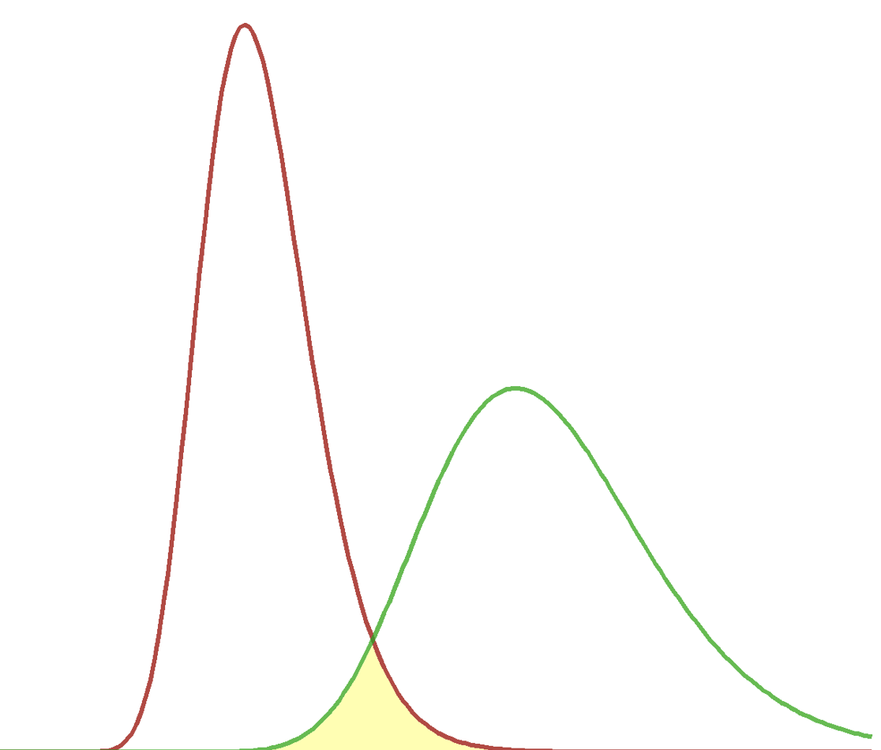
Latent Feature Vector Source Domain
Latent Feature Vector Source Domain
Predicted Source Domain labels
Cross-Entropy Loss
Actual Source Domain labels
MMD-Loss
MMD-Loss
Latent Feature Vector Target Domain
Latent Feature Vector Target Domain
Predicted Target Domain labels

Slide 6
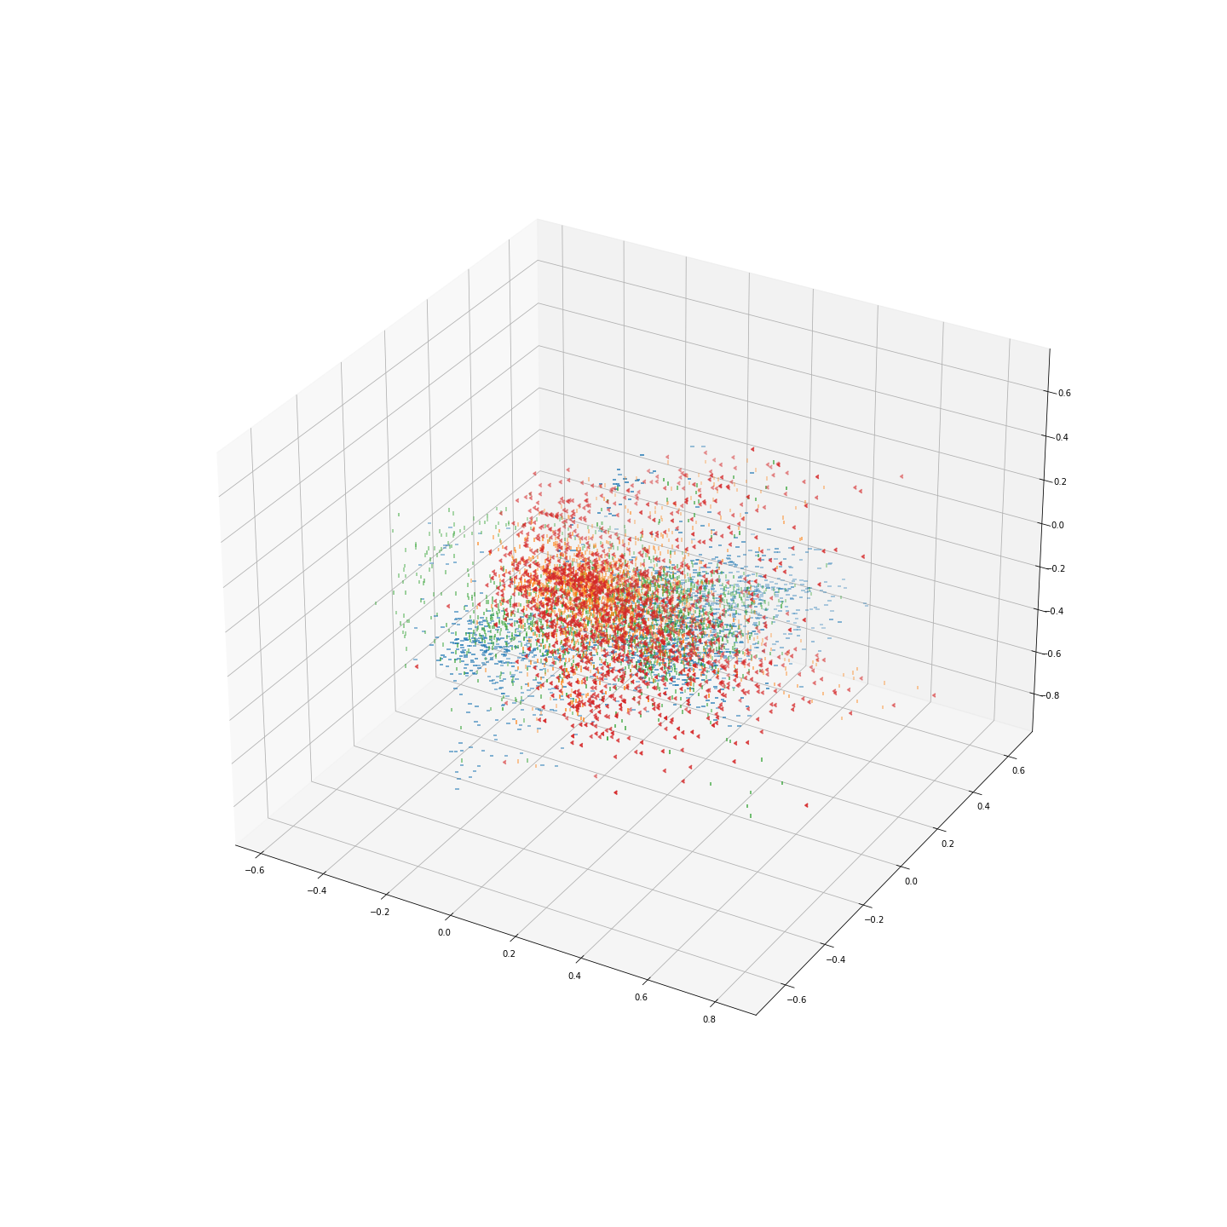
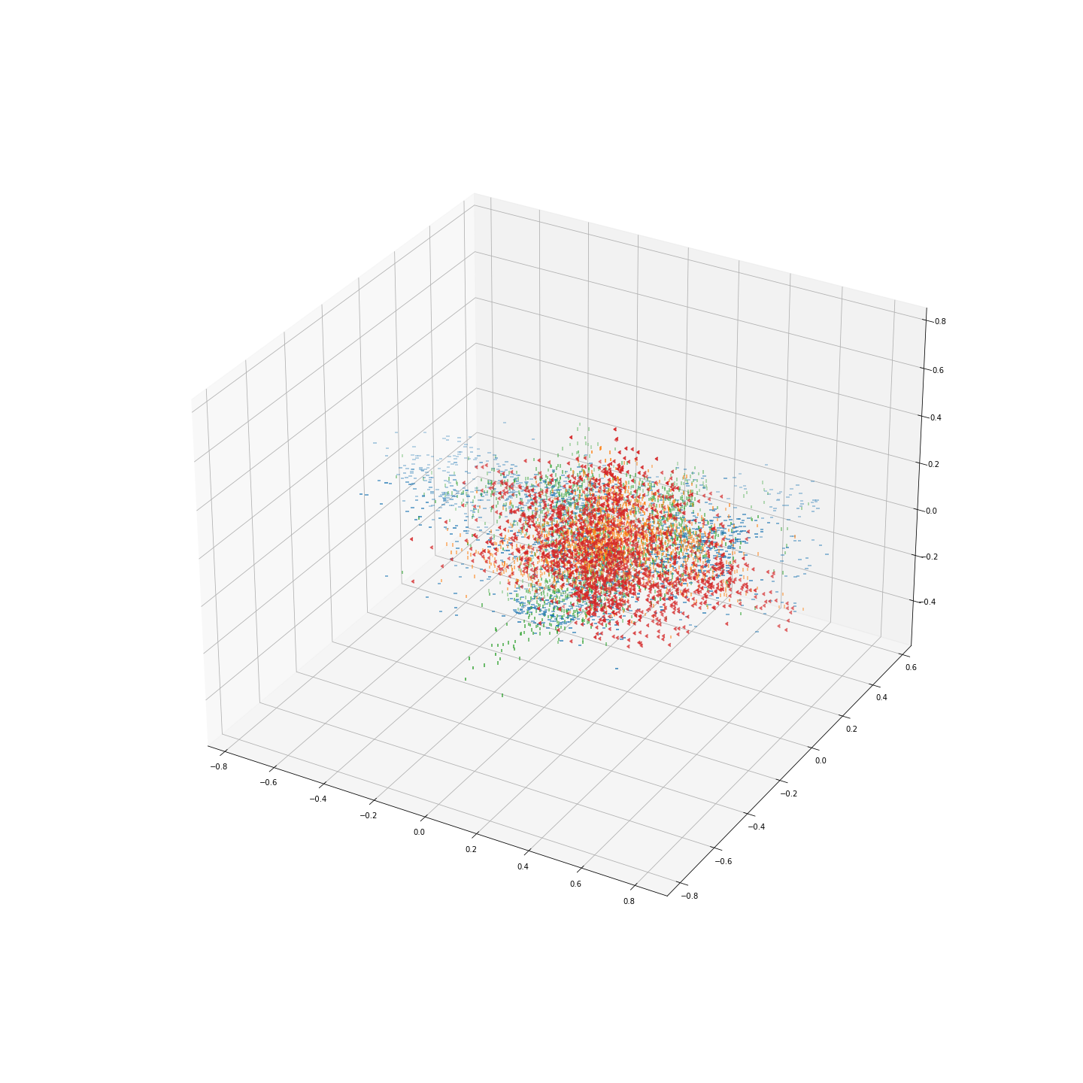
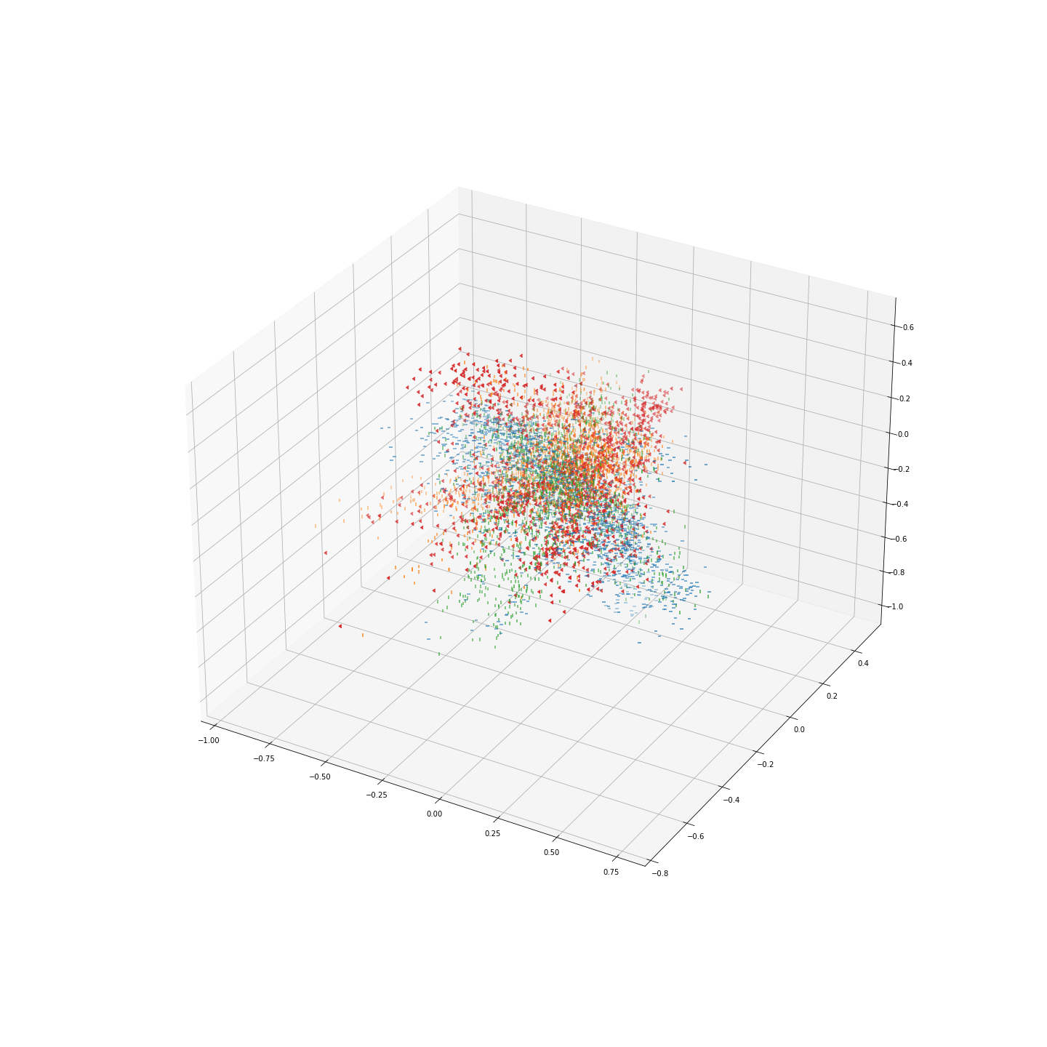
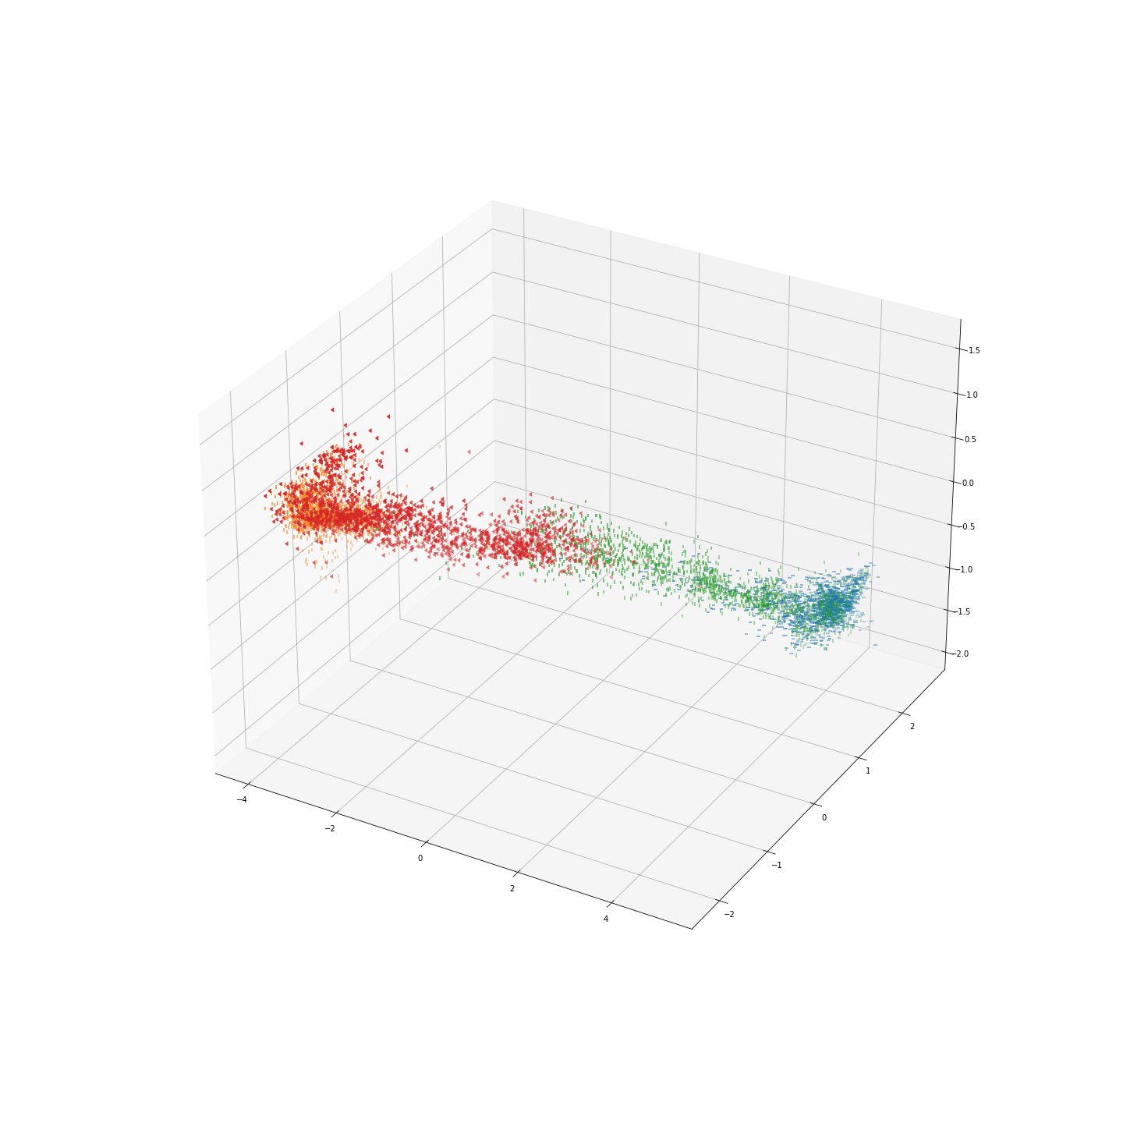
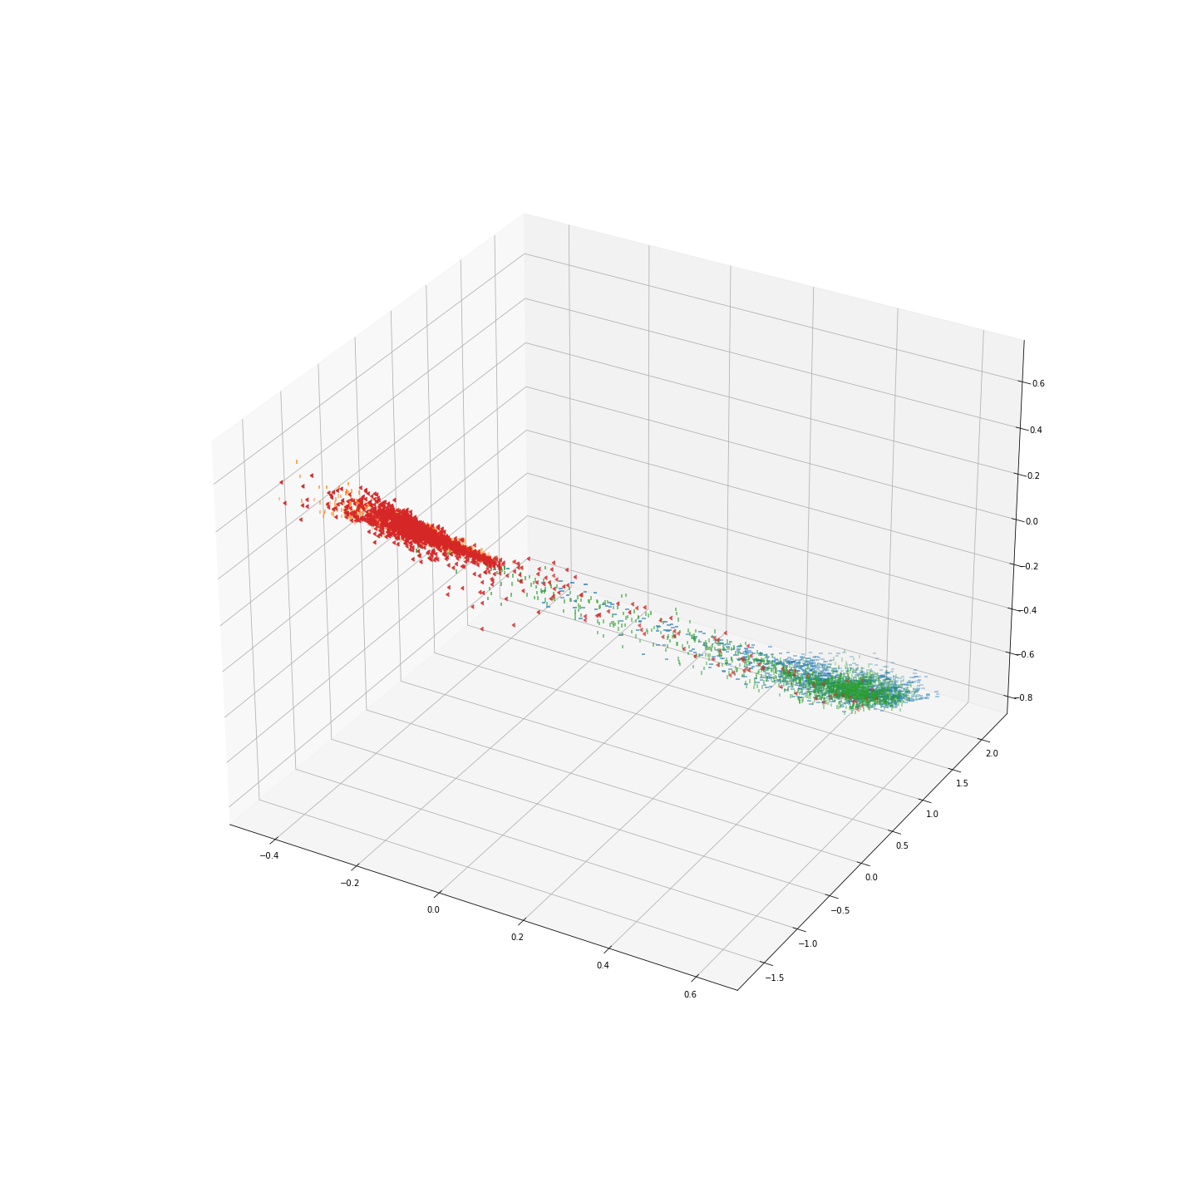
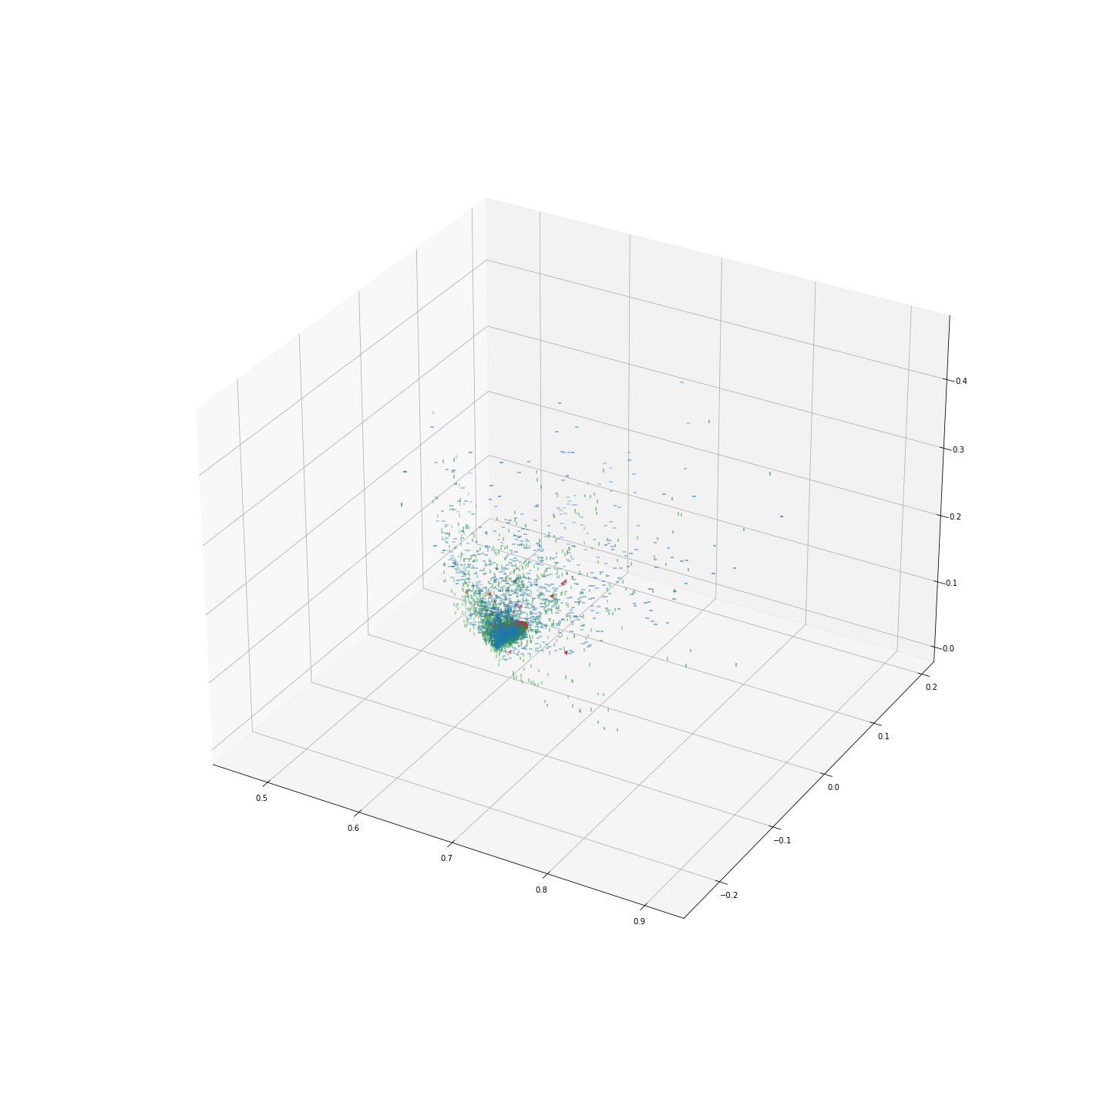
GAMMA = 0
GAMMA = 2.5
GAMMA = 10
Epoch 0
Epoch 6
Neuron 1 →

Slide 7
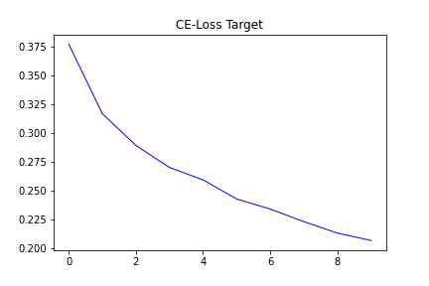
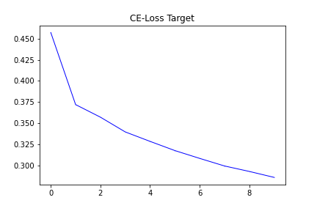
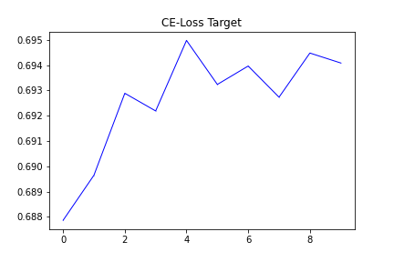
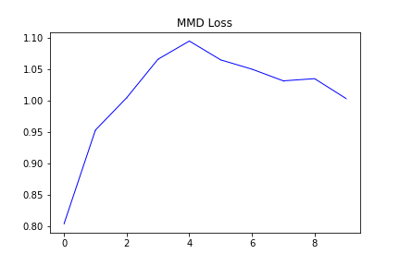
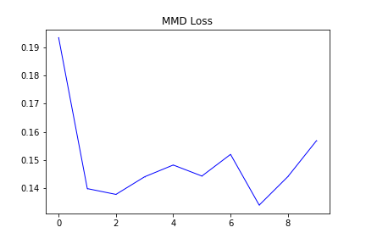
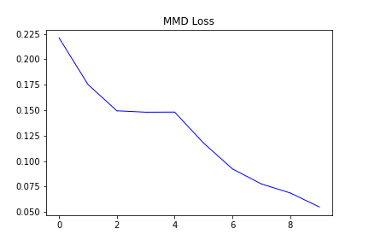


GAMMA = 0
GAMMA = 2.5
GAMMA = 10
CE-LOSS
CE-LOSS
CE-LOSS
MMD-LOSS
MMD-LOSS
MMD-LOSS

Slide 8
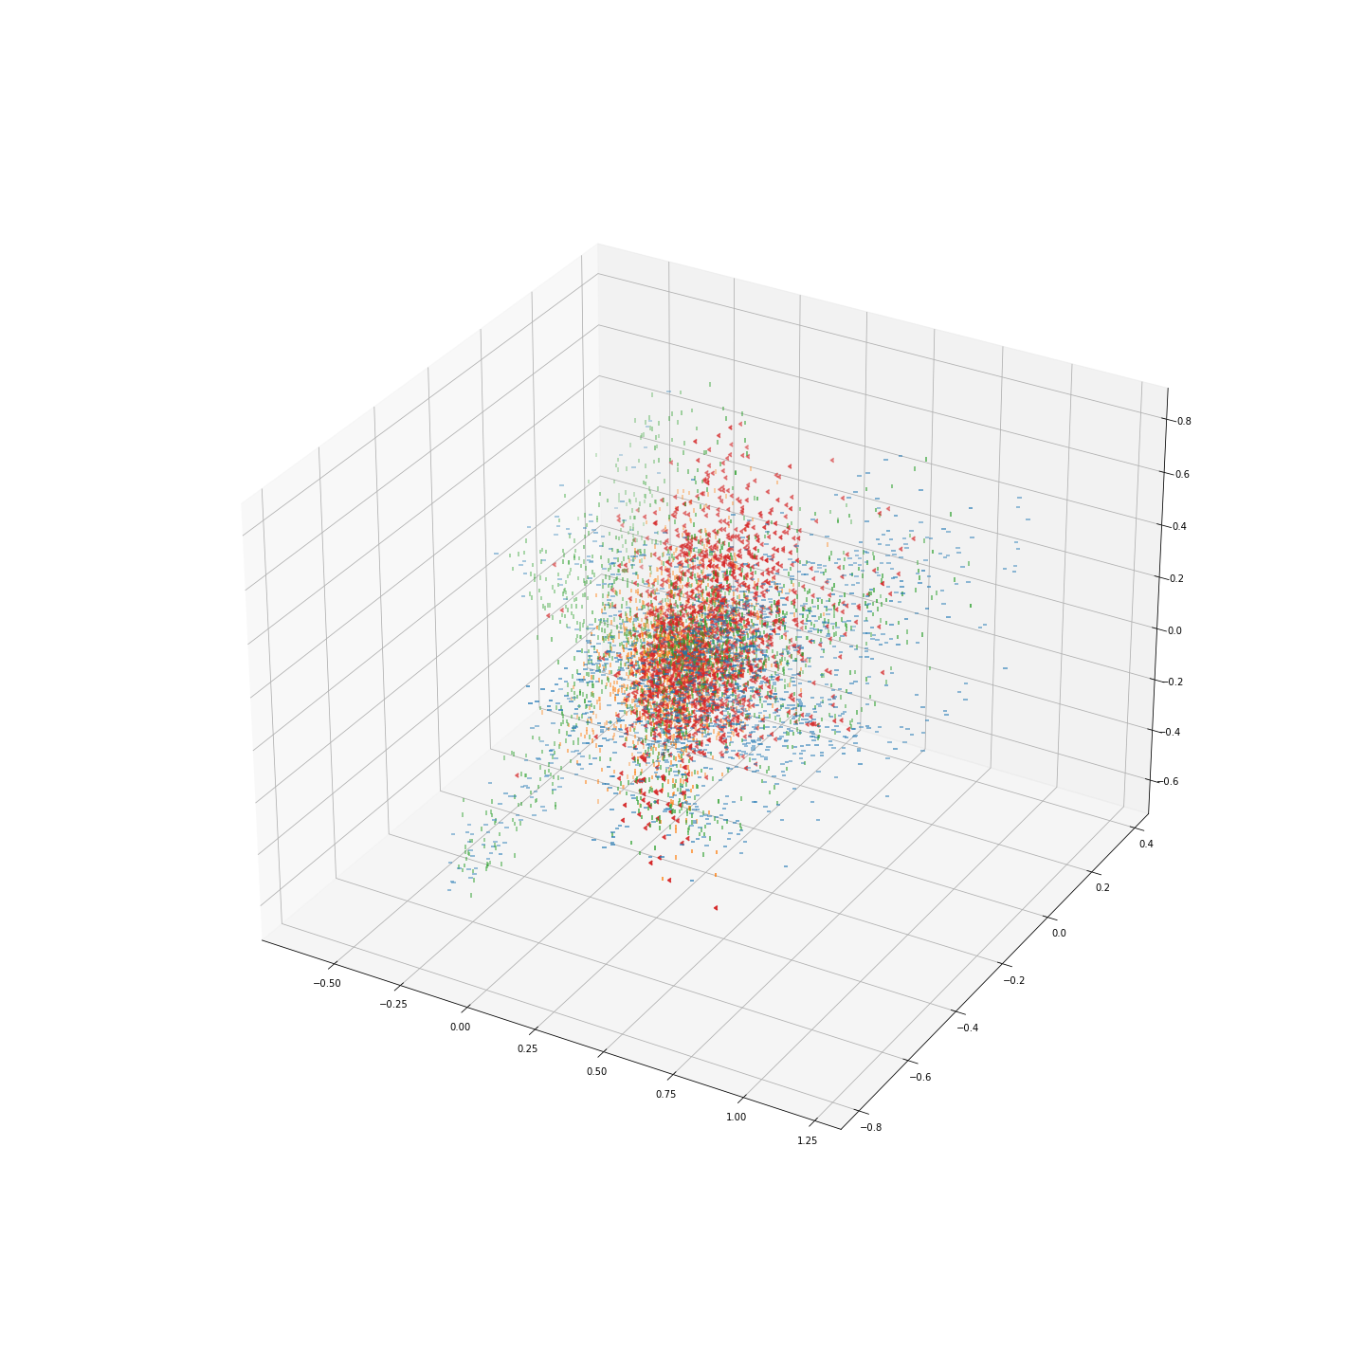
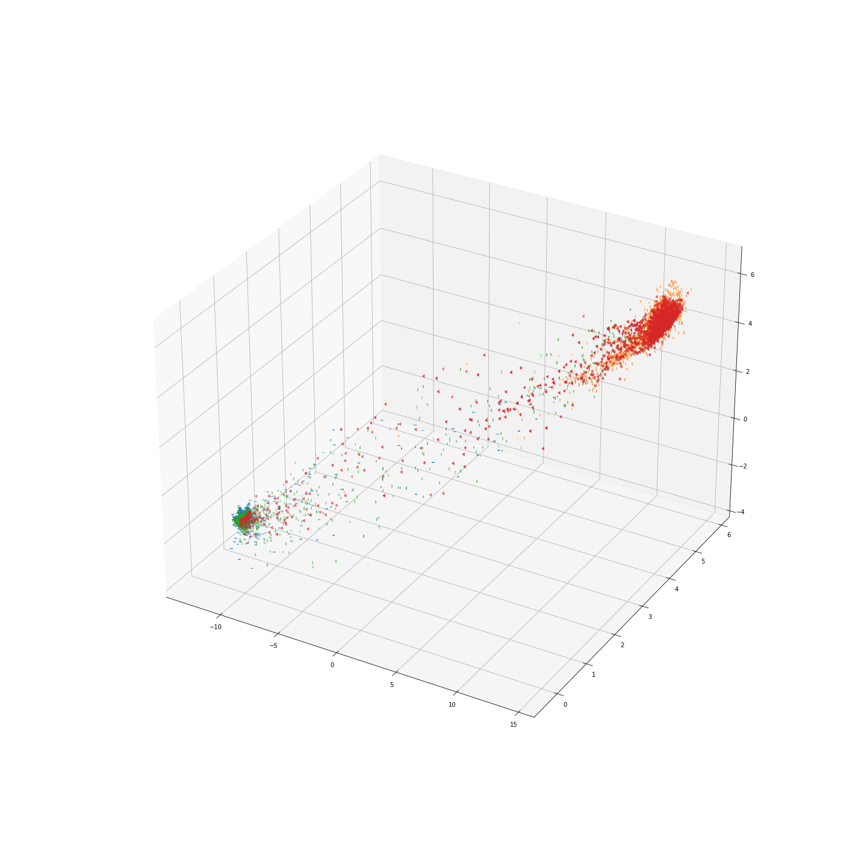
Unlabeled MMD loss
Labeled MMD loss
Epoch 0
Epoch 6

Slide 9

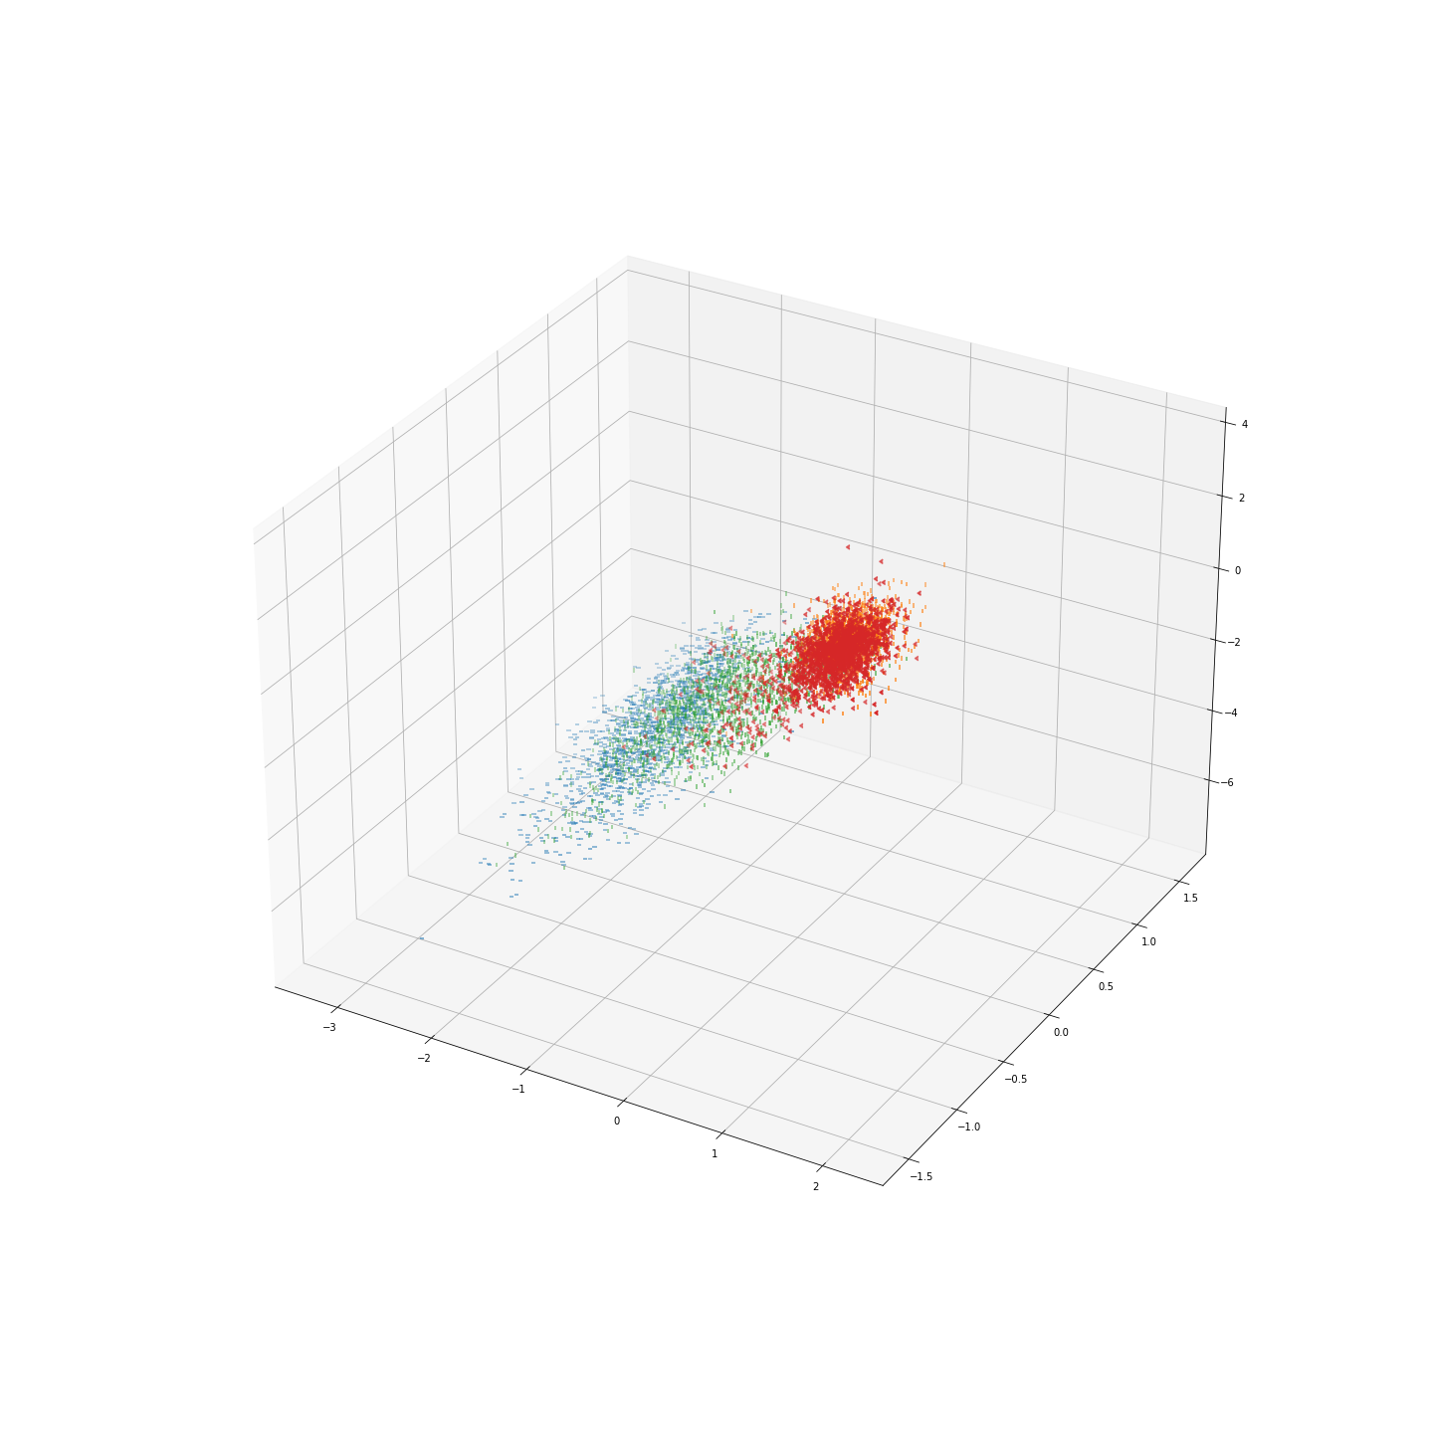
Unlabeled MMD Loss with target CE-Loss
Labeled MMD Loss
Epoch 0
Epoch 6

Slide 10
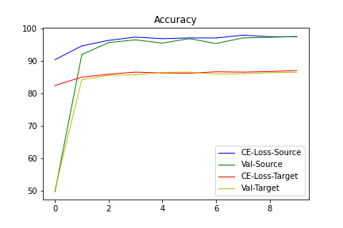
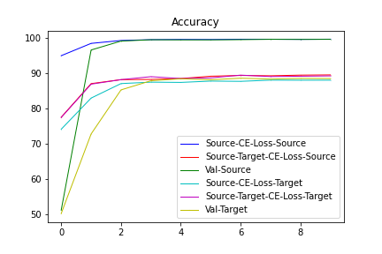

Slide 11
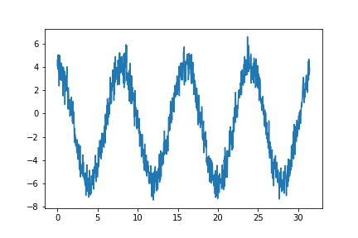
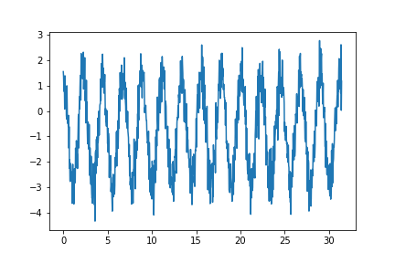
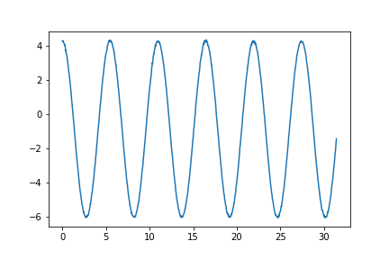
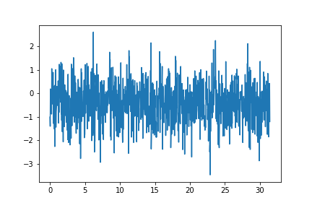
CLASS 0 DOMAIN 0
CLASS 1 DOMAIN 1

Slide 12
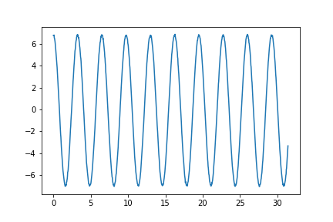
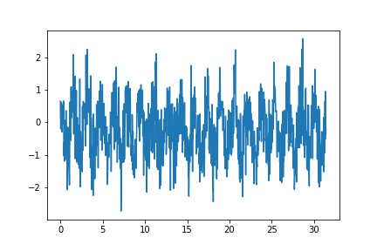
CLASS 0
CLASS 1
DOMAIN 0
DOMAIN 1

Slide 13
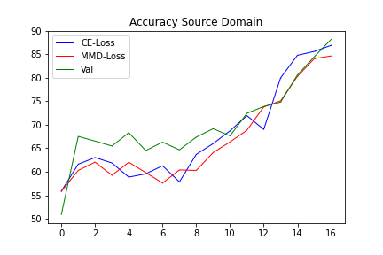
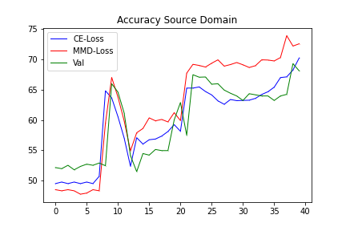
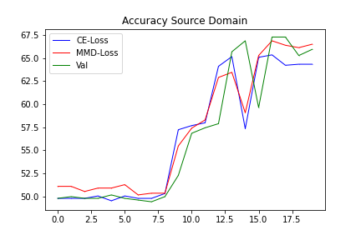
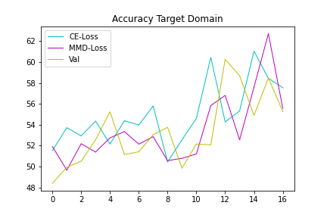
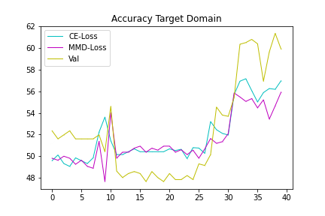
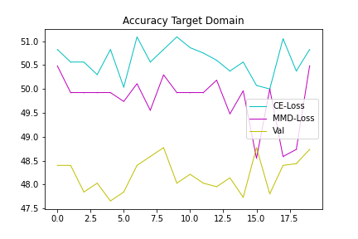
Regular MMD
Labeled MMD

Slide 14
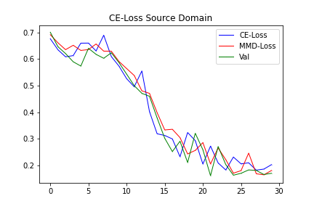
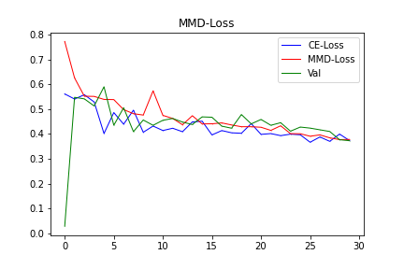

Slide 15
MAI | JUNI | JULI | AUGUST | SEPTEMBER
Beenden von MMD Versuchen | Experimente für Forschungsfragen überlegen | Vergleichen von Möglichkeiten | Schreiben von zweiter Methode | Finalisieren von Masterarbeit
Schreiben von MMD Kapitel |  |  | Schreiben von Einleitung | Präsentation
Einlesen in weitere Möglichkeiten |  |  | Schreiben von Conclusion | Puffer 2 Wochen
Lücken im Stand der Technik identifizieren |  |  | Schreiben von zweiter Methode | Verbessern von Verbesserungsvorschlägen
Forschungsfragen festlegen |  |  | Finalisieren von Masterarbeit

Slide 16
Weitere Möglichkeiten
Autoencoder for finding better latent feature space
LSTM CNN
Generative adversarial network (GAN)
Extensive preprocessing
Preprocessing to 2d images and using advanced 2D pretrained feature extractor (AlexNet, …)
Analysing features from data better
Instance-based instead of feature based domain adaption
Other special losses (contrastive loss, …)

Slide 17
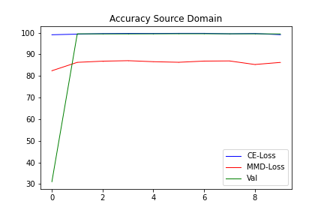
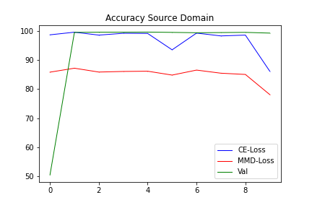
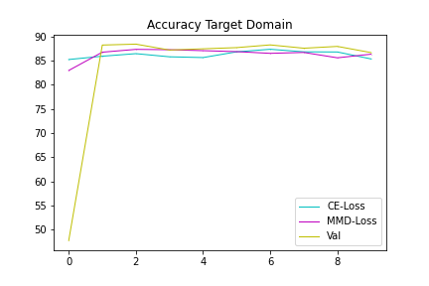
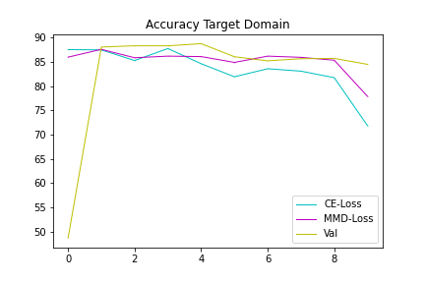
Regular FC & CNN MMD
Regular FC MMD

Slide 18
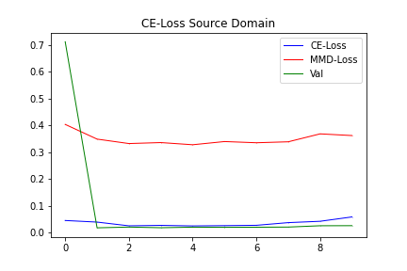
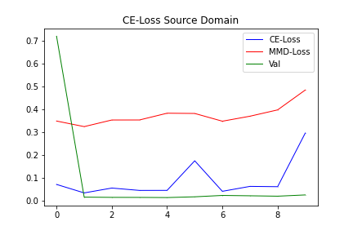
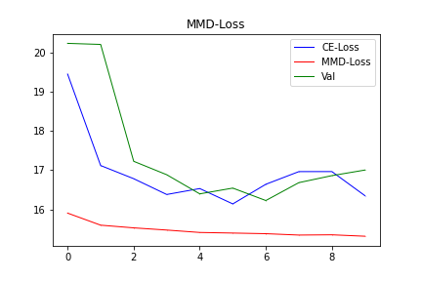
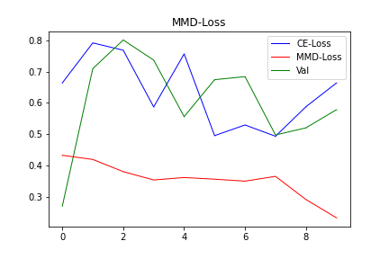
Regular FC & CNN MMD
Regular FC MMD

Slide 19
Regular FC & CNN MMD
Regular FC MMD
MMD-Loss
MMD-Loss
MMD-Loss
MMD-Loss
MMD-Loss
MMD-Loss
MMD-Loss
MMD-Loss
MMD-Loss
3x1x1000
64x1x901
64x1x300
32x1x293
32x1x293
32x1x97
32x1x95
32x1x95
1x1x3040
1x1x100
1x1x3
1x1x2
1x100
1x4
1x10
1x5
1x5
Conv
Max-Pool
Conv
Batch-Norm
Max-Pool
Conv
Batch-Norm
Flatten
FC
FC
FC
optimizer = torch.optim.Adam('params': model_cnn.parameters(), lr=1e-3, betas=(0.9, 0.999))

Slide 20
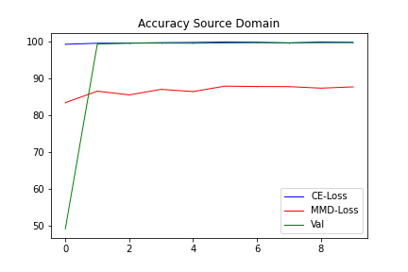
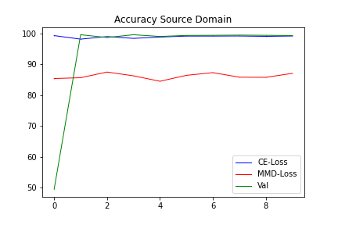
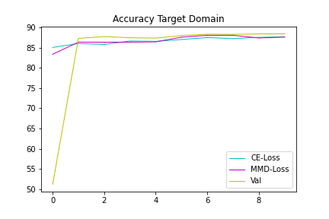
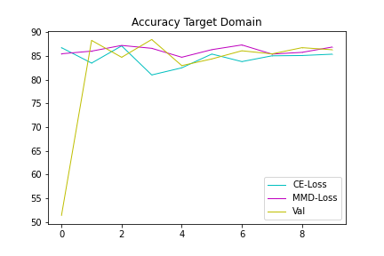
Regular FC & CNN MMD
Regular FC MMD

Slide 21
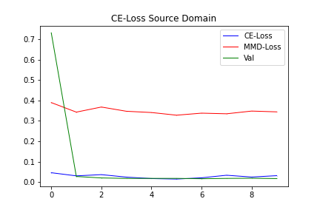
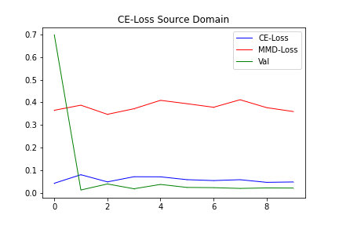
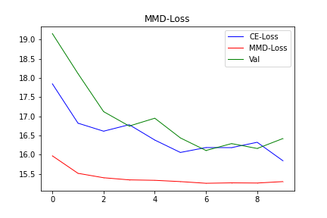
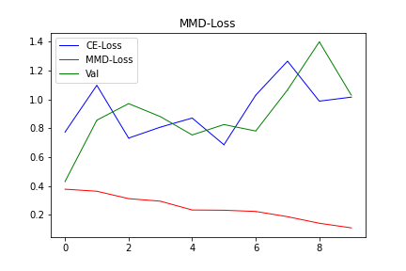
Regular FC & CNN MMD
Regular FC MMD

Slide 22
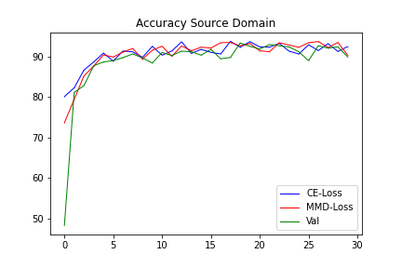
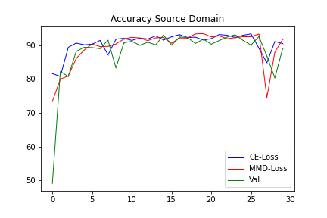




FC+CNN
FC
No mmd

Slide 23






FC+CNN
FC
No mmd

Slide 24
Input Layer
Hidden Layer
Hidden Layer
Output Layer

Slide 25


W_{1,j}
i₁
W_{2,j}
i₂
Activation Function
_{x}
$$φ$$
o_{j}
W_{3,j}
i₃
b_{j}

Slide 26








W_{1,j}
x₁
$w_{i,j}∗ x_{i}+b_{j}$
$$\frac{δy}{δw},\frac{δy}{δb}$$
W_{2,j}
y_{j}
x₂
Activation Function
_{x}
z$j$
$$φ$$
Loss
$$\hat{yj}$$
$$L$$
W_{3,j}
$$\frac{δ\hat{y}}{δy}$$
$$\frac{δL}{δ\hat{y}}$$
x₃
b_{j}

Slide 27

Flatten CNN Output
Input
Feature Map
Feature Map
Feature Map
Output
Convolution
Convolution
Convolution
Flatten
FC

Slide 28
1
0
1
0
1
0
0
1
1
1
0
1
0
1

Slide 30
1
5
1
4
1
6
Stride = 2
2
1
1
1
1
1
9
7
9
1
1
2
1
2
1
7
8
6
4
1
1
4
1
2
5
6
9
1
2
1
1
7
1
1
1
1
3
0
1
1
1
1
1
1
1
5
1
1
1
2
4
8
4
4
5
8
1
1
1
1
1
1
8
4
4
5
8
5
1
1
1
3
1
8
4
4
5
5
1
1
3
1
3
1
8
5
5
8
8
6
1
1
1
1
3
9
6
6
6
8
Stride = 1

Slide 31
Dilation = 2
1
5
1
4
1
6
5
11
6
12
2
1
1
1
1
1
8
7
4
8
1
1
2
1
2
1
5
5
12
4
4
1
1
4
1
2
7
9
3
10
1
2
1
1
7
1
1
1
1
3
0
1
1
1
1
1
1
1
5
1
1
1
2
4
8
4
4
5
8
1
1
1
1
1
1
8
4
4
5
8
5
1
1
1
3
1
8
4
4
5
5
1
1
3
1
3
1
8
5
5
8
8
6
1
1
1
1
3
9
6
6
6
8
Dilation = 1

Slide 32
Zero padding = 1
0
0
0
0
0
0
1
2
2
2
1
0
1
1
1
1
0
2
5
5
5
3
0
1
2
1
2
0
2
5
4
4
3
0
1
1
0
1
0
3
5
3
9
8
0
2
1
1
7
0
2
3
2
8
7
0
0
0
0
0
0
1
1
1
2
4
4
5
1
1
1
1
4
4
6
1
1
1
3
6
6
8
1
3
1
3
Zero padding = 0

Slide 33
0
1
0
0
1
1
1
1
1

Slide 34
0
1
0
0
1
1
1
1
1

Slide 35
Data X
Training
Model
Label y
Class 1
Model 1
Task 1
Class 2
Transfer Learning
Transfer knowledge
Class 3
Model 2
Task 2
Class 4
Training
Source Domain
Model 1
Class 1
Domain Adaption
Transfer knowledge
Class 2
Target Domain
Model 2

