Slide 1
Employee Management
The software for time tracking, vacation management and employee data management

Slide 2




What are the core features?
Time tracking for all
Booking/request YOUR vacation
Mange employee data like a boss
Role based system access
Dynamic screen behaviour according to user role

Slide 3
User roles:
Roles | Access Level
Employee | Time booking and vacation
Manager (encompasses previous role) | Views his team and not assigned employees, approves or disapproves vacation, CRUD operations on his tream and not assigned employees
Admin (encompasses previous role) | Views all managers and employees, CRUD operations on managers and other admins

Slide 4

Ready for a few examples? Impressions from our software

Slide 5

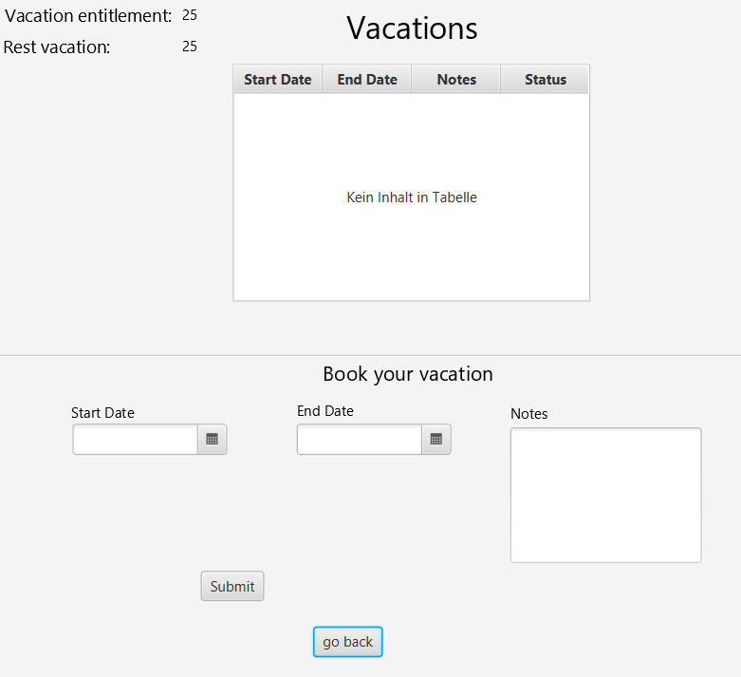
Vacation
Texts adapts to the user`s role:
Workflow:
1. Employee applies for vacation
2. Vacation Request gets pending status
3. Supervisor approves or denies
4. Status changes either to approved or
Rejected
Applications set to expired automatically

Slide 6


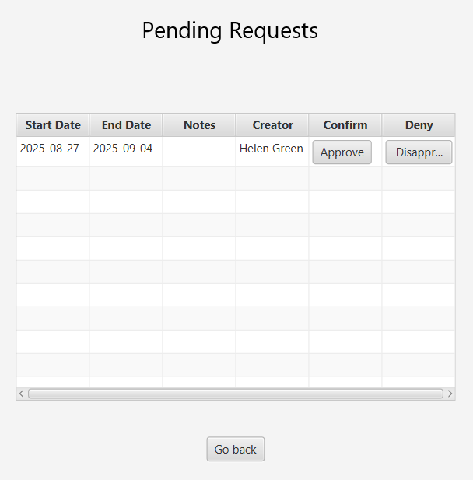
Approve/Deny vacation request
A manager can approve or deny the vacation request
Workflow: Each line is a vacation request of a subordinate
As sooon as the vacation request is accepted or denied it vanishes from the table view

Slide 7
Now we continue with the LIVE demonstration

