Slide 2
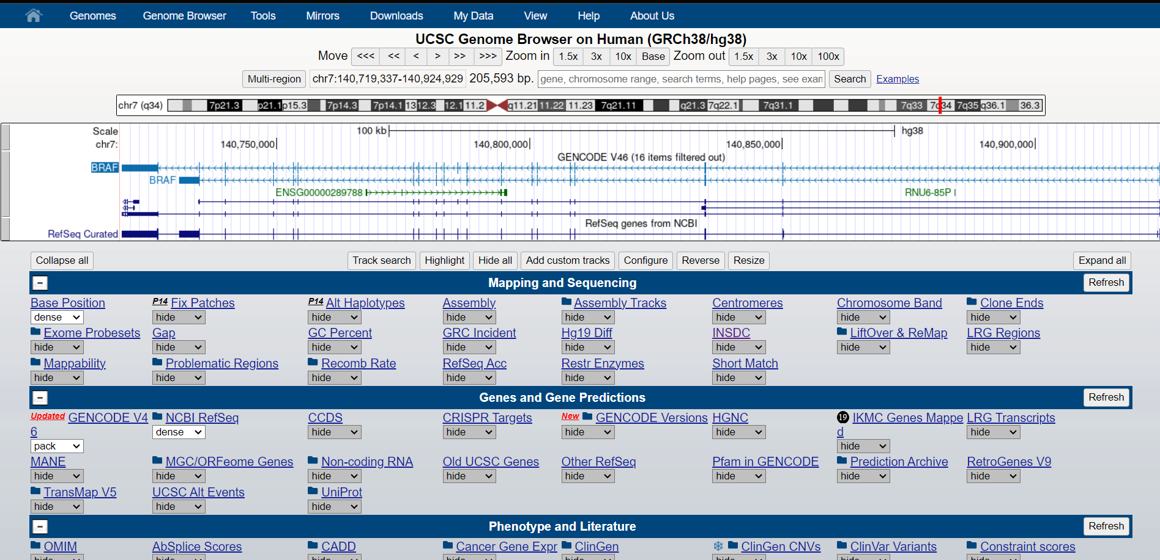
1
2
3
4
5
6

Slide 3



Dense
Squish
Pack/Full

Slide 4
