Slide 1
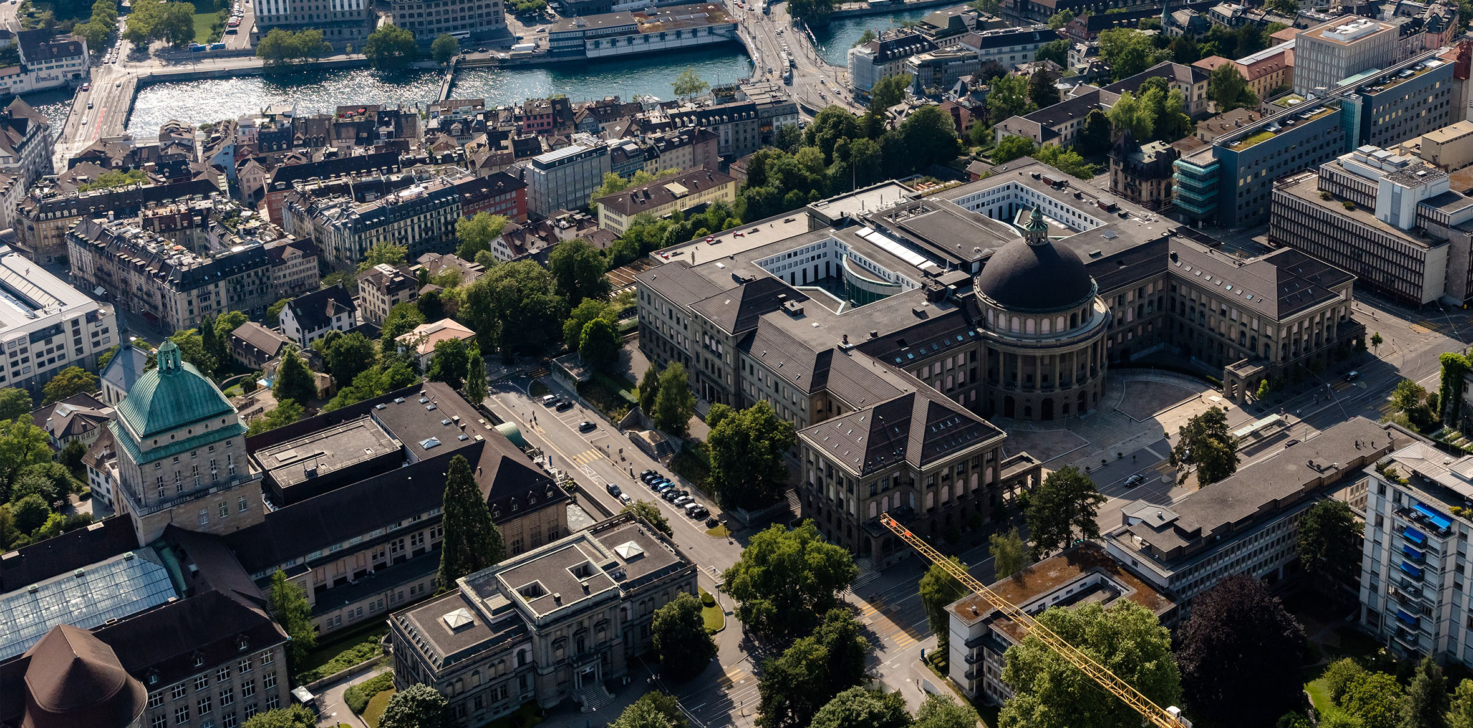
Hier steht der Titel der Präsentation
Organisationseinheit verbal optional auf 2 Zeilen
Prof. Dr. Beat Muster
Funktion des Präsentierenden
TT. Monat JJJJ, Ort

Slide 2
Inhaltsverzeichnis/Agenda
Titel Inhalt 1
Titel Inhalt 2
usw.

Slide 3
What are we interested in tomographic methods

Slide 5
Overview what does my the DHM-Pipline do, importance of phase images
abc

Slide 6
How does a Hologram work

Slide 7
DHM how does it work

Slide 8
Workflow before me

Slide 9
Problems of this workflow

Slide 10
Specific Problems that where solved

Slide 11
Workflow: Surface plane subtraction

Slide 12
Workflow: Focusing

Slide 13
Workflow: background subtraction

Slide 14
Workflow: averaging

Slide 15
Workflow: Quantifying improvements

Slide 16
Clear seperation between image

Slide 17
Segmentation and Tracking with U-Net

Slide 18
What is Ilastik Ilastik for training images

Slide 19
Output: Time-lapse video

Slide 20
Output linage with features, cell cycles

Slide 21
Summary, pros and cons

Slide 22
Summary and outlook
Images
Easy, explanation what was done

Slide 23
Questions

