Slide 1
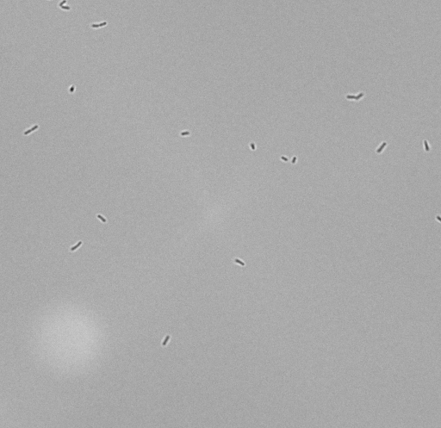
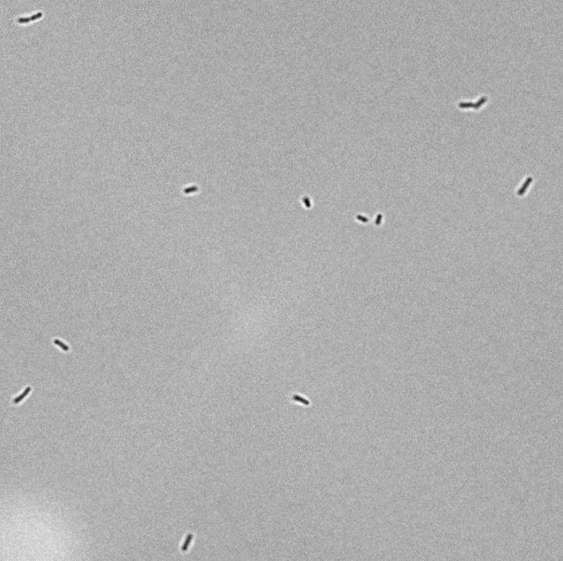
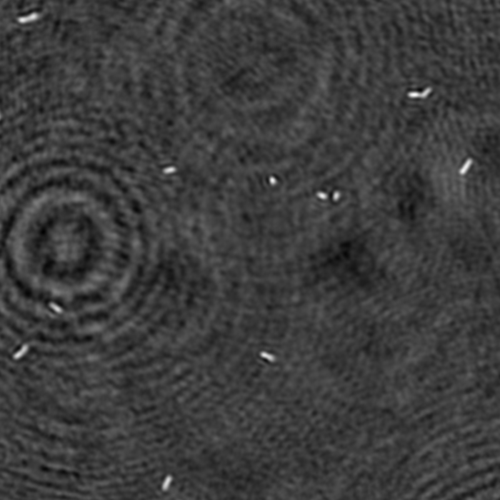
Align with Phase Image
Align with:
Rotation
Zoom
Solve for minimal phase cross correlation error with iterative grid searches.

Slide 2
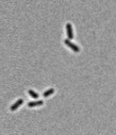
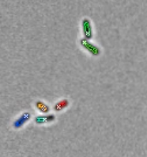
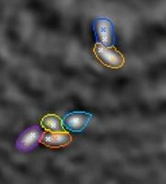
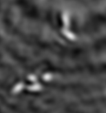
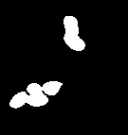
Separate bacteria’s with brightfield images
Find cores on brightfield images.
Find bacteria’s shape with phase images.
Combine and extend cores with water shedding.

